Slide 1
Frequency Information
Conv Block 1&2
Conv Block 3
Conv Block 4
FDA
CFA
SFA
FEO
先画框架，试试这种嵌入型结构

Slide 2
Frequency Information
FDA
FEO
Conv Block 1&2
Conv Block 3
Conv Block 4
CFA
SFA
上色，渐变高光与阴影加立体感

Slide 3
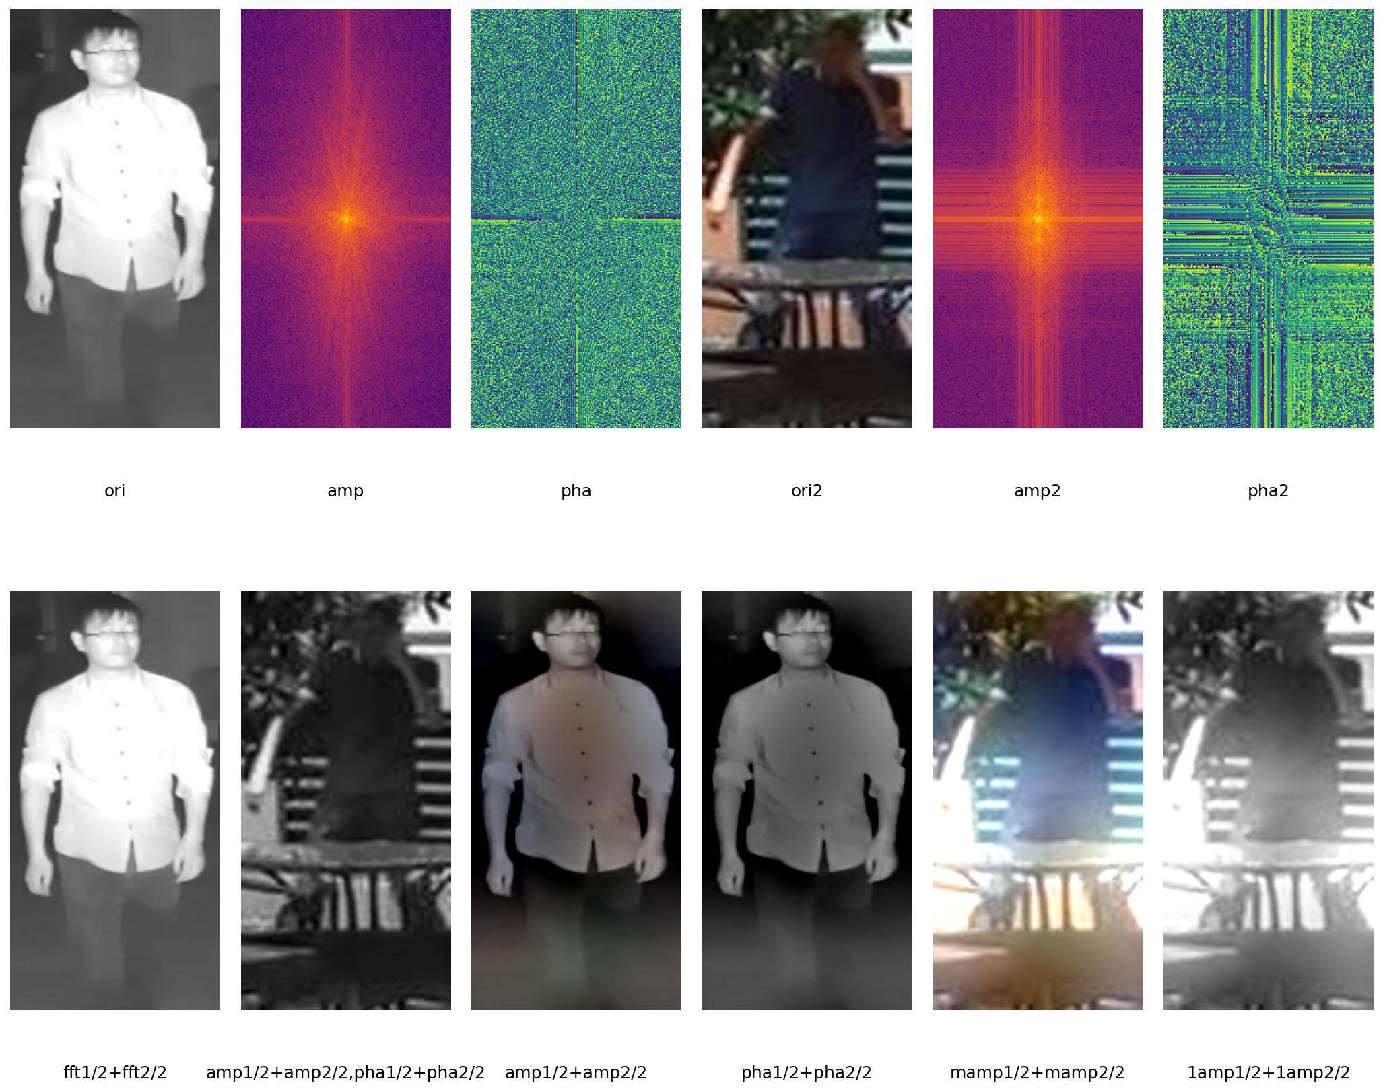
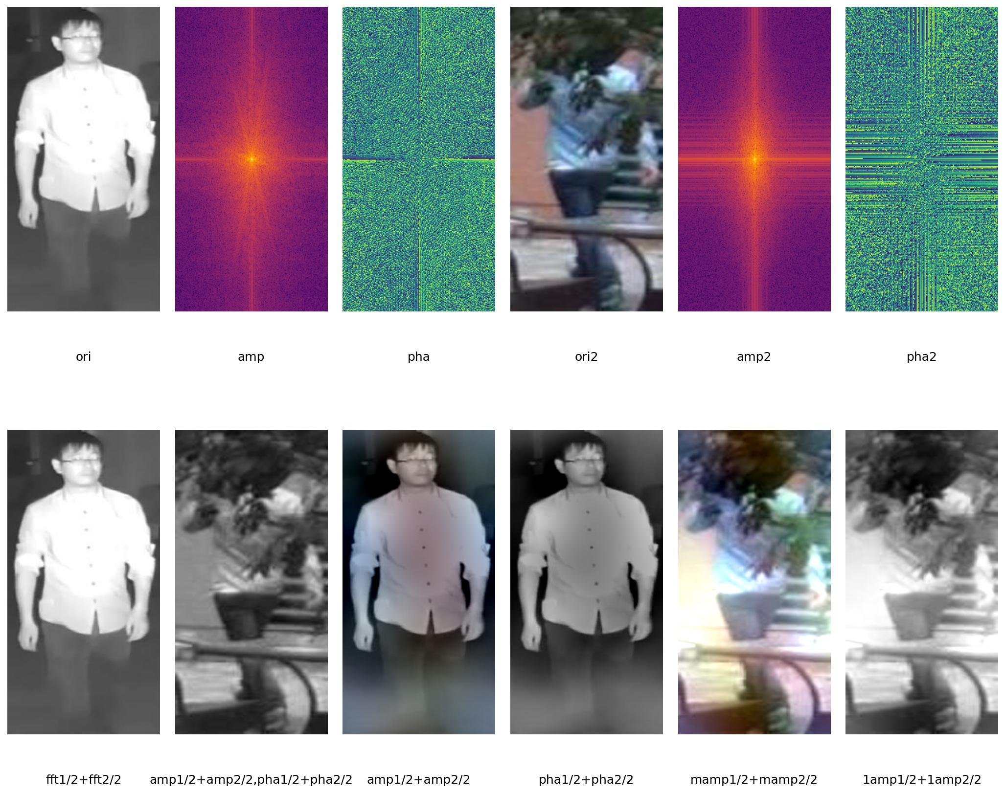



Frequency-based Data Augmentation (FDA)
Frequency Information
Frequency Enhancement Optimization (FEO)
FFT
IFFT
CLS
$$𝓛_{id}$$
Swap Low-Frequency
Components
2D-FFT
$$𝓛_{me}$$
FDA
FEO
Conv Block 1&2
Conv Block 3
Conv Block 4
CFA
SFA
$$𝓛_{kl}$$
FFT
IFFT & Gray
Amplitude
Phase
F-CLS
Channel-wise Frequency
Attention (CFA)
Spatial-wise Frequency
Attention (SFA)
High
Q
2D-IFFT
1D-FFT
1D-IFFT
Q
Low
2D-
IFFT
K
1D-FFT
GAP
2D-FFT
K
2D-FFT
V
V
填充模块

Slide 4



Frequency Swap Augmentation (FSA)
Frequency Information
Frequency Auxiliary Optimization (FAO)
FFT
IFFT
CLS
$$𝓛_{id}$$
Swap Low-Frequency
Components
2D-FFT
$$𝓛_{eu}$$
FSA
FAO
Conv Block 1&2
Conv Block 3
Conv Block 4
CFM
SFM
$$𝓛_{kl}$$
FFT
IFFT & Gray
f-CLS
Amplitude
Phase
Channel-wise Frequency
Modulation (CFM)
Spatial-wise Frequency
Modulation (SFM)
High
Q
2D-IFFT
1D-FFT
1D-IFFT
Q
Low
2D-
IFFT
K
1D-FFT
GAP
2D-FFT
K
2D-FFT
V
V
微调配色

Slide 5



probability=0.5
Input
Conv Block 1
RFA
Conv Block 2
MFEN
Conv Block 3
MFEN
Conv Block 4
FAO
Inference
FFT
Overall Farmwork
FFT
FFT
Low-Frequency
Amplitude
Pooling
Pooling
Input
Input
Low-Frequency High-Frequency
BN
BN
Conv
Conv
Swap
f-CLS
CLS
Gate
Expert
Expert
…
Expert
K
Q
FFT
FFT
$$𝓛_{eu}$$
Weighted Sum
Filter
IFFT
IFFT
Gray
V
…
IFFT
Conv
BN
$$𝓛_{id}$$
$$𝓛_{kl}$$
Output
Filter
Expert
(MFEN)
Multi-Frequency Expert Network
（RFA）
Random Frequency Augmentation
(FAO)
Frequency Auxiliary Optimization
方法改进换框架，突出主要模块

Slide 6
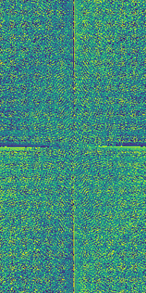
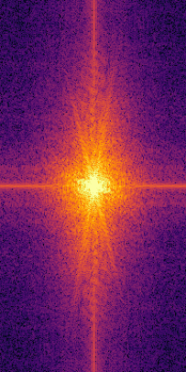
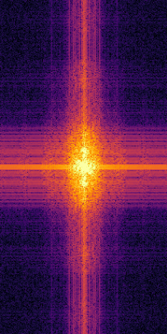
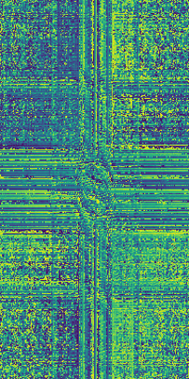



Overall Framework
Input
RFA
Conv Block
MFEN
MFEN
FAO
Conv Block
Conv Block
Conv Block
Inference
FFT
FFT
FFT
Low-Frequency
Amplitude
Pooling
Pooling
Input
Input
…
BN
BN
Gate
Expert
Expert
Expert
Conv
Conv
f-CLS
CLS
Swap
K
Q
Weighted Sum
FFT
FFT
$$𝓛_{eu}$$
Low-
Frequency
High-
Frequency
Filter
IFFT
IFFT
Gray
V
IFFT
Conv
…
BN
$$𝓛_{id}$$
$$𝓛_{kl}$$
(MFEN)
Multi-Frequency
Expert Network
Output
Filter
Expert
(RFA) Random
Frequency Augmentation
(FAO) Frequency
Auxiliary Optimization
配色改进，模块背景也使用渐变高光提亮，前一版比较素

Slide 7




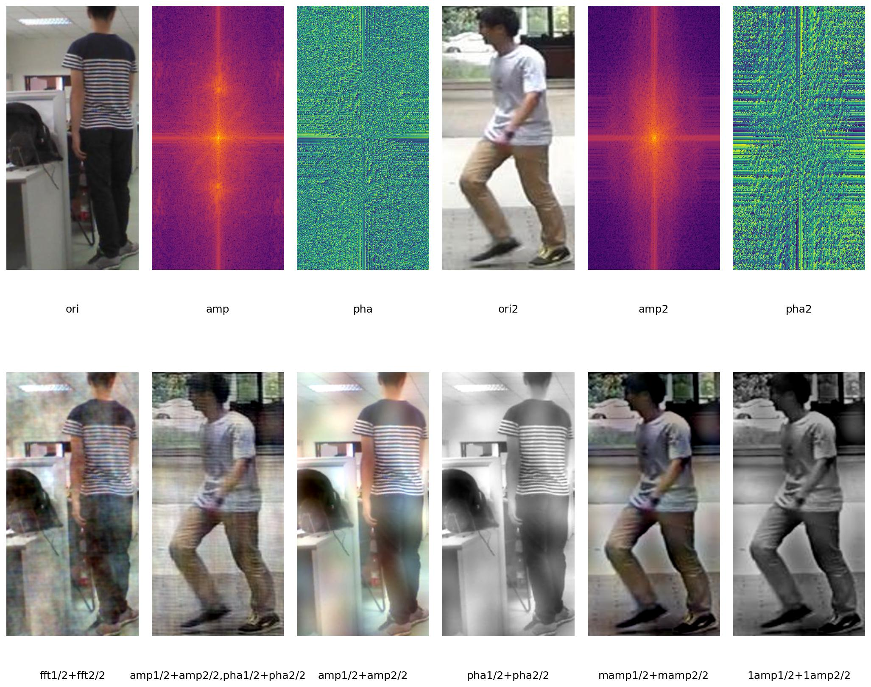
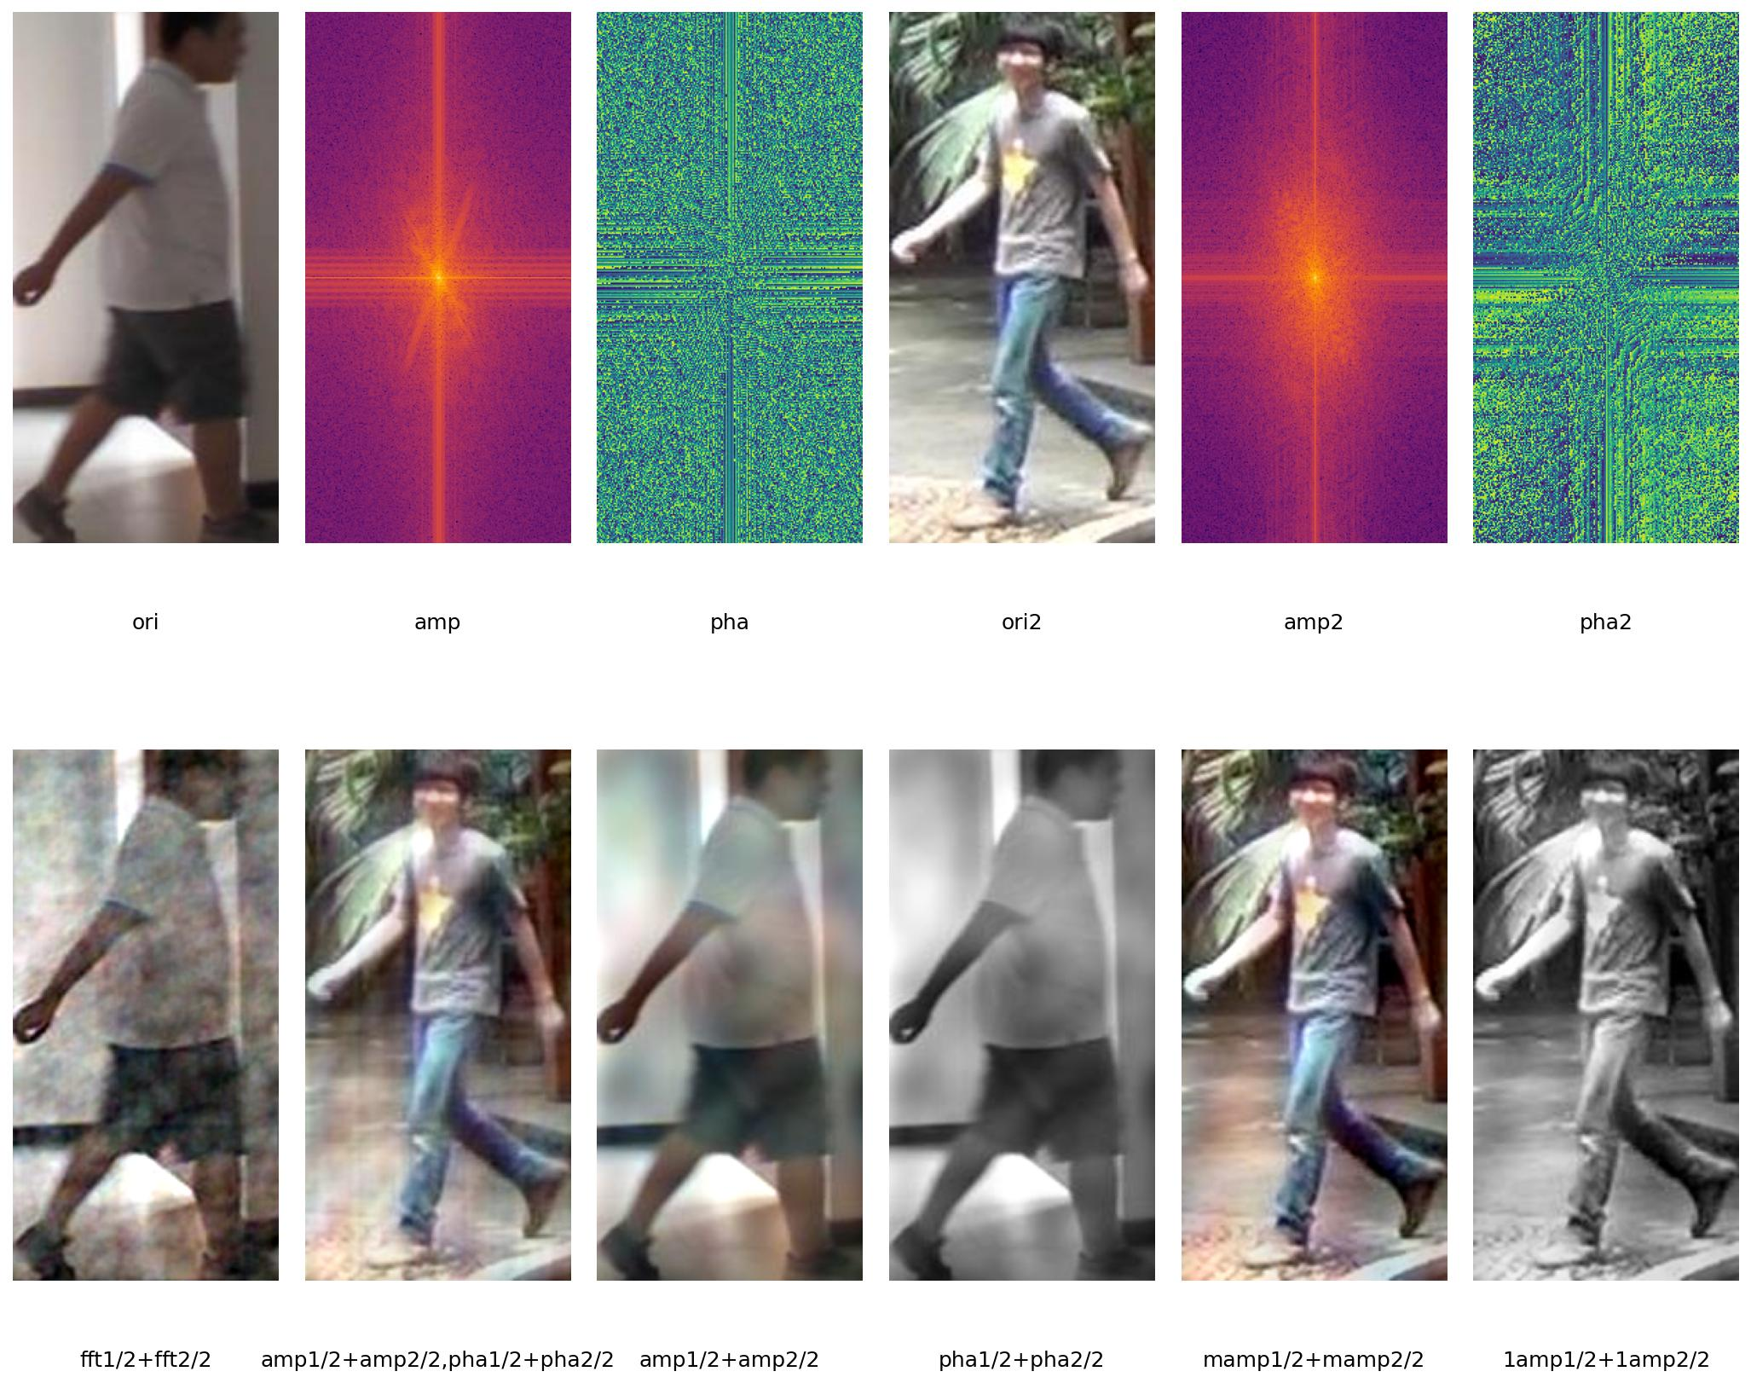
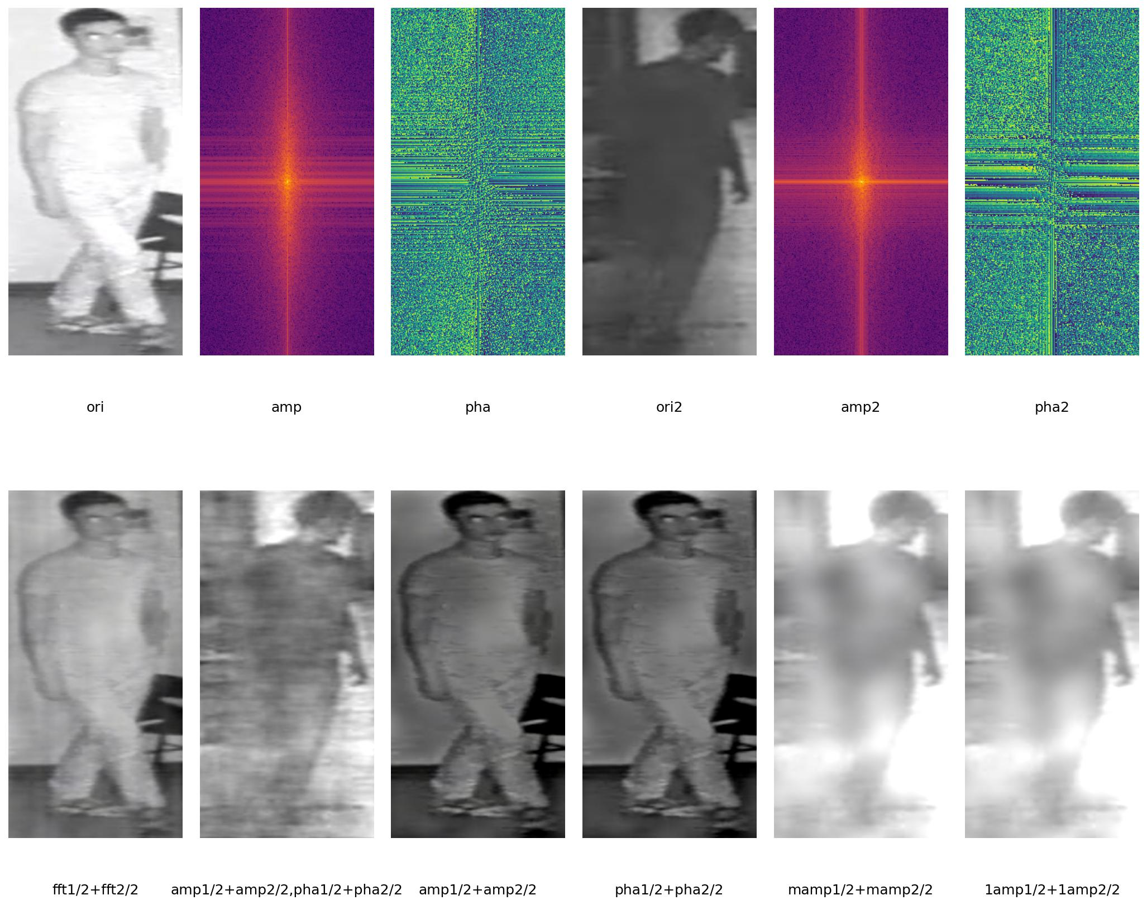
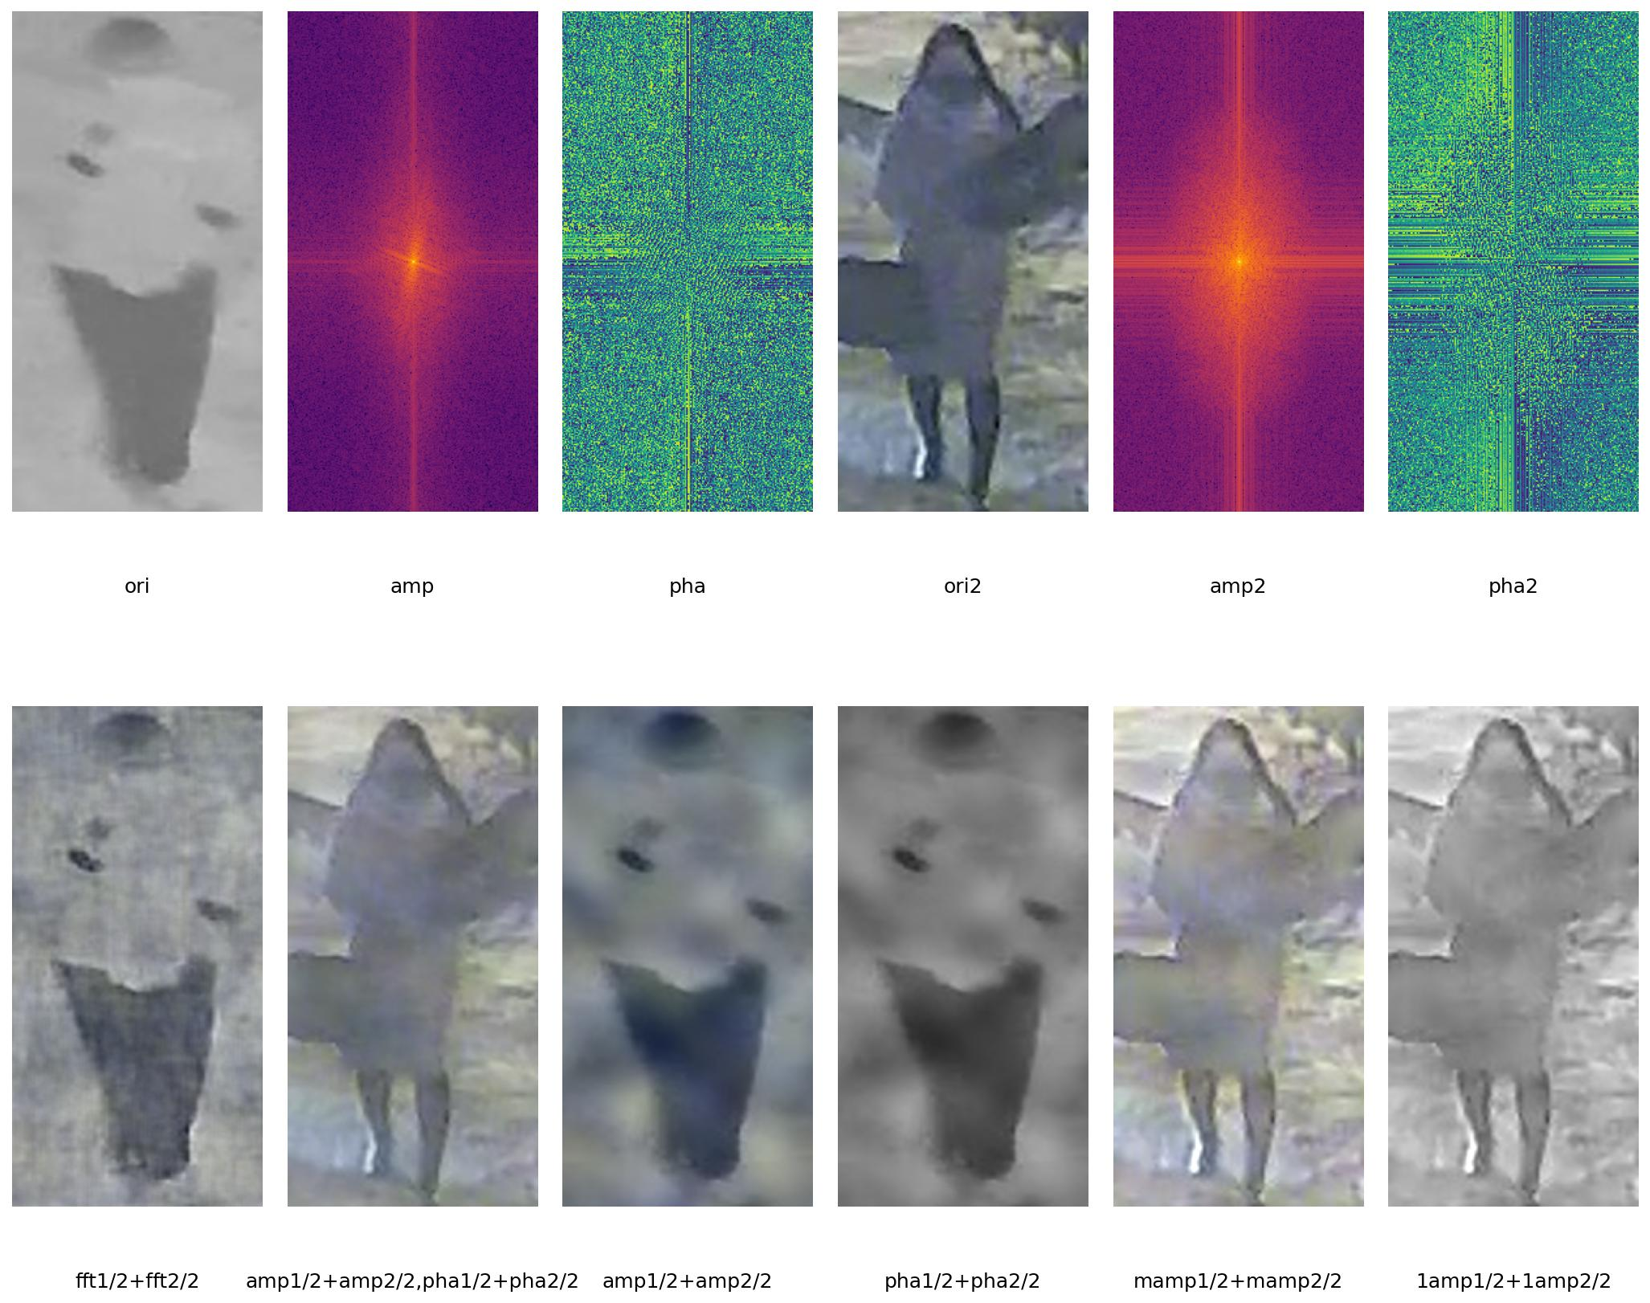
Visible Modality
Close (Overexposure)
Far (Underexposure)
Infrared Modality
Lighting Condition
Magnitude
Phase
Illumination
Color
Structure
Shape
第一版

Slide 8



RGB
Diverse Lighting Conditions
Visible Modality
Close (Overexposure)
Far (Underexposure)
Amplitude
+ Brightness
+ Color
IR
Infrared Modality
Phase
+ Structure
+ Shape
Frequency-Aware Framework (Ours)
Frequency Information
Data
Model
Loss
Optimization
丰富配色

Slide 9
RGB
Diverse Lighting Conditions
Visible Modality
Close (Overexposure)
Far (Underexposure)
Amplitude
Brightness
Color
×
IR
Infrared Modality
Phase
Structure
Shape
✔
Frequency-Aware Framework (Ours)
Frequency Information
Frequency Information
Data
Model
Loss
Optimization
继续丰富配色

Slide 10

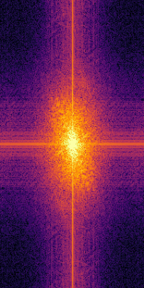
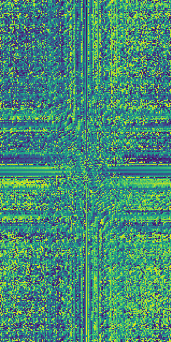
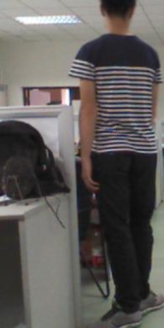
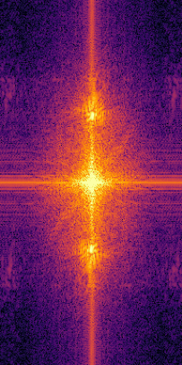
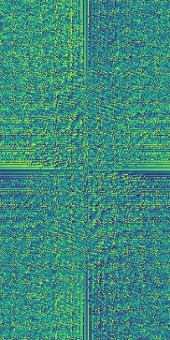
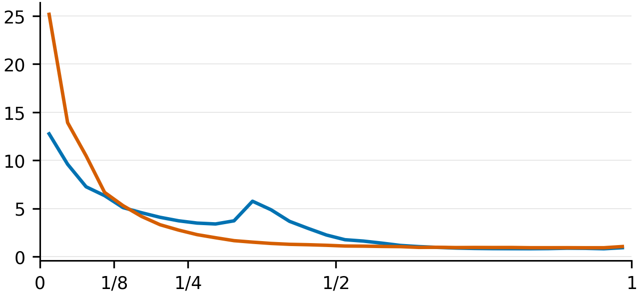
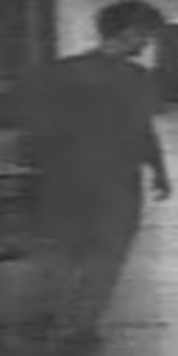
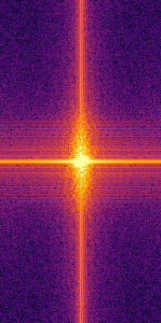
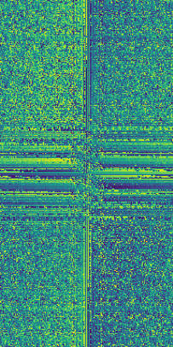
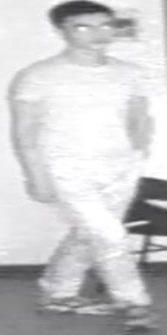
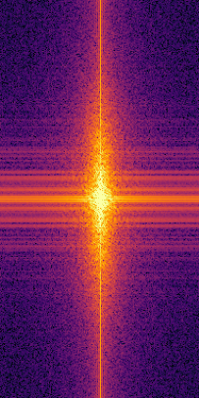
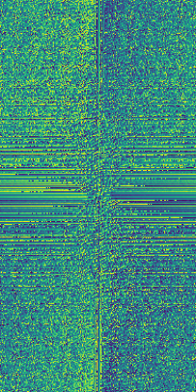
RGB
Visible Modality
Amplitude
Phase
Amplitude
Phase
Low-
frequency
IR
High-
frequency
RGB
Amplitude ratio (%)
Far (Underexposure)
Close (Overexposure)
IR
Infrared Modality
Amplitude
Phase
Amplitude
Phase
添加一些内容
顺便改个配色风格

