Slide 1

Strategie
Approach: Divide problem into three steps
Preparation
FirstSolution
Optimize
All steps can be implemented, tested, optimized indipendently
Interface between steps: *.csv file

Slide 2
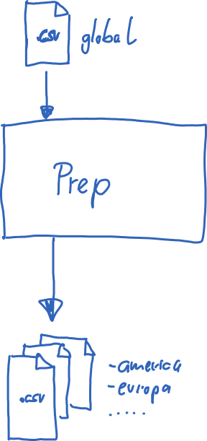
Step 1 Preparation (already implemented)
Approach: Devide global area in to local areas like amerika, europa….
Goal:
Use only local are to work with => heavy scalable
Use domain know how, by dividing in to areas you prevent that santa flyes over the atlantic, because, most probably this is not a good idea
All areas can be looked at and optimized indipendently

Slide 3
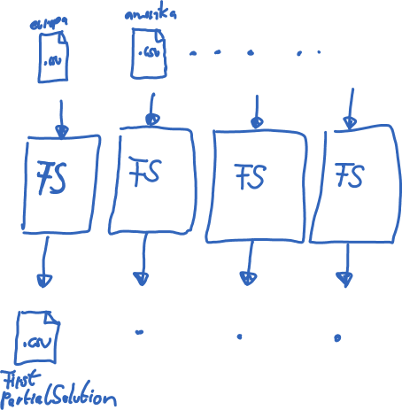
Step 2 First Solution (internal strategie: ???????????????????????)
Goal: Find first partial good solution for individual areas
All areas can be looked at and optimized indipendently
It is possible to use different, algos/heuristics or even technologies for different areas
The different ares can be computed complet seperated from each other
What are the best ares to be defined is an open question

Slide 4
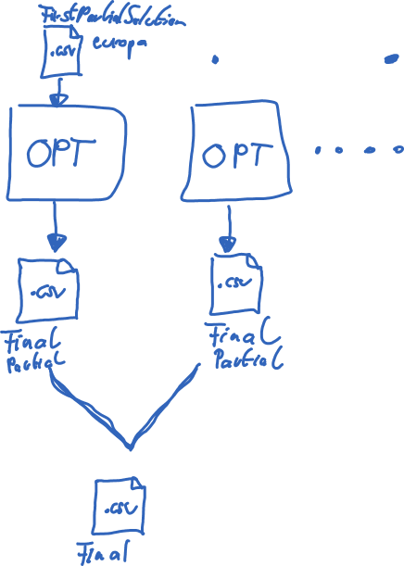
Step 3 Optimize (internal strategie: Genetic Algo)
Goal: Optimize first solution
All areas can be looked at and optimized indipendently
Or there can be some intersection of areas
Special: here the geografic picture can be used like:
The chanse that Americans have sex with asians or europeans is low, because there are big oceans between them ☺
…
..

Slide 5
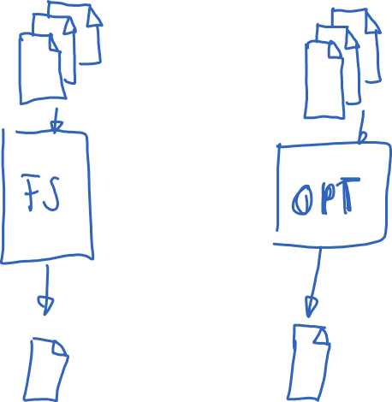
Additional:
Of corse, it is allowed to intersect areas and use the intersection as imput for step 2 or step 3

