Slide 1
MICRO L’AFENTIKA
The Best

Slide 2
Outline
01
02
03
04
Instruction Set Architecture
ALU Operations
Memory Instructions
Flow Control Instructions
Flow Control Instructions
Data Paths
05

Slide 3
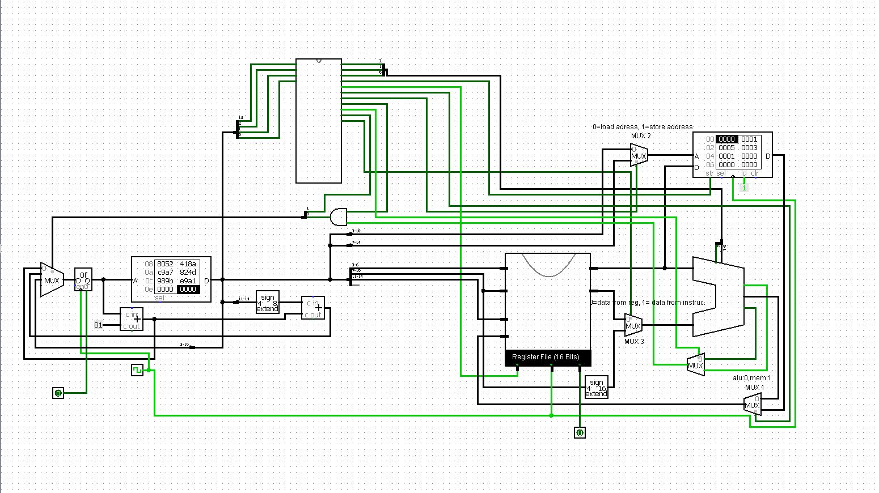

Slide 4
Instruction Set Architecture
Micro L’Afentika is a 16-bit microprocessor
16 registers
It is interfaced with a data memory that has 2⁸ addressable locations (2 bytes each)
It operates on 16-bit instructions
It can perform 16 distinct instructions that spread across 3 categories
We will look at that in a bit (1,0)

Slide 5
The Instructions and Their Opcodes
Add | Subtract | Multiply | Divide | AND | OR | XOR | Negate
0000 | 0001 | 0010 | 0011 | 0100 | 0101 | 0110 | 0111
Beq | Bne | Jump | ADDi | load | store | ORi | ANDi
1000 | 1001 | 1010 | 1011 | 1100 | 1101 | 1110 | 1111

Slide 6
Control Unit
The CU is the “brain” of the brain, to put it.
It gives signals and controls what exactly happens when instructions are executed
The control unit takes bits 0, 1, 2 and 15 (opcodes) of all instructions and generate appropriate signals to control the following:
- ALU Operations
- Register Write Enable
- Memory Write Enable
- MUX Select Controls
- Flow control signals

Slide 7
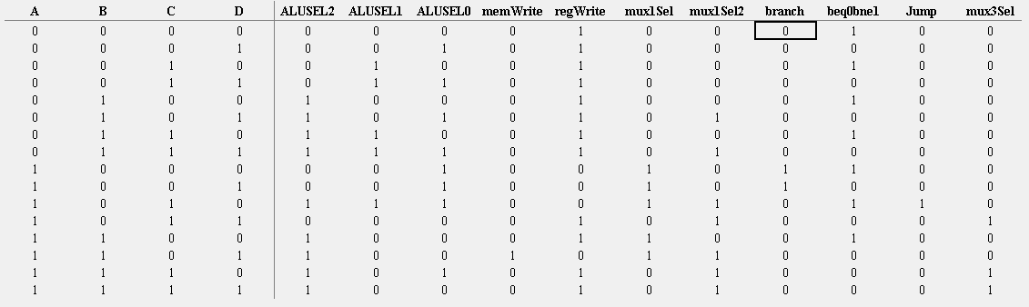
Control Unit
Truth table for creating the circuit of the control unit:

Slide 8
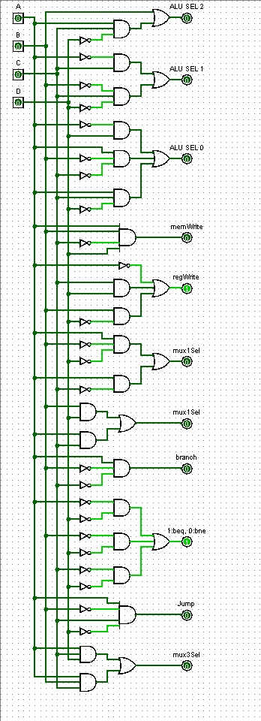
Hardware Realization of the CU

Slide 9
General ALU Operations (With only Register Locations)
All ALU instructions have 4 different parts
- The opcode
- 3 register locations specified with 4 bits each
The format
1 Bit | 4 bits | 4 bits | 4 bits | 3 bits
Opcode | Destination | Source 2 | Source 1 | Opcode
15 | 14:11 | 10:7 | 6:3 | 2:0

Slide 10
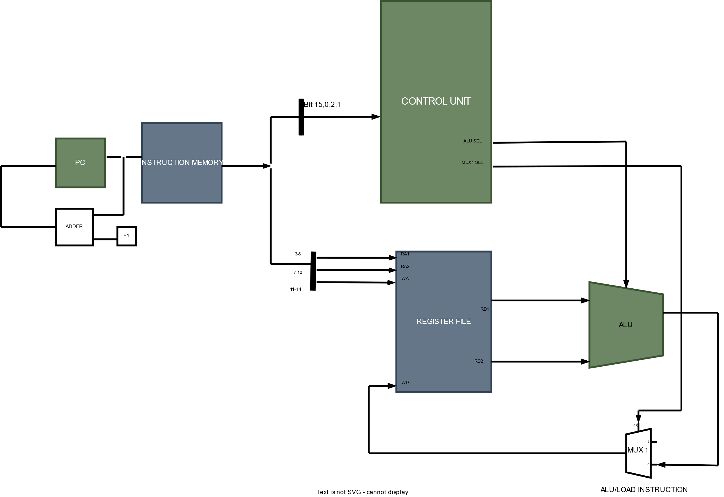
ALU Instructions

Slide 11
ALU Instructions with Immediate
These allow the user to also enter at most one operand as part of the instructions
This is possible for only three ALU operations:
- AND
- OR
- ADD
3. Instruction Format
Bits | 15 | 14:11 | 10:7 | 6:3 | 2:0
Description | Opcode | Destination | Immediate | Source Operand 1 | Opcode
Number of bits | 1 | 4 | 4 | 4 | 3
ANDi | 1111 | ORi | 1110 | ADDi | 1011

Slide 12
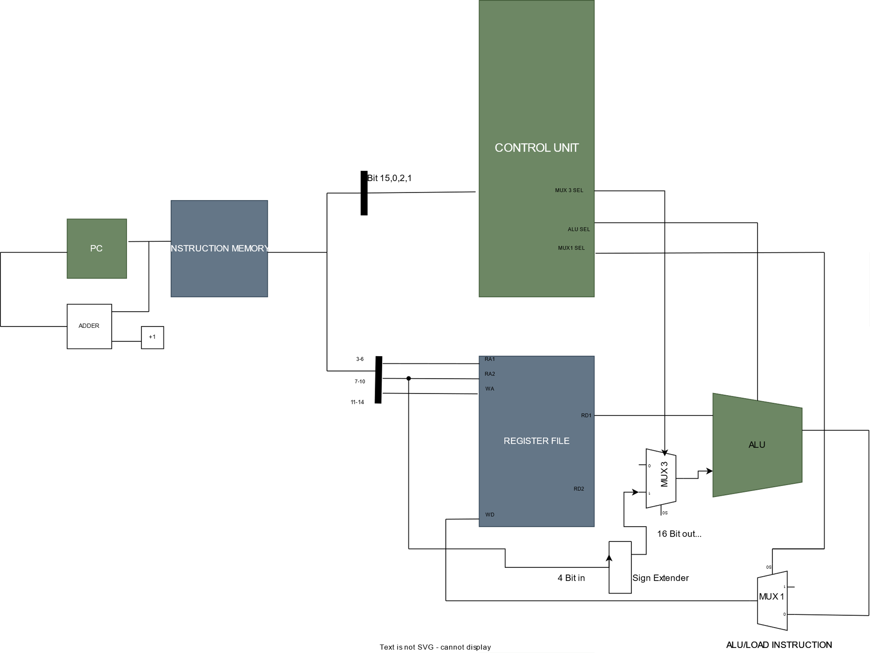
ALU (Immediate) Instructions

Slide 13
Memory Instructions
There are two instructions that allow the microprocessor to communicate with memory
The memory instructions are
- Load instruction: moving data from memory to register
- Store instruction: moving data from register to memory
3. Instruction format of memory instructions:
Bits | 15 | 14:11 | 10:3 | 2:0
Description | Opcode | Register (Destination) | Memory Address (Source) | Opcode
Number of bits | 1 | 4 | 8 | 3
Bits | 15 | 14:7 | 6:3 | 2:0
Description | Opcode | Memory Address (Destination) | Register (Source) | Opcode
Number of bits | 1 | 8 | 4 | 3

Slide 14
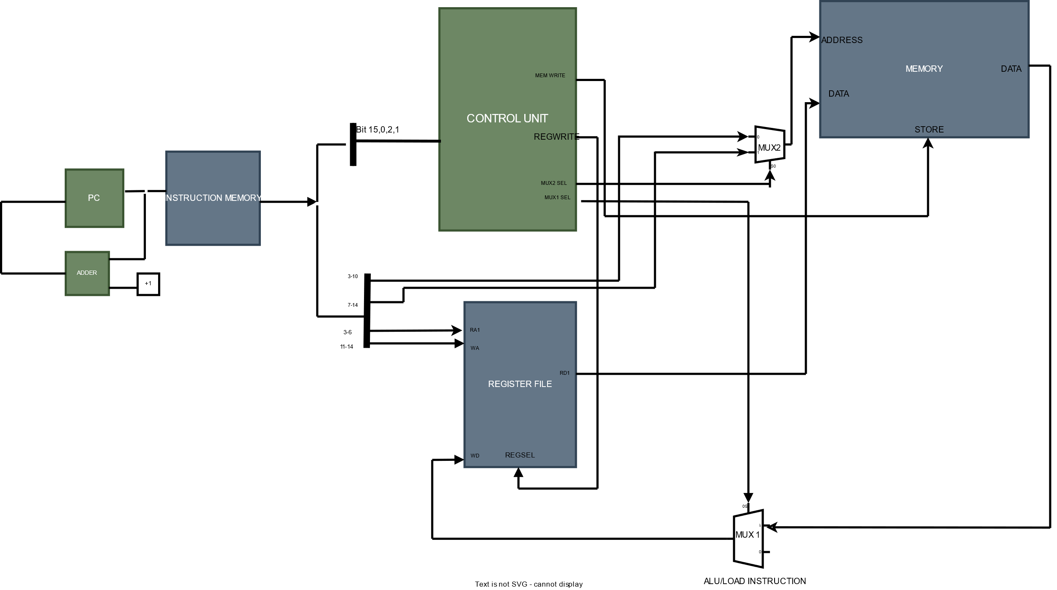
Memory Instructions

Slide 15
Flow Control Instructions
There are two major instructions used to control the flow of the instructions
- Branch Instructions
- Unconditional Jump instruction
2.

Slide 16
Flow Control Instructions
Branch Operations
The branch operations take two operands and a 4 bit program counter offset.
Branch Equal (Beq): if the operands are equal
Branch Not Equal (Bne): if the operands are not equal
Bits | 15 | 14:11 | 10:7 | 6:3 | 2:0
Description | Opcode | Offset (value to add to (PC + 1)) | Source Operand 2 | Source Operand 1 | Opcode
Number of bits | 1 | 4 | 4 | 4 | 3

Slide 17
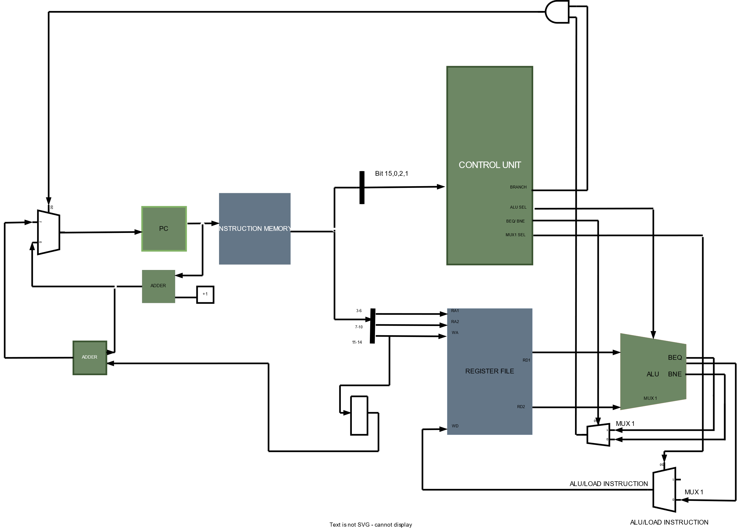
Branch Instructions

Slide 18
Flow Control Instructions
Jump Operation
The Jump operations allow the program counter to point to a specific address of the instruction memory.
This allows the program to skip over some number of instructions
Bits | 15 | 14:11 | 10:3 | 2:0
Description | Opcode | Unused | New address of the program counter | Opcode
Number of bits | 1 | 4 | 8 | 3

Slide 19
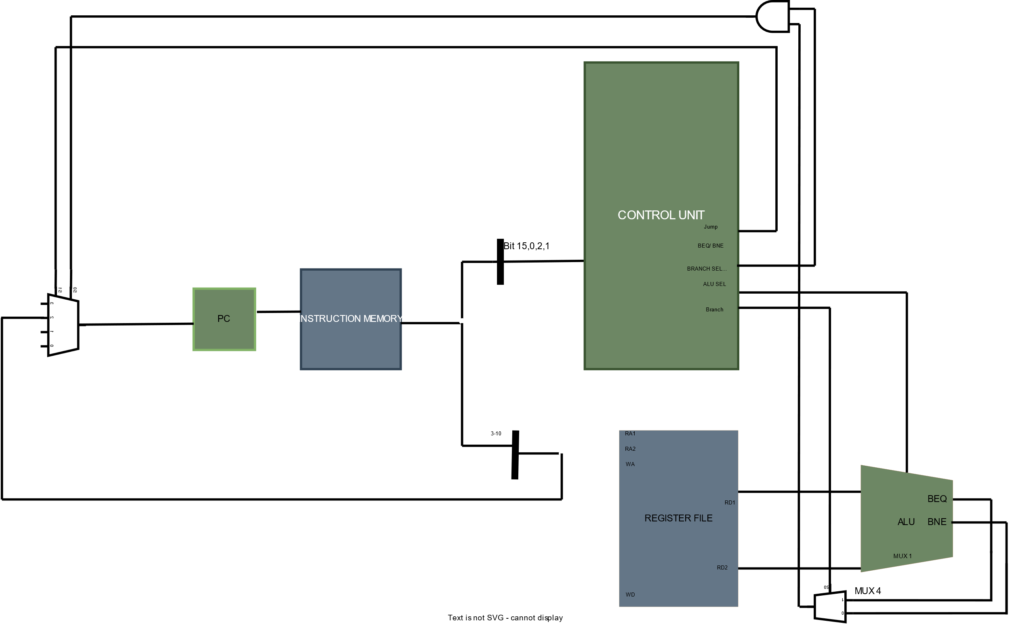
Jump Instructions
Branch
Beq/Bne

Slide 20
Now, The Eternals… Oh sorry, “internals”

Slide 21
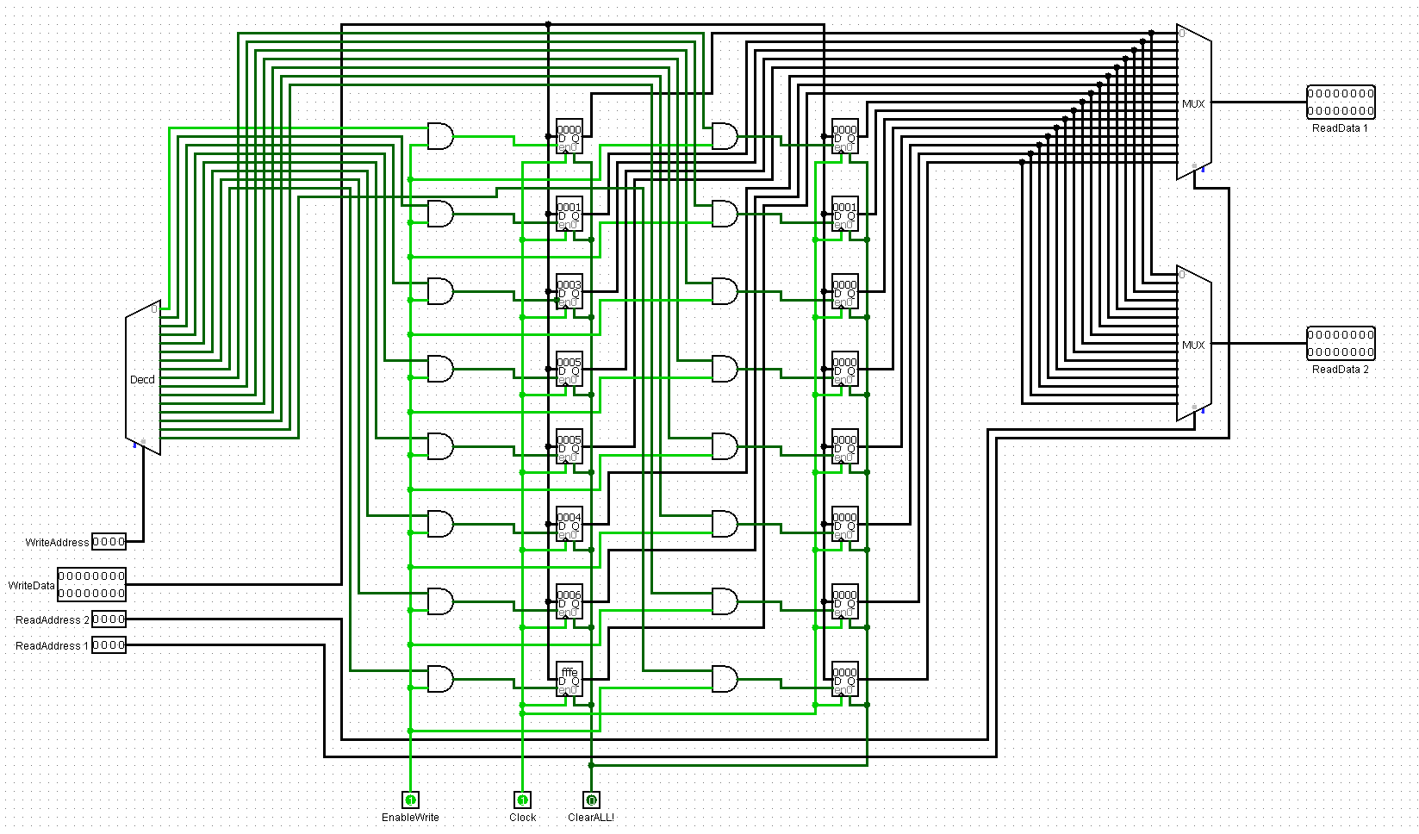
Register File

Slide 22
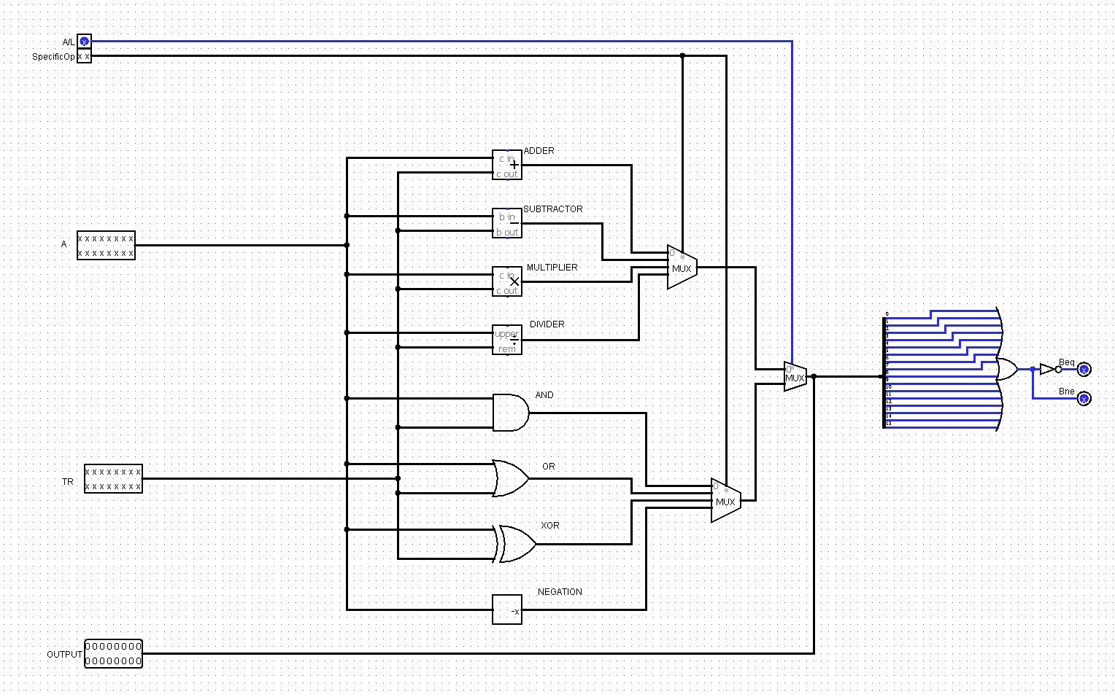
ALU

Slide 23
Sample Programme
load reg1 [mem1] ; reg1 = 1
load reg2 [mem3] ; reg2 = 3
load reg3 [mem1] ; reg3 = 1
load reg4 [mem2] ; reg4 = 5
add reg5, reg3, reg2 ; reg5 = reg2 + reg3 = 4
add reg6, reg4, reg1 ; reg6 = reg1 + reg4 = 6
beq -3, reg3, reg4 ; goes back to line 5 if reg3 == reg4 but 1 != 5
sub reg7, reg4, reg2 ; reg7 = reg2 – reg4 = -2
jmp 10 ; move to instruction line 11 (index starts at 0)
mul reg8, reg3, reg1 ; reg8 = reg1 x reg3 (never executed)
ANDi, reg9, 3, reg4 ; reg9 = reg4 AND 3 = 1
store mem4, reg9 ; mem4 = [reg9] = 1
addi reg3, 1, reg3 ; reg3 = reg3 + 1 = **
bne -3, reg3, reg4 ; loop: goes back to line 12 if [reg3] != [reg4]
880C
901C
980C
A014
2990
3208
3980
3A11
8052
418A
C9A7
824D
989B
E9A1
mem1 = 1
mem2 = 5
mem3 = 3

Slide 24
Thanks!

