Slide 1
Blueprint To The Call of Duty Big League
By:Kwadwo Kyei
NLP: Text Mining

Slide 2
Agenda
Introduction
Problem Statement
Case Study
Methodology
Word Cloud
Sentiments
Polarity
Emotional Class
Data Insights
Recommendation

Slide 3









Introduction
Background: Call of Duty is an e-sports first person shooting video game published by Activision. It currently has over 70 million players worldwide and according to load out , an e-sport magazine, Call of Duty generates over $1.1 billion in revenue and organizes yearly tournaments worth a total prize pot of $4.6 million.
Call of Duty currently has an e-league with 9 city-based teams under individual ownership each with their own player rosters.

Slide 4



Problem Statement
E-League teams struggle with creating and maintaining a huge online presence in the social media scene. A huge and active online presence not only transcribes to more revenue from advertisements but it is also instrumental in poaching and maintaining quality e-sport players.

Slide 5
Purpose
The purpose of this text mining analysis is to analyze the tweet sentiments of call of duty e-sports teams and how their tweets reflects on their follower’s tweets.
We would be using three e-sport teams as our case study.
Team | Location | Follower Count
Atlanta Faze | Atlanta, U.S.A | 76.7K
London Royal Ravens | London, U.K | 56.9K
Los Angeles Guerrillas | LA, U.S.A | 33.8K

Slide 6
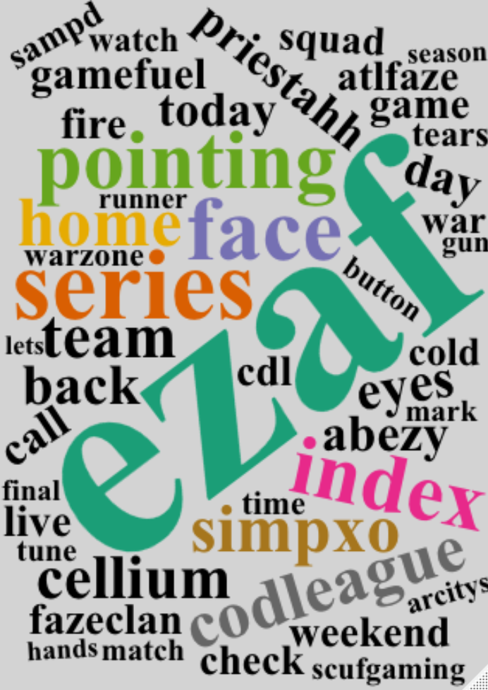
Word Cloud
A word cloud is an image composed of words used in a particular text or subject, in which the size of each word indicates its frequency or importance.

Slide 7
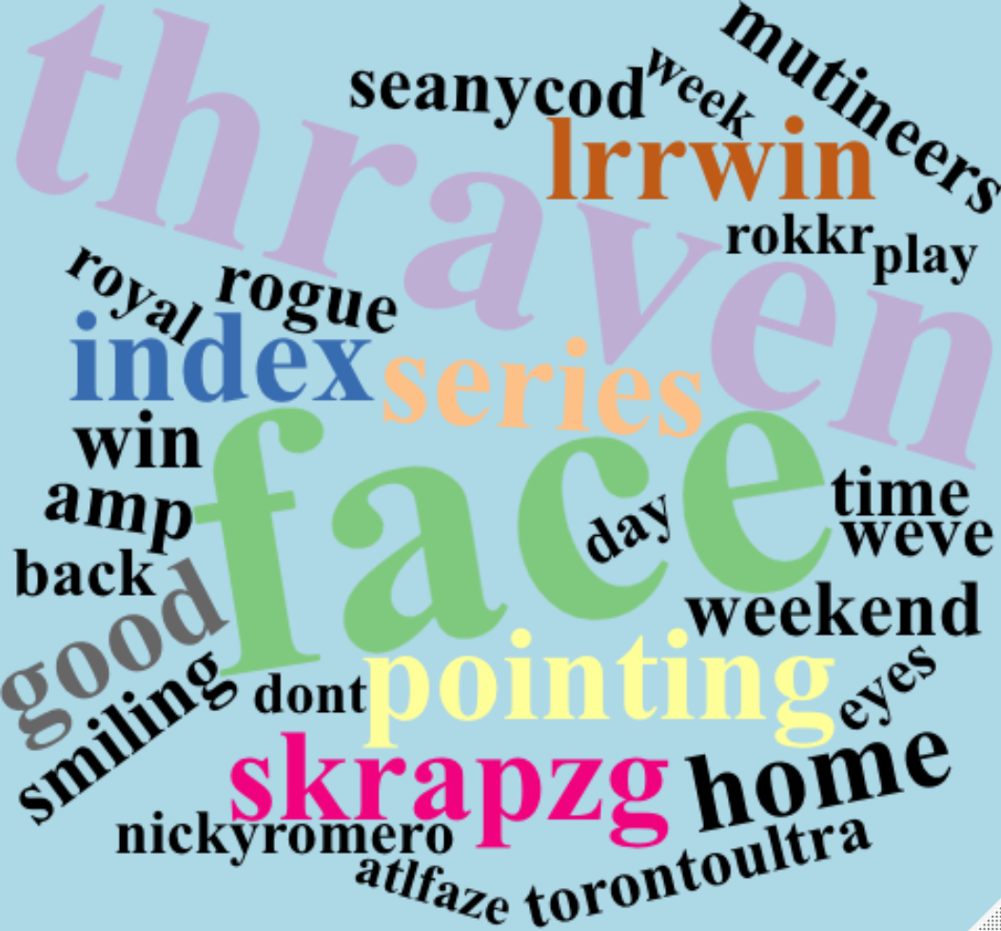
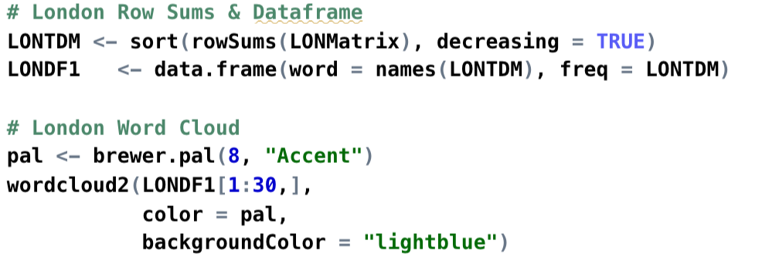
Word Cloud

Slide 8
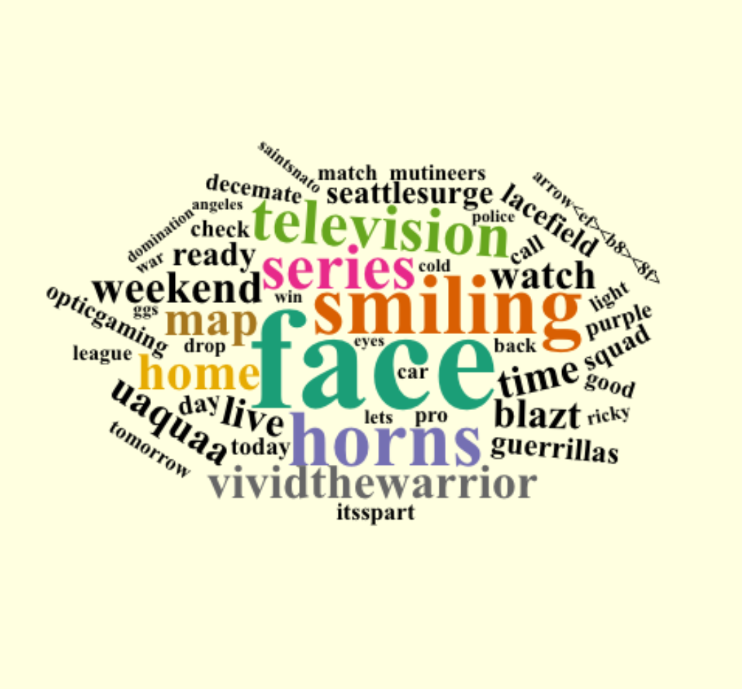
Word Cloud

Slide 9
Team Polarity
Polarity Scoring
Context Cluster | Assigned Values
Neutral Words | 0
Positive “good” | 1
Amplifiers “very” | 0.8
de-Amplifiers “hardly” | -0.8
Negators “not” | -1
Polarity is the emotion expressed in a sentence. It can be positive, negative or neutral.
Polarity | Atlanta | Los Angeles | London
Total Sentences | 1579 | 980 | 3200
Total Words | 14376 | 7339 | 20660
Ave Polarity | 0.1099577 | 0.09298064 | 0.09090142

Slide 10
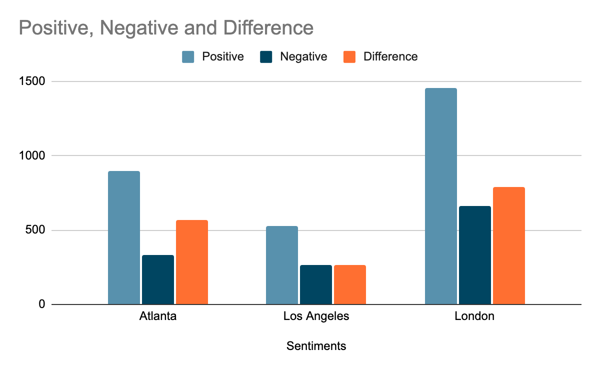
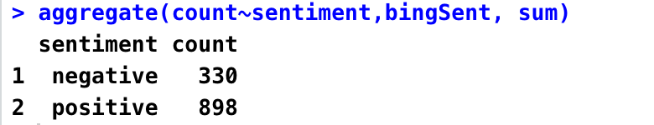
Team Sentiments
Sentiments analyzes the text of the writer (positive, negative, neutral)
Sentiments | Atlanta | Los Angeles | London
Positive | 898 | 527 | 1453
Negative | 330 | 264 | 662
Difference | 568 | 263 | 791
% of Word Positivity | 73% | 67% | 67%

Slide 11
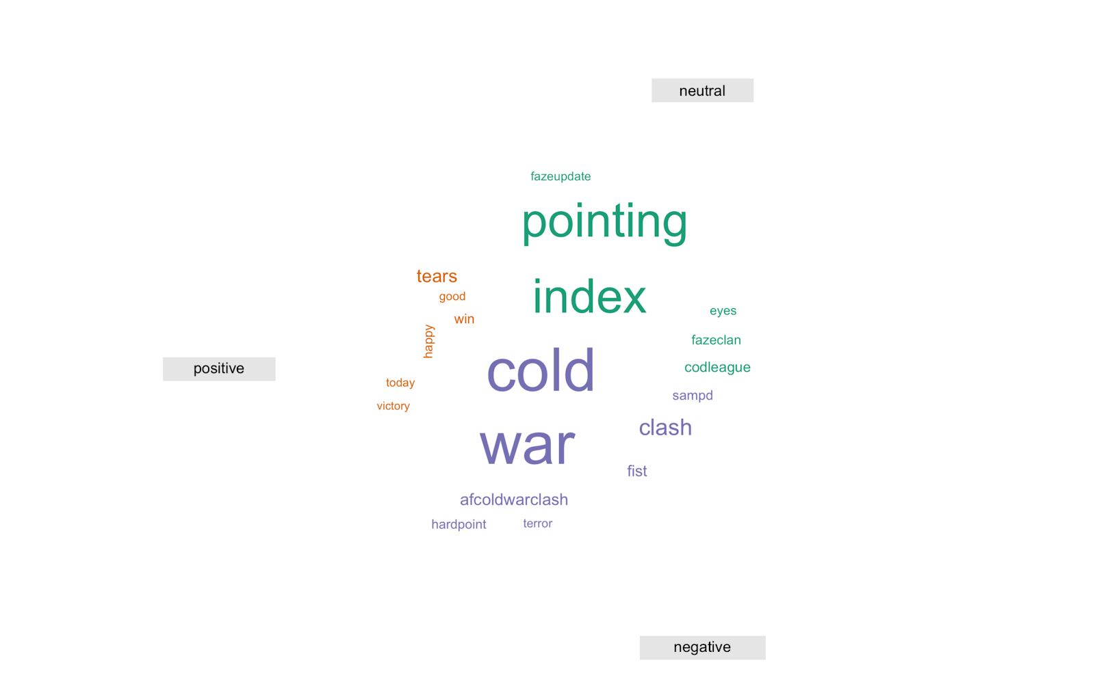
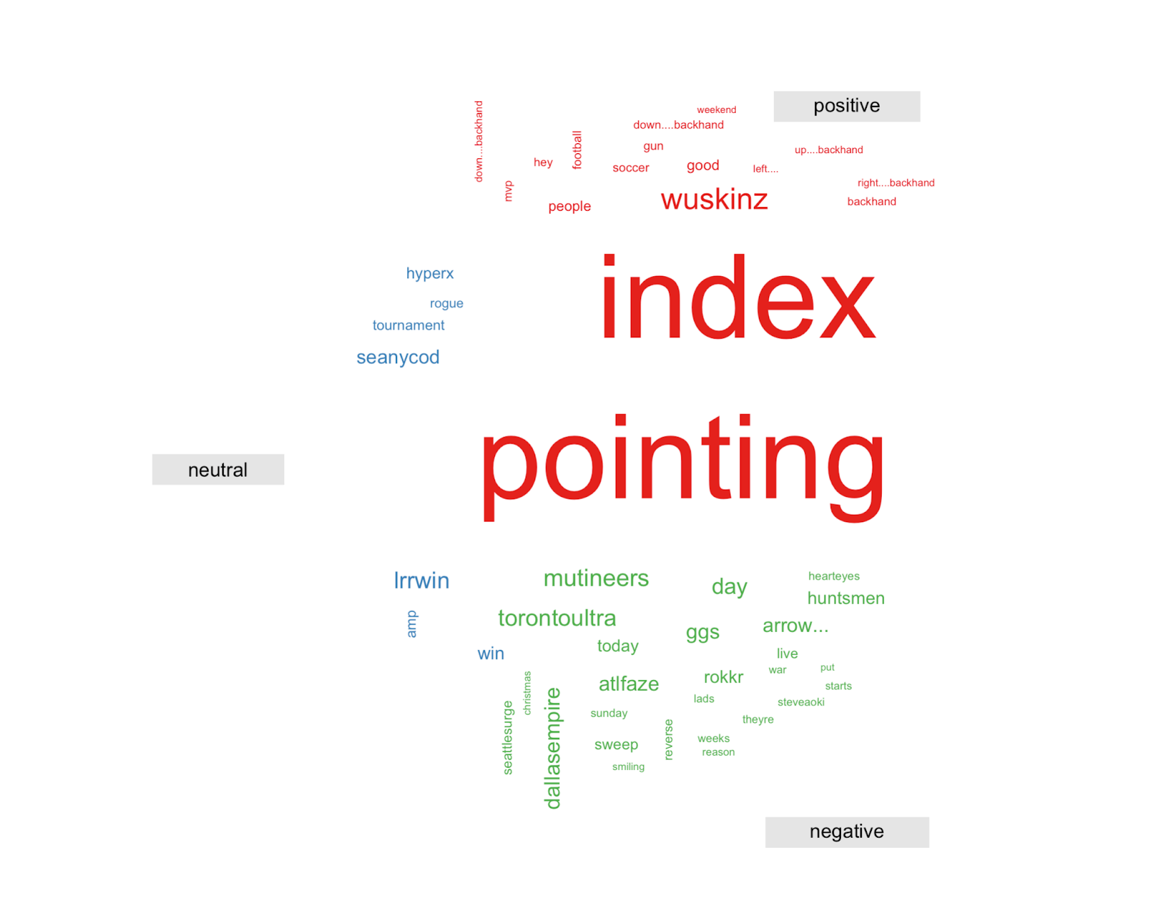
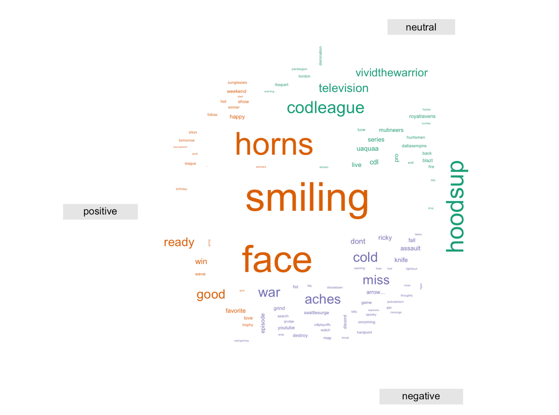
Polarity Comparison Cloud

Slide 12
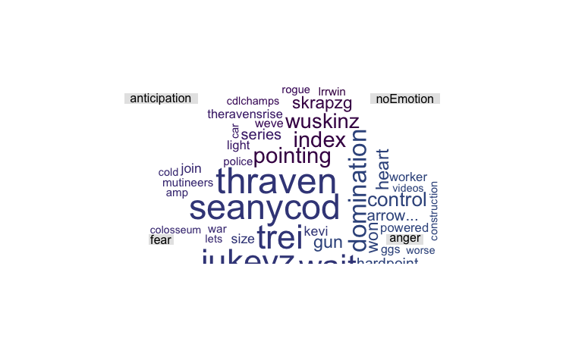
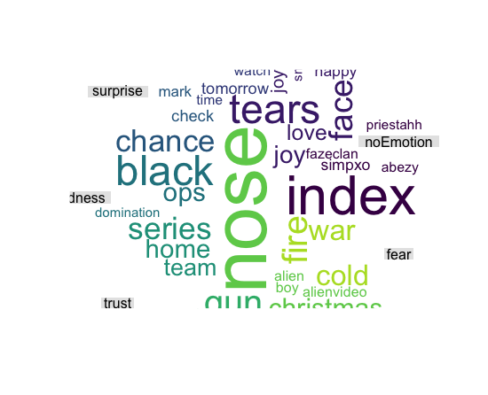
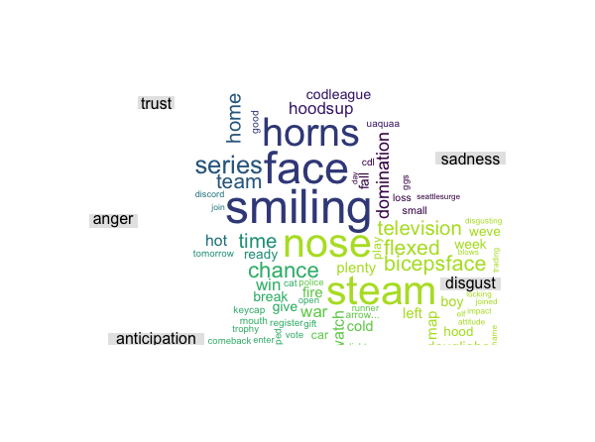
Emotional Comparison Cloud

Slide 13
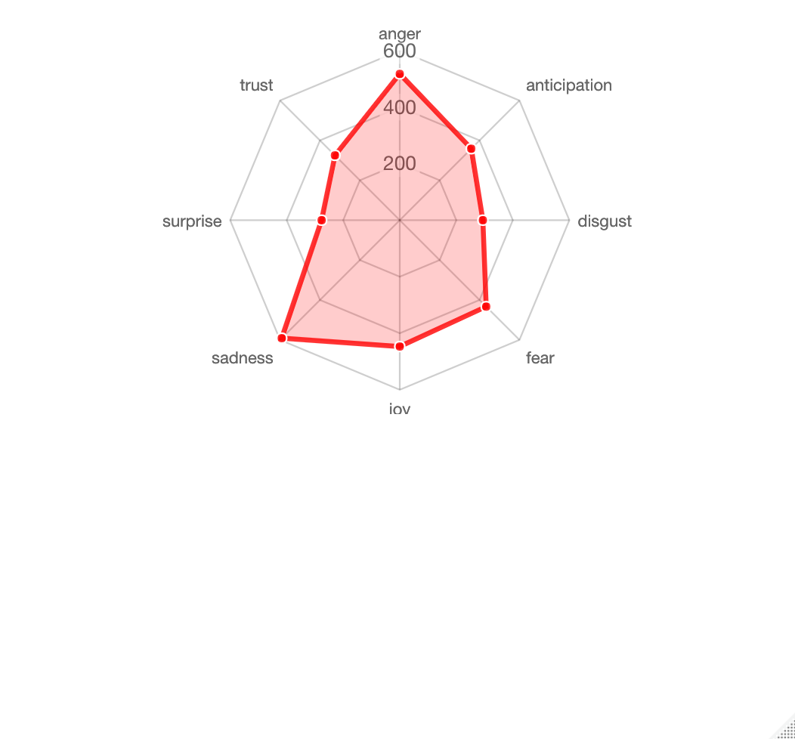
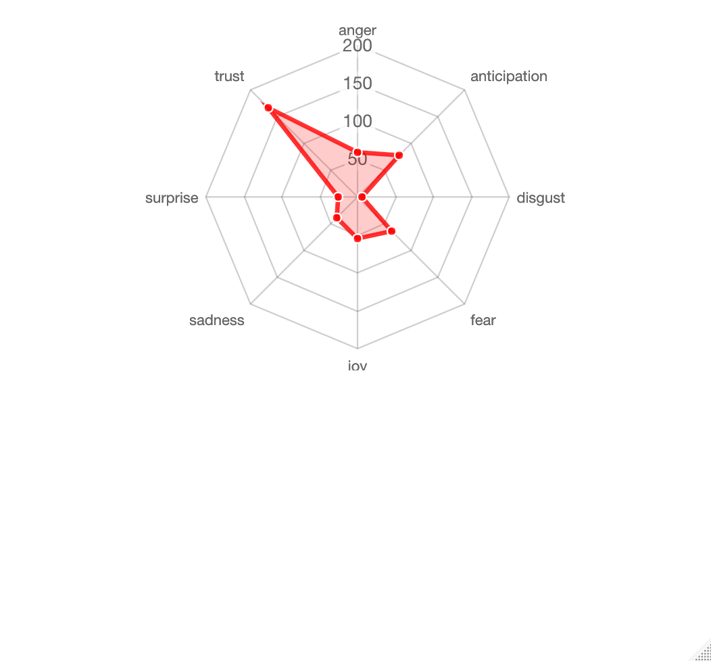
Team Follower’s EmoChart

Slide 14
Conclusion
An in a team’s polarity trust and anticipation from its followers
A in a team’s polarity anger and sadness from its followers

Slide 15
REcommendation
In regard to my findings, I would recommend every new COD e-sport team looking to make a positive social impact on twitter to post their tweets in a positive manner as it shows that positive tweets result in a positive attitude from followers.

