Slide 2
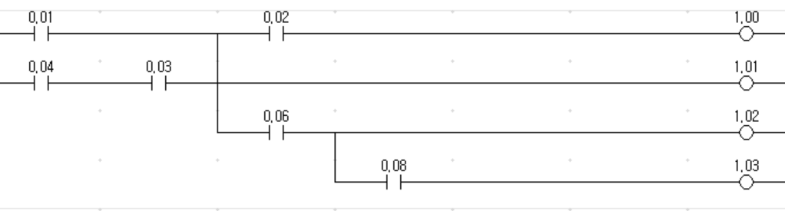
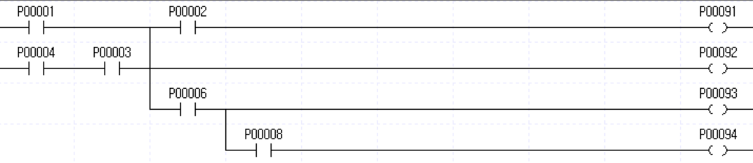
출력 후 AND 허용 여부
LD 0.01
LD 0.04
AND 0.03
ORLD
OUT TR0
AND 0.02
OUT 1.00
LD TR0
OUT 1.01
AND 0.06
OUT 1.02
AND 0.08
OUT 1.03
OUT 이후 바로
AND 사용 허용
LOAD 0.01
LOAD 0.04
AND 0.03
OR LOAD
MPUSH
AND 0.02
OUT 1.00
MLOAD
OUT 1.01
MPOP
AND 0.06
OUT 1.02
AND 0.08
OUT 1.03
OUT 이후 바로
AND 사용 불허
Notes:
옴론
LD 0.01
LD 0.04
AND 0.03
ORLD
OUT TR0
AND 0.02
OUT 1.00
LD TR0
OUT 1.01
AND 0.06
OUT 1.02
AND 0.08
OUT 1.03
산전
LOAD 0.01
LOAD 0.04
AND 0.03
OR LOAD
MPUSH
AND 0.02
OUT 1.00
MLOAD
OUT 1.01
MPOP
AND 0.06
OUT 1.02
AND 0.08
OUT 1.03

Slide 3
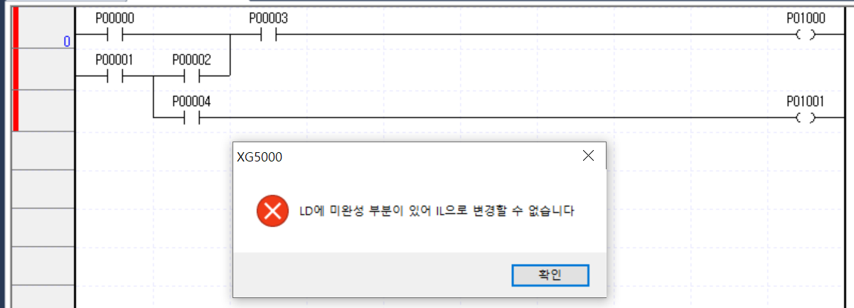
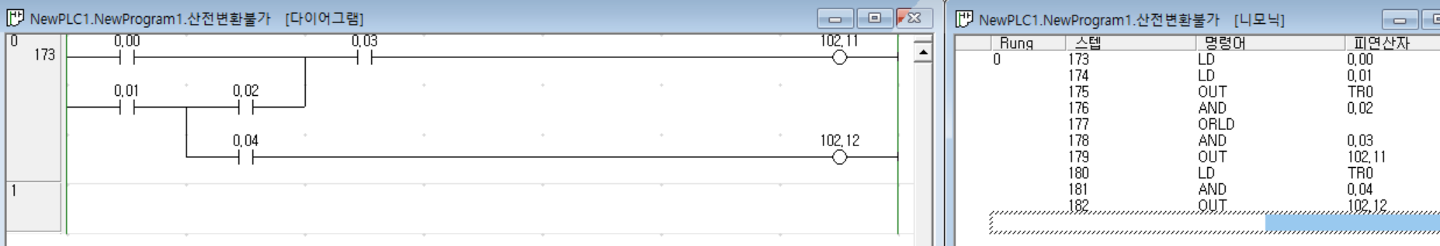
Xg5K 변환 불가 case
Branching 이후 merging

