Slide 2
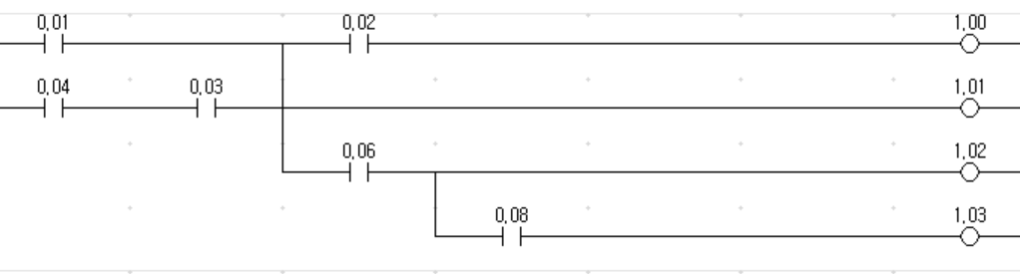
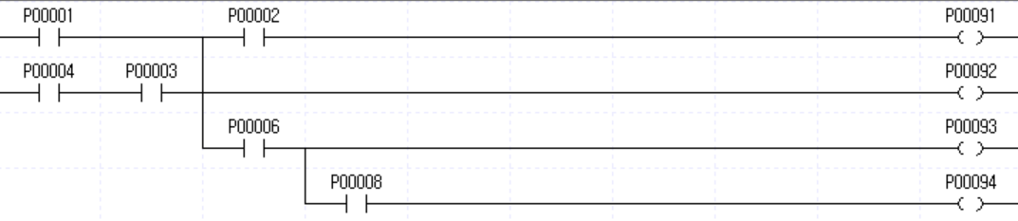
출력 후 AND 허용 여부
LD 0.01
LD 0.04
AND 0.03
ORLD
OUT TR0
AND 0.02
OUT 1.00
LD TR0
OUT 1.01
AND 0.06
OUT 1.02
AND 0.08
OUT 1.03
OUT 이후 바로
AND 사용 허용
LOAD 0.01
LOAD 0.04
AND 0.03
OR LOAD
MPUSH
AND 0.02
OUT 1.00
MLOAD
OUT 1.01
MPOP
AND 0.06
OUT 1.02
AND 0.08
OUT 1.03
OUT 이후 바로
AND 사용 불허
Notes:
옴론
LD 0.01
LD 0.04
AND 0.03
ORLD
OUT TR0
AND 0.02
OUT 1.00
LD TR0
OUT 1.01
AND 0.06
OUT 1.02
AND 0.08
OUT 1.03
산전
LOAD 0.01
LOAD 0.04
AND 0.03
OR LOAD
MPUSH
AND 0.02
OUT 1.00
MLOAD
OUT 1.01
MPOP
AND 0.06
OUT 1.02
AND 0.08
OUT 1.03

Slide 3
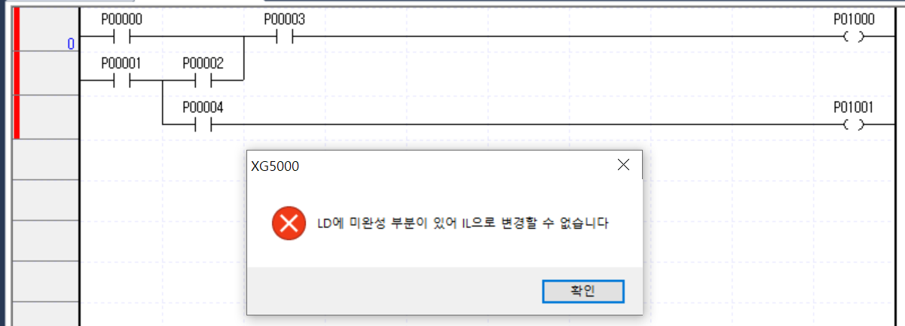
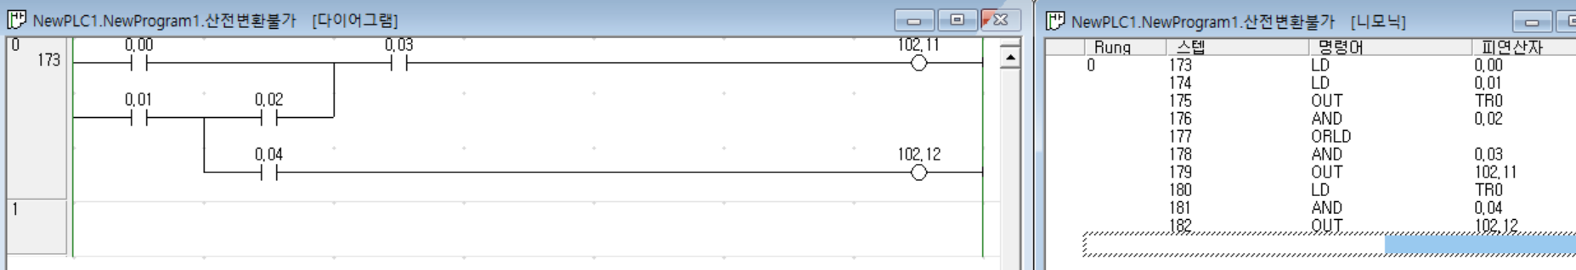
Xg5K 변환 불가 case
Branching 이후 merging

Slide 4
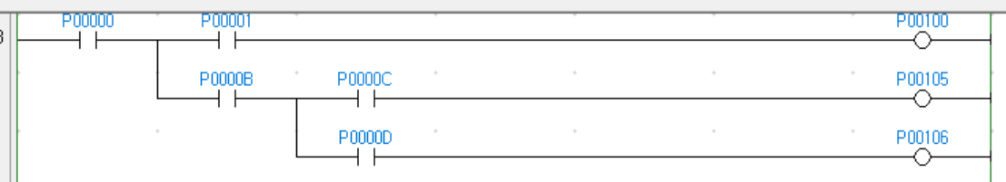
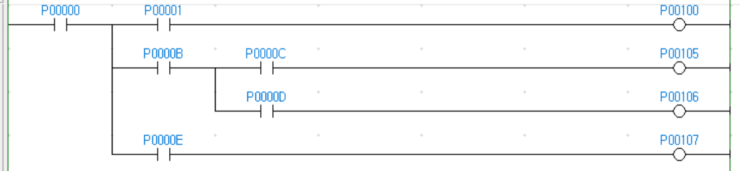
CXP IL TR overwrite (재사용)
LD P00000
OUT TR0
AND P00001
OUT P00100
LD TR0
AND P0000B
OUT TR0
AND P0000C
OUT P00105
LD TR0
AND P0000D
OUT P00106
TR0
TR0
TR1 이 맞으나, TR0 를 모두 소진해서 TR0 를 더 이상 사용할 필요가 없는 상황에서는 TR0 를 재사용하는 듯.
TR0
TR1
LD P00000
OUT TR0
AND P00001
OUT P00100
LD TR0
AND P0000B
OUT TR1
AND P0000C
OUT P00105
LD TR1
AND P0000D
OUT P00106
LD TR0
AND P0000E
OUT P00107

