Slide 1
Java 8 Workshop
Java Language Changes

Slide 2
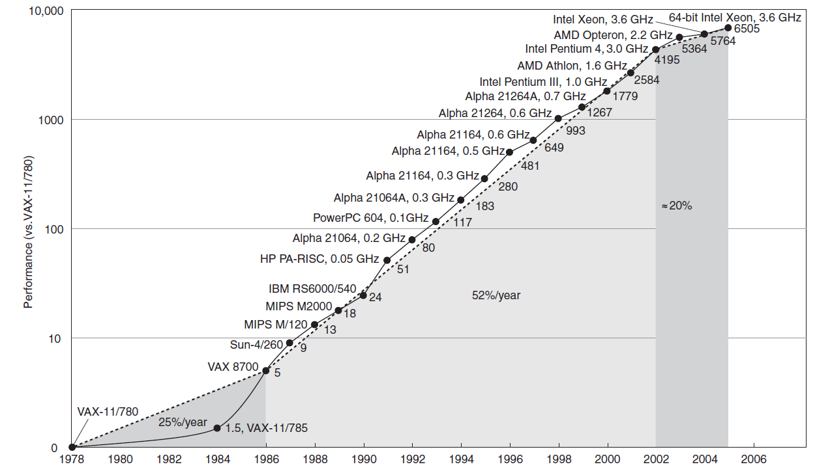
Evolution of processor speed
Copyright © 2009 Elsevier, Inc. All rights reserved.
Notes:
This chart plots performance relative to the VAX 11/780 as measured by the SPECint benchmarks (see Section 1.8). Prior to the mid-1980’s, processor performance growth was largely technology-driven and averaged about 25% per year. The increase in growth to about 52% since then is attributable to more advanced architectural and organizational ideas. By 2002, this growth led to a difference in performance of about a factor seven. Performance for floating-point-oriented calculations has increased even faster. Since 2002, the limits of power, available instruction-level parallelism, and long memory latency have slowed uniprocessor performance recently, to about 20% per year. Copyright © 2009 Elsevier, Inc. All rights reserved.

Slide 3
Go Parallel
Moore’s Law
More cores but not faster cores
Serial API’s
Limited to a shrinking fraction of available processing power
Parallel API’s
Multi-threading is hard
Little support in mainstream languages

Slide 4
Sequential vs. Parallel Execution
s.setColor(RED)
Sequential Execution
Must process elements in the specified order
Parallel Execution
Requires code to be modelled as data
s.setColor(RED)
s.setColor(RED)
s.setColor(RED)
s.setColor(RED)
Example
External vs. Internal
Iteration
for (Shape s : shapes) {
}
shapes.forEach( );
s.setColor(RED)
s.setColor(RED)

Slide 5
Sequential vs. Parallel Execution
s.setColor(RED)
Sequential Execution
Must process elements in the specified order
Parallel Execution
Requires code to be modelled as data
s.setColor(RED)
s.setColor(RED)
s.setColor(RED)
s.setColor(RED)
Sequential Execution
For-loop is inherently sequential
Must process elements in the specified order
Parallel Execution
Code expressed independently of the thread in which it will run
Requires code to be modelled as data

Slide 6
Internal Iteration
shapes.forEach( );
s.setColor(RED)
Requires code to be modelled as data
The client delegates the iteration to the library
Allow for performance optimizations
Reordering of data
Parallelism
Short-circuiting
Laziness
Client code can be clearer
Focus on stating the problem
s.setColor(RED)
s.setColor(RED)
s.setColor(RED)
s.setColor(RED)

Slide 7
Modelling Code as Data
« Callback interface »
button.addActionListener(new ActionListener() {
public void actionPerformed(ActionEvent e) {
System.out.println(e);
}
});

Slide 8
Anonymous Inner Classes
Various problems
Bulky syntax
Confusion wrt. this
Inflexible class-loading and instance-creation semantics
Inability to capture non-final local variables
Inability to abstract over control flow
Advantage
Cleanly integrated in Java’s type system: a function value with an interface type

Slide 9
Modelling Code as Data
« Callback interface »
button.addActionListener(new ActionListener() {
public void actionPerformed(ActionEvent e) {
System.out.println(e);
}
});
Lambda expressions
button.addActionListener( e -> System.out.println(e) );
Lighter-weight
« Anonymous Methods »

Slide 10
Lambda Expressions
(String s) -> { System.out.println(s); … }
(String s) -> System.out.println(s)
s -> System.out.println(s);
(int x, int y) -> return x + y
(int x, int y) -> x + y
(x, y) -> x + y
() -> 42

Slide 11
Typing Lambda Expressions
button.addActionListener( e -> System.out.println(e) );
??? listener = e -> System.out.println(e) ;
Functional Interfaces
Lambda expression represented as an interface
Not simply syntactic sugar
ActionListener listener = e -> System.out.println(e) ;
functional interface
function

Slide 12
Functional Interfaces
@FunctionalInterface
public interface ActionListener {
public void actionPerformed(ActionEvent e);
}
ActionListener listener = e -> System.out.println(e) ;
Single abstract method
Optional annotation: @FunctionalInterface
Captures design intent
Checked at compile-time

Slide 13
Functional Interfaces
No changes in Java type system
Existing API’s can profit from lambda expressions
java.lang.Runnable
java.util.Comparator
java.io.FileFilter
commons-collections Transformer

Slide 14
Functional Interfaces
Package java.util.function provides new commonly used functional interfaces
Predicate T → boolean
Function T → R
BiFunction (T, S) → R
UnaryOperator T → T
BinaryOperator (T, T) → T
Consumer T → (void)
Supplier () → R
Variations for primitive types

Slide 15
Target Typing
Type of a lambda is inferred from the surrounding context
public interface ActionListener {
public void actionPerformed(ActionEvent e);
}
ActionListener listener = e -> System.out.println(e) ;
Consumer<String> consumer = e -> System.out.println(e) ;
public interface Consumer<T> {
void accept(T t);
}

Slide 16
Target Typing
Lambda expression can be assigned if
Target is a functional interface type
Same number of parameters
Same parameter types
Compatible return type
Compatible exceptions
public interface BiFunction<T, U, R> {
R apply (T t, U u);
}
BiFunction<String, Integer, Character> =
(String string, Integer i) -> string.charAt(i)

Slide 17
Method References
When you want to call an existing method
More compact & readable
± Shorthand for lambda expressions
Static Methods
Function<String, Integer> parse =
(String s) -> Integer.parseInt(s);
≈
Function<String, Integer> parse = Integer::parseInt;

Slide 18
Method References
Instance Methods
Invocation target is the first parameter
String.toUpperCase()
Function<String, String> toUpperCase =
(String s) -> s.toUpperCase();
Function<String, String> toUpperCase = String::toUpperCase;
String.charAt(Integer)
BiFunction<String, Integer, Character> charAt =
(String s, Integer i) -> s.charAt(i)
BiFunction<String, Integer, Character> charAt = String::charAt

Slide 19
Method References
Instance Methods
Specific instance
Constructors
Set<String> knownNames = …
Predicate<String> isKnown =
(String s) -> knownNames.contains(s);
Predicate<String> isKnown = knownNames::contains;
Supplier<Set<String>> setFactory =
() -> new TreeSet<String>();
Supplier<Set<String>> setFactory = TreeSet::new;

Slide 20
Exercises
Lambda Expressions
Functional Interfaces
Method References

Slide 21
Go Parallel
So now we can finally do this:
Collection shapes = …;
shapes.forEach( s -> s.setColor(RED));
We cannot add methods to interfaces
?
Collection shapes = …;
Collections.forEach( shapes,
s -> s.setColor(RED));

Slide 22
Default Methods
Add new methods to existing interfaces
Provide a default implementation
Concrete classes can override default methods
Previously compiled classes inherit default implementation
public interface Collection<T> {
default void forEach(Consumer<T> action) {
for (T t : this) {
action.accept(t);
}
}
}

Slide 23
Default Methods
Allows evolution if API’s
NOT « Traits »
Java remains statically typed
Multiple inheritance ?
Type (interfaces)
Behaviour (default methods)
State

Slide 24
Default Methods
F
m3()
A
m2()
m3()
Object
B
m2()
C
m1()
E
m1()
D
m1()
m2()
Conflicts ?
Classes win
Most specific ancestor wins
Ambiguity is a compile-time error

Slide 25
Fluent API’s
Default and Static methods on interfaces
Allow for « fluent-style » API’s
Comparator<Person> comparator =
Comparator.comparing(Person::getLastName)
.thenComparing(Person::getFirstName)
.thenComparingInt(Person::getAge);

Slide 26
Exercises
Default Methods
New methods in java core classes

Slide 27
Putting it all together
List<Person> people = ...
Collections.sort(people, new Comparator<Person>() {
public int compare(Person x, Person y) {
return x.getLastName().compareTo(y.getLastName());
}
});

Slide 28
Putting it all together
Collections.sort(people, new Comparator<Person>() {
public int compare(Person x, Person y) {
return x.getLastName().compareTo(y.getLastName());
}
});
Collections.sort(people, (Person x, Person y) ->
x.getLastName().compareTo(y.getLastName()));
Collections.sort(people,
Comparator.comparing((Person p) -> p.getLastName()));
Collections.sort(people,comparing(p -> p.getLastName()));
Collections.sort(people, comparing(Person::getLastName));
people.sort(comparing(Person::getLastName));

Slide 29
Go Parallel
So now we can finally do this:
Or this:
Collection shapes = …;
shapes.forEach( s -> s.setColor(RED));
?
Collection shapes = …;
Collection greenShapes =
shapes.filter( s -> s.getColor()==GREEN);
Collection greenShapeSizes =
greenShapes.map( s -> s.getSize());
Double average = greenShapeSizes.average();

Slide 30
Go Parallel
Utility methods on Collections would inherently have a performance impact Even written like this :
What we want is :
Double average = shapes
.filter( s -> s.getColor()==GREEN)
.map( s -> s.getSize())
.average();
Double average = shapes
.filter( s -> s.getColor()==GREEN)
and also map( s -> s.getSize())
and also average();

Slide 31
Introducing Streams
Need for a new concept : Stream
Double average = shapes.stream()
.filter( s -> s.getColor()==GREEN)
.map( s -> s.getSize())
.average();
Collection
shapes
Stream
Stream
stream
Stream
filter
average
Double
map
Lazy
Eager
Lazy

Slide 32
Stream Optimizations
Laziness-seeking
Stream Properties
Sized (Collection)
Distinct (Set)
Ordered (List)
Sorted
shapes.filter( s -> s.getSize() > 42 )
.findFirst()
treeSet.stream().sorted()
set.stream().distinct()
NOP

Slide 33
Support filter-map-reduce pattern
Collection<T>
Collection<T>
Stream<T>
Stream<T>
Stream<U>
IntStream
U
int
int*
List<U>
stream()
filter( Predicate<T> )
map( Function<T, U> )
mapToInt( ToIntFunction<T> )
reduce( BinaryOperator<U> )
sum( )
max( )
collect( toList() )

Slide 34
Stream API
Stream Collection<T> → Stream<T>
ParallelStream Collection<T> → Stream<T>
Filter Stream<T> → Stream<T>
Distinct Stream<T> → Stream<T>
Sorted Stream<T> → Stream<T>
Map Stream<T> → Stream<U>
Reduce Stream<T> → T
Collect Stream<T> → Collection<T>
FlatMap Stream<Collection<T>> → Stream<T>

Slide 35
Creating a Stream
Collection<T> Stream<T>
Arrays.stream(T[]) Stream<T>
IntStream.range(from, to) IntStream
Stream.iterate(T, UnaryOperator) Stream<T>
BufferedReader.lines() Stream<String>
Files.walk(Path) Stream<Path>
Random.ints() IntStream

Slide 36
Exercises
Map-Filter-Reduce operations
Creating Streams

Slide 37
Reduce
Streams provide an abstraction over sequential / parallel behaviour
How does reduction work in parallel ?
int sum = intStream.sum();
int sum = intStream.parallel().sum();

Slide 38
Reduction Operator
Sequential
Parallel
1
2
3
4
5
6
7
8
...
3
11
15
6
26
…
…
T result = stream.reduce(BinaryOperator<T> accumulator)
Associativity (a+b)+c == a+(b+c)

Slide 39
Reduction: Empty Streams ?
Identity element
Explicit default
IntStream.of().sum() == 0
IntBinaryOperator product = (i,j) -> i * j;
IntStream.of().reduce(1, product) == 1
?
IntStream.of().max() == ?

Slide 40
Optional Values
« The operation may not produce a result »
Conditional use of value
Default behaviour if value is absent
Alternative to using null values
OptionalInt result = IntStream.of().max();
if (result.isPresent()) { … }
result.ifPresent( i -> System.out.println(i) );
connection.setTimeout(result.orElse(-1));
Connection.setPort(result.orElseThrow(
() -> new IllegalStateException("no port")));

Slide 41
Collect
« Mutable » Reduction
Stream.collect
supplier create result
accumulator modify result
combiner combine results
Collectors utility class
new ArrayList<T>();
list.add(t)
list1.addAll(list2)
List<?> list = stream.collect(Collectors.toList());

Slide 42
Collectors
toList() List<T> toSet() Set<T>
toMap Map<K, V>
Function<T, K> keyMapper
Function<T, V> valueMapper
Joining String
String delimiter

Slide 43
Collectors
groupingBy Map<K, List<T>>
Function<T, K> classifier
groupingBy Map<K, D>
Function<T, K> classifier
Collector<T, ?, D> downStream
partitioningBy Map<Boolean, List<T>>
Predicate<T>

Slide 44
Exercises
Collectors
Complex examples

Slide 45
Reference
Brian Goetz
State of the Lambda http://cr.openjdk.java.net/~briangoetz/lambda/ lambda-state-final.html
State of the Lambda: Libraries Edition http://cr.openjdk.java.net/~briangoetz/lambda/ lambda-libraries-final.html
José Paumard
http://www.slideshare.net/jpaumard

Slide 46
Why not replacing Collections API ?
Major task
Adoption lag of many years

Slide 47
Key drivers
Make parallelism more accessible to developers
Remove unnecessary impediments to migrate code form sequential to parallel
Encourage idioms that are both sequential- and parallel-friendly.
Shift focus from what computation should be performed, rather than how it should be performed

Slide 48
Why explicit ?
Balance between making parallelism easier but not invisible
Goal to make it explicit but unobstrusive
Making parallelism transparent would introduce nondeterminism and the possibility of data races when users might not expect it

Slide 49
Why no « Function Types »
The idea was considered and rejected (for now)
Add complexity to the type system
Further mix structural & nominal types
Divergence of library styles
Callback interfaces versus Function types
Syntax could be unwieldy
Further exposure & limitations by erasure
Notes:
Java is almost entirely nominally typed

