Slide 1

Project one
Topic Impart of remote work on mental health
Name: Rosemond Kwakyewaa Apau
Program: Artificial Intelligence Bootcamp

Slide 2
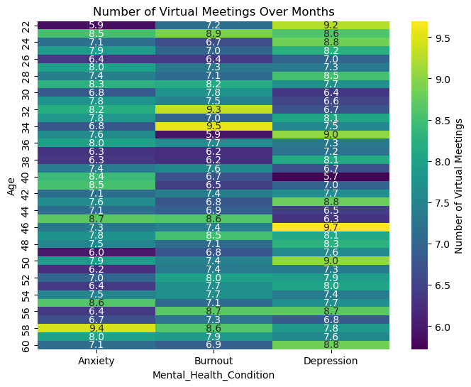
The Correlation Between Age, Mental Health Condition And Virtual Meeting
The heatmap reflects how the frequency of virtual meetings aligns with the mental health challenges experienced by different age groups.
These trends highlight the need to tailor support for specific age groups, ensuring younger individuals have the resources to manage anxiety and middle-aged professionals receive help to prevent burnout

Slide 3
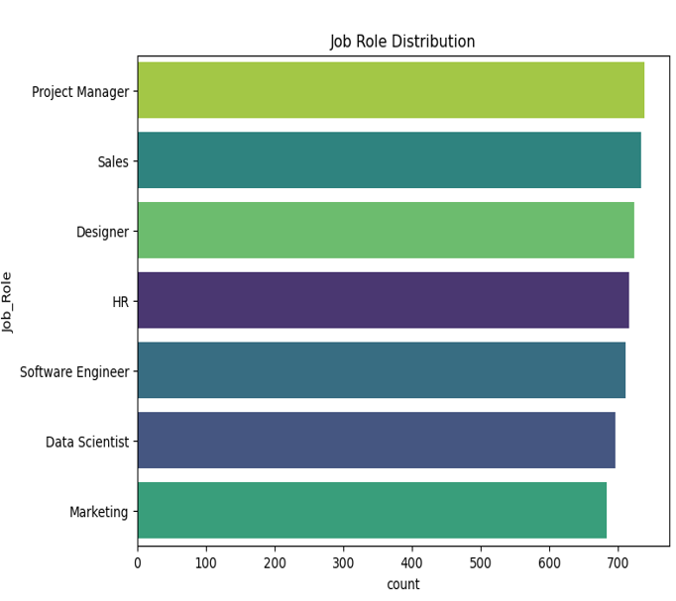
Job roles distribution
Project Managers and Marketing roles, with higher counts, may face greater stress due to increased responsibilities in remote work settings.
Sales, Designers, and HR roles, with balanced distribution, could experience varied mental health impacts based on individual role demands.
Software Engineers and Data Scientists, with slightly lower representation, may face isolation challenges in remote settings, impacting mental health.
Tailored mental health strategies should focus on high-pressure roles (e.g., Project Managers) and remote adaptability for tech-heavy roles (e.g., Data Scientists
Encouraging role-specific mental health programs can enhance employee well-being across all job categories.

Slide 4
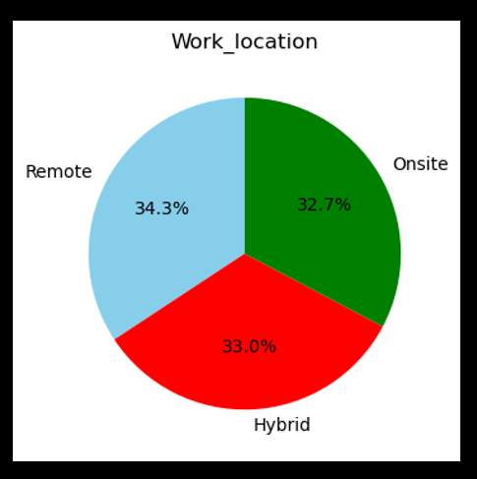
Work location
Remote Work (34.3%):
Provides flexibility and better work-life balance but risks isolation and blurred work-life boundaries.
Hybrid Work (33.0%):
Combines the best of remote and onsite, reducing isolation while maintaining collaboration, positively impacting mental health.
Onsite Work (32.7%):
Facilitates direct interaction but may increase commuting stress and rigid schedules, potentially affecting mental well-being.

Slide 5
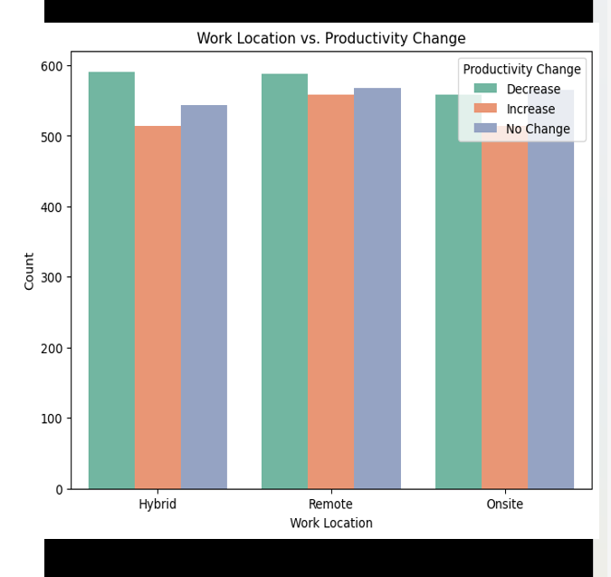
Work Location Vs Productivity Change
Hybrid Work shows relatively high counts of productivity increases.
Remote Work shows high counts of productivity increases are observed, slightly less than hybrid.
Onsite Work has comparable counts of increases and decreases in productivity.
Conclusion:
Hybrid work appears to offer the best balance for productivity and, likely, mental health, as it combines the advantages of both remote and onsite models.
Employers should focus on supporting mental health in remote work by fostering connection and engagement, while also addressing stressors like commute and rigidity in onsite roles.

Slide 6
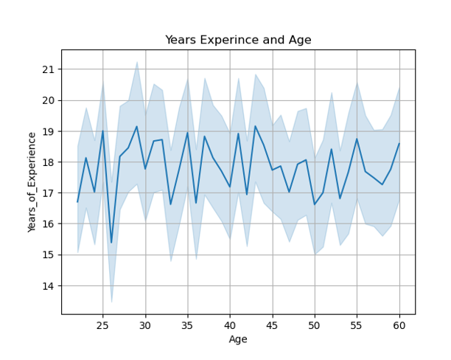
Years experience and age
Younger employees with less experience may require more support in remote work to reduce stress.
Older employees with stable experience adapt better to remote work due to professional stability.
Variability in experience could impact mental health; less experienced workers may face higher stress.
Structured mentorship and regular check-ins can support mental health in remote work settings.
Tailored mental health programs are crucial to address the unique needs of different age and experience groups.

Slide 7


Conclusion: Mental health impacts in remote work vary across job roles due to differences in responsibilities and work demands. High-pressure roles like Project Managers and Marketing professionals are more susceptible to stress, while roles like Software Engineers and Data Scientists may face challenges with isolation. A balanced, role-specific approach to mental health support, including stress management programs and fostering collaboration, is essential to ensure employee well-being and productivity across all job categories.

