Slide 1
Creating a Built for BlackBerry WebWorks Application
JAM 31
Ken Wallis (@ken_wallis)
Jason Scott
Bryan Tafel
May 14-16, 2013

Slide 2
Introduction
What are we doing today?

Slide 3
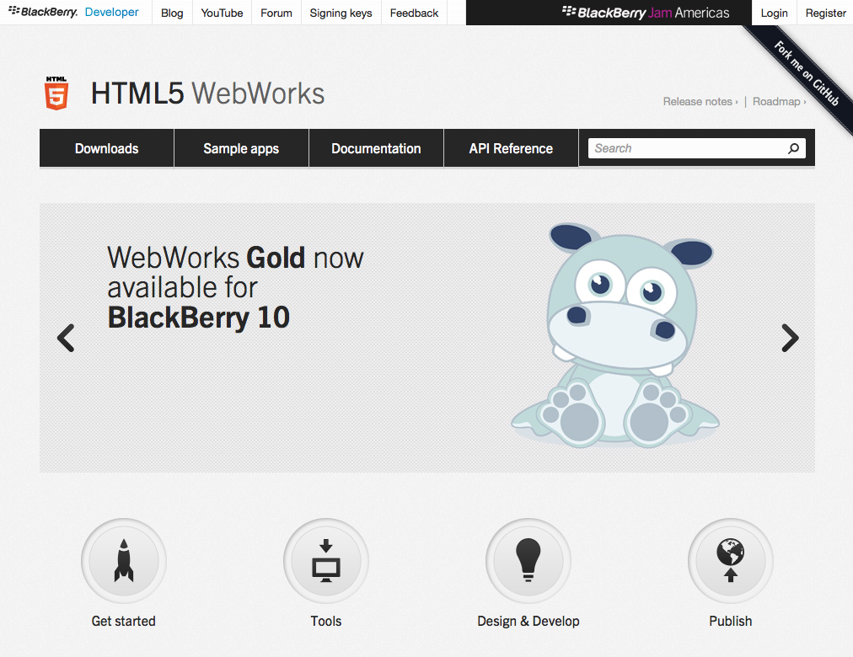
Bookmark this Page
http://developer.blackberry.com/html5

Slide 4
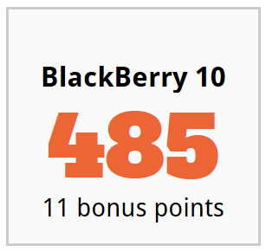
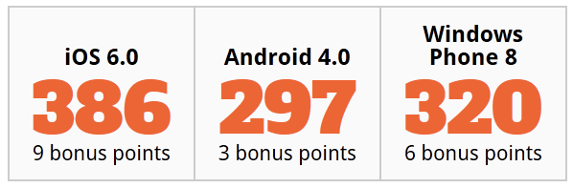
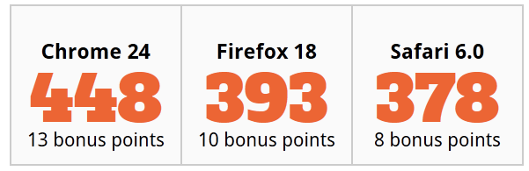
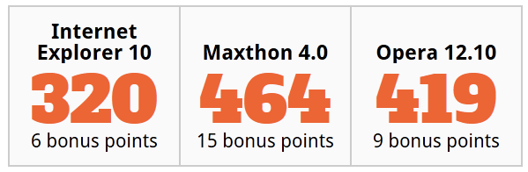
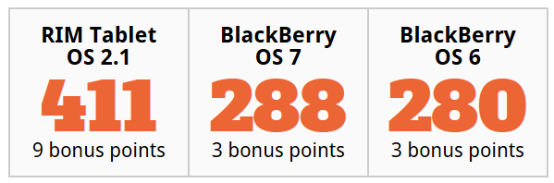
HTML5Test.com/compare/browser/index.html
Mobile
Desktop
Notes:
Now, let’s look at our leadership in HTML5 standards conformance. I’m sure most of you are familiar with HTML5Test.com. They have a really cool feature there where you can choose 3 browsers and get a detailed comparison report on them. Check it out.
By any measure, BlackBerry 10 is, and has been for many months, an aggressive contender in the conformance numbers game.
If you compare BlackBerry 10 browser with other mobile vendor’s browsers such as iOS, Android, and WP8, BlackBerry 10 comes out on top.
If you compare BlackBerry 10 browser with even the top desktop browsers on the market, BlackBerry 10 comes out on top. There are other 3rd party browsers I didn’t show here that perform better than some shown here, but none of them scores as high as BlackBerry 10.
The BlackBerry 10 Browser maintains the highest conformance in all categories across all device types.

Slide 5
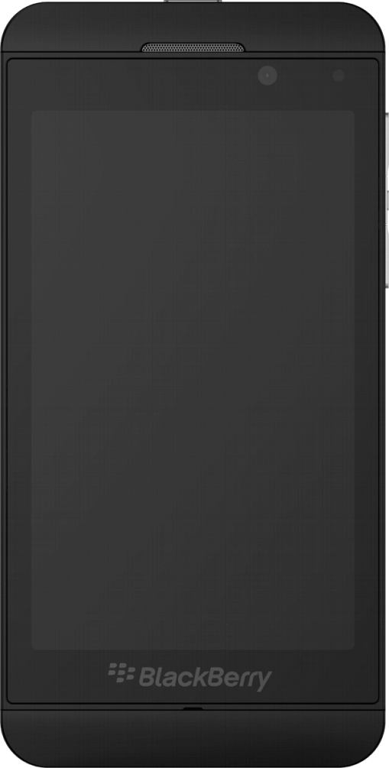
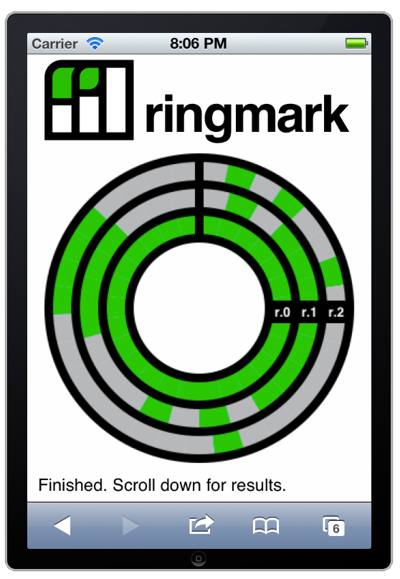
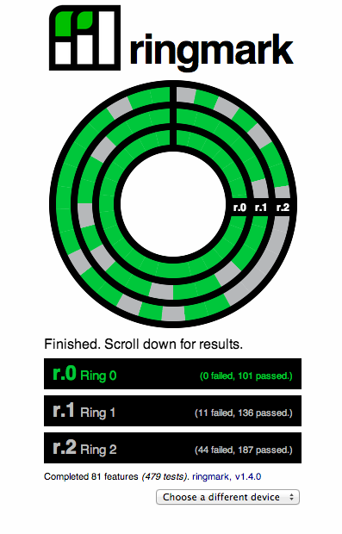
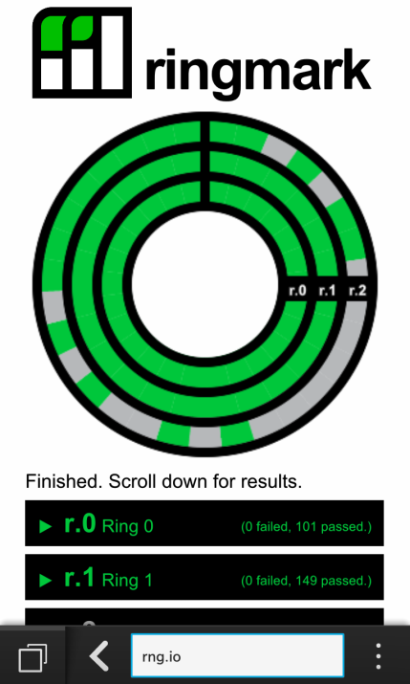

ringmark on BlackBerry 10
BlackBerry 10 is the first vendor mobile browser to pass ringmark ring 1!
A web-based test suite for capabilities that modern web apps require
Notes:
I’m sure most of you are also familiar with the ringmark test suite developed by Facebook.
BlackBerry 10 is the first mobile vendor browser to pass ringmark 1. This was no small feat. My understanding is that our web team has been working closely with the ringmark folks to improve bugs and various issues in the tests that will benefit the industry as a whole.
Again, another example of industry leadership you would expect from a TOP TIER Browser provider.

Slide 6

The BlackBerry Web Platform
Performance is always feature #1
New CSS support
File System APIs
getUserMedia
indexedDB
WebGL

Slide 7
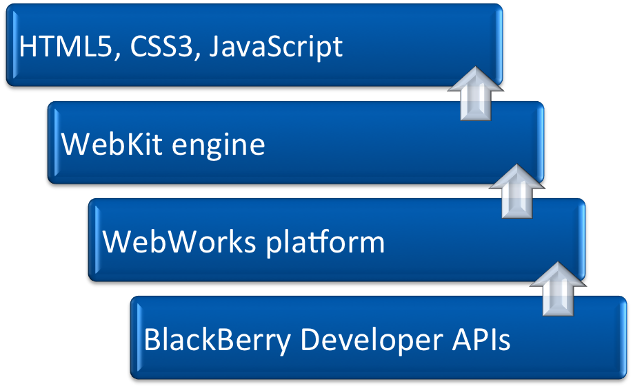






HTML5 Powered by Native
http://developer.blackberry.com/html5/api

Slide 8




Built for BlackBerry
Higher level of quality
Added level of evaluation by BlackBerry
Minimum criteria
Higher profile in BlackBerry World, Social media marketing, etc.
FREE!
Integrated
Social
Beautiful

Slide 9
Criteria
User Benefits
  Genuine entertainment, enhanced productivity, enriched communication
User Experience
Performance
  CPU, memory, battery, network, background
Security
Service Integration
  Payment, BBM, Invocation, NFC

Slide 10
Intro to Tools and Environment
Demo (5 minutes)

Slide 11
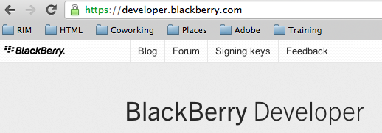
Request Keys
https://developer.blackberry.com/

Slide 12
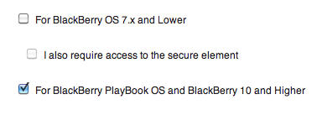
Request Keys
https://www.blackberry.com/SignedKeys/codesigning.html

Slide 13
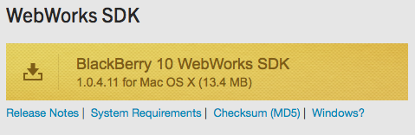
Download Tools
https://developer.blackberry.com/html5/download/sdk

Slide 14

Register Your Computer
https://developer.blackberry.com/html5/documentation/signing_setup_bb10_apps_2008396_11.html
client-RDK-xxxxxx.csj - This is the file that you use to sign your applications and publish to the BlackBerry App World storefront.
client-PBDT-xxxxx.csj - This file is used to generate a debug token that you can use to test your application on a device.

Slide 15
First App
Walk-through (40 Minutes)

Slide 16
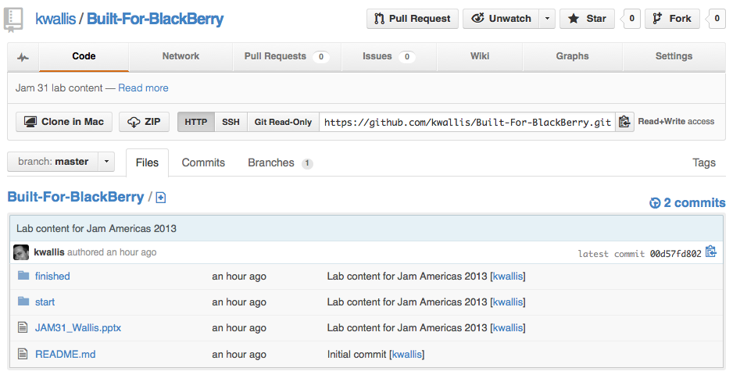
Intro
Download the lab material:
http://github.com/kwallis/Built-For-BlackBerry

Slide 17
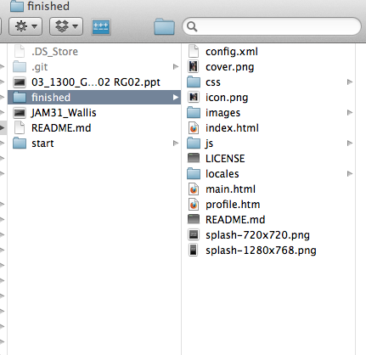
Intro
Open the finished folder

Slide 18
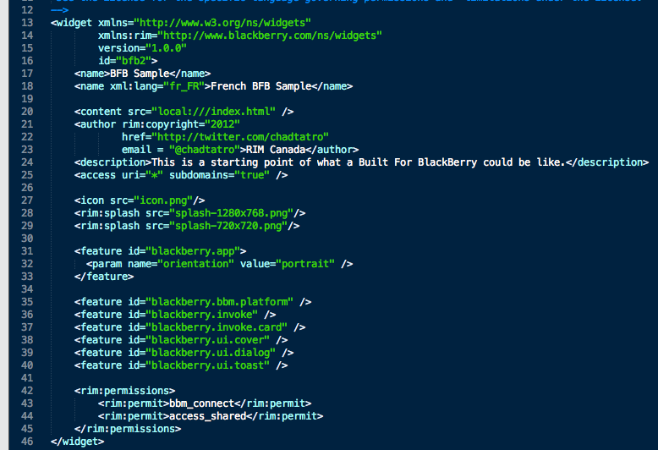
Intro to config.xml
https://developer.blackberry.com/html5/documentation/code_sample_creating_a_bb_widget_config_document_834683_11.html

Slide 19
Intro to config.xml
Change the following to something unique (for signing):
id
name
author

Slide 20
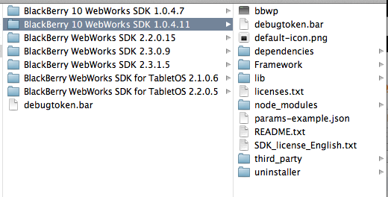
Build and Sign Built-For-BlackBerry
Signing process:
https://developer.blackberry.com/html5/documentation/signing_your_bb10_app_2008398_11.html

Slide 21
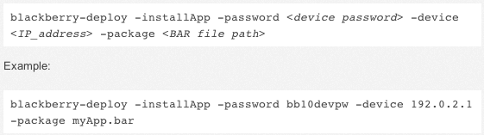
Deploy Built For BlackBerry
https://developer.blackberry.com/html5/documentation/running_your_bb10_app_2008471_11.html

Slide 22
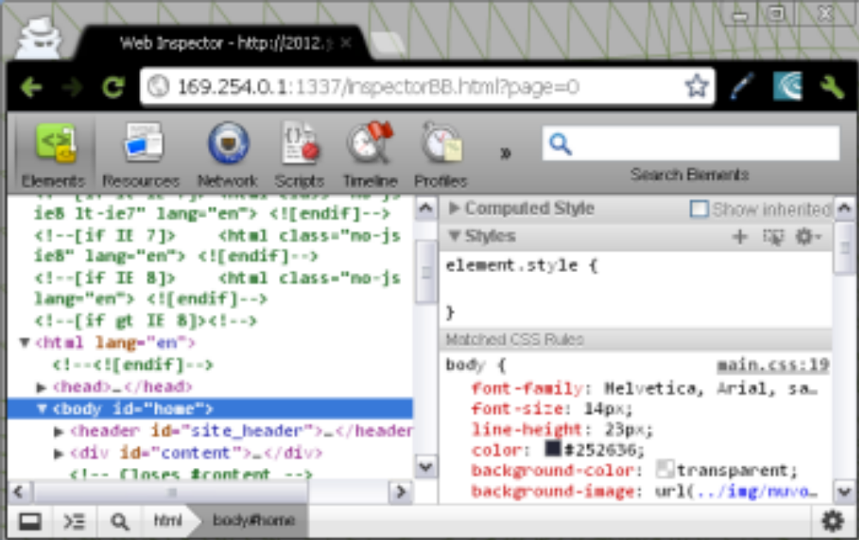
Quick Demo Web Inspector

Slide 23
Coding Samples
BlackBerry Messenger (20 Minutes)

Slide 24
BlackBerry Messenger
This sample outlines how to integrate with BlackBerry Messenger to retrieve user information and invite BlackBerry Messenger contacts to download the application.
Source
  ????
  Documentation
  https://developer.blackberry.com/html5/apis/blackberry.bbm.platform.html
  https://developer.blackberry.com/html5/apis/blackberry.bbm.platform.users.html

Slide 25
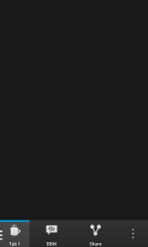
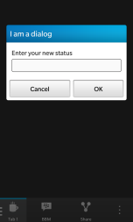
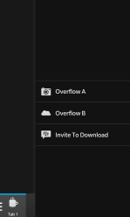
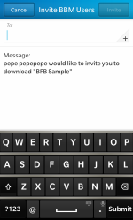
Task 1 (3 Minutes)
Download the sample source and build it using the BlackBerry 10 WebWorks SDK. Deploy the resulting BAR file to your device and familiarize yourself with the application and implemented functionality.

Slide 26
Task 2 (2 Minutes)
In bfb_bootstrap.js, modify the register function to supply a valid, unique, 36-character UUID.
  You can generate a new UUID from http://www.guidgenerator.com/.
Once your UUID is set, recompile the application and test the registration process.

Slide 27
Task 3 (3 Minutes)
In bfb_bootstrap.js, modify the register function to implement the remaining error codes and provide a meaningful message to the user.
  Error codes are available in the blackberry.bbm.platform.onaccesschanged documentation.

Slide 28
Task 4 (3 Minutes)
In bfb_bootstrap.js, modify the populate function to obtain values from the user’s BBM profile and set the various field values.
  Use the implementation of blackberry.bbm.platform.self.displayName as an example.
  The remaining fields include status, statusMessage, personalMessage, ppid, handle, appversion, and bbmsdkVersion.

Slide 29
Task 5 (3 Minutes)
In bfb_bootstrap.js, modify the save function to allow the user to initiate a change to the Status and Status Message properties of the BBM profile.
  You will need to leverage the status, message and onComplete variables.
  See: blackberry.bbm.platform.self.setStatus

Slide 30
Task 6 (3 Minutes)
In bfb_bootstrap.js, modify the save function to allow the user to initiate a change to the Personal Message property of the BBM profile.
  You will need to leverage the message and onComplete variables.
  See: blackberry.bbm.platform.self.setPersonalMessage

Slide 31
Task 7 (2 Minutes)
In bfb_bootstrap.js, modify the inviteToDownload function to allow the user to invite other BBM contacts to download this application.
  See: blackberry.bbm.platform.users.inviteToDownload

Slide 32
Coding Samples
Media Capture and Cards (30 Minutes)

Slide 33
Media Capture and Cards
This sample outlines how to invoke Cards (Camera and File Picker) as well as the HTML implementation for capturing media via <input>
Documentation
  https://developer.blackberry.com/html5/apis/blackberry.invoke.card.html
  https://developer.blackberry.com/html5/apis/blackberry.invoke.html

Slide 34
Task MC1 (2 Minutes)
In main.html, modify the HTML Media Capture panel to include an <input> element for photo capture
  You will need to accept image/*
  You will need to capture via camera
In main.html, modify the HTML Media Capture panel to include an <input> element for video capture
  You will need to accept video/*
  You will need to capture via camcorder

Slide 35
Task MC2 (3 Minutes)
In invoke.js, modify the invoke function and implement the arguments that are used when invoking the camera Card
  You will need to assign options
    Unlike File Picker, Camera requires a direct variable assignment
    instead of {}
  You will need to assign onComplete
  You will need to assign onCancel
  You will need to assign onInvoke
  See: blackberry.invoke.card.invokeCamera
Use the implemented File Picker as an example

Slide 36
Task MC3 (10 Minutes)
In invoke.js, modify the invoke function and implement the custom Card invocation
  You will need to leverage the blackberry.invoke.invoke function
  Sample target: sys.browser
  Sample uri: http://www.blackberry.com
  Sample type: audio/mpeg3
  Sample action: bb.action.VIEW
  When launching a third-party application, the primary options will be target, type, and data
    If the target corresponds to a Card entry point, it will be opened within your application as opposed to as a separate application

Slide 37
Task MC4 (10 Minutes)
In invoke.js, modify the invoke function for the custom Card type
  Leverage the filepicker implementation as an example and for more information on various flags that can be set
  Test out three or four different configurations

Slide 38
Coding Samples
Share (20 Minutes)

Slide 39
Share
Add Share Button
Invoke File picker
Choose file(s)
Invoke Share Card

Slide 40
Add Share Button (2 minutes)
In your HTML file add a share button
  Add an action to the ActionBar beside the BBM action
  When it is clicked is should call invokeFilePicker();
Notes:
<div onclick="invokeFilePicker();" id="btnShare" data-bb-type="action" data-bb-style="button" data-bb-img="images/icons/share.png">Share</div>

Slide 41
Invoke the file picker ( 7 minutes)
blackberry.invoke.card.invokeFilePicker
  Pass Details
  Handle OnDone
    We need to create a share request with this event (NEXT Step)
    Leave this as an empty function
  Handle OnCancel
    We Need to show an cancelled message
  Handle OnInvoke
    Need to show an error or success message
Notes:
Details:
Details will be empty for this example, just pass the details obj from invokeFilePicker
OnCancel:
toast("cancelled " + reason);
OnInvoke:
if (error) {
toast("invoke error " + error);
} else {
console.log("invoke success ");
}

Slide 42
Handle OnDone
Create Request from the OnDone File Picker
  action: bb.action.SHARE
  uri: the path to our file
  target_type: ["APPLICATION", "VIEWER", "CARD”]
Send request to loadShareCard
Notes:
var title = "Share Image";
var request = {
action: 'bb.action.SHARE',
uri: 'file://' + path,
target_type: ["APPLICATION", "VIEWER", "CARD"]
};
loadShareCard(title, request);

Slide 43
Share Card
In loadShareCard
  Call blackberry.invoke.card.invokeTargetPicker
Notes:
You don’t need to worry about the success and error callbacks for this example
blackberry.invoke.card.invokeTargetPicker(request, title,
// success
function() {},
// error
function(e) {
});

Slide 44
Coding Samples
Localization (20 Minutes)

Slide 45
Localization
Localize your app name
Localize app icon
Localize splashscreen

Slide 46
Localize app name (5 minutes)
TASK L1
In your config.xml file, specify a French translation for your application name
  Use fr_FR for the French language code
  Reference:
  https://developer.blackberry.com/html5/documentation/name_element_834672_11.html
Notes:
<div onclick="invokeFilePicker();" id="btnShare" data-bb-type="action" data-bb-style="button" data-bb-img="images/icons/share.png">Share</div>

Slide 47
Localize app icon (5 minutes)
In your application directory, create an icon for French
  Use fr_FR for the French language code
  Reference:
  https://developer.blackberry.com/html5/documentation/icon_element_834676_11.html
Notes:
<div onclick="invokeFilePicker();" id="btnShare" data-bb-type="action" data-bb-style="button" data-bb-img="images/icons/share.png">Share</div>

Slide 48
Localize splashscreen (5 minutes)
In your application directory, create a French splashscreen
  Use fr_FR for the French language code
  Reference:
  https://developer.blackberry.com/html5/documentation/rim_splash_element.html
Notes:
<div onclick="invokeFilePicker();" id="btnShare" data-bb-type="action" data-bb-style="button" data-bb-img="images/icons/share.png">Share</div>

Slide 49
THANK YOU
JAM 31
Ken Wallis (@ken_wallis)
Jason Scott
Bryan Tafel
May 14-16, 2013

