Slide 1



Predicting Tissue-Specific Gene Expression from Blood Using AI
Data Science Project Pt. 1 (MAST90106)
The University of Melbourne
Presented by
Kartika Waluyo, 1000555
Vrinda Rajendar Rajanahally, 1129446
Supervised by
Roberto Bonelli PhD, CSL Research
Brendan Ansell PhD, WEHI
Prof Melanie Bahlo, WEHI
Monther Alhamdoosh PhD, CSL Research
Ziad Al Bkhetan PhD, The University of Melbourne
Prof Michael Kirley, The University of Melbourne
25 June 2021

Slide 2
Introduction
Gene expression
Measured through RNA sequencing
Indicates the “activation status” of genes in a tissue
Widely used in medical research to understand disease mechanisms and assess the effectiveness and safety of new treatments
INSERT PICTURE ABOUT RNA DNA GENE EXP.

Slide 3
Problem
To assess new treatments corresponding to certain tissues, need to understand the gene expression of said tissues
Gene expression varies across tissues
Obtaining samples from heart, lung, brain and other organs is often not possible
Goal
Development of a machine learning algorithm that can reliably predict gene expression in many different tissues when only gene expression measurements in whole blood are available

Slide 4
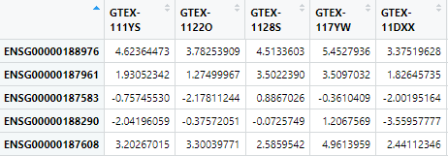
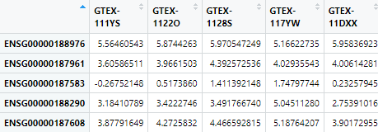
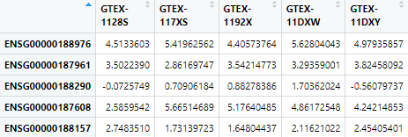
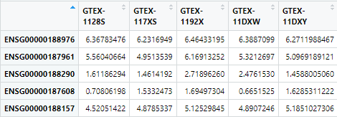
Data
INSERT GTEX ICON
Publicly available dataset (GTEx) containing gene expression of 54 post-mortem tissues from almost 1,000 individuals
INSERT BLOOD ICON
INSERT LUNG ICON
INSERT BLOOD ICON
INSERT BRAIN ICON
Notes:
Explain: For each tissue, keep the shared genes and shared donors with blood only

Slide 5
Preliminary Data Analysis
Exploration of similarities between each tissue and whole blood
Shared genes
Shared donors
Gene expression correlation

Slide 6
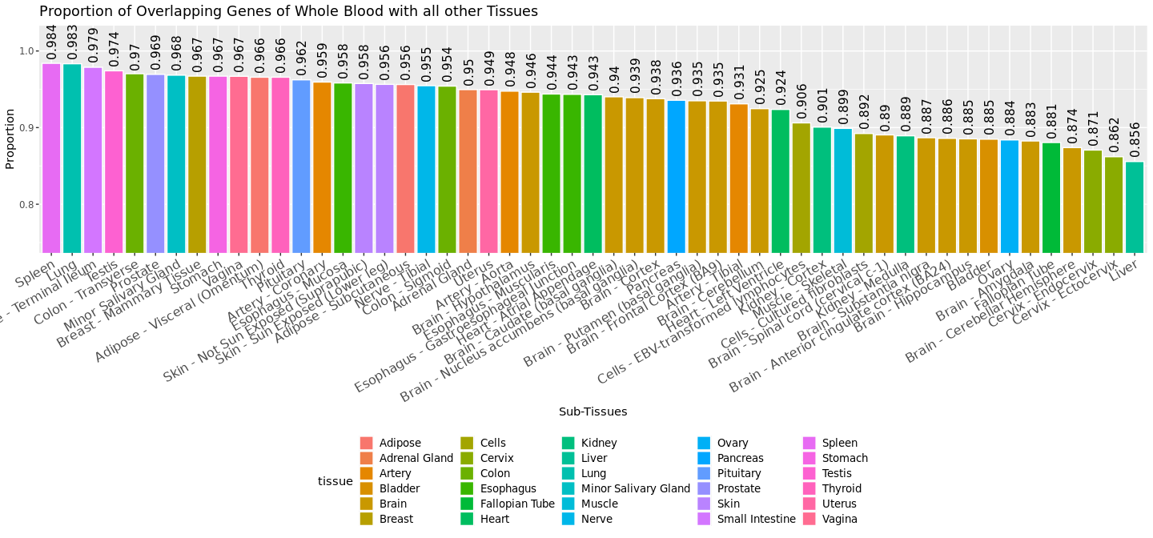
1. Shared Gene
Top 3:
Spleen
Lung
Small Intestine

Slide 7
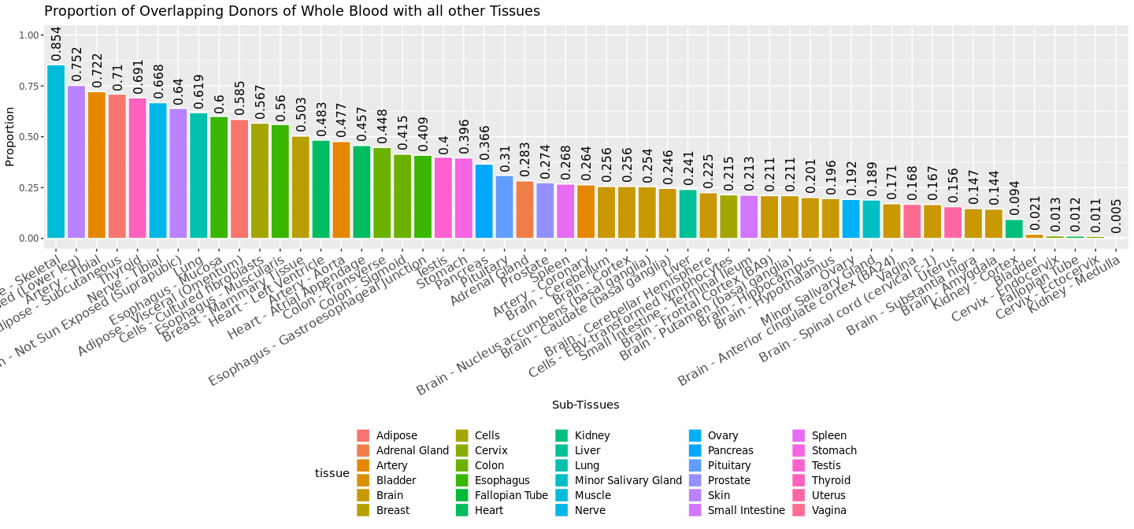
2. Shared Donor
Top 3:
Muscle – skeletal
Skin – sun exposed
Artery – Tibial

Slide 8
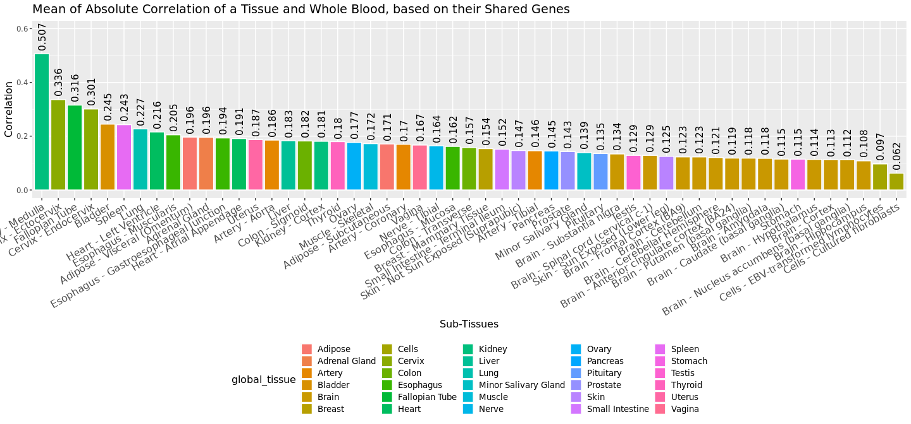
3. Correlation
Pairwise correlation between each gene in whole blood's gene expressions with the same gene in other tissues' gene expressions.
Top 3:
Kidney – Medulle
Cervix – Ectocervix
Fallopian Tube

Slide 9
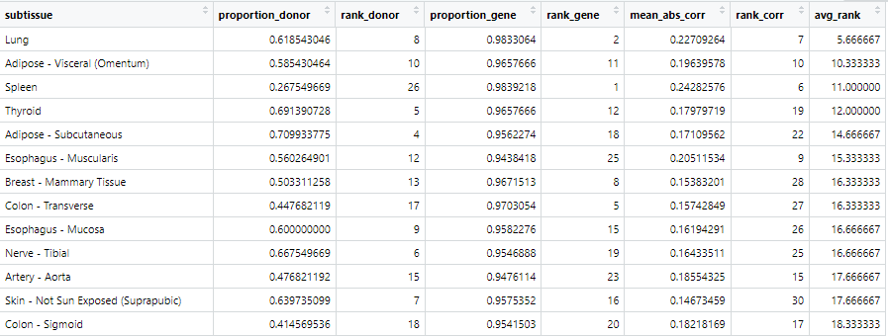
Tissue Selection
Rank tissued based on the previously observed measures
Snapshot of the ranks
Notes:
Lung has the lowest rank
Meaning: most similar to blood in terms of shared donor, shared genes and correlation
Skin-not sun exposed
Low correlation with blood
Nerve-tibial
?? Nort sure why

Slide 10
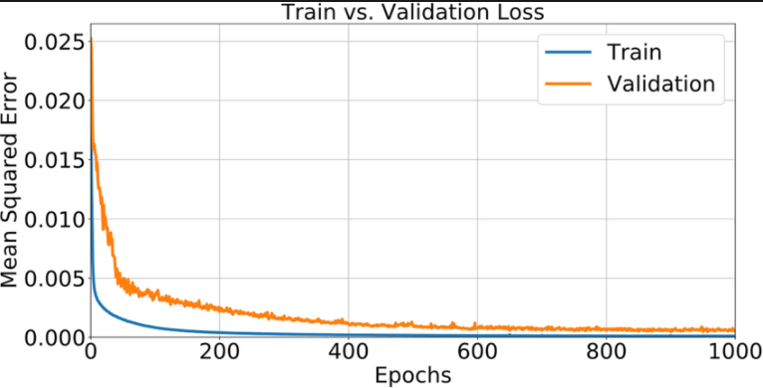
Training, Validation, and Test Set
Notes:
Explanation:
Split dataset into train and test set
Split the train set into train and validation set
Train the model using train set
Validate using validation set
Validation error should decrease together with train error
If train error decreases but validation error increases : overfitting
Both have to reach plateau
Validation: to choose the best hyperparameter value for the model
Test: to get the error from unseen data

Slide 11
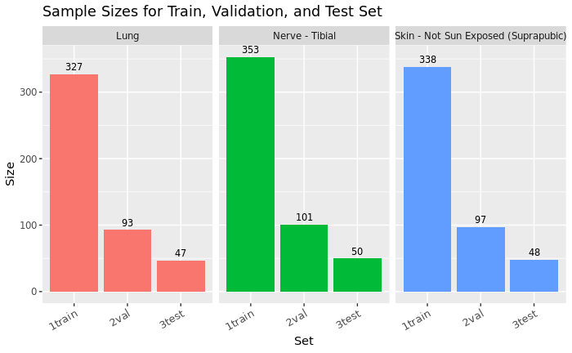
By the method of trial and error, random sets of proportions were tried and tested on the chosen tissues
It is decided to use 70:20:10
Notes:
Explain : for each tissue, the test set has > 30 sample

Slide 12
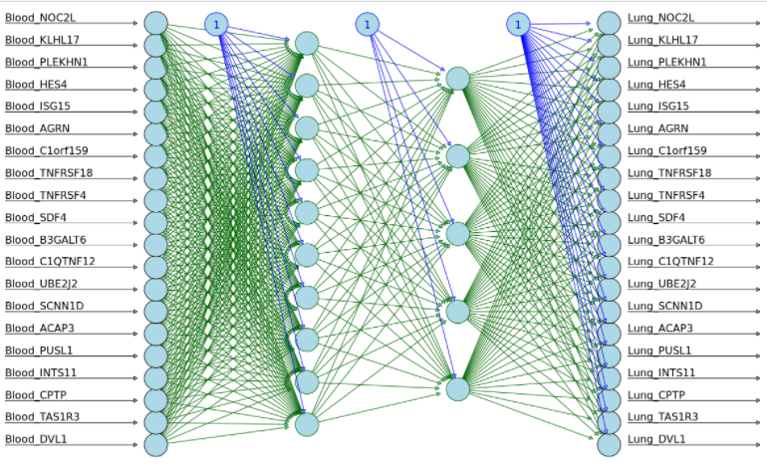
Preliminary Model
Neural Network with 2 hidden layers (10 and 5 nodes)
Notes:
Train : the model will be trained using the training set from both whole blood and lung
Validation / test : the model will be given the unseen validation/test set from whole blood and it will give us the prediction of the corresponding genes in lung
Parameter tuning : number of node, number of hidden layer, number of epoch (still undecided)

Slide 13
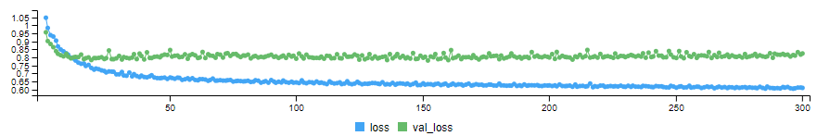
Preliminary Result
Notes:
Mention that this preliminary model is just to test if we can get it working
Highlight: at the few first epoch there is obvious decreases in both losses
meaning: the model is learning something new in every epoch
The result : the model is learning something but not really useful (the validation loss is not decreasing , instead a bit increasing)

Slide 14
Plan for Next Semester
Model deployment
For each proposed model:
Making use of the validation set(s), find the best hyperparameters for the model
Final model selection
After obtaining the best parameters for each model, choose the model that generates the best result
Assessment
Using the selected model, test assess the accuracy using the test set
Algorithm development
Development of a user friendly algorithm for users for future deployment

Slide 15
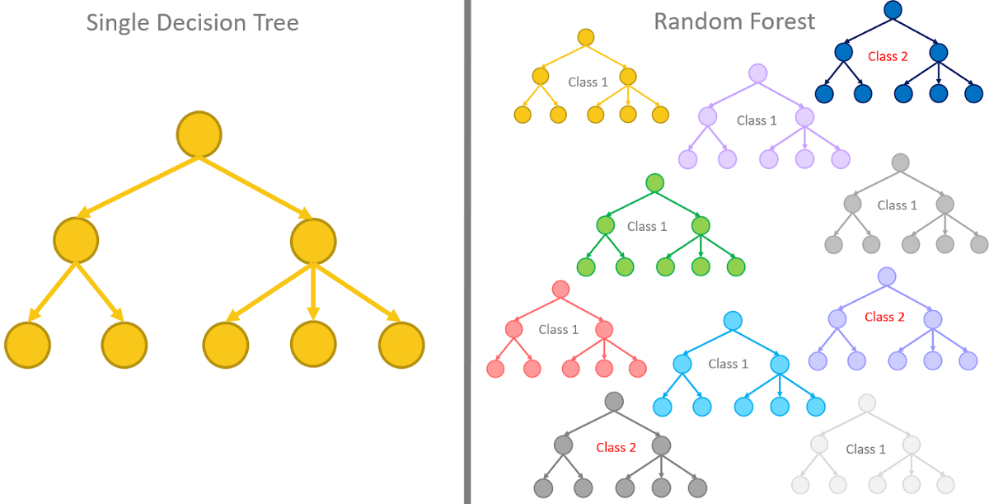
Random Forest
XGBoost (XGB)
Notes:
Implement eXtreme gradient boosting or XGBoost (XGB)
Input : matrix of the gene expression of Whole Blood
Expected output : a random forest of the best predictors for gene expression in the other tissue

Slide 16
Acknowledgement

Slide 17
Questions

Slide 18
Thank You

