Slide 1



Predicting Tissue-Specific Gene Expression from Blood Using AI
Data Science Project Pt. 1 and 2 (MAST90106 & MAST90107)
The University of Melbourne
Presented by
Kartika Waluyo, 1000555
Vrinda Rajendar Rajanahally, 1129446
Supervised by
Roberto Bonelli PhD, CSL Research
Brendan Ansell PhD, WEHI
Prof Melanie Bahlo, WEHI
Monther Alhamdoosh PhD, CSL Research
Ziad Al Bkhetan PhD, The University of Melbourne
Prof Michael Kirley, The University of Melbourne
25 June 2021

Slide 2
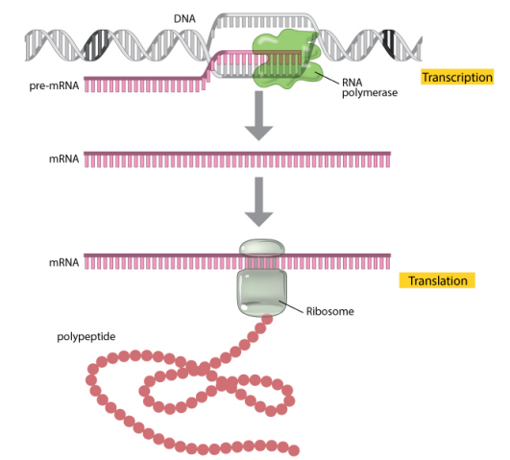
Introduction
Gene expression
Measured through RNA sequencing
Indicates the “activation level” of genes in a tissue
Widely used in medical research to understand disease mechanisms and assess the effectiveness and safety of treatments
Image source: https://www.nature.com/

Slide 3
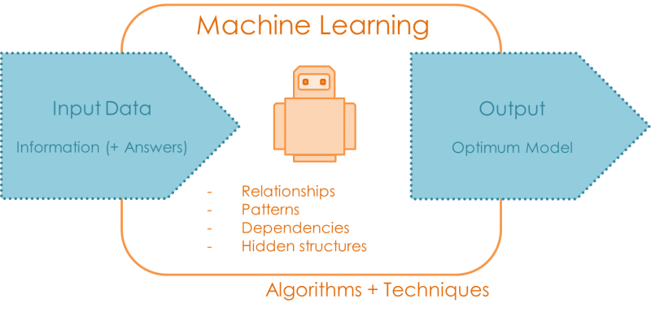
Problem
Gene expression varies across tissues
Obtaining samples from heart, lung, brain and other organs is often not possible
Goal
Image source: https://quantdare.com/
Notes:
To assess new treatments corresponding to certain tissues, need to understand the gene expression of said tissues
Goal: Development of a machine learning algorithm that can reliably predict gene expression in many different tissues when only gene expression measurements in whole blood are available

Slide 4

Data
The Genotype-Tissue Expression (GTEx)
Publicly available dataset containing gene expression of 54 post-mortem tissues from almost 1,000 individuals
Website: https://www.gtexportal.org/home/
Notes:
The Genotype-Tissue Expression (GTEx) project is an ongoing effort to build a comprehensive public resource to study tissue-specific gene expression and regulation. Samples were collected from 54 non-diseased tissue sites across nearly 1000 individuals,

Slide 5


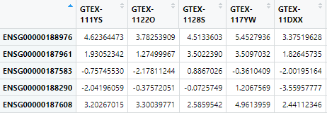
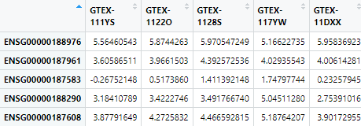

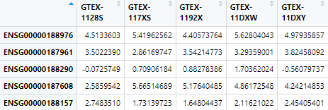
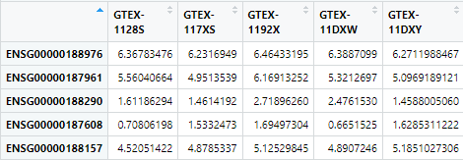
Data Preprocessing
Notes:
Explain: For each tissue, keep the shared genes and shared donors with blood only
Justification?

Slide 6
Preliminary Data Analysis
Exploration of similarities between each tissue and whole blood
Shared expressed genes
Shared donors
Gene expression correlation

Slide 7
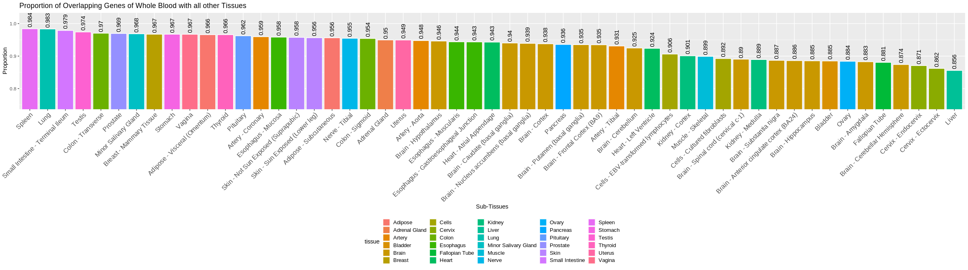
1. Shared Expressed Genes
Top 3:
Spleen
Lung
Small Intestine

Slide 8
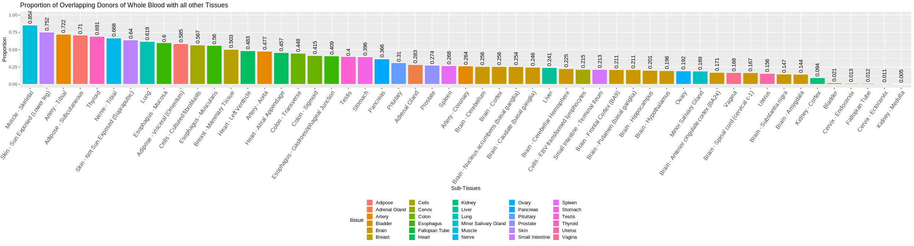
2. Shared Donors
Top 3:
Muscle – skeletal
Skin – sun exposed
Artery – Tibial

Slide 9
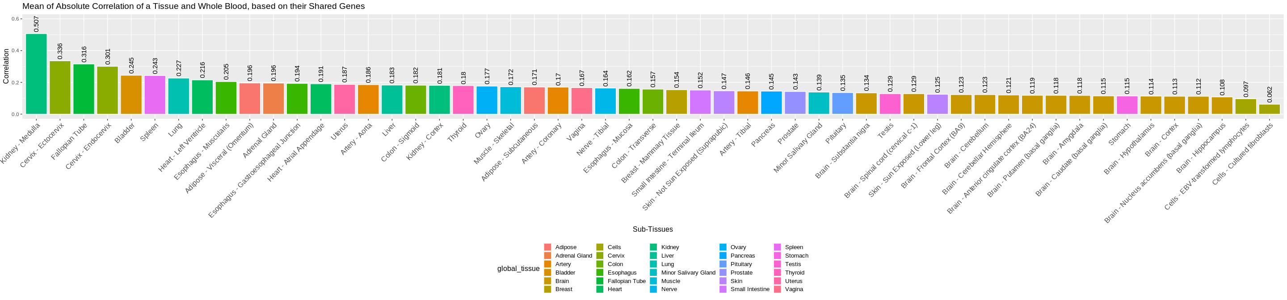
3. Correlation
Pairwise correlation between each gene in whole blood's gene expressions with the same gene in other tissues' gene expressions.
Top 3:
Kidney – Medulle
Cervix – Ectocervix
Fallopian Tube

Slide 10
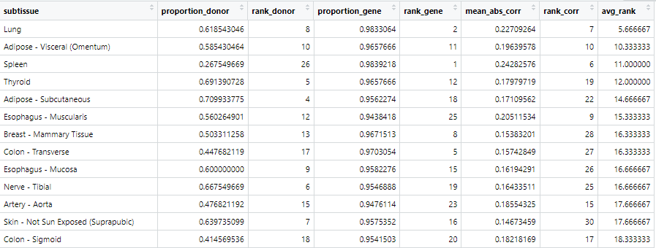
Tissue Selection
Rank tissued based on the previously observed measures
Snapshot of the ranks
Notes:
Lung has the lowest rank
Meaning: most similar to blood in terms of shared donor, shared genes and correlation
Skin-not sun exposed
Low correlation with blood
Nerve-tibial
?? Not sure why
Mention that from here we only work with lung

Slide 11
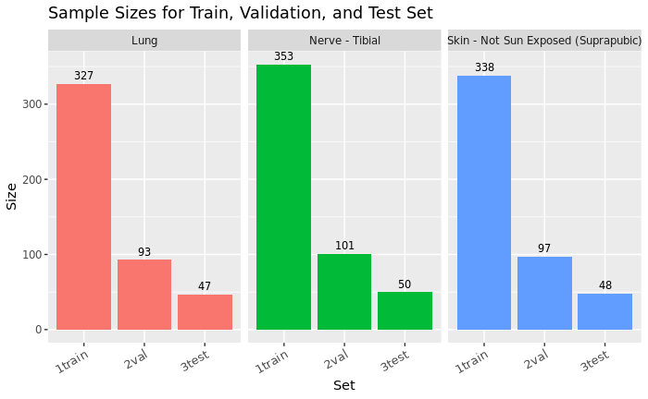
Training, Validation, and Test Set
We decided to use a division of 70:20:10
Notes:
Not used bcs cross validation is better than holdout

Slide 12

Cross-validation
80%
20%
Image source: https://scikit-learn.org/stable/modules/cross_validation.html
Notes:
Split the data into training and test set 80:20
Split the training data into 5 folds
Train the models using training data
For hyperparameter tuning , do 5-fold CV
Maybe explain about: 1st iteration use Fold1 as test set and Fold2-5 as training set, 2nd iteration use Fold2 as test set and Fold1,3-5 as training set, and so on
Take the average evaluation measure from 5 iterations
Choose the best hyperparameter combination
Train all the training set using the best hyperparameter value
Test using test set

Slide 13
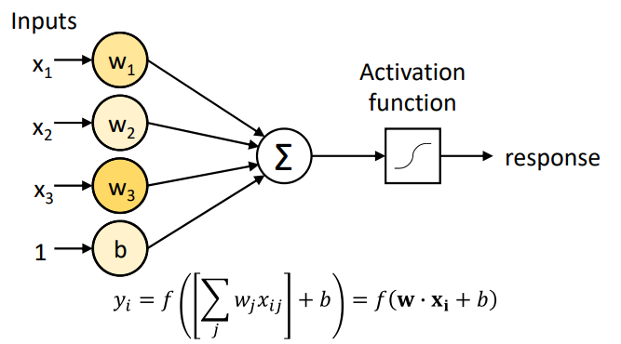
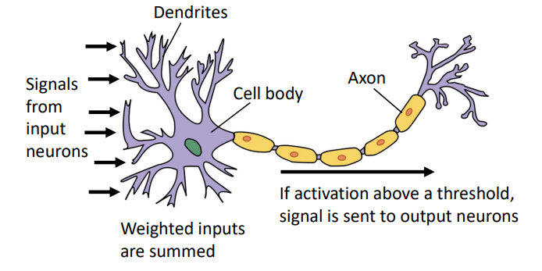
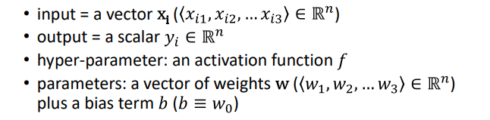
Neural Network
Biological Neuron
Artificial Neuron
Image Source: Anatomy and Physiology, US National Cancer Institute SEER Program
Notes:
Training a NN entails finding the weights which minimize errors on the training data
The classic way to train a NN is by iterating over examples in a training dataset
Each iteration over the whole dataset is called an epoch

Slide 14
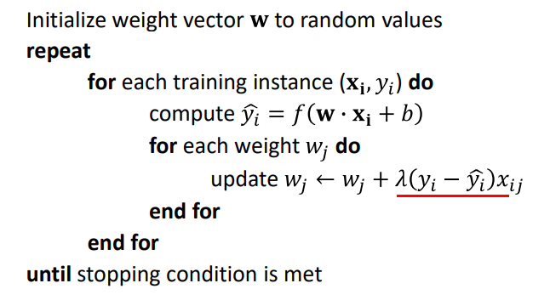
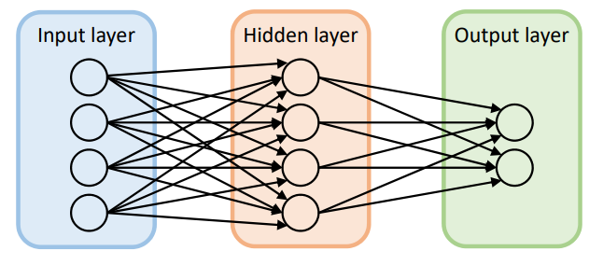
Algorithm
Hyperparameter:
Number of Layer
Number of Unit
Learning Rate: Required for backpropagation/gradient descent
Epoch: Number of iteration over the whole dataset
Notes:
Algorithm:
• For training examples, compute y based on current weights
• Update weights based on the difference between predicted y and true label
However,
Need to find correct weights for the output neuron(s), and all the neurons in the hidden layer
Can’t use the algorithm in the hidden layer – we don’t know what values these neurons are supposed to produce for the input
• There is no one set of “correct” values for this layer – multiple possible solutions
• Solution: backpropagation
Backpropagation:
• Form of gradient descent – iterative process for finding the weight parameters that minimize error
• Just like single perceptron training, requires a learning rate
• Idea: look at the derivative of error and update weights in the direction that would reduce error
• Compute errors at the output layer w.r.t. each weight using partial differentiation
• Propagate errors back to each of the earlier layers

Slide 15
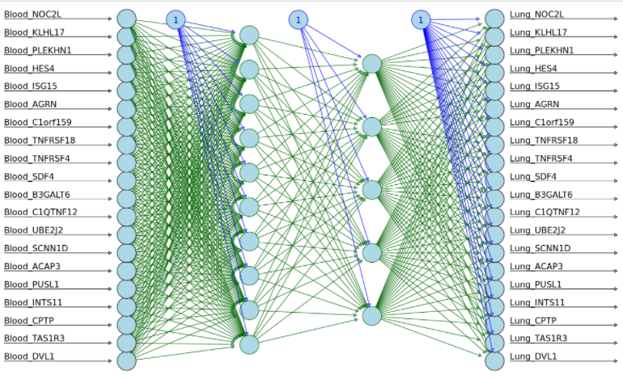
Illustration of how our neural network model might look
Input
1st hidden layer
2nd hidden layer
Output

Slide 16
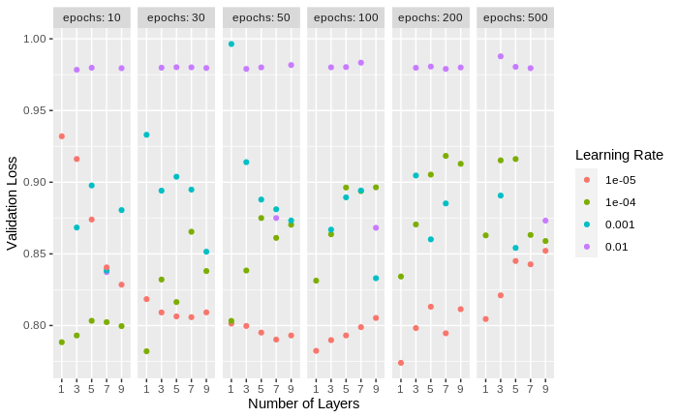
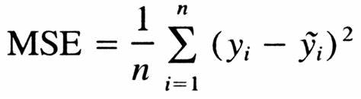
Hyperparameter Tuning
On number of layers, learning rate, and number of epochs
Loss Function

Slide 17
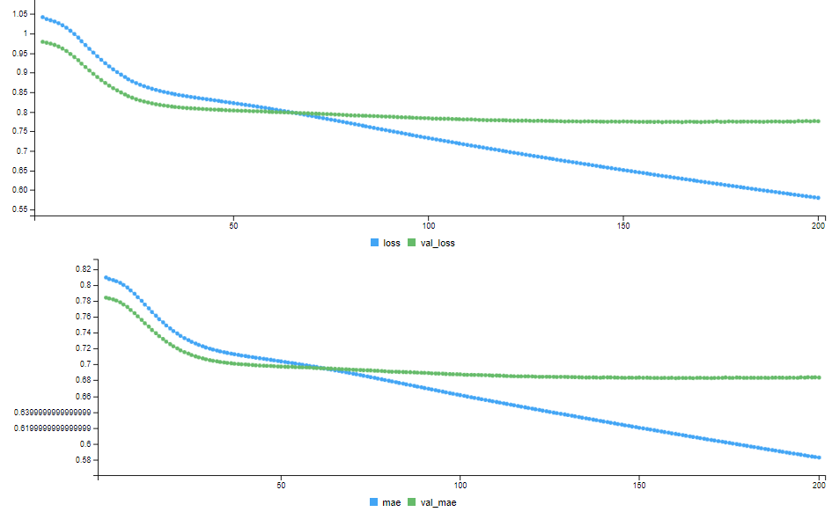
Result
Using 1 hidden layer of 100 units, e⁻⁵ learning rate, with 200 epochs

Slide 18
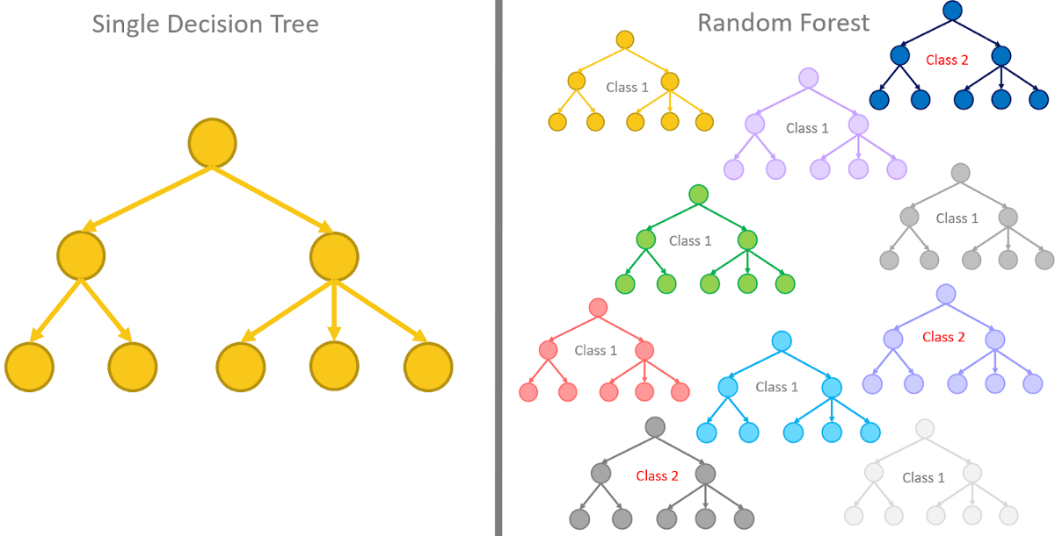
eXtreme Gradient Boosting (XGBoost)
An ensemble of decision trees
Notes:
Mention : 1 model for 1 gene bcs the model doesn’t accept multivariate output
So input: the whole gene matrix from blood
Output: 1 gene from lung
Boosting is an ensemble technique where new models are added to correct the errors made by existing models. Models are added sequentially until no further improvements can be made.

Slide 19
Hyperparameters
Eta: learning rate
Number of Rounds: number of iterations
Gamma: minimum loss reduction required to make a further partition on a leaf node of the tree.
Maximum Depth: maximum depth of a tree

Slide 20
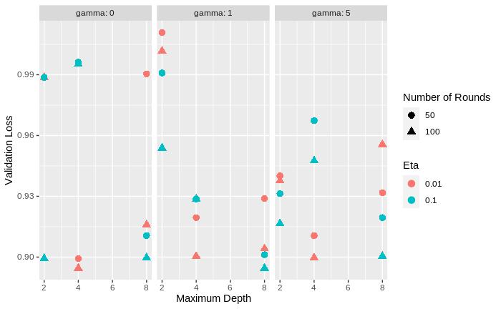
Hyperparameter Tuning
On 50 random genes
On gamma, maximum depth, eta, and number of rounds
Loss Function
Best hyperparameter combination: gamma=1, maximum depth=8, eta=0.1, and number of rounds=100
Notes:
Explain briefly how long the grid search took and the fact that only 50 random genes were used.
Explain that after the best performance parameter were chosen, the model was trained again on all genes

Slide 21
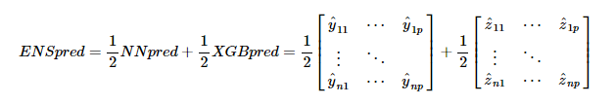
Ensemble Prediction
Notes:
The most simplistic version of the ensemble prediction possible, a model could be trained to do this better!

Slide 22
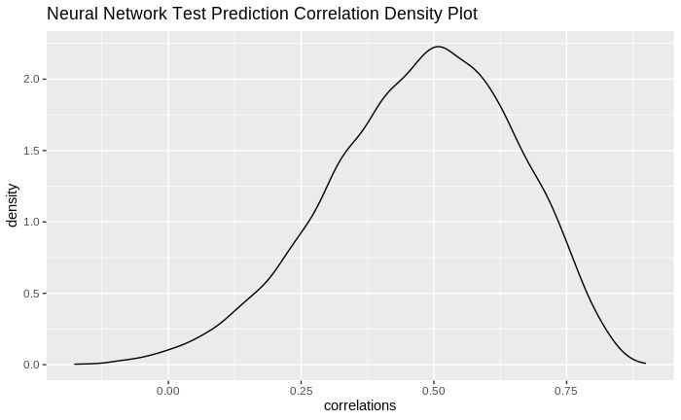
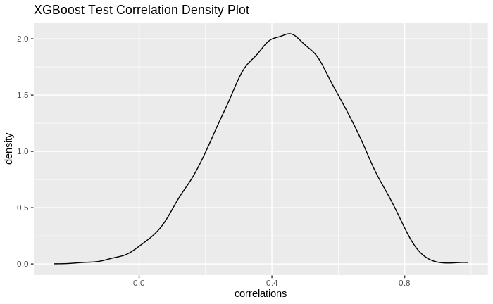
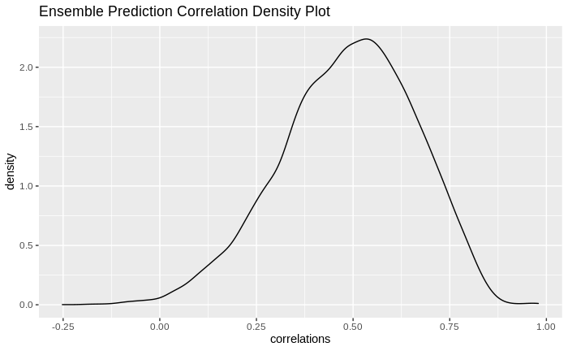
Evaluation
Model | Median Correlation
Neural Network | 0.4887672
XGBoost | 0.4364047
Ensemble | 0.4976427
Compute the correlation for each gene in the prediction and the true value
Notes:
Plot: density plot of the correlation from ensemble prediction
High density for positive correlation
Read for Basu et al how much was their reached correlation and compare to our results (this will be super important for the report as well)

Slide 23
Future Directions
Create model and tune hyperparameter for all tissues
Use all genes from both tissues
Use another ML model for the ensemble instead of only taking the average prediction
Notes:
Mention that the previous results are only for lung

Slide 24
We would like to extend a heartfelt thank you to all our mentors involved in this project!

Slide 25
Questions?

Slide 26
Thank You

