Slide 1
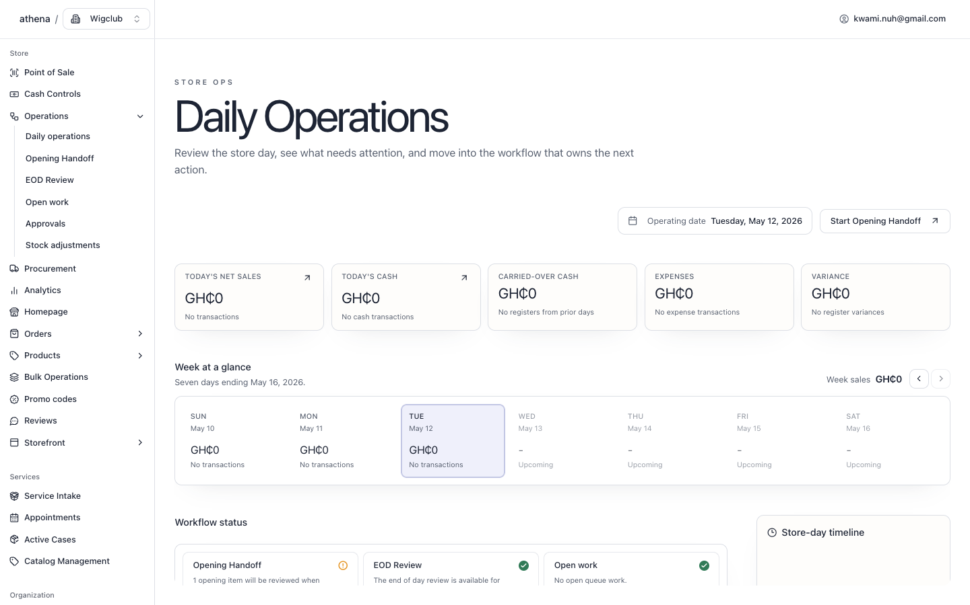
ATHENA
The business OS for the owner who runs everything.
Sell in person. Sell online. Replenish stock. Control cash. Run services. Close the day with evidence instead of guesswork.
Built for solo retail and service operators
Source: Athena live app and repo business OS audit.

Slide 2
WHY NOW
Small operators do not need more apps. They need one control loop.
Athena turns the messy daily flow into one operating rhythm:
Sell
Control
Replenish
Serve
Learn
→
→
→
→
POS, online checkout, orders
drawers, approvals, daily close
stock pressure, POs, receiving
intake, appointments, cases
storefront behavior, history
Every action leaves evidence for the next one.

Slide 3
DAILY COMMAND
Start the day knowing what needs attention.
Daily Operations combines sales, cash, carry-forward work, approvals, registers, POS sessions, expenses, and the store-day timeline.
7
1
0
workflow checks
opening item
open exceptions
Pitch line: Athena is the morning standup, the mid-day signal, and the end-of-day proof.

Slide 4
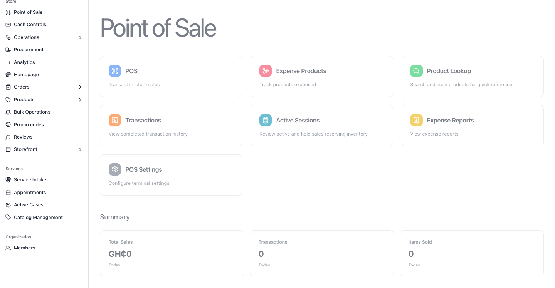
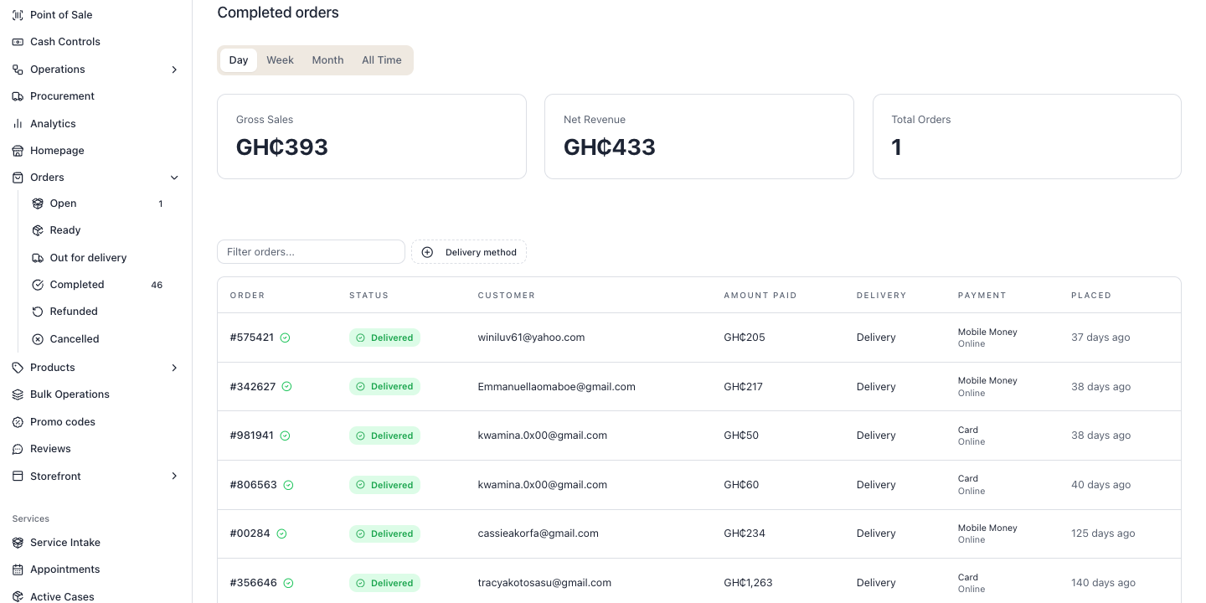
SELL
One sales layer for walk-ins and online orders.
The owner can move from checkout to completed orders without losing register, payment, delivery, or customer context.
46
GH₵433
POS
completed orders visible
net revenue in demo data
in-store checkout hub

Slide 5
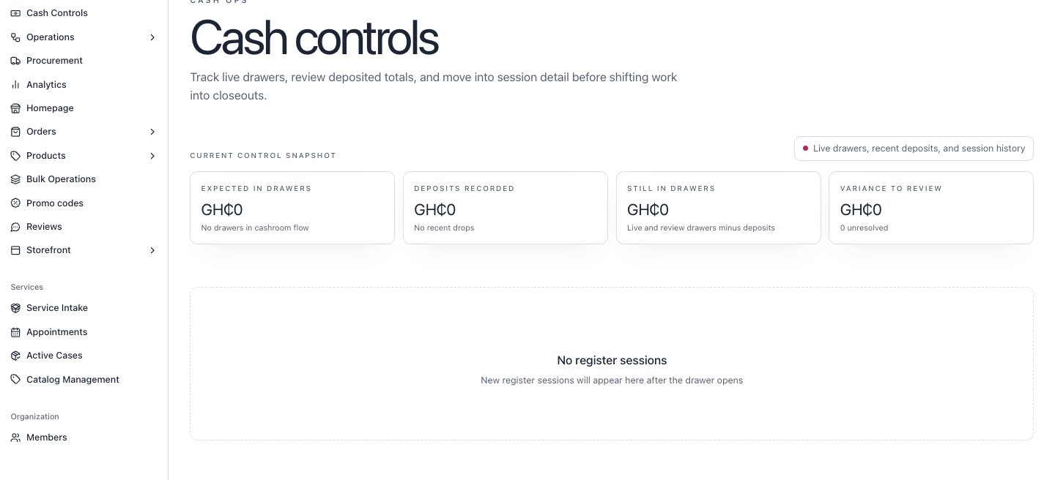
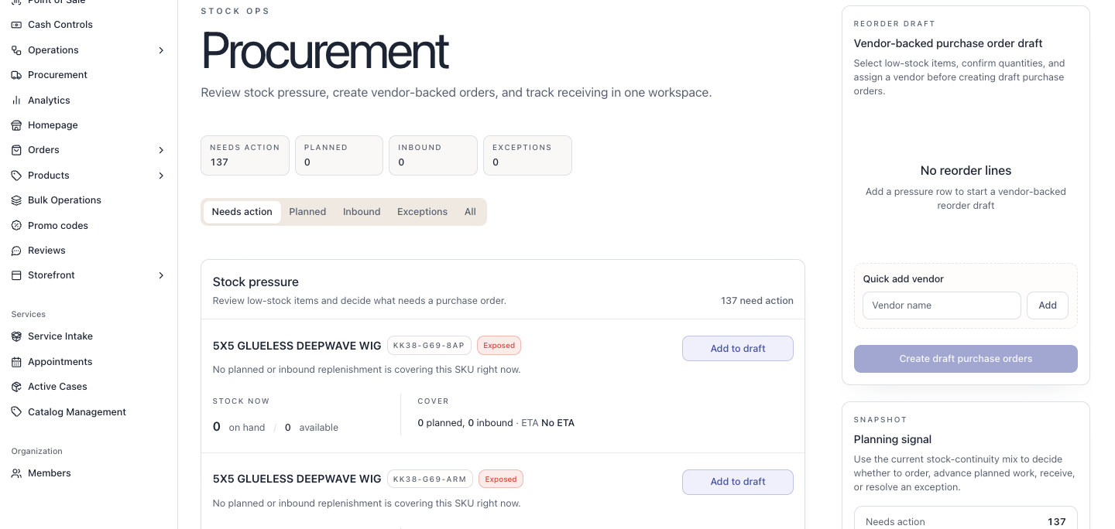
CONTROL
Cash and stock stop living in memory.
Athena binds the physical shop back to operational evidence: drawer sessions, deposits, variances, low-stock pressure, purchase drafts, and receiving.
137
GH₵0
SKUs needing action
variance to review
The owner sees what to order, what to deposit, and what to close before the day drifts.

Slide 6
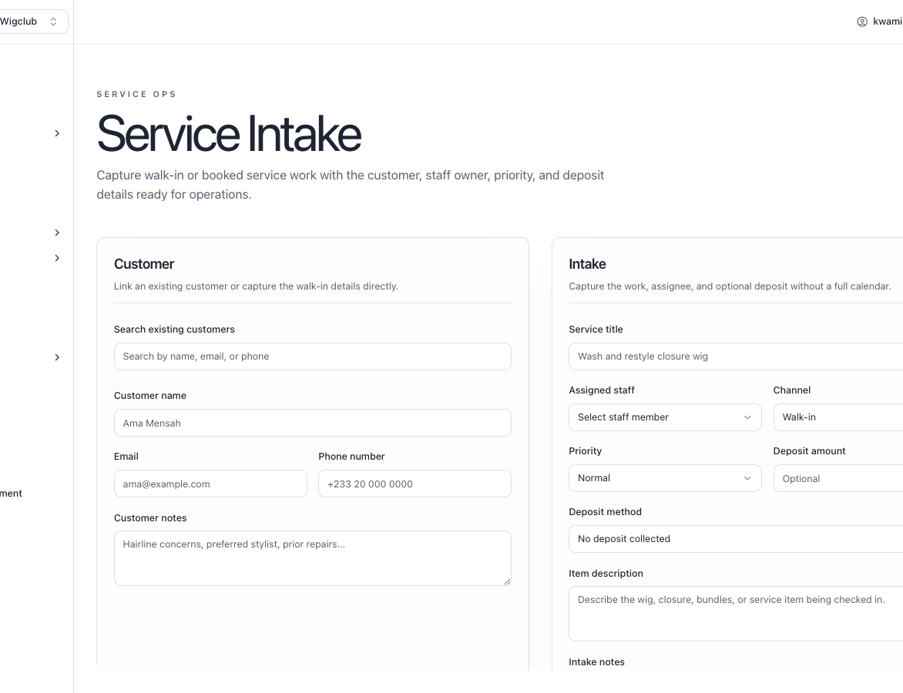
SERVE
Services are real operations, not side notes.
Capture
walk-in or booked service work
Assign
staff owner, priority, channel
Collect
deposit and customer details
Operate
appointments, active cases, catalog rules
Retail + service workflows can share one customer and stock truth.

Slide 7
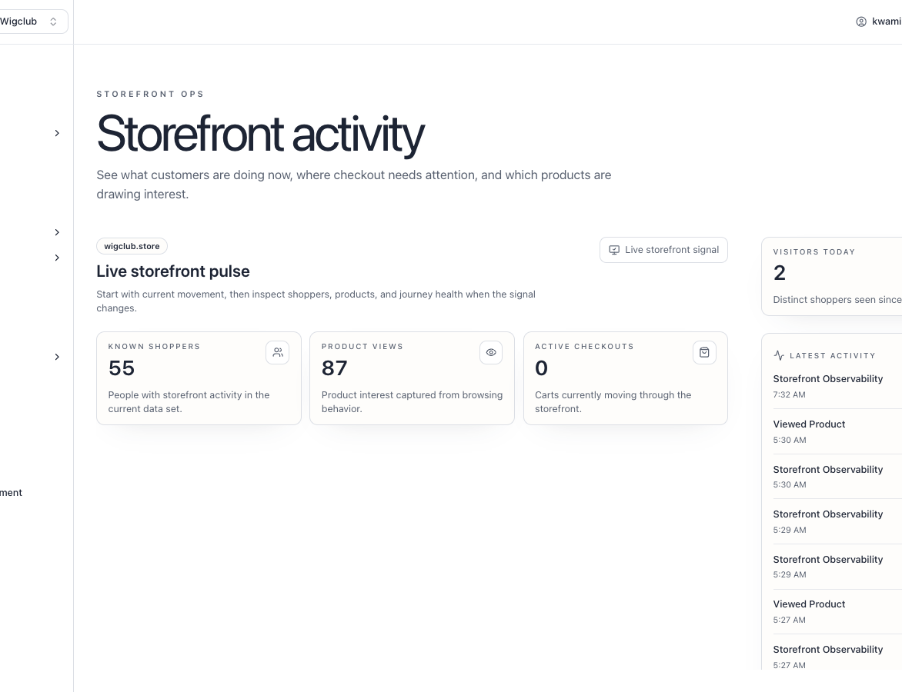
LEARN
Storefront behavior becomes an operating signal.
Athena shows who is moving, which products are drawing attention, and where checkout needs follow-up.
55
87
2
known shoppers
product views
visitors today
The next best action starts with real behavior.

Slide 8
THE ASK
Athena helps one owner run like a team.
The pitch is simple: compress the daily back office into one calm control surface, then let every sale, stock move, service case, and cash action strengthen the next decision.
Fewer blind spots
Faster handoffs
cash, stock, orders, services, approvals
daily open, close, queues, staff work
Better customer memory
Owner leverage
online behavior plus transaction history
the system remembers what the owner cannot
Run the business from the operating day outward

