Slide 1
HEALTH INFORMATION SYSTEM
Managing Clients and Health Programs
By
SCOLLAR KWAMBOKA OYAGI
27/04/25

Slide 2
Purpose
Problem
Doctors who struggle to track client health history and manage program enrollments manually.
Solution: A web-based Health Information System for:
Registering clients.
Managing health programs.
Enrolling clients into services.
Accessing client profiles via API for interoperability.

Slide 3
System Architecture
Frontend: Vue.js Backend: Firebase Firestore Database Authentication: Firebase Authentication API Exposure: Secure REST API endpoints for external access

Slide 4
Features
Client Registration: Add new patients with personal and medical details.
Program Management: Create programs like “Tuberclosis" or "HIV Care."
Enrollment: Easily enroll clients into one or multiple health programs.
API Access: Share client data securely with other systems if needed.

Slide 5
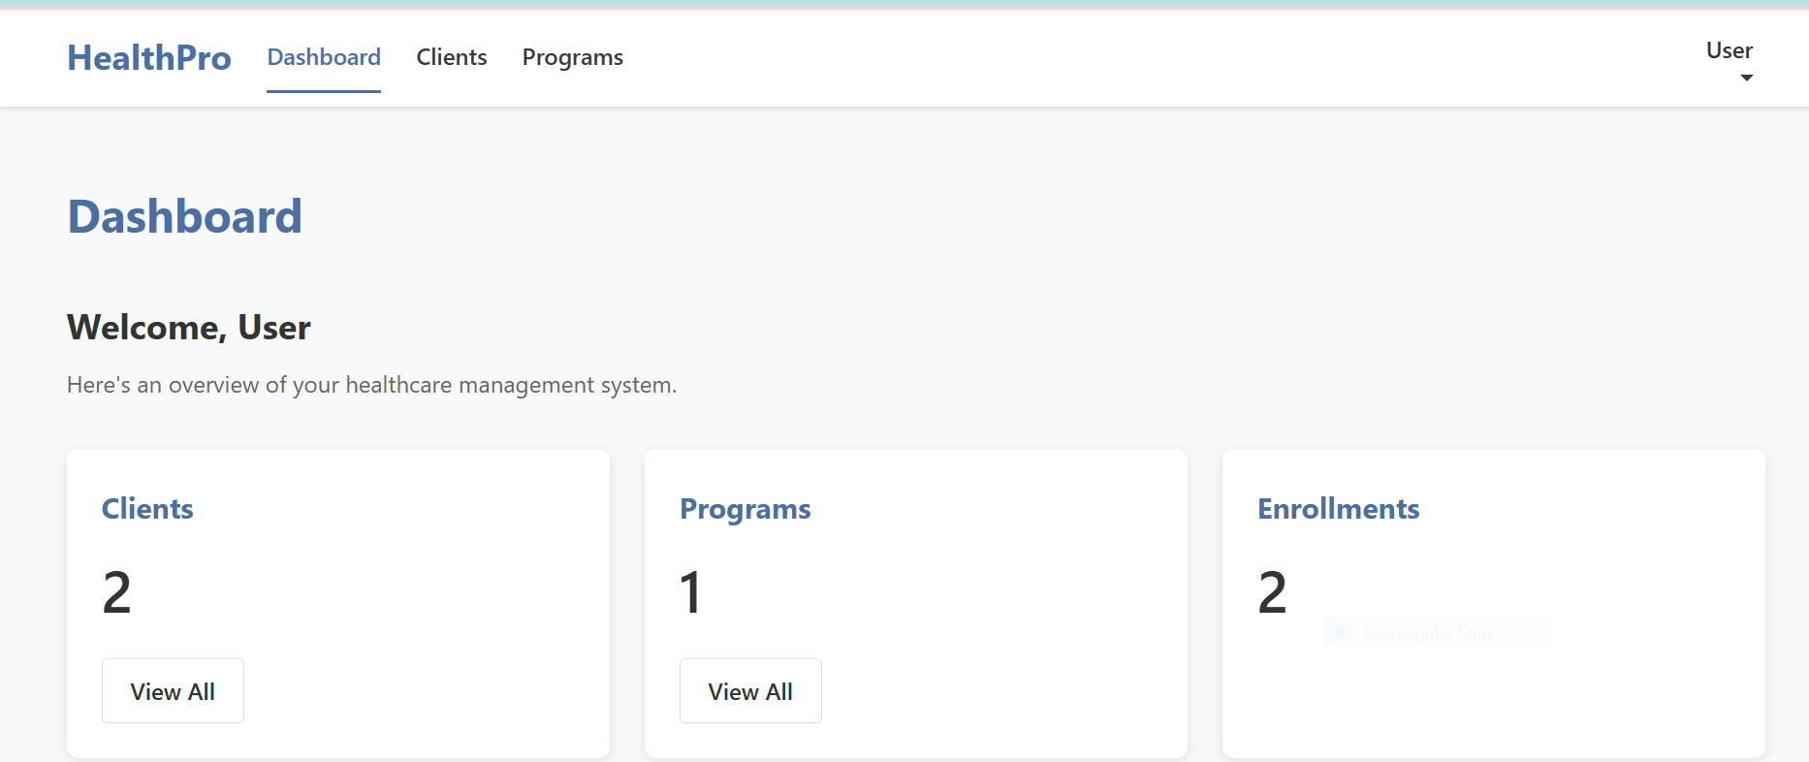
User Interface-Homepage

Slide 6
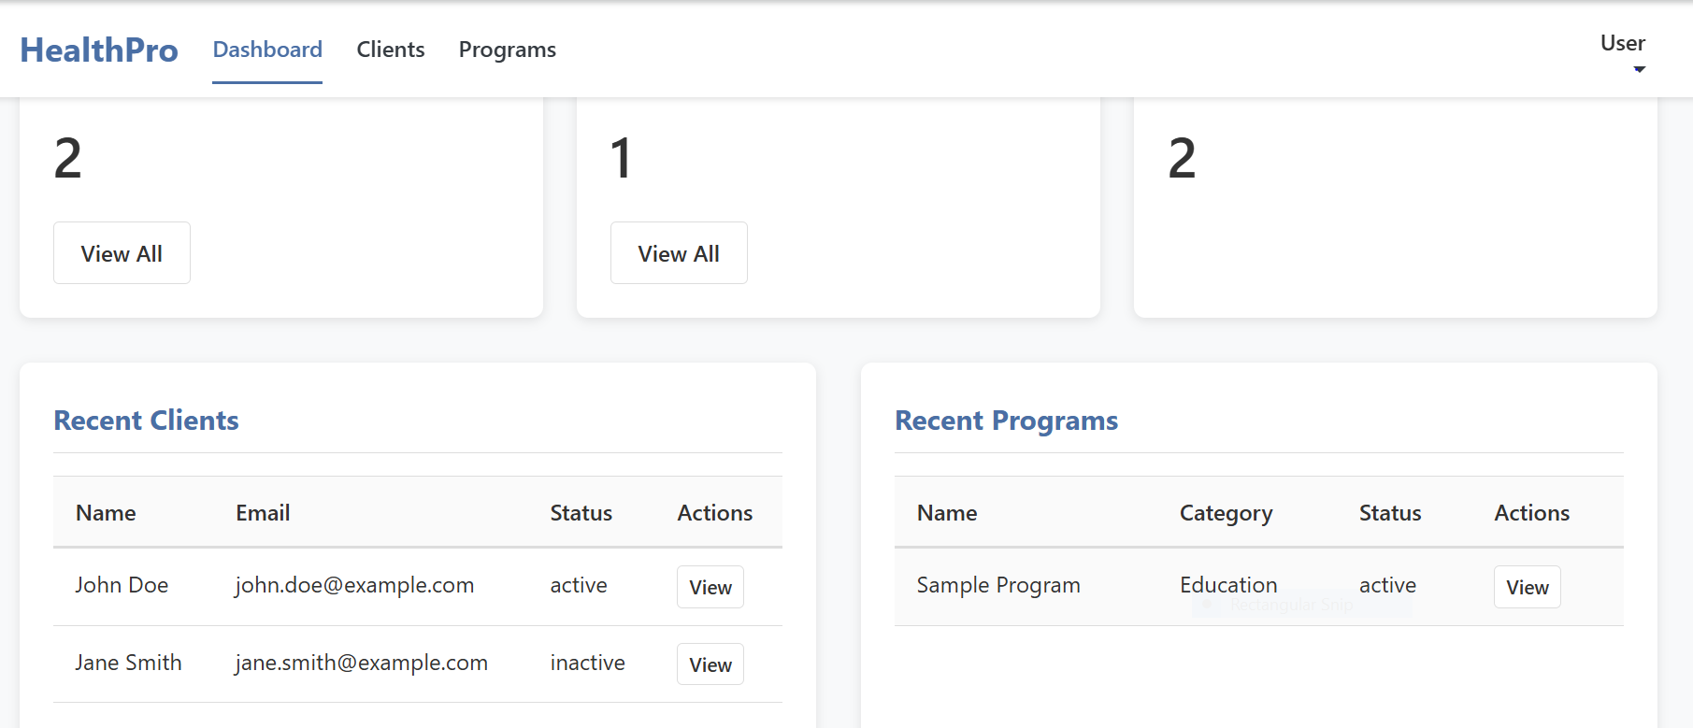
User Interface -client

Slide 7
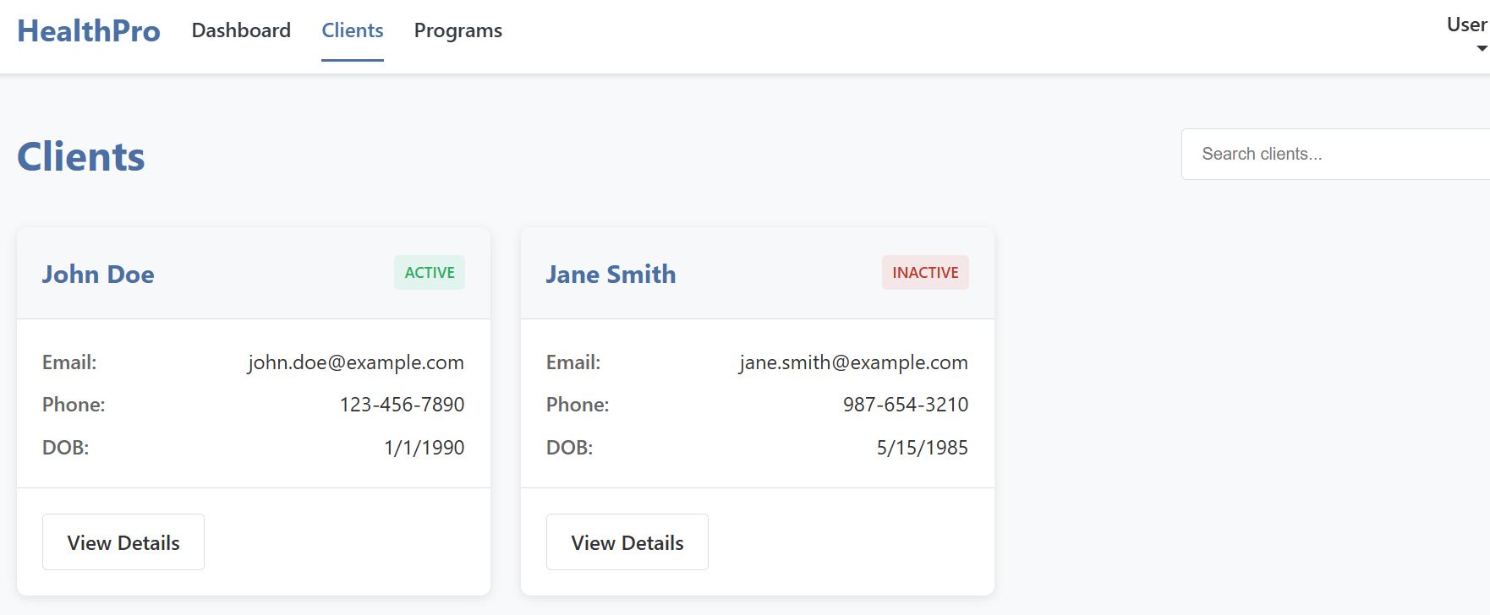
User Interface-client details

Slide 8
Flowchart
Login → Doctor logs into the system.
Dashboard → Main control panel appears.
Register Client → Add new client with details.
Create Health Program → Define services like "Nutrition Support," "Malaria Treatment," etc.
Enroll Client → Assign clients to programs.
View/Update Profiles → Manage client data.
Expose Profile via API → Allow external systems to securely access client info.

Slide 9
Challenges and solutions
Challenge | Solution
Authentication issues | Implemented Firebase Auth and error handling
Complex form validation | Used VeeValidate and custom rules
API security concerns | Added token-based access control

Slide 10
Future Improvements
Introduce SMS reminders for client appointments.
Implement detailed analytics dashboards.

Slide 11
Conclusion
Our Health Information System simplifies health program management, empowers doctors, and improves client care. Future integration with national health systems will broaden its impact.

