Slide 1
COST DRIVERS IN HEALTHCARE AND FACTORS AFFECTING THE OUTCOMES OF TREATMENT
By Kwame acheampong

Slide 2
Introduction
Problem Statement
  Healthcare facilities face rising treatment costs and inconsistent patient outcomes across various medical conditions and care settings. However, the specific cost drivers within treatment pathways and their direct impact on clinical outcomes remain unclear. This problem requires a comprehensive analysis of how treatment decisions, resource use, and care settings influence both healthcare spending and patient health outcomes.

Slide 3
Objectives
Analyze patient billing data in order to determine the contributors of healthcare cost
Recommend practical measures that can help reduce patient spending
Assess the relationship between patient and hospital related variables and test results.
Identify risk factors associated with poor test results.

Slide 4
Research Questions
Do certain medical conditions lead to higher billing amount?
Does the choice of healthcare provider influence billing amount?
Does the type of admission influence billing amount?
Which demographic group incur higher medical expense?
Are certain medical conditions more prone to poor outcomes?
What actionable recommendations can be made to reduce the overall treatment cost?
How does medical condition, age , length of stay influence the test results?

Slide 5
Data Preparation
Tools used
  Google colab
Data cleaning
  No duplicated observed
  No null values observed

Slide 6
Data Overview
Dataset had 16columns
30,000 unique patients
20 medical conditions
1000 doctors
6 hospitals
6 insurance providers
3 admission type categories
20 medications
2 target columns (Billing amount, Test result)
Time span of data : January 2022 –November 2022

Slide 7
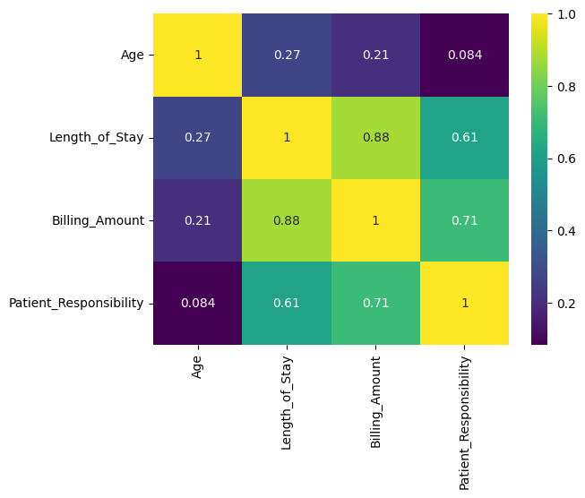
Numerical correlation
Significant correlations between the numerical variables.
Age of patient has minimal influence on billing amount.
Length of stay has a pronounce influence on the billing amount.

Slide 8
Initial Insights
Numerical columns are positively skewed.
Outliers observed in numerical columns.
Age distribution centered between 38-60 years with small number of elderly patients(outliers).
Most patients stayed 3-7 days. Small section of patients experienced longer stay( outliers).
Most patients were billed between 6000-38000$. Small number of patients were billed quite high(outliers). Likely indicator of the resources used or the kind of medical condition.
Most patients experienced low out of pocket payments, indicative of high insurance cover rate, as compared the patients who had high patient responsibility(outliers). These ones had no insurance cover.
Patients are uniformly distributed amongst the hospital.
Majority of the cases reporting to the hospital were emergency cases.

Slide 9
Analyses

Slide 10
Age grouping
Dataset has a wide range of ages and to be able to do meaning analysis there will have to be a grouping of the ages.
WHO age classification
  Children : 0-9 years
  Youth: 10-19 years
  Young Adult: 20- 39years
  Middle Age: 40-59 years
  Elderly: 60+ years

Slide 11
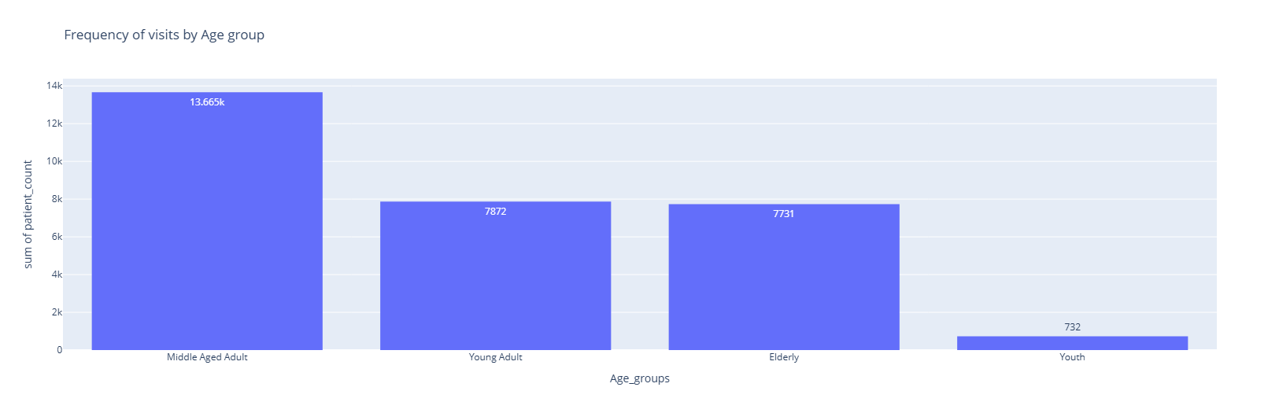
Frequency of hospital visits by age groups
More middle -aged people are visiting the hospital.

Slide 12
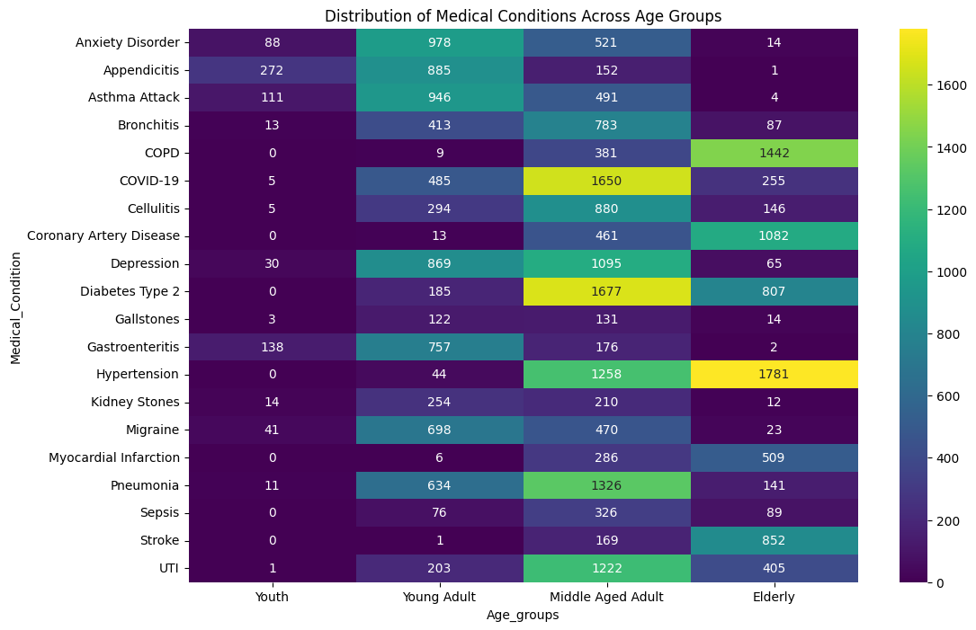
Distribution of medical condition across age groups
Hypertension, stroke, diabetes, coronary artery disease, COPD prominent amongst elderly.
Asthma, appendicitis, anxiety disorder, gastroenteritis prominent in the youth.
Asthma, migraine, depression, appendicitis, anxiety disorder, gastroenteritis prominent in young adults.
Diabetes, hypertension, COVID-19, depression, pneumonia, UTI prominent in middle aged adults.

Slide 13
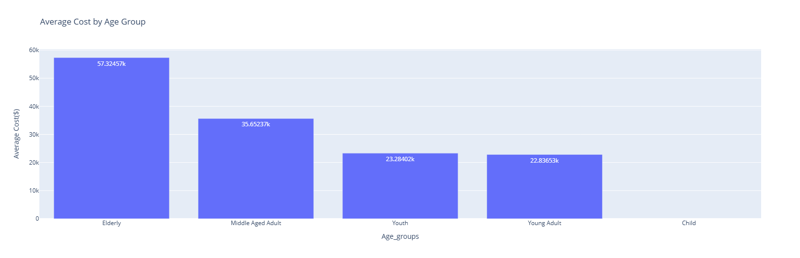
Influence of Age group on Billing Amount
Elderly patients spent more on healthcare.
Healthcare expenditure increases with age.

Slide 14
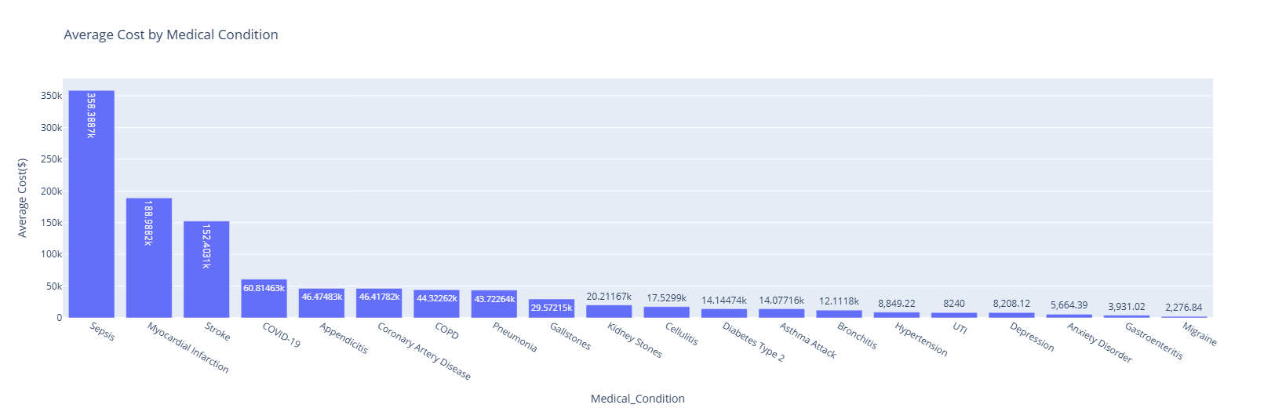
Influence of medical condition on billing amount
It cost more in treatment depending on the medical condition presented at the hospital.
Sepsis is the most expensive medical condition to treat.
Migraine is the least expensive medical condition to treat.

Slide 15
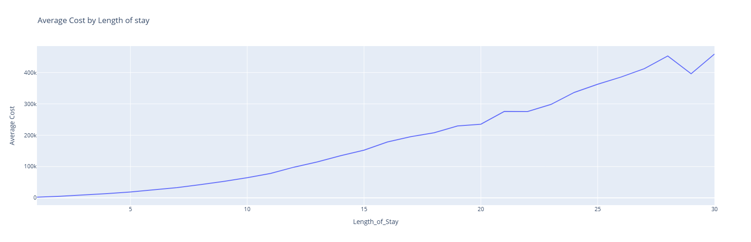
Influence of length of stay on billing amount
Average cost of treatment increases with increasing number of days spent at the hospital.

Slide 16
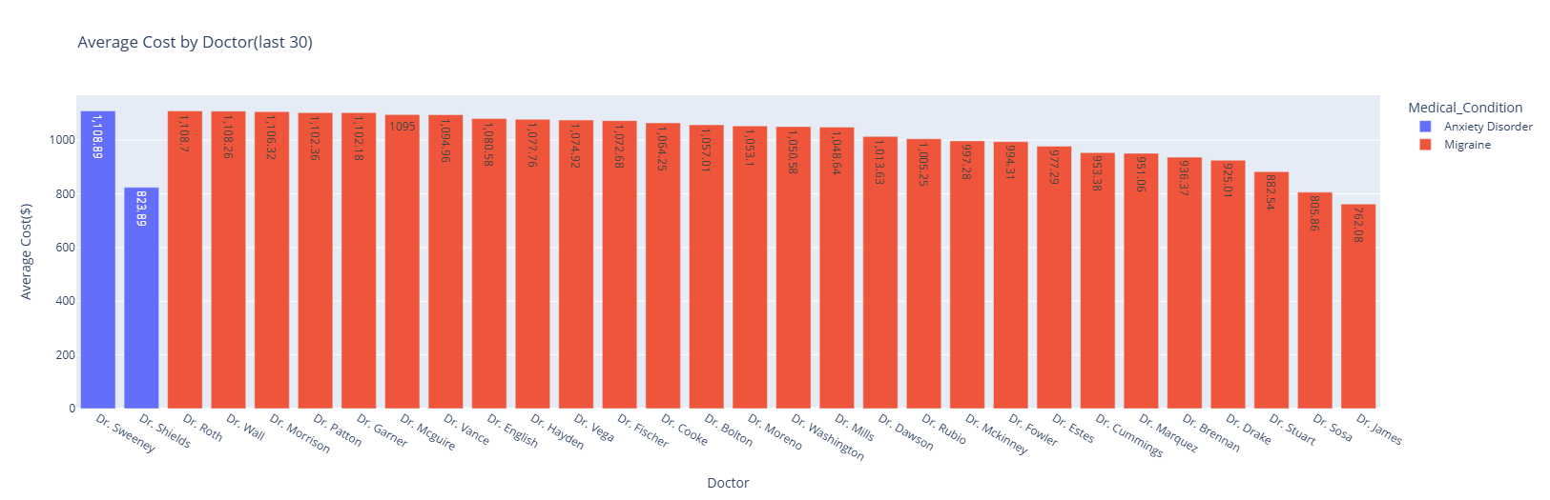
Influence of doctors on billing amount
Choice of doctor influences how much is spent likely due to the different approaches each one may have in treatment or likely comorbidities

Slide 17
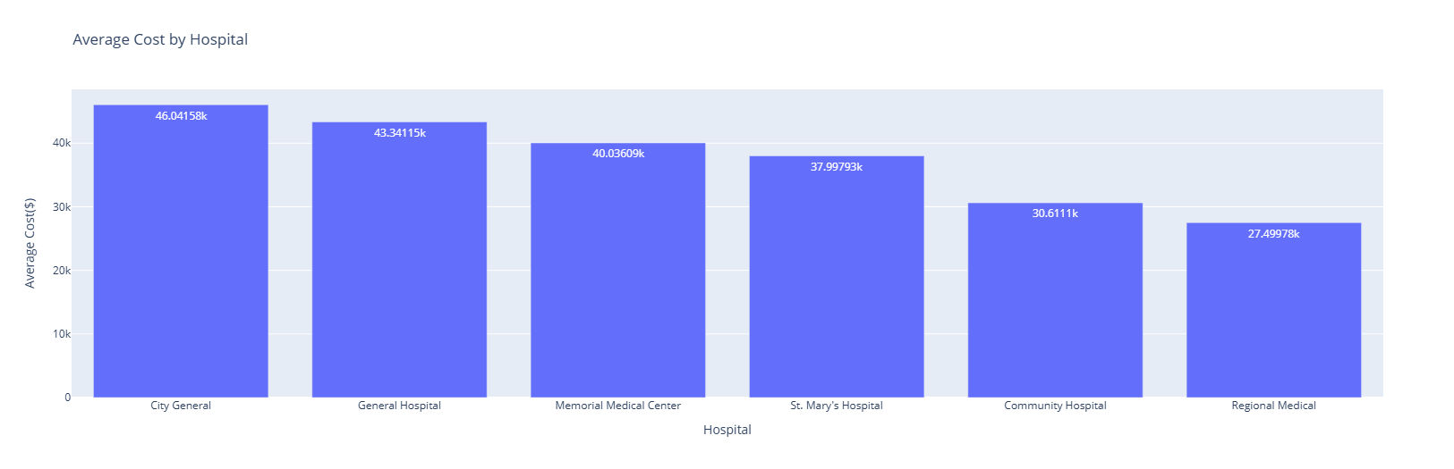
Influence of the choice of hospital on billing amount
It cost the most to get treatment from City General hospital and the least to get treatment form Regional Medical Hospital.

Slide 18
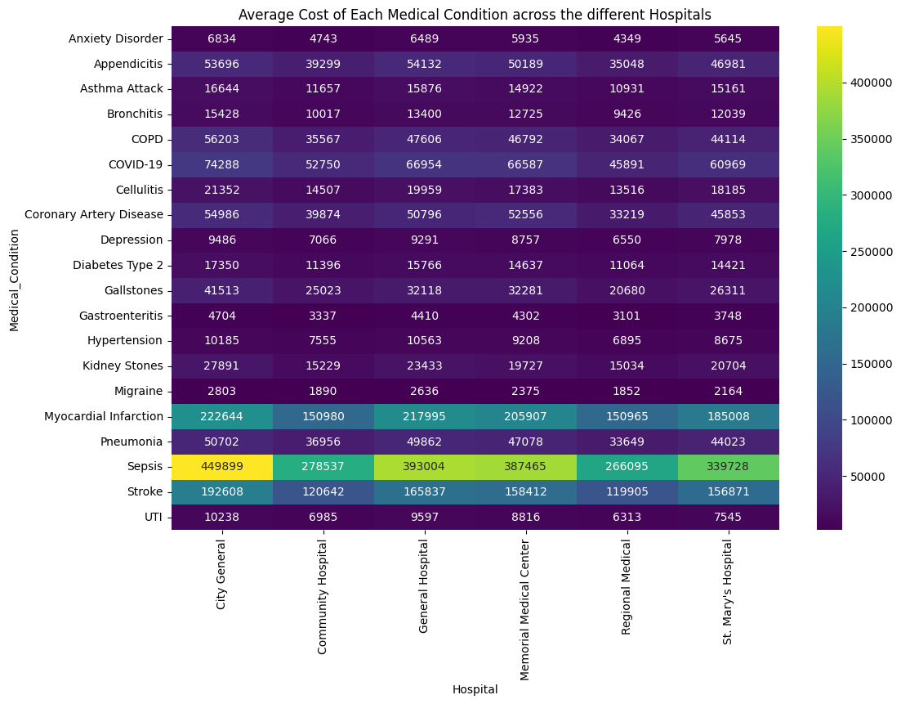
Average cost of medical condition across the hospitals
Difference in average cost of treatment of sepsis at City General and Regional medical is $18,3804.00

Slide 19
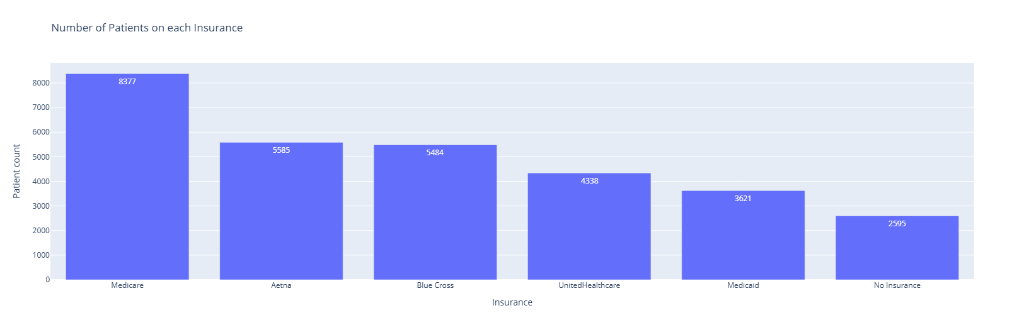
Insurance coverage
There is a significant number of people(2595) who do not have insurance and have to pay their total bills out of pocket.
Despite Medicare having an insurance cover of 80% , it covers the largest number of patients.

Slide 20
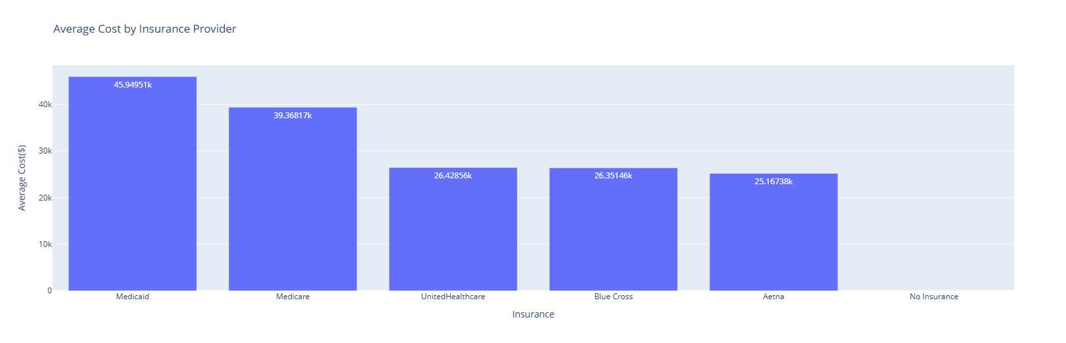
Average cost paid by insurance provider
Medicaid insurance pays the highest bills for patients.

Slide 21
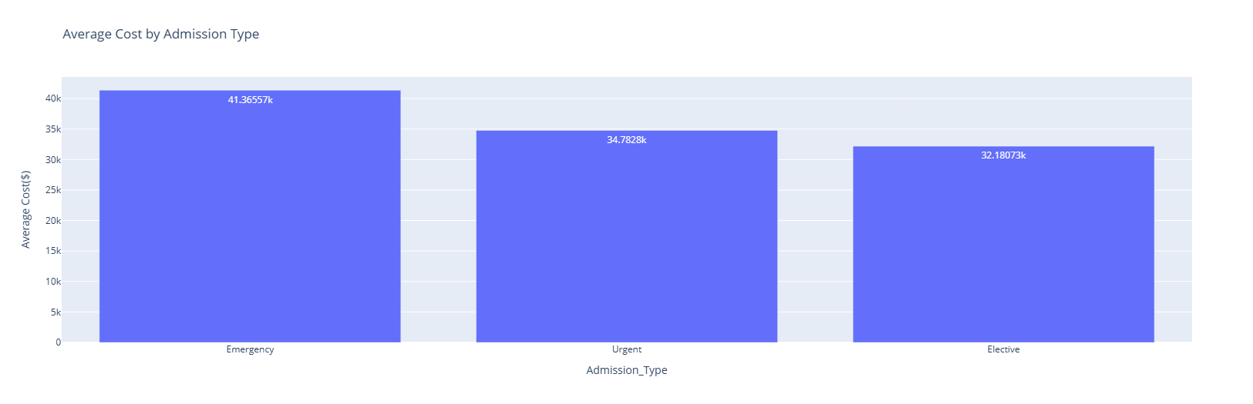
Influence of the type of admission on billing amount
Emergency admissions incur the highest costs, followed by urgent admissions, with elective admissions being the least expensive.

Slide 22
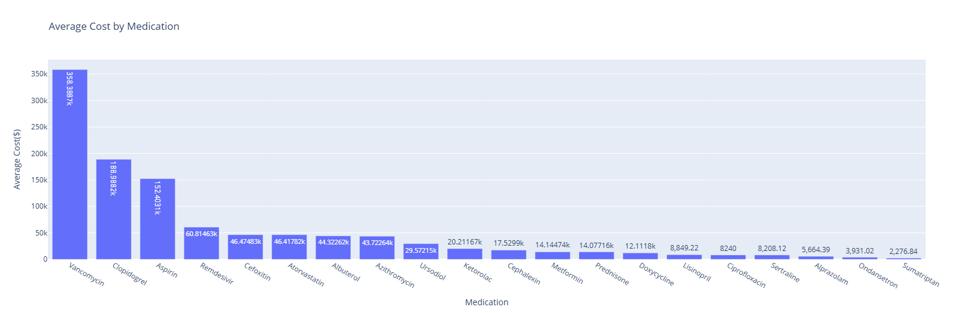
Influence of medication on billing amount
Vancomycin contributes significantly to cost of treatment
Least expensive contributor is sumatriptan

Slide 23
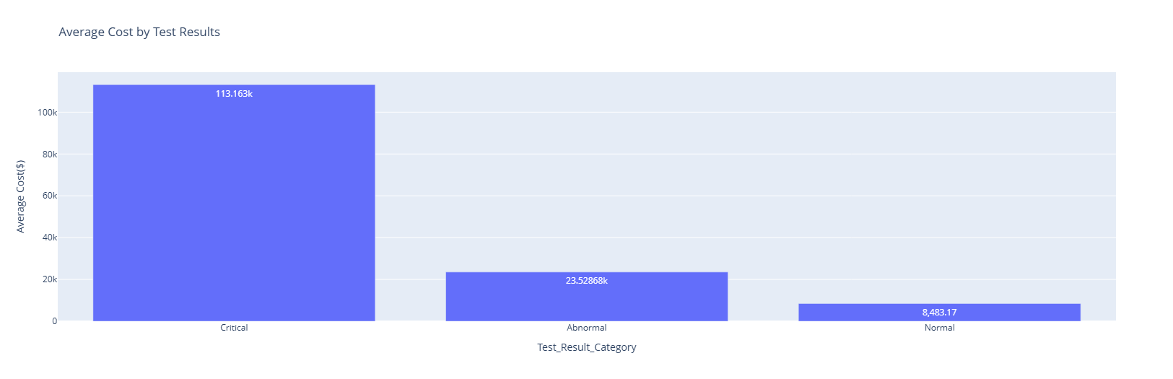
Influence of test results on billing amount
Critical conditions are expensive to treat

Slide 24
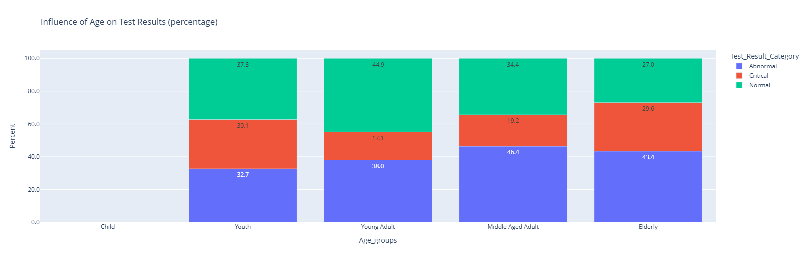
Influence of age group on test results
Young adults have the highest proportion of it's group having normal results.
Youth has the highest proportion of it's group having critical results.
Middle age has the highest proportion having abnormal results.

Slide 25
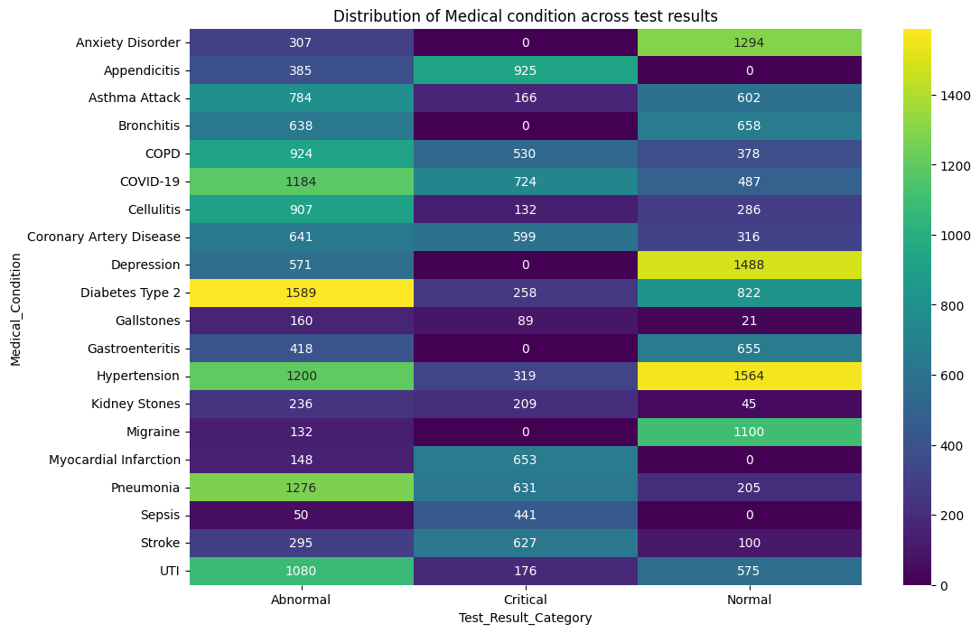
Distribution of medical conditions across test results
Abnormal results dominate across most conditions, particularly for chronic and infectious diseases such as diabetes Type 2, hypertension, pneumonia, COVID-19, and UTI.
Critical results are concentrated in acute, life-threatening conditions, including appendicitis, myocardial Infarction, stroke, sepsis, and pneumonia.

Slide 26
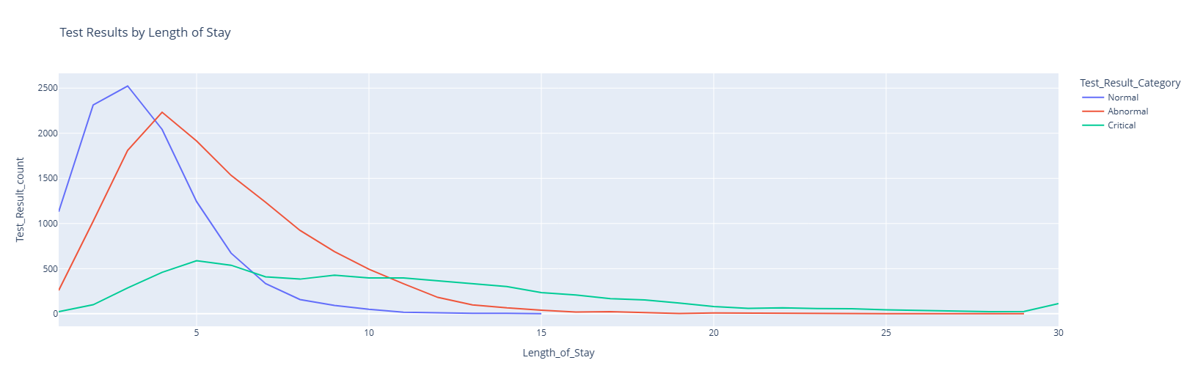
Relationship between test results and length of stay
Normal test results are associated with shorter hospital stays, peaking around 2 - 4 days, and decline sharply thereafter. This suggests quicker diagnosis, treatment, and discharge.
Abnormal results peak slightly later (around 4-6 days) and show a longer tail, indicating moderate severity and requiring extended monitoring or treatment.
Critical test results are strongly associated with prolonged length of stay, with extended distribution that persists beyond 10 - 20 days, reflecting higher severity.

Slide 27
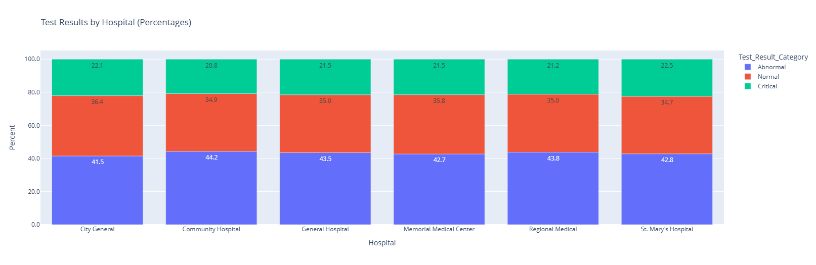
Influence of hospitals on test results
There is an almost uniform distribution of test results across the different hospitals, indicative of similar healthcare standards or protocols in all the facilities.

Slide 28
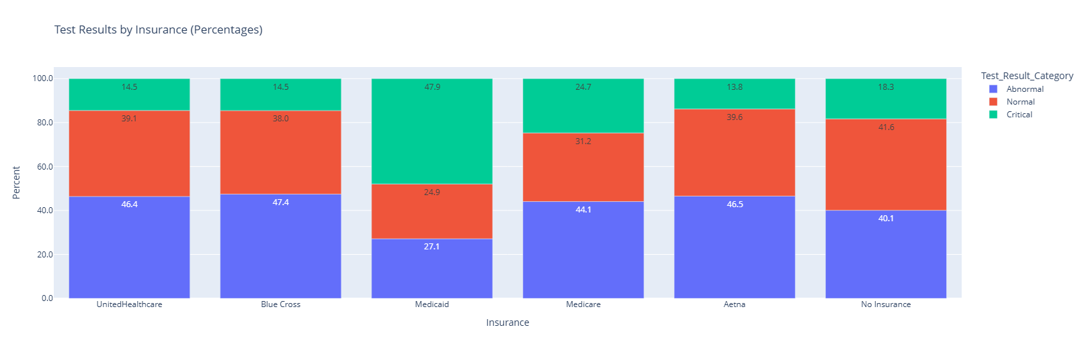
Distribution of percentage proportion of test results for insurance providers
Medicaid patients show the highest proportion of critical test results (47.9%).
Medicare patients have a more balanced distribution, with substantial abnormal (44.1%) and normal (31.2%) results, and a moderate critical share (24.7%).
Uninsured patients show elevated normal and abnormal proportions, which may indicate delayed presentation until conditions worsen.

Slide 29
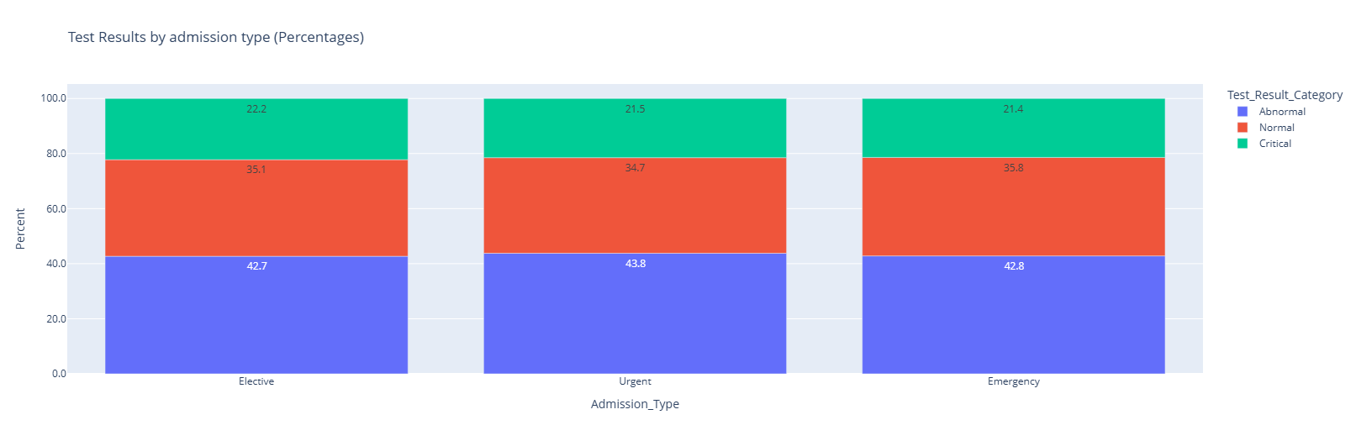
Influence of admission type on test results
Type of admission does not influence the test results. Healthcare provision /protocol is standardized.

Slide 30
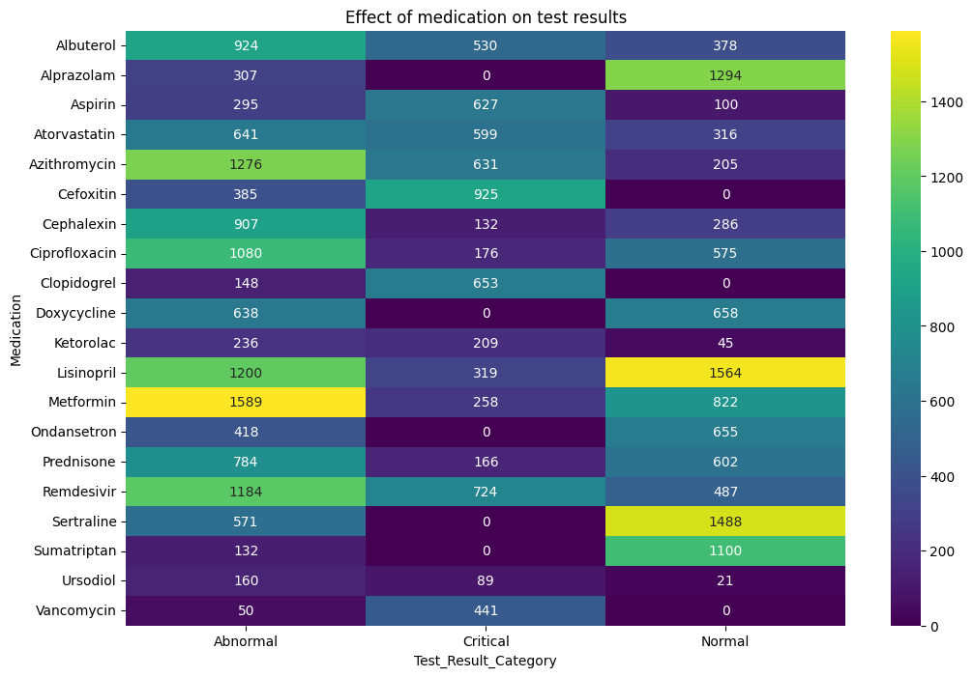
Relationship between medication and test results
Chronic disease medications such as Metformin, Lisinopril, and Atorvastatin are associated with high volumes of abnormal and normal results.
Antibiotics and antivirals (e.g., Azithromycin, Ciprofloxacin, Vancomycin, Remdesivir) show higher proportions of critical and abnormal results, consistent with their use in acute and severe infections.

Slide 31
Research Questions Answered
1. Does medical conditions affect billing amount?
  Yes, it does, billing amount varied with different medical conditions
2. Does healthcare facility influence billing amount?
  Yes, it does. Across different hospitals but medical condition remaining the same, the billing varied with some hospitals having almost a 69% increase in billing amount
3. Does type of admission affect billing amount?
  Yes, it does. Protocols differ for the different type of admissions and this determines how much is paid
4. Which demographic group incur higher medical expense?
  Elderly patients i.e. those who are 60 years and above have a higher medical expenditure
Are certain medical conditions or age groups more prone to poor test outcomes?
  Yes, there are. Risk groups that have a significant portion of patients having either abnormal or critical results are Sepsis, Myocardial Infarction, Appendicitis, Stroke, Kidney stones, Coronary Artery Disease

Slide 32
Research Questions Answered
What recommendations can be made to reduce treatment cost?
      Visit a hospital at the onset of any condition, do not wait till it's an emergency. Delay may increase your expenses
      Choose a hospital that best fits your financial strength e.g. Regional Hospital charges the least compared to City General hospital
      Subscribe to a health insurance
      Be health conscious(exercise, eat well, rest properly, etc.)
Does medical condition, medication, age, length of hospital stay influence test results?
      The kind of medical condition presented does not influence test results
      Age has an influence on test results as younger people generally may recover faster compared to older people
      The test result may influence how a patient stays in the hospital

Slide 33
Key findings
Emergency admissions are the most frequent, accounting for approximately 50% of all cases.
Approximately 22% of patients had “Critical” test results. These are significantly more expensive with an average billing of $113,163 compared to only $8483 for patients with ‘Normal’ test results.
Medicare is the dominant insurance provider with 8377 patients. 8.65% of patients are listed as having “No insurance”.

Slide 34
Recommendation
Preventive care focus: The middle aged, young adult and elderly represent demographic groups with the highest number of hospital visits. A targeted public health campaigned focused on this group may help promote healthier lifestyles
Do not wait for a medical condition to become severe before visiting a hospital
Comprehensive health insurance education guide for the uninsured

Slide 35
Conclusion
Sepsis, Myocardial infarction and stroke are the most expensive conditions with sepsis averaging billing amount of approximately $358000 per case. Implementation of early warning sign systems will catch the conditions early and help reduce cost and improve patient outcome
Significant variance in treatment costs exists, with City General charging 69% more for Sepsis than Regional Medical. Investigate the drivers behind the 69% price gap—whether due to higher complication rates, longer lengths of stay, or administrative overhead.
High volume cases are being treated via emergency admissions, that is about 50% of cases. This is indicative of poor primary care management leading to preventable high cost emergency visits. Transition from a reactive "Emergency-first" model to a proactive "Primary care-first" model.
Patients with no insurance are paying for all their bills out-of-pocket. Proactively identify uninsured patients upon admission and educate and guide them on the need for a health insurance

