Slide 1
COST DRIVERS IN HEALTHCARE AND FACTORS AFFECTING THE OUTCOMES OF TREATMENT
By Kwame acheampong

Slide 2
Introduction
Problem Statement
  Healthcare facilities face rising treatment costs and inconsistent patient outcomes across various medical conditions and care settings. However, the specific cost drivers within treatment pathways and their direct impact on clinical outcomes remain unclear. This problem requires a comprehensive analysis of how treatment decisions, resource use, and care settings influence both healthcare spending and patient health outcomes.

Slide 3
Objectives
Analyze patient billing data in order to determine the contributors of healthcare cost
Recommend practical measures that can help reduce patient spending
Assess the relationship between patient and hospital related variables and test results.
Identify risk factors associated with poor test results.

Slide 4
Research Questions
Do certain medical conditions lead to higher billing amount?
Does the choice of healthcare provider influence billing amount
Does the type of admission influence billing amount?
Which demographic group incur higher medical expense, and what pattern exists across age groups?
What actionable recommendations can be made to reduce the overall treatment cost
How does medical condition, age , length of stay influence the test results

Slide 5
Research Questions
Does medication influence the test results
Are certain medical conditions more prone to poor outcomes.

Slide 6
Data Preparation

Slide 7
Tools used
Google colab

Slide 8
Data Overview
Dataset had 16columns
30,000 unique patients
20 medical conditins
1000 doctors
40341 doctors
6 hospitals
6 insurance providers
3 Admission type categories
20 medications
2 target columns (Billing amount, Test result)
Time span of data : January 2022 –November 2022

Slide 9
Data cleaning
Observation
  Dataset was clean
.

Slide 10
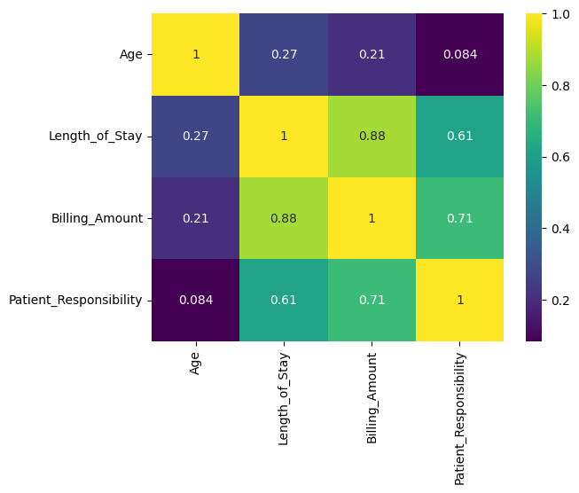
Numerical correlation
Significant correlations between the numerical variables
Age of patient has minimal influence on billing amount
Length of stay has pronounce influence on the billing amount

Slide 11
Initial Insights
Numerical columns are positively skewed
Outliers observed in numerical columns
Age distribution centered between 38-60 years with small number of elderly patients(outliers
Most patients stayed 3-7 days. Small section of patients experienced longer stay( outliers)
Most patients were billed between 6000-38000$. Small number of patients were billed quite high(outliers). Likely indicator of the resources used or the kind of medical condition
Most patients experienced low out of pocket payments, indicative of high insurance cover rate, as compared the patients who had high patient responsibility(outliers). These ones had no insurance cover.

Slide 12
Initial Insight
Patients are uniformly distributed amongst the hospital
Majority of the cases reporting to the hospital were emergency cases

Slide 13
Analyses

Slide 14
Age grouping
WHO age classification
  Children : 0-9 years
  Youth: 10-19 years
  Young Adult: 20- 39years
  Middle Age: 40-59 years
  Elderly: 60+ years

Slide 15
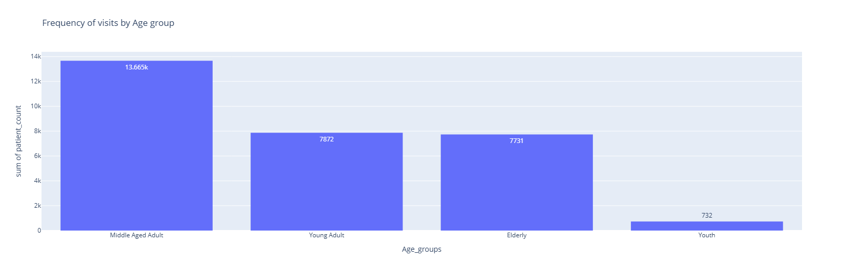
Frequency of hospital visits
More middle -aged people are visiting the hospital,

Slide 16
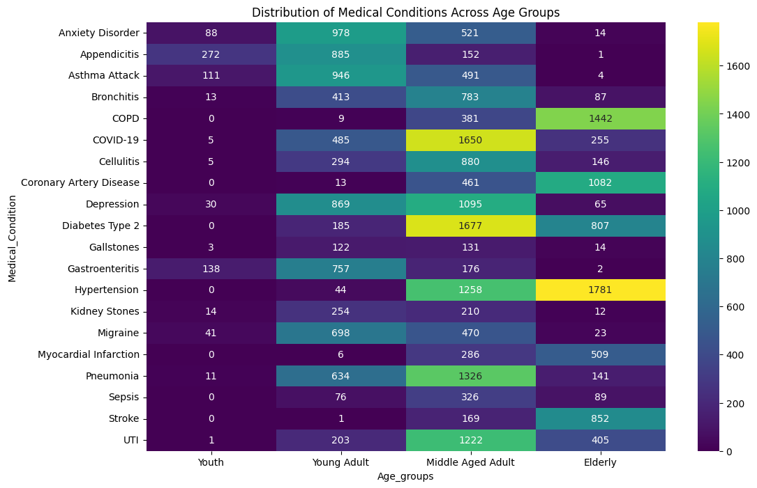
Distribution of medical condition across age groups
Hypertension, stroke, diabetes, coronary artery disease, COPD prominent amongst elderly
Asthma, appendicitis, anxiety disorder, gastroenteritis prominent in the youth
Asthma, migraine, depression, appendicitis, anxiety disorder, gastroenteritis prominent in young adults
Diabetes, hypertension, COVID-19,Depression, Pneumonia, UTI prominent in Middle aged adults

Slide 17
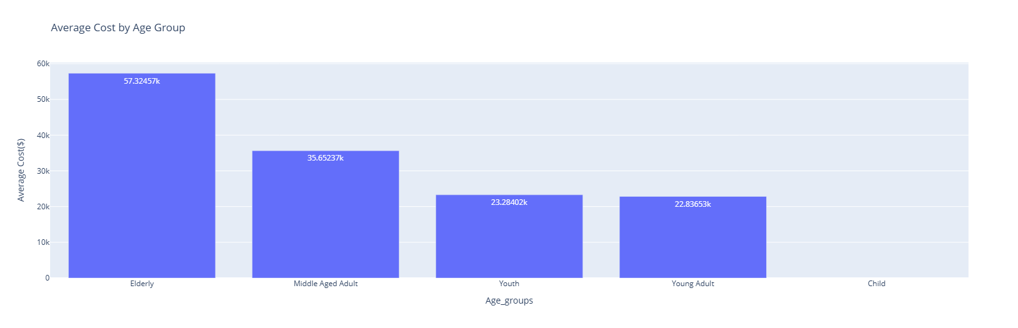
Influence of Age group on Billing Amount
Elderly patients spent more on healthcare
Healthcare expenditure increases with age

Slide 18
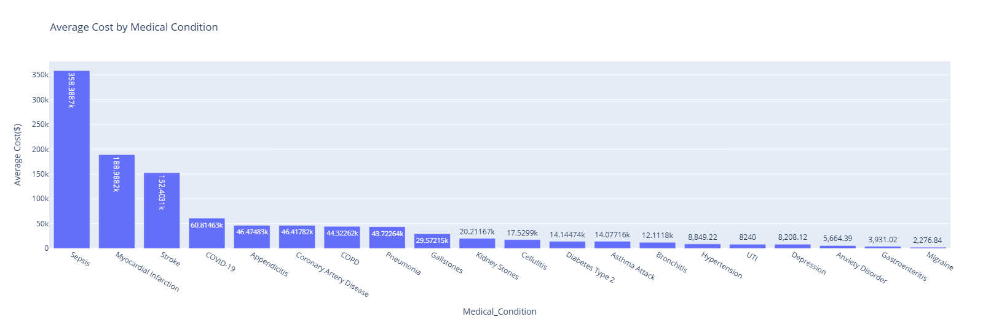
Medical Condition against Cost
It cost more in treatment depending on the medical condition presented at the hospital
Sepsis is the most expensive medical condition to treat
Migraine is the least expensive medical condition to treat

Slide 19
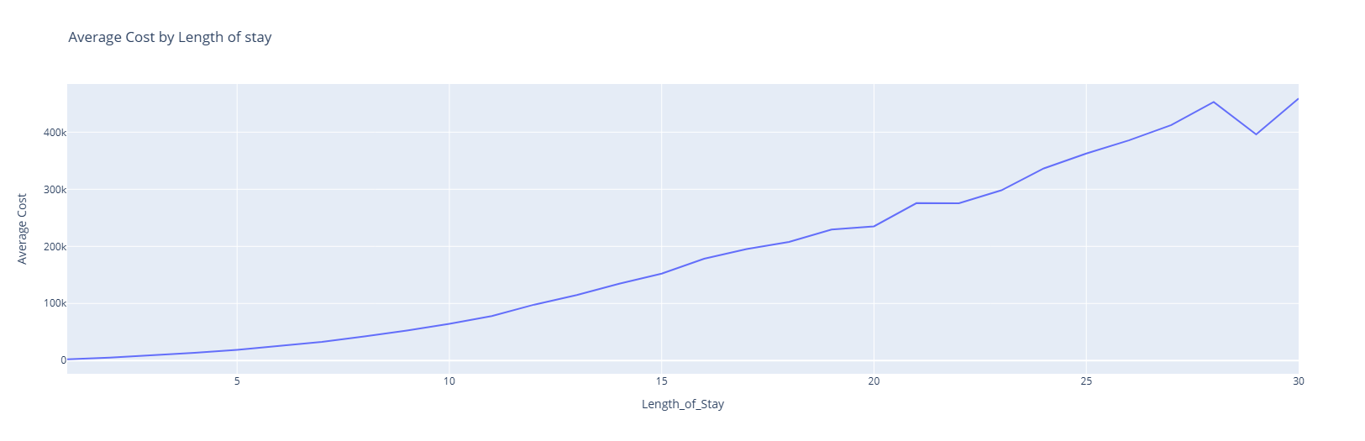
Average cost by length of stay
Cost of treatment increases with increasing number of days spent at the hospital

Slide 20
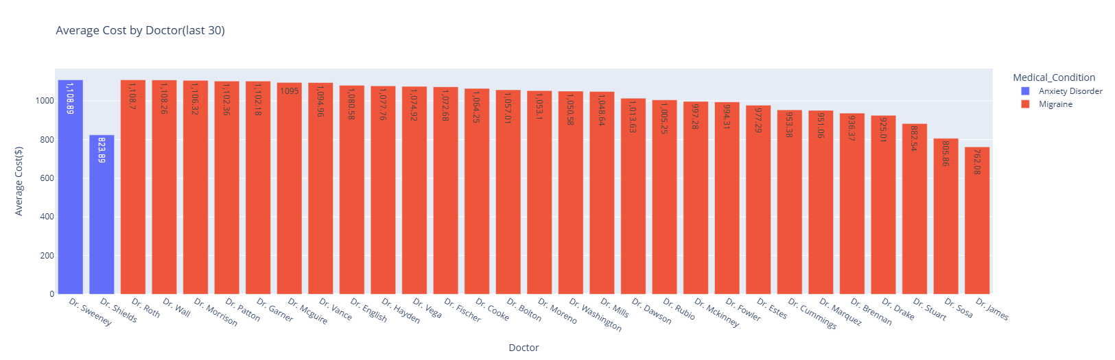
Doctor against Cost
Choice of doctor influences how much is spent likely due to the different approaches each one may have in treatment or likely comorbidities

Slide 21
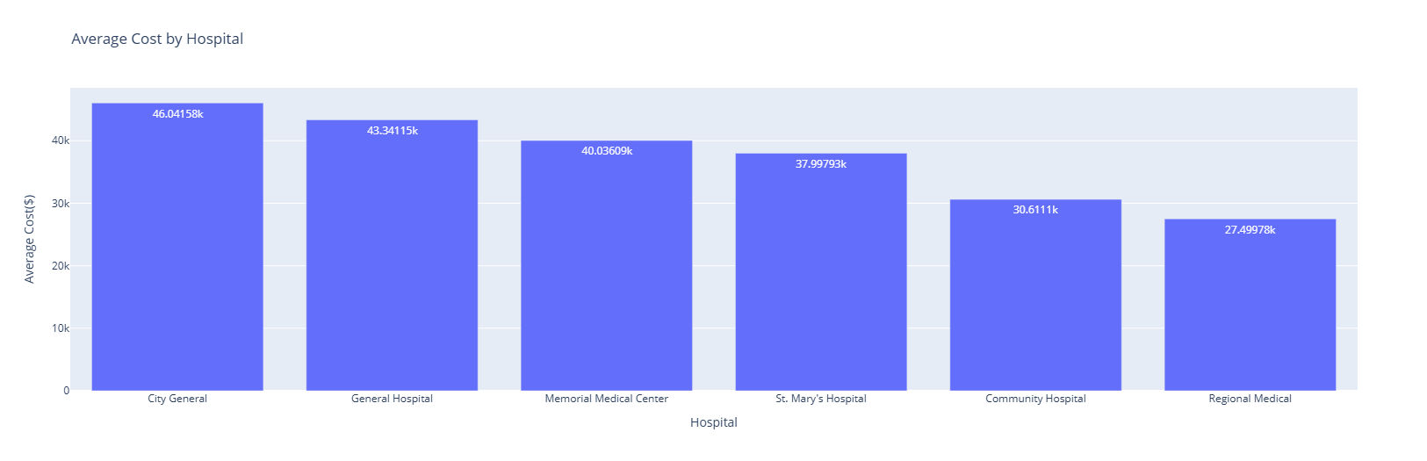
Hospital against Cost
It cost the most to get treatment from City General hospital and the least to get treatment form Regional Medical Hospital

Slide 22
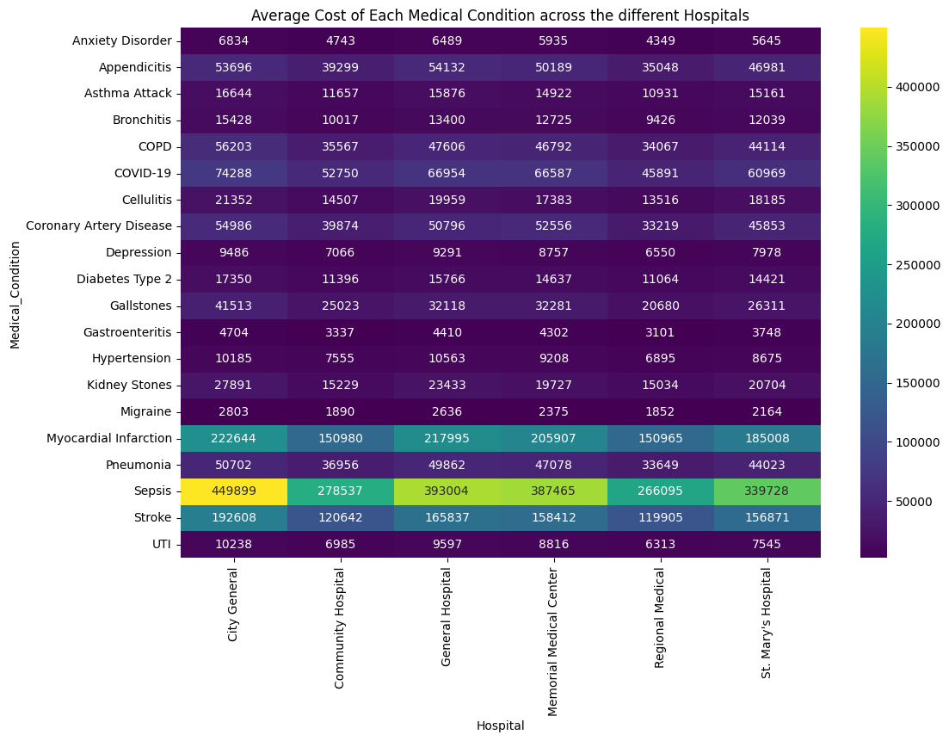
Hospital Vs Medical condition
Difference in cost of treatment of sepsis at City General and Regional medical is $183804.00

Slide 23
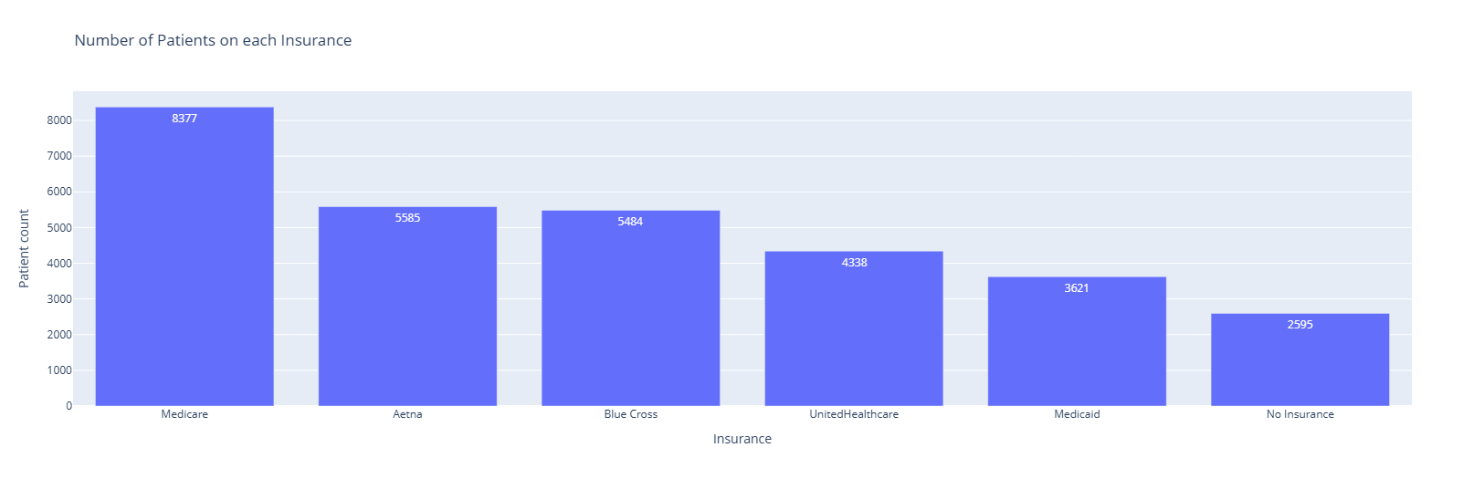
Insurance coverage
There is a significant number of people(2595) who do not have insurance and have to pay their total bills out of pocket
Despite Medicare having an insurance cover of 80% it covers the largest number of patients.

Slide 24
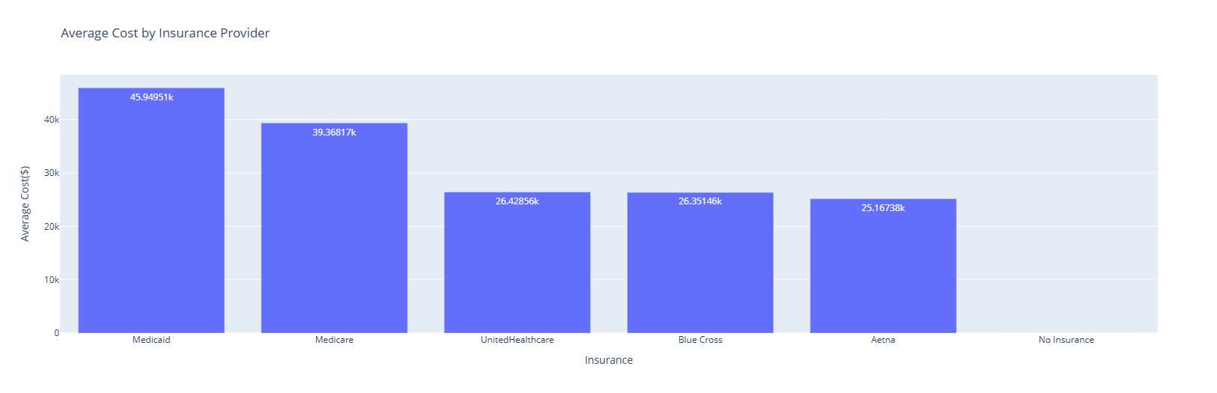
Average insurance cover
Medicaid insurance pays the highest bills for patients

Slide 25
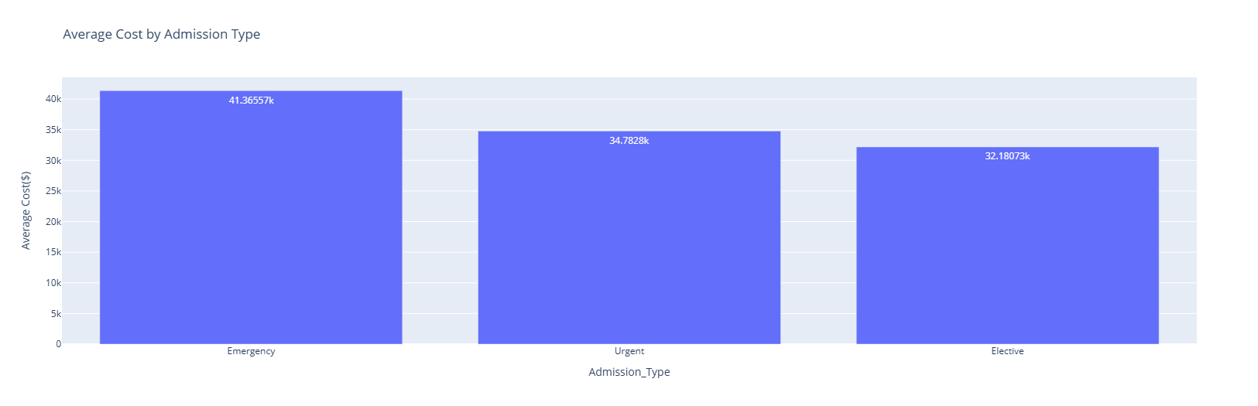
Admission type against cost
Emergency admissions incur the highest costs, followed by urgent admissions, with elective admissions being the least expensive

Slide 26
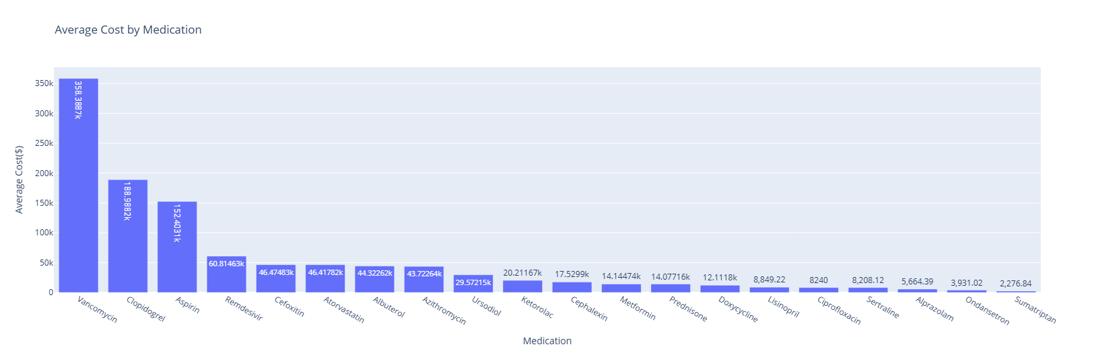
Medication against cost
Vancomycin contributes significantly to cost of treatment
Least expensive contributor is sumatriptan

Slide 27
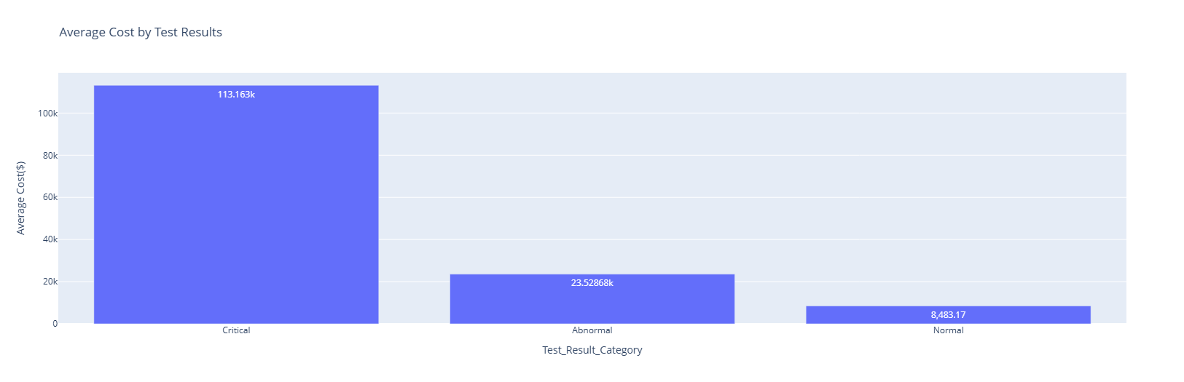
Test results against cost
Critical conditions are expensive to treat

Slide 28
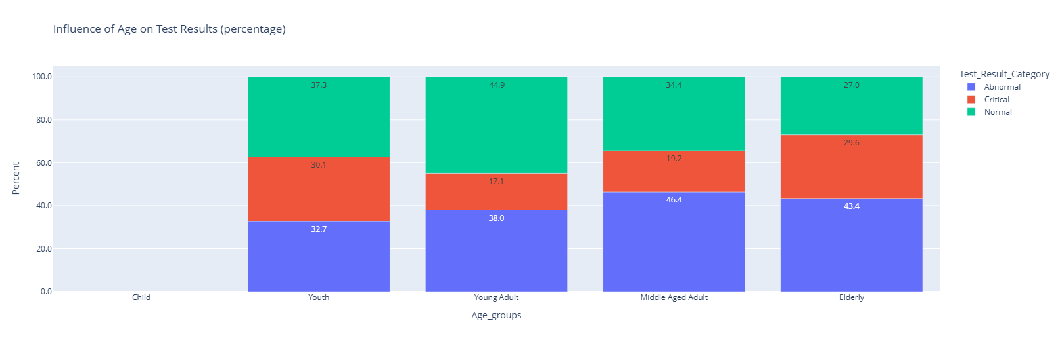
Age group against Test results
Young adults have the highest proportion of it's group having normal results
Youth has the highest proportion of it's group having critical results
Middle age has the highest proportion having abnormal results

Slide 29
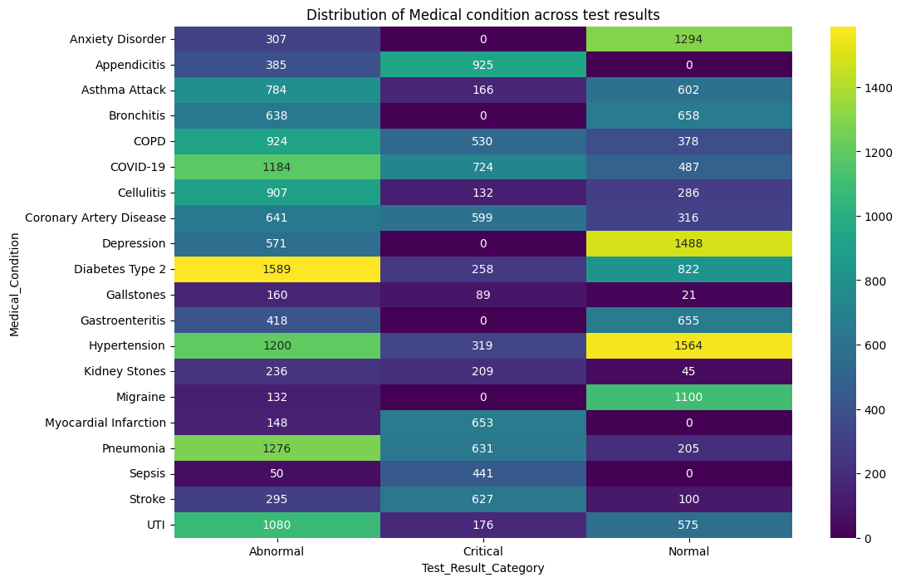
Medical condition against Test results
Abnormal results dominate across most conditions, particularly for chronic and infectious diseases such as Diabetes Type 2, Hypertension, Pneumonia, COVID-19, and UTI.
Critical results are concentrated in acute, life-threatening conditions, including Appendicitis, Myocardial Infarction, Stroke, Sepsis, and Pneumonia

Slide 30
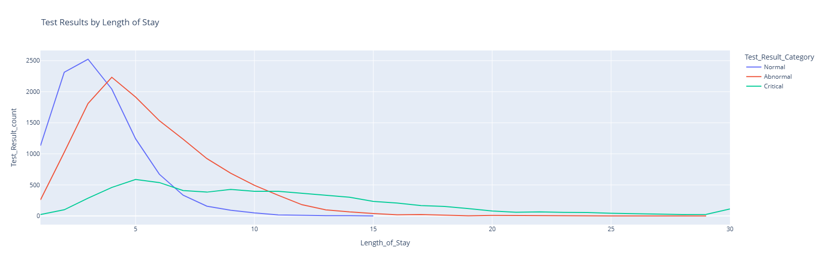
Length of stay against Test results
Normal test results are associated with shorter hospital stays, peaking around 2 - 4 days, and decline sharply thereafter. This suggests quicker diagnosis, treatment, and discharge.
Abnormal results peak slightly later (around 4-6 days) and show a longer tail, indicating moderate severity and requiring extended monitoring or treatment.
Critical test results are strongly associated with prolonged length of stay, with extended distribution that persists beyond 10 - 20 days, reflecting higher severity.

Slide 31
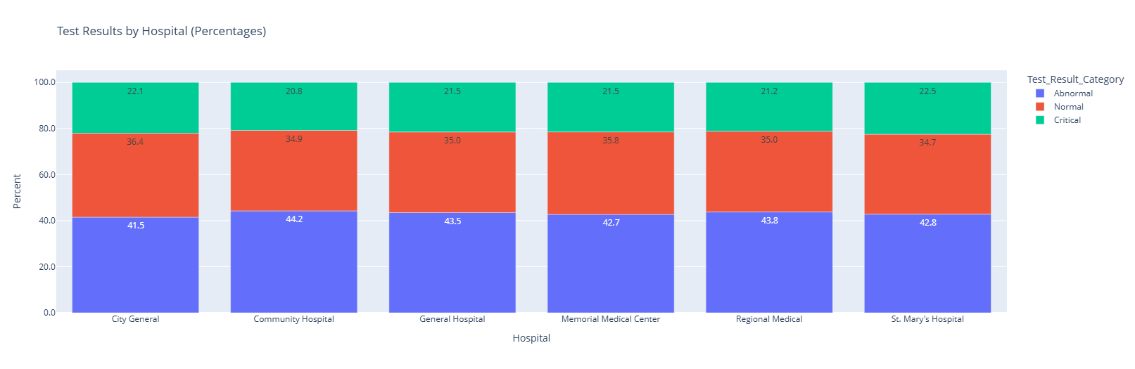
Hospital against Test results
There is an almost uniform distribution of test results across the different hospitals, indicative of similar healthcare standards or protocols in all the facilities.

Slide 32
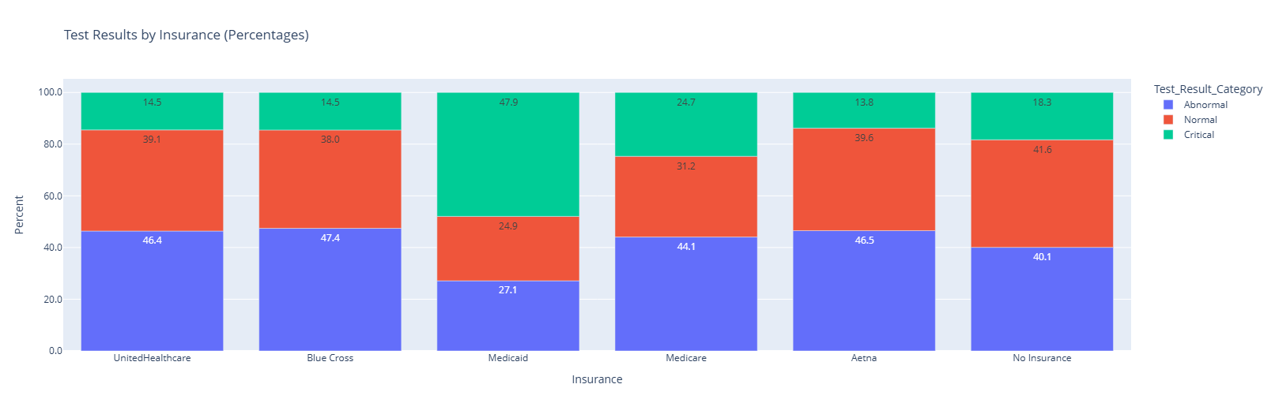
Insurance against cost
Medicaid patients show the highest proportion of critical test results (47.9%)
Medicare patients have a more balanced distribution, with substantial abnormal (44.1%) and normal (31.2%) results, and a moderate critical share (~24.7%)
Uninsured patients show elevated normal and abnormal proportions, which may indicate delayed presentation until conditions worsen

Slide 33
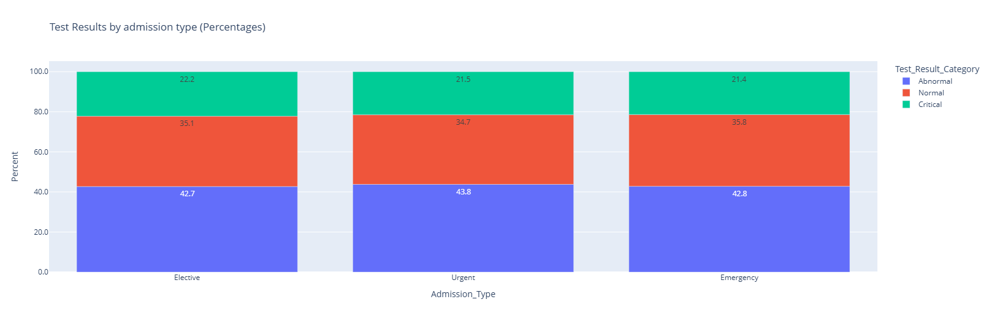
Admission type against test results
Type of admission does not influence the test results. Healthcare provision /protocol is standardized

Slide 34
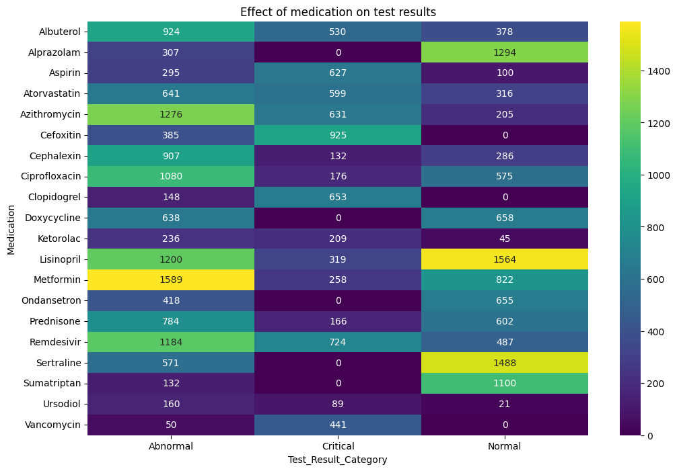
Medication against Test results
Chronic disease medications such as Metformin, Lisinopril, and Atorvastatin are associated with high volumes of abnormal and normal results
Antibiotics and antivirals (e.g., Azithromycin, Ciprofloxacin, Vancomycin, Remdesivir) show higher proportions of critical and abnormal results, consistent with their use in acute and severe infections

Slide 35
Research Questions Answered
1. Does medical conditions affect billing amount?
  Yes, it does, billing amount varied with different medical conditions
2. Does healthcare facility influence billing amount?
  Yes, it does. Across different hospitals but medical condition remaining the same, the billing varied with some hospitals having almost a 69% increase in billing amount
3. Does type of admission affect billing amount?
  Yes, it does. Protocols differ for the different type of admissions and this determines how much is paid
4. Which demographic group incur higher medical expense?
  Elderly patients i.e. those who are 60 years and above have a higher medical expenditure

Slide 36
Research Questions Answered
What recommendations can be made to reduce treatment cost?
      Visit a hospital at the onset of any condition, do not wait till it's an emergency. Delay may increase your expenses
      Choose a hospital that best fits your financial strength e.g. Regional Hospital charges the least compared to City General hospital
      Subscribe to a health insurance
      Be health conscious(exercise, eat well, rest properly, etc.)
Does medical condition, medication, age, length of hospital stay influence test results?
      The kind of medical condition presented does not influence test results
      Age has an influence on test results as younger people generally may recover faster compared to older people
      The test result may influence how a patient stays in the hospital*

Slide 37
Research Questions Answered
Are certain medical conditions or age groups more prone to poor test outcomes?
    Yes, there are. Risk groups that have a significant portion of patients having either abnormal or critical results are Sepsis, Myocardial Infarction, Appendicitis, Stroke, Kidney stones, Coronary Artery Disease

Slide 38
Key findings
Emergency admissions are the most frequent, accounting for approximately 50% of all cases.
Approximately 22% of patients had “Critical” test results. These are significantly more expensive with an average billing of $113,163 compared to only $8483 for patients with ‘Normal’ test results.
Medicare is the dominant insurance provider with 8377 patients. 8.65% of patients are listed as having “No insurance”.

Slide 39
Recommendation
Preventive care focus: The middle aged, young adult and elderly represent demographic groups with the highest number of hospital visits. A targeted public health campaigned focused on this group may help promote healthier lifestyles
Do not wait for a medical condition to become severe before visiting a hospital
Comprehensive health insurance education guide for the uninsured

Slide 40
Conclusion
Sepsis, Myocardial infarction and stroke are the most expensive conditions with sepsis averaging billing amount of approximately $358000 per case. Implementation of early warning sign systems will catch the conditions early and help reduce cost and improve patient outcome
Significant variance in treatment costs exists, with City General charging 69% more for Sepsis than Regional Medical. Investigate the drivers behind the 69% price gap—whether due to higher complication rates, longer lengths of stay, or administrative overhead.
High volume cases are being treated via emergency admissions, that is about 50% of cases. This is indicative of poor primary care management leading to preventable high cost emergency visits. Transition from a reactive "Emergency-first" model to a proactive "Primary care-first" model.
Patients with no insurance are paying for all their bills out-of-pocket. Proactively identify uninsured patients upon admission and educate and guide them on the need for a health insurance

