Slide 1
AUTOMATED EMAIL CLASSIFICATION SYSTEM FOR THE ASHESI SUPPORT CENTRE By: Kwame Owusu Boahene
Computer Science: Applied Project

Slide 2
BACKGROUND
Ashesi Support Center is the hub for solutions for IT, facilities, logistics and other issues on campus
Email is used as a point of contact for the support center
The support center classifies emails as either IT or an operations issue
Source: Support Center

Slide 3


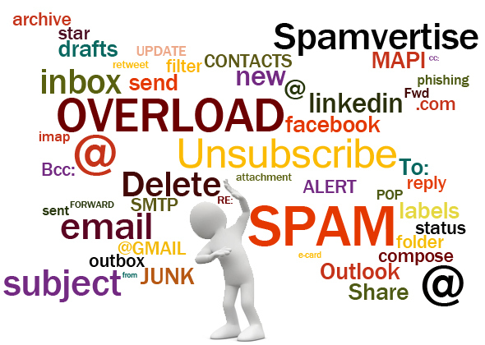
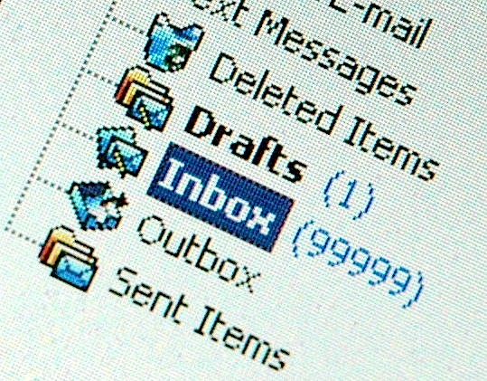
PROBLEM
In peak periods the support center receives over 40 emails a day.
Support center operates in teams.
Some emails may not report a problem.
Source: Support Center

Slide 4
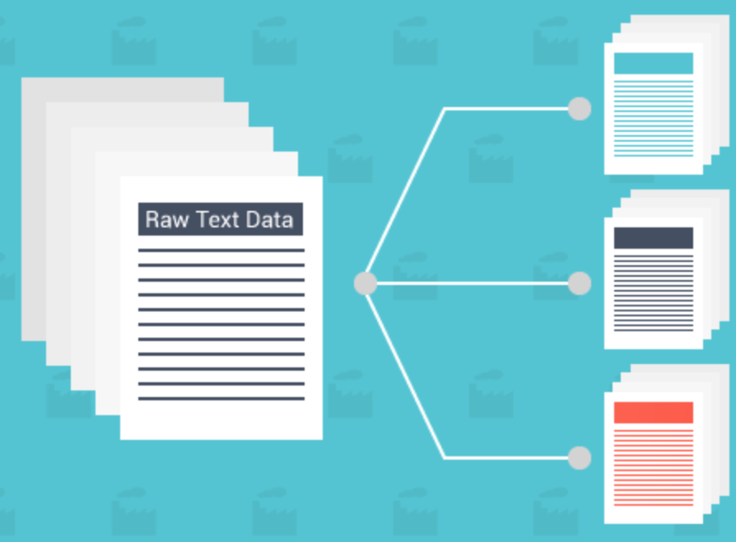
SOLUTION
An email classification system that classifies emails as either IT, Operation or Other automatically.
Other
Operations
IT

Slide 5
RELATED WORK
CLASSIFICATION ALGORITHMS
Support Vector Machine and Naïve Bayes usually outperform other classification
DATASET
A dataset is needed to train the model that Is used to predict the class of an email.
PREPROCESSING
An essential step in email classification is preprocessing the training data for the learning model or algorithm
Source: [1, 2, 3, 4, 5 and 6]

Slide 6
DATASET
Dataset consisted of over 6000 emails
It was presented in .pst format hence there was a need to convert it to a readable format. (Systools Converter)
Manually label the email as Operations, IT and other emails
MuPDF was used to extract the subject and body from the email pdf
The extracted email was saved in a json format.

Slide 7
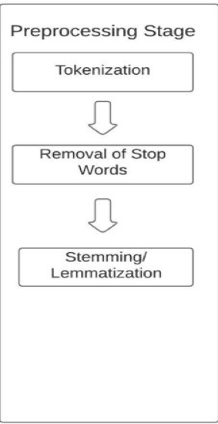
PREPROCESSING STAGE
Split each email into words
Take out symbols and stop words. E.g. at, in, so etc.
Convert words to their root form e.g. (come, coming, came = come)
Built using NLTK library in python.

Slide 8
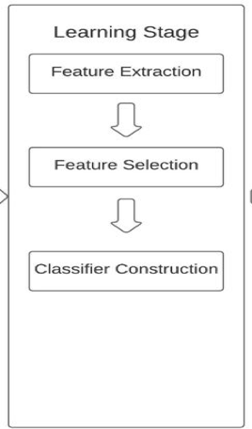
LEARNING AND CLASSIFICATION STAGE
Convert tokens into attribute vectors – TFIDF was used here
Overfitting– L2 regularization
Build a model – Naïve Bayes and SVM
Built using Scikit-learn in python
Notes:
Features IT- internet, projector, telephone Operations – hostel, bed, transport, lights, bathroom, kitchen Other- Design lab, uber, health, invitation
Overfitting occurs when your model corresponds exactly to the dataset you using such that when presented with a new data it cant predict the class
Sparse solution
Naïve Bayes is a probabilistic model which works on the assumption that features are independent
Use graphs

Slide 9
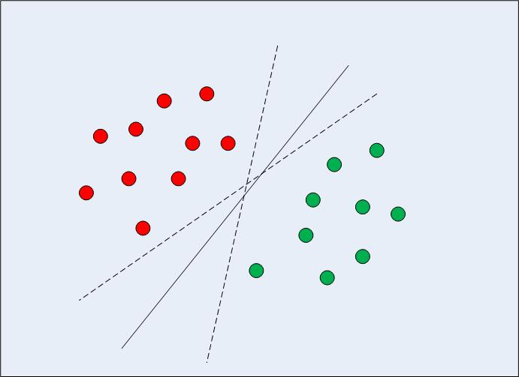
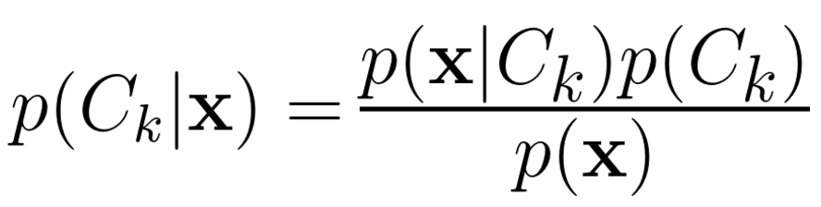
MODELS
Naïve Bayes
SVM
Notes:
SVM finds a hyperplane which best maximizes the difference between two classes
For multi classification in SVM I used the one vs the rest approach what this does is for each class
Overfitting occurs when your model corresponds exactly to the dataset you using such that when presented with a new data it cant predict the class
Sparse solution
Naïve Bayes is a probabilistic model which works on the assumption that features are independent
Use graphs

Slide 10
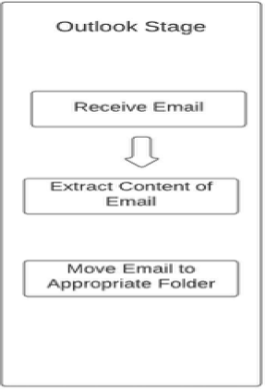
OUTLOOK STAGE
Extract body from email
Send email to the classification system
Move email into appropriate folder
Built using Visual Basic for Applications(VBA)

Slide 11
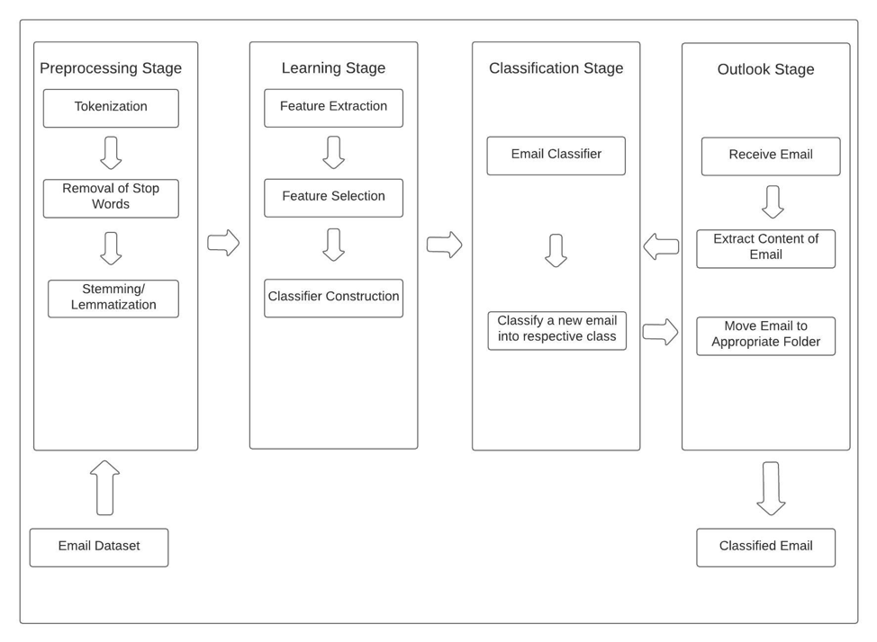
SYSTEM ARCHITECTURE

Slide 12
TEST
Test Results
Accuracy of 91% and 85% was achieved for SVM and Naïve Bayes respectively.

Slide 13
CONCLUSION
Limitations
Microsoft does not allow developer mode in MacOS
Dataset was not labelled.
.pst format
Future Works
Dataset for other research work and projects
Further classification within IT and Operations
Determining an appropriate responder & responds based on classification

Slide 14
[1] Ani Nenkova and Amit Bagga. 2003. Email classification for contact centers. In Proceedings of the 2003 ACM symposium on Applied computing (SAC '03). ACM, New York, NY, USA, 789-792. DOI: https://doi.org/10.1145/952532.952689
[2] Taiwo Ayodele, Rinat Khusainov, and David Ndzi. 2007. Email classification and summarization: A machine learning approach. In 2007 IET Conference on Wireless, Mobile and Sensor Networks (CCWMSN07), 805–808. DOI: https://doi.org/10.1049/cp:20070271
[3] Mihajlo Grbovic, Guy Halawi, Zohar Karnin, and Yoelle Maarek. 2014. How Many Folders Do You Really Need?: Classifying Email into a Handful of Categories. In Proceedings of the 23rd ACM International Conference on Conference on Information and Knowledge Management (CIKM ’14), 869–878. DOI: https://doi.org/10.1145/2661829.2662018
[4] Xiao-Lin Wang and Cloete, "Learning to classify email: a survey," 2005 International Conference on Machine Learning and Cybernetics, Guangzhou, China, 2005, pp. 5716-5719 Vol. 9. DOI: 10.1109/ICMLC.2005.1527956
[5] Shrawan Kumar Trivedi and Shubhamoy Dey. 2013. Effect of feature selection methods on machine learning classifiers for detecting email spams. In Proceedings of the 2013 Research in Adaptive and Convergent Systems (RACS '13). ACM, New York, NY, USA, 35- 40. DOI: https://doi.org/10.1145/2513228.2513313
[6] R. Deepa Lakshmi and N. Radha. 2010. Spam classification using supervised learning techniques. In Proceedings of the 1st Amrita ACM-W Celebration on Women in Computing in India (A2CWiC '10). ACM, New York, NY, USA, Article 66, 4 pages. DOI: http://dx.doi.org/10.1145/1858378.1858444

