Slide 1




THE SCALP EDITION
It looks like dandruff. It often isn't.
Why scalp flaking keeps coming back, and what finally treats it.
01 / 08
swipe

Slide 2


02 / 08
THE CYCLE
The two-week shampoo cycle
A new shampoo helps for two weeks. Then the flakes come back, along with the itch. Dark shirts get retired. The cycle repeats for years.

Slide 3
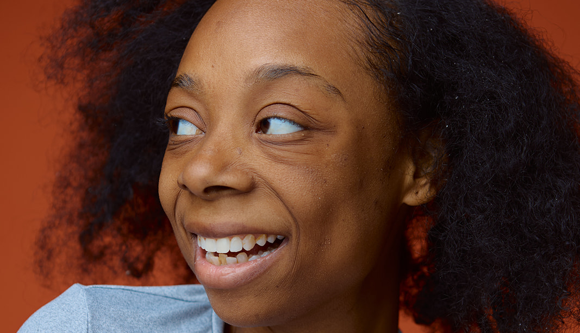
03 / 08
THE CAUSE
Recurring flakes usually have a name: seborrheic dermatitis
It's tied to Malassezia, a yeast that lives on nearly every scalp. Some skin reacts to it with flaking and itch. That reaction is medical, and the shampoo aisle was never built to treat it.

Slide 4

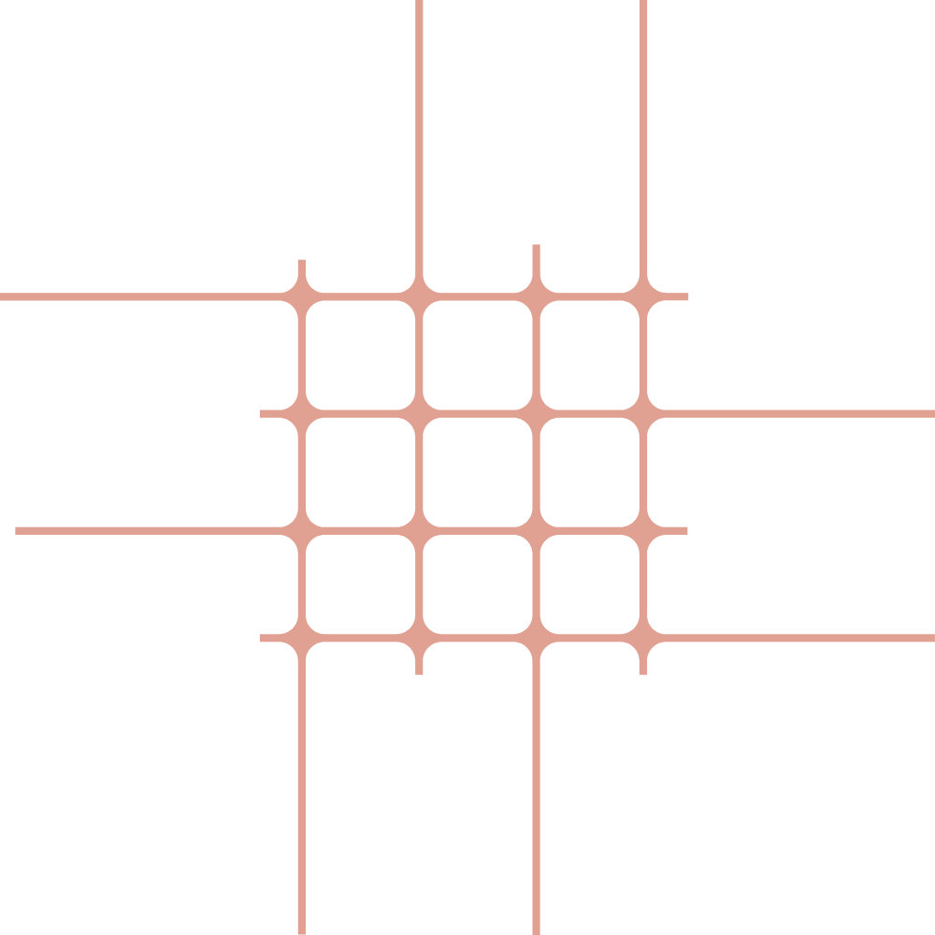

04 / 08
THE WAIT
3.6
years
The average time spent chasing a wrong diagnosis for a chronic skin condition. Flaking gets written off as dryness or product buildup while the actual cause goes untreated.

Slide 5
05 / 08
THE DIFFERENCE
Washing flakes away isn't the same as treating them
THE SHAMPOO AISLE
Lifts flakes off the surface. The yeast underneath stays.
PRESCRIPTION CARE
Targets the yeast and calms the inflammation it triggers.

Slide 6


06 / 08
OFTEN MISSED
On darker skin, it rarely looks like the textbook photos
Flaking can show up as lighter patches, ring-shaped spots, or irritation along the hairline. On deeper skin tones these signs get misread more often. Care should know what to look for.

Slide 7

SAVE THIS
The short version
1
Flakes that keep coming back are usually a yeast reaction, not dryness.
2
Shampoo manages the symptom. Treatment addresses the cause.
3
Darker skin shows different signs, and they get missed more often.
4
A provider can tell the difference from clear photos and history.
07 / 08

Slide 8

START HERE
08 / 08
Scalp care, reviewed by a licensed provider
Kyn Skyn connects patients with licensed providers who review photos and history online, then build a treatment plan. No waiting room.
MONTHLY CARE PLAN
$29.99
/ month
Provider review and treatment plan included. Check‑ins after.
Get a Kynsultation
kynskyn.com

