Slide 1
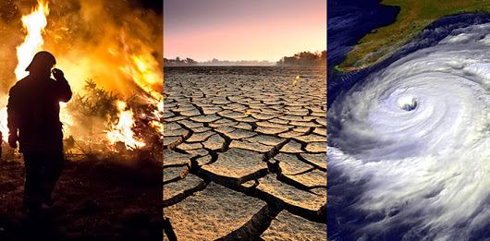
KAGGLE COMPETITION: EDSA CLIMATE CHANGE BELIEF ANALYSIS 2021

Slide 2
Classification_AE2_DSFT21
TEAM MEMBERS
Saveshnee Govender
Kiren Sewnath
Leon Smith (Leader)
Kwanda Silekwa
Mokitlana Rinkie Sekgobela
Thato Kgoale
Ali Elimam (Team Supervisor)

Slide 3
Introduction
Data science- scientific methods, processes, algorithms to extract knowledge.
Predict the sentiment of Tweets related to climate change for the specific Tweet ID.

Slide 4
Data cleaning
Inspection of Dataframes
Checked for missing and unique data.
Removal of Web-urls and punctuations
TweetTokenizer() was used to clean data for analysis.

Slide 5
Data cleaning cont…
Stemming and Lemmatization
Stopwords removal
Join Tokens

Slide 6
Data analysis (EDA)
Class Types
Tweets
Word Cloud
Word Frequency
Testing Data

Slide 7
More Data Cleaning
Keep only normal characters
Removal of punctuation
Tweet Tokeniser
Extraction of hashtags and mentions
Get title from urls

Slide 8
Revisit EDA/ Feature Engineering
Feature extraction
Pre-processing required
CountVectorizer
TfidfVectorizer
Train Test Split

Slide 9
The models tested
LR-Logistic Regression
RF- Random Forest
GBC-Gradient Boosting Classifier
XGB- XGBoost
(everyone please include the models you tested)

Slide 10
Results
Models | Accuracy | RSME
LR- Logistic Regression
RF- Random Forest
GBC- Gradient Boosting Classifier
XGB- XGBoost

Slide 11
Concluding remarks
What did we conclude based on the models we tested, which one did we chose to be the best and why.
The models tried and tested were Random Forest, Linear Regression and XGBoost algorithms.
It was concluded that the best model for the data sets used is XGBoost
99% accuracy
0.4 root mean error

Slide 12
Acknowledgements
Special thanks to Ali Elimam for his supervision over the team and his support and helpful recommendations through out the project.

Slide 13
THANK YOU

