Slide 1
Midterm prep
February 15, 2022

Slide 2
Pipelines
As per other exam topics, I will not ask you to write code, but you are expected to understand existing code.
What is there to know about pipelines?
Why we use them.
How they operate.

Slide 3
When did we introduce pipelines?
scaler = StandardScaler()
scaler.fit(X_train_toy)
train_scaled = scaler.transform(X_train_toy)
scaler = StandardScaler()
scaler.fit(X_test_toy)
test_scaled = scaler.transform(X_test_toy)
We saw other scenarios of poorly preprocessed data

Slide 4
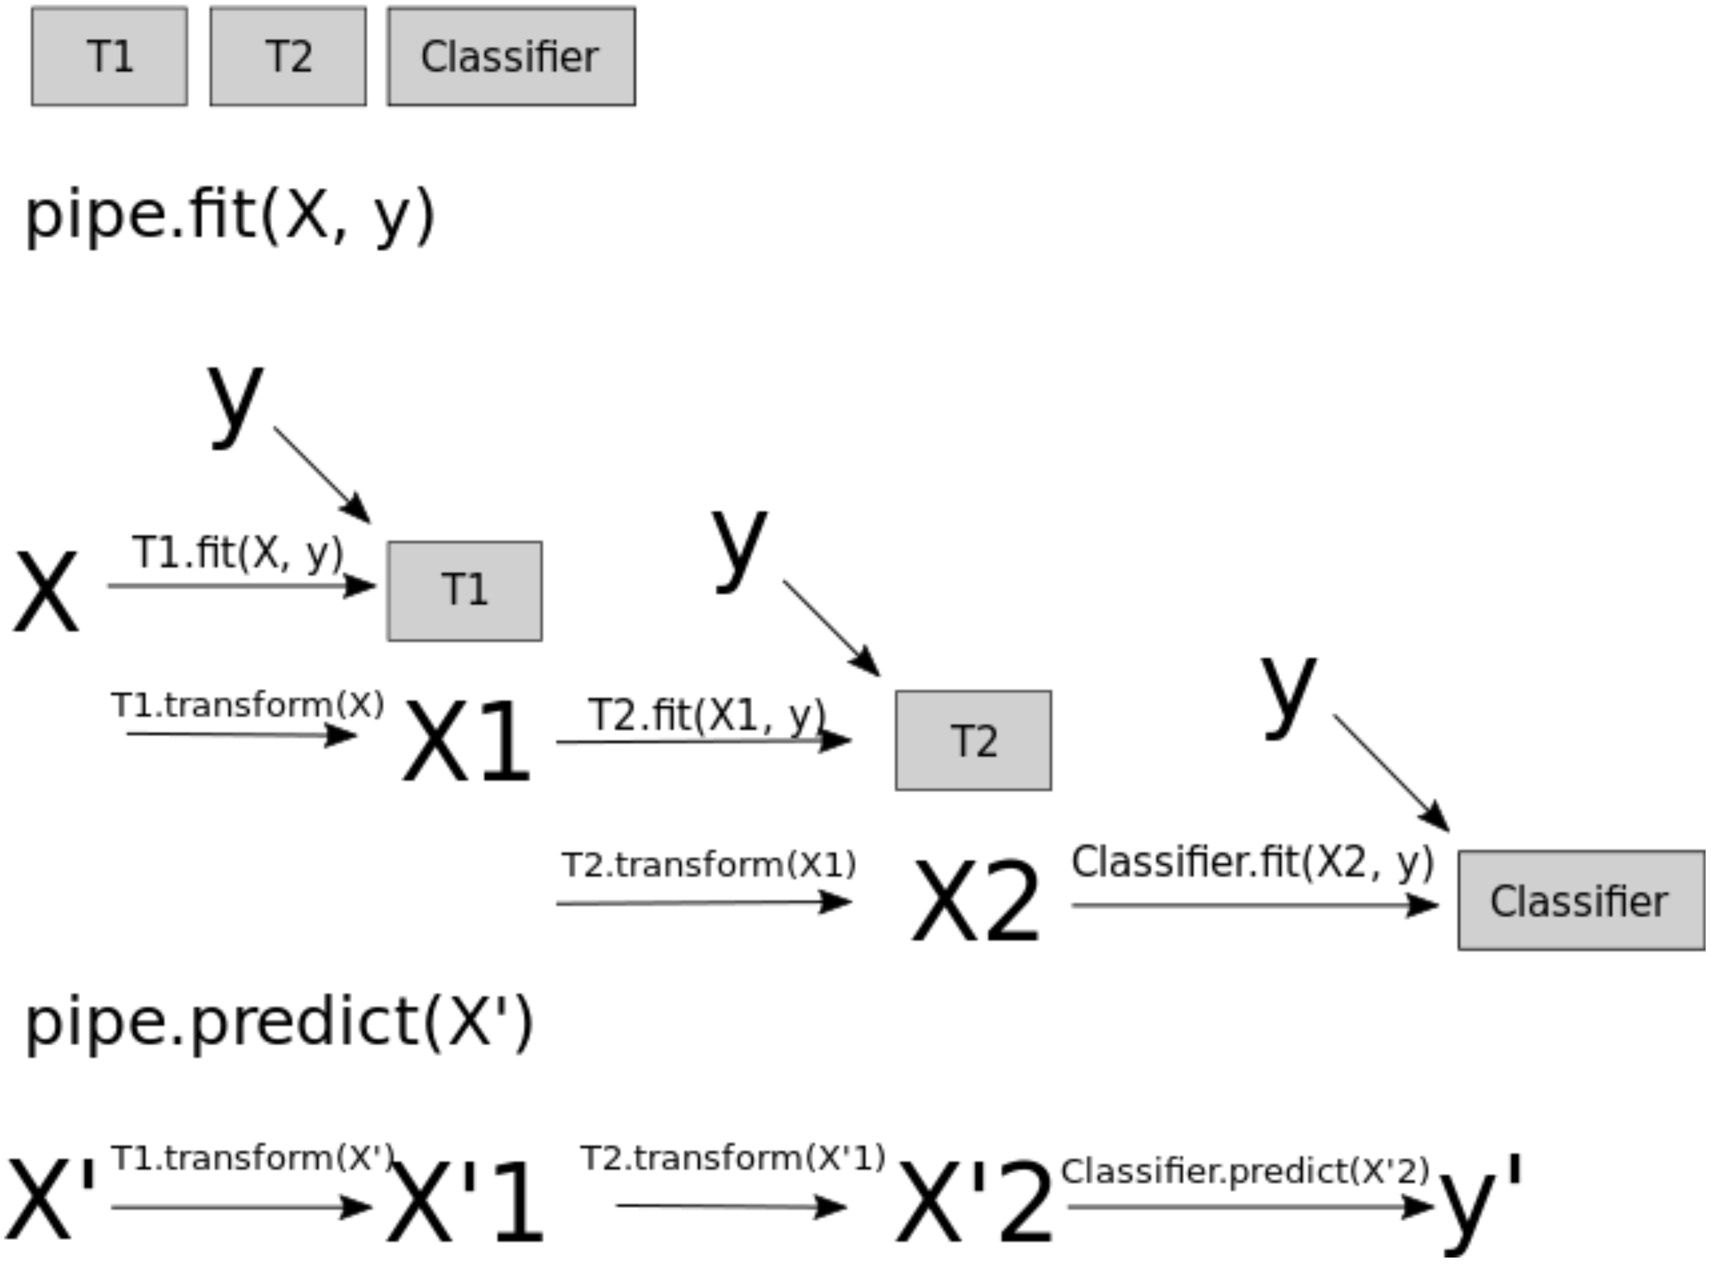
How do pipelines operate?
pipe = make_pipeline(
SimpleImputer(strategy="median"), StandardScaler(), KNeighborsRegressor())
pipe.fit(X_train, y_train)
pipe.predict(X_train)
pipe.predict(X_test)
cross_validate(pipe, X_train, y_train, cv = 5)

Slide 5
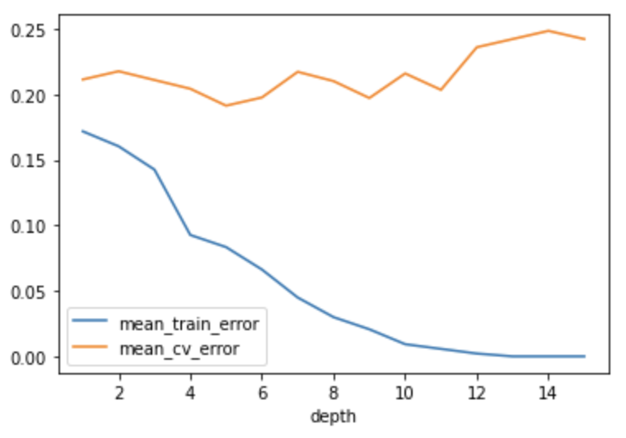
Hyperparameter tuning
Most (all) classifiers have hyperparameters that can be used to “regulate” learning.
The goal is to find good balance between over and underfitting
Can we do this without cross-validation?

Slide 6
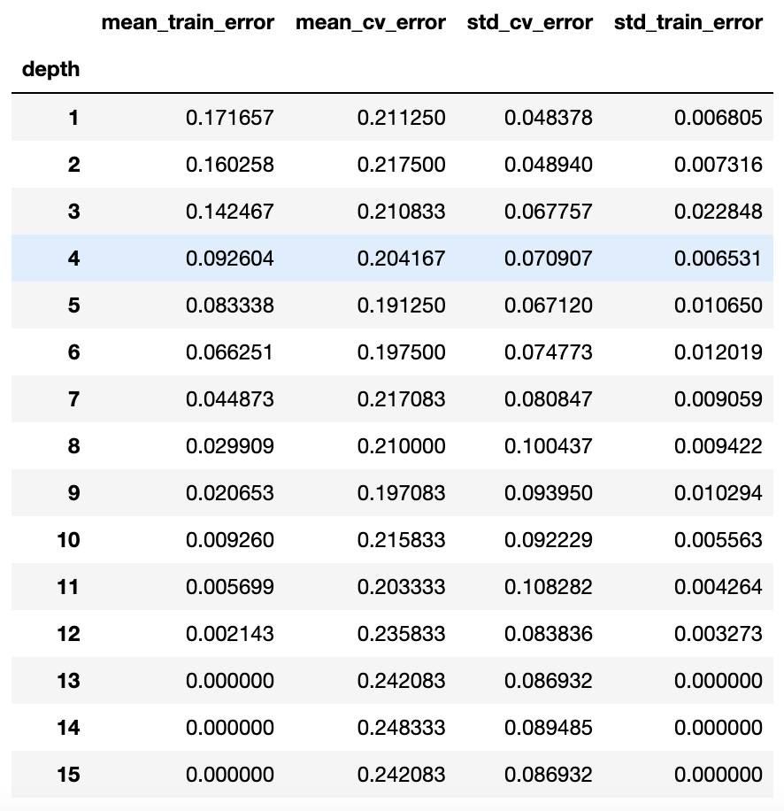
Hyperparameter tuning – 1 parameter
param_grid = {"max_depth": np.arange(1, 16)}
for depth in param_grid["max_depth"]:
model= DecisionTreeClassifier(max_depth=depth)
scores = cross_validate(model, X_train, y_train, cv=10, return_train_score=True)

Slide 7
Hyperparameter tuning – 2 or more parameters
Tuning more than 1 parameter is more challenging because:
The optimal parameter combination may not match the values obtained when optimizing 1 parameter at the time
It is computationally costly
Solutions: GridSearchCV and RandomizedSearchCV

Slide 8
GridSearchCV
pipe_svm = make_pipeline(StandardScaler(), SVC(gamma=0.1))
param_grid = {
"svc__gamma": [0.001, 0.01, 0.1, 1.0, 10, 100],
"svc__C": [0.001, 0.01, 0.1, 1.0, 10, 100],
}
grid_search = GridSearchCV(
pipe_svm, param_grid, cv=5, n_jobs=-1, return_train_score=True
)
grid_search.fit(X_train, y_train)

Slide 9
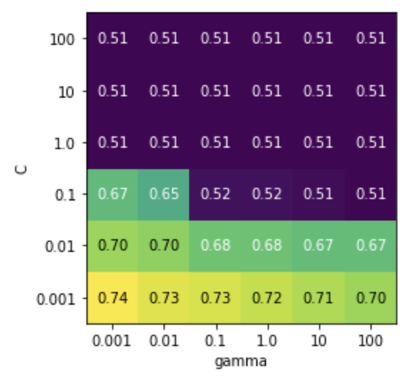
Heatmap
scores = np.array(results.mean_test_score).reshape(6, 6)
# plot the mean cross-validation scores
mglearn.tools.heatmap(
scores,
xlabel="gamma",
xticklabels=param_grid["svc__gamma"],
ylabel="C",
yticklabels=param_grid["svc__C"],
cmap="viridis",
);

Slide 10
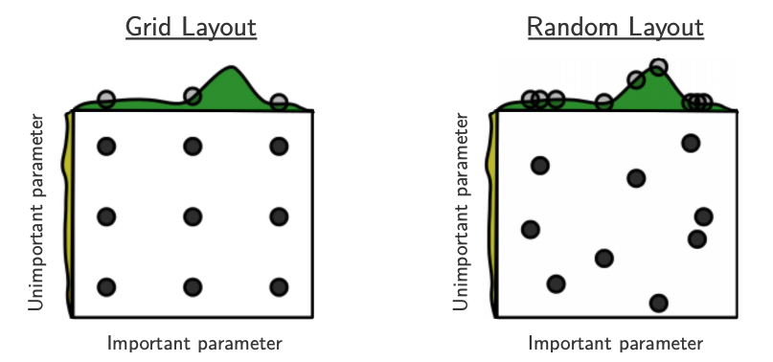
Things to consider when using GridSearchCV
Hyperparameters range
Computational cost
If one (or more) hyperparameter is not helping the score, we waste a lot of time changing it and we gain nothing

Slide 11
RandomizedSearchCV
Can produce more interesting results thanks to the less rigid way used to explore combinations of hyperparameters
I can control the exact number of iterations
param_grid = {
"svc__gamma": [0.001, 0.01, 0.1, 1.0, 10, 100],
"svc__C": [0.001, 0.01, 0.1, 1.0, 10, 100],
}
random_search = RandomizedSearchCV(
pipe_svm, param_distributions=param_grid, n_jobs=-1,
n_iter=10, cv=5)

Slide 12
RandomizedSearchCV
Even better, I can use hyperparameter distributions instead of exact values:
param_dist = {
"svc__C": uniform(0.1, 1e4),
"svc__gamma": loguniform(1e-5, 1e3),
}

Slide 13
Optimization bias/Overfitting of the validation set
Typically a problem caused by small datasets
If the validation set is small, it has its own generalization problems: the best hyperparameters found here are not reflective of the best hyperparameter for the problem
This is made worse by trying many models and many different combinations of hyperparameters → one of them may get lucky

Slide 14
Example
Consider a multiple-choice (a,b,c,d) "test" with 10 questions:
If you choose answers randomly, expected grade is 25% (no bias).
If you fill out two tests randomly and pick the best, expected grade is 33%.
Optimization bias of ~8%.
If you take the best among 10 random tests, expected grade is ~47%.
If you take the best among 100, expected grade is ~62%.
If you take the best among 1000, expected grade is ~73%.
If you take the best among 10000, expected grade is ~82%.
You have so many "chances" that you expect to do well.
But on new questions the "random choice" accuracy is still 25%.

Slide 15
Final Exercise!
Think of a question/topic (make it specific)
Turn to your neighbor and ask! They have 3 minutes to answer
Switch roles
Give each other feedback
Did you understand their answer?
Do you think it was complete?
Did they use the correct vocabulary?

