Slide 1
Calibration & Scan Process

Slide 2
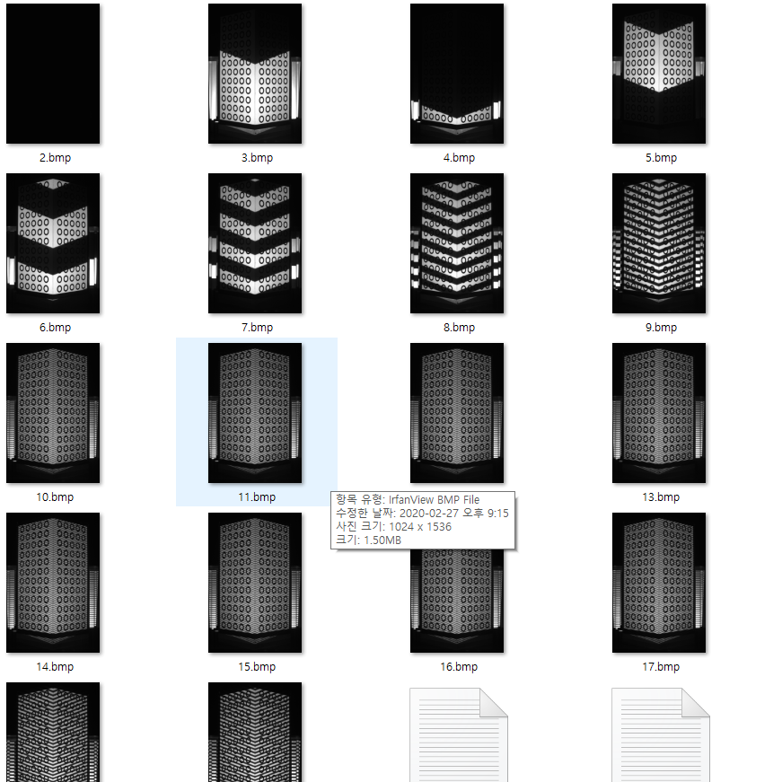
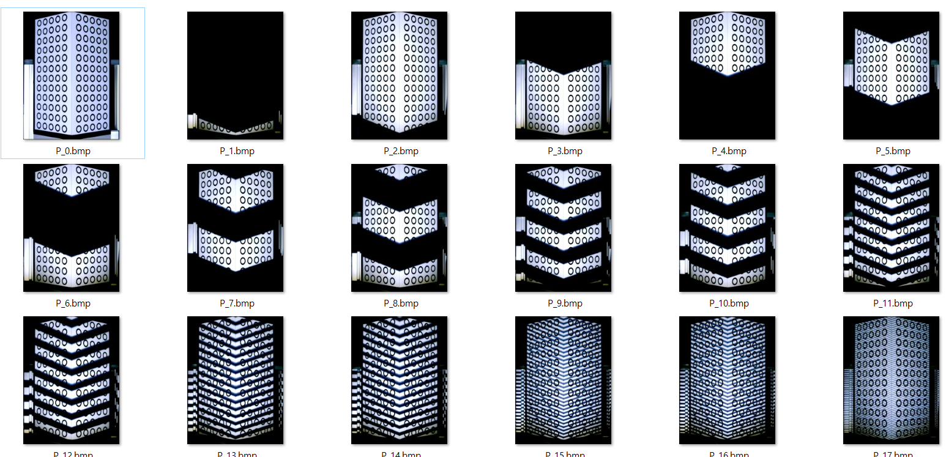
calibration pattern and scan pattern
모든 것에 대하여 reverse pattern
but, 캘리브레이션에 대해서도 왼쪽과 같은 shift 패턴 투사..
현재는 shift pattern

Slide 3
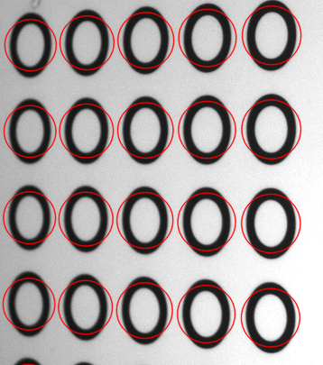
Camera Calibration
Circle Pattern Detection Made Simplified and Robust
지금까지는 Calibration Pattern 찍을 때 상당한 어려움
새로운 버전에서는 서클만 가려지지 않게 잘 나오게 찍으면 됨. 최신 OpenCV Blob detection 이용
CCalibration::DetectCirclePoints

Slide 4
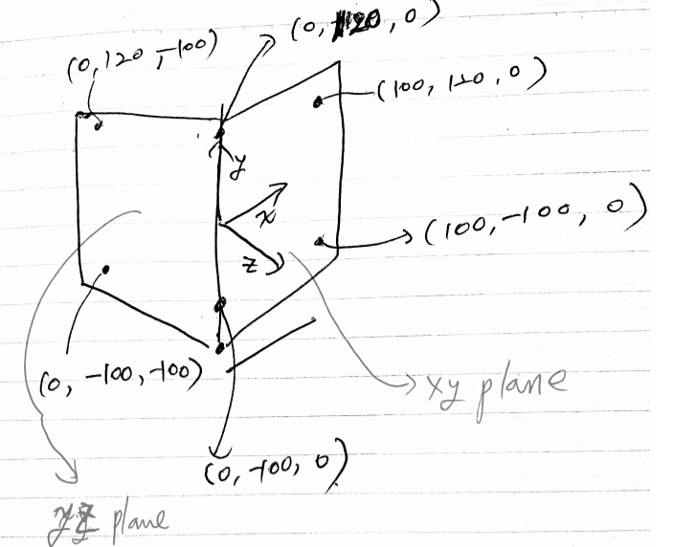
From Calibration board
x,y,z and x,y pairs
calibrate it!
calibration board

Slide 5
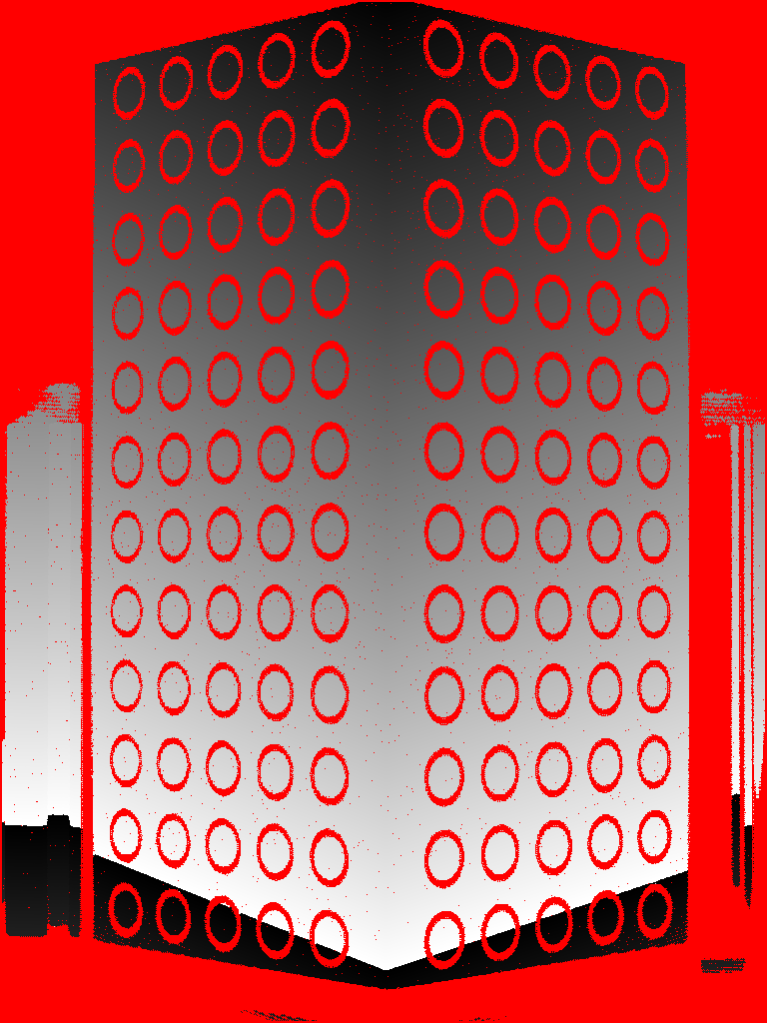
Camera Pose
Once we know camera pose everything gets easy
We know calibration objects’ planes
We get projector grey code from camera images
this is projector’s stripe address
yz plane
xy plane

Slide 6
Camera Pose
Once we know camera pose everything gets easy
We know calibration objects’ planes
We get projector grey code from camera images
extract lines with same grey code,
and project the points onto yz or xy plane and compute the “stripe plane”

Slide 7
We can easily approximate camera pose and focal length and internal parameters(Distortions too)
Therefore, you should always undistort the input image
void CCalibration::undistort_image(QImage& im)
camera.txt Camera’s Pose
0.701142 -0.002597 0.713017
-0.017472 -0.999756 0.013539
0.712808 -0.021951 -0.701016
-441.541125 38.085340 434.280902
camera orientation
camera position
camera_intrinsic.txt
1024 1536 camera resolution
512.000000 768.000000 cx, cy
3307.802459 3307.802459 fx, fy
-0.156038 0.000000 0.000000 0.000000 0.000000 0.000000 K1, K2, K3…

Slide 8
projector.txt
First Stripe
위치 18.311430 97.648375 0.000000
방향 -0.015376 -0.572585 -0.819701
방향 0.363095 -0.767032 0.528984
각도 0.023761
second Stripe
angle
프로젝터 calibration
회전축

Slide 9
Optimization (Bundle Adjustment)
3차원 object: (x, y, z) on calibration board
projector code (x, 0)
z축
800x600의 400 번째 stripe
이전 plane 구조로 projector camera(pcamera) 초기화. angle은 focal length와 연관
pcamera의 pose와 focal length를 varying 하면서 reprojector 에러를 최소화
x축
y축 (projector)

