Slide 1
ML Final Project : Ames Housing Prices Prediction and Classification
Kwanyu Kim
Byungheon Kim
Notes:
Hello, everyone. I’m Jeongseok Lee and a PhD student at Robotics Lab in Seoul National University.
Today, my talk is about dynamics simulations for multibody systems.

Slide 2
1. Data Preprocessing
Continuous & Discrete
Nothing to do (except normalization)
Ordinal
Categorical & Ordered
Assign integers 1,2,3 … Discrete variables
Nominal
Categorical & not ordered
Assigning integers doesn’t make sense
Make dummy variables !
1 nominal variable Several binary variables
NA : fill up with the mean values of each column
Normalization
Neural Network : min/max scaler [0,1]
PCA : Normal Distribution

Slide 3
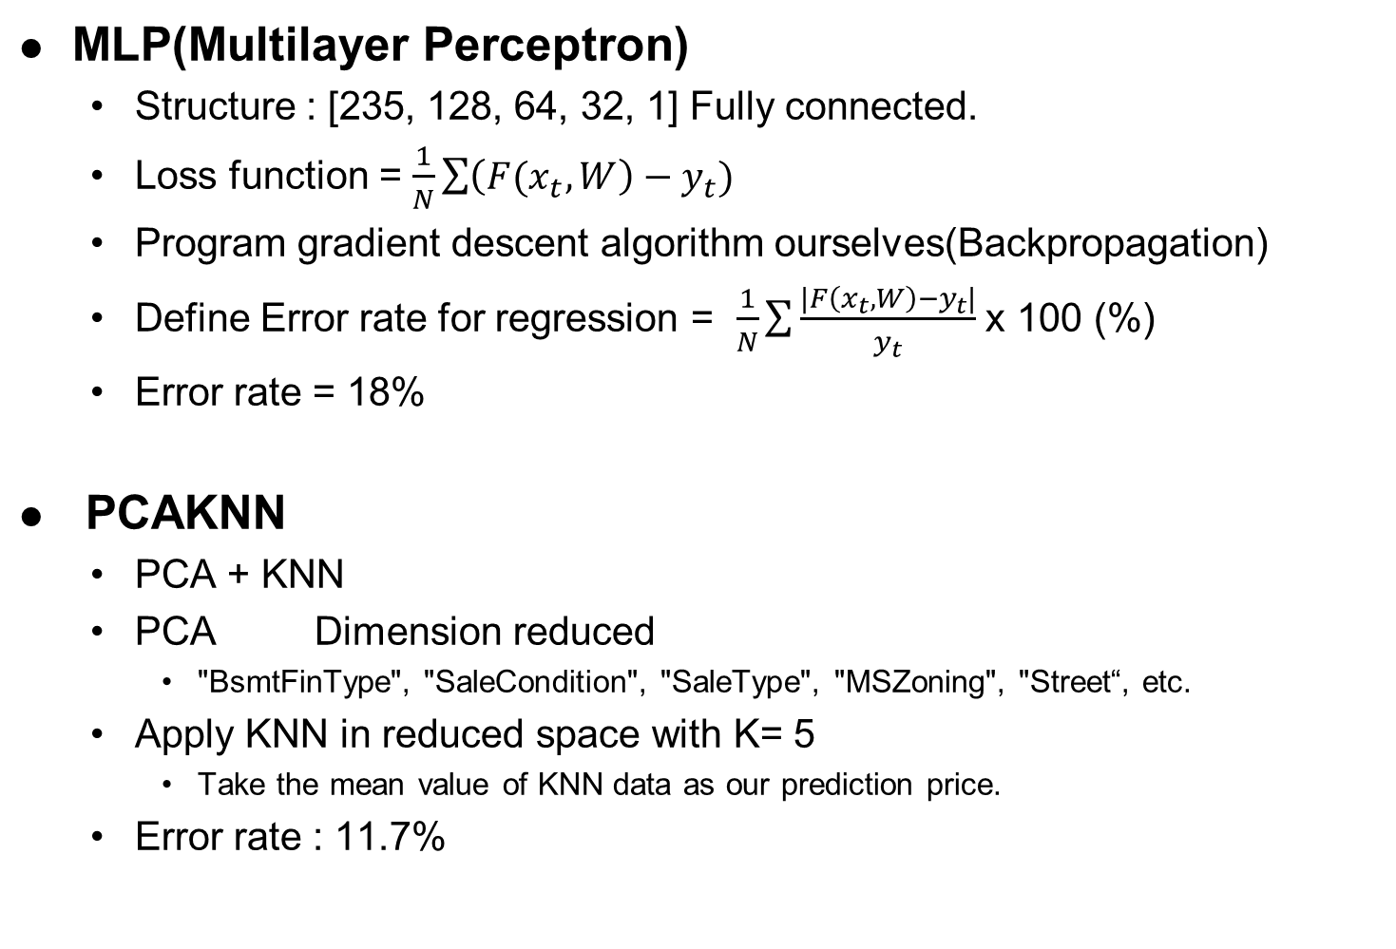
2. Price Prediction
MLP(Multilayer Perceptron)
Structure : [235, 128, 64, 32, 1] Fully connected.
Loss function = $\frac{1}{N}\sum{\left({F(x}_{t},W\right)−y_{t})}$
Program gradient descent algorithm ourselves(Backpropagation)
Define Error rate for regression = $\frac{1}{N}\sum{\frac{|F\left(x_{t},W\right)−y_{t}|}{y_{t}}}$ x 100 (%)
Error rate = 18%
PCAKNN
PCA + KNN
PCA Dimension reduced
"BsmtFinType", "SaleCondition", "SaleType", "MSZoning", "Street“, etc.
Apply KNN in reduced space with K= 5
Take the mean value of KNN data as our prediction price.
Error rate : 11.7%

Slide 4
2. Price Prediction
Why PCAKNN works better?
Housing price : not high complexity.
Highly Depends on several variables(YearBuilt, LotArea, SaleCondition, etc.)
MLP may raise overfitting problem
PCA works better.
Self Performance Check w/o test data
K-fold Cross Validation
K=10
Error rate stabilized.
MLP : 14~23% fluctuating w/o K-fold
By K-fold, stabilized at 18%

Slide 5
3. Price range classification
MLP
Use softmax cross entropy cost function.
Use the same structure as classification
Error rate : 14% (w/o ensemble)
PCAKNN
PCA + KNN
PCA Dimension reduced
"BsmtFinType", "SaleCondition", "SaleType", "MSZoning", "Street“, etc.
Apply KNN in reduced space with K= 5
Take majority vote in KNN data.
Error rate : 11% (w/o ensemble)

Slide 6
3. Price range classification
Ensemble
Use k-fold Cross Validation
Generate k different training data set.
K different trained models.
Reduce the variance
Less noisy than the single model
Raise performance by computing more.
Error rate : MLP (9%), PCAKNN(7%)

