Slide 1
Priority Queues
서승현 교수
Prof. Anes Seung-Hyun Seo
(seosh77@hanyang.ac.kr)
Division of Electrical Engineering
Hanyang University, ERICA Campus

Slide 2
Where we are ?
Graph
Tree
Binary Tree
Binary Search Tree
AVL Search Tree
Heap
Notes:
Before starting today class, Let's see what we have learned.

Slide 3
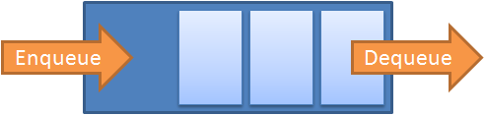
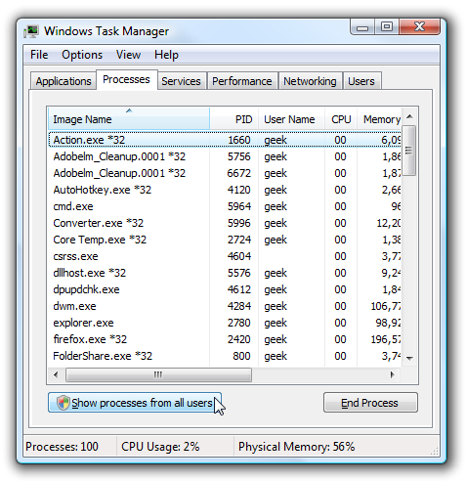
Queue
FIFO queue
Elements are served by order of arrival
No priority among elements
What if there are priorities?

Slide 4
Priority Queues
Priority queue
A collection of elements such that each element has an associated priority.
(priority = key, content)
Similar to dictionary
Lower/higher keys(min-heap/max-heap) represent higher priorities
Operations
Insert
Find/Remove min or max key
 | 13, John | 9, Mary | 3, Mike
Insert (5, Alex)
13, John | 9, Mary | 5, Alex | 3, Mike

Slide 5

Example – Priority Queues
Emergency room
What if patients are served based on a FIFO queue?
(key = waiting time)
Average waiting time
(90 + 115 + 155 + 170)/4 = 132.5
15, John | 40, Mary | 25, Alex | 90, Mike

Slide 6
Example – Priority Queues
Emergency room
Priority queue
Patients with less waiting time are served first
Average waiting time
(15 + 40 + 80 + 170)/4 = 76.25
This can be preferable
90, Mike | 40, Mary | 25, Alex | 15, John

Slide 7
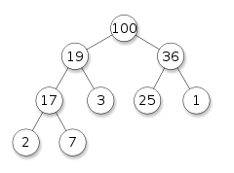
Priority Queues
Implemented based on “heap”
Heap is a tree-based structure.
A heap is a binary tree whose left and right subtrees have values less(max-heap)/greater (min-heap) than or equal to their parents.
Min heap
Keys of parents ≤ those of children
Max heap
Keys of parents ≥ those of children
Max heap

Slide 8
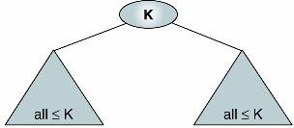
Heap
Heap: a binary tree structure with the properties …
[Rule 1] The tree is complete.
[Rule 2] The key value of each node is greater than or equal to the key value in each of its descendants (MAX heap)
Cf. MIN heap: key value of each node is less than or equal to the key value in each of its descendants.
<MAX heap>
Notes:
Which point is different from the binary search tree?

Slide 9
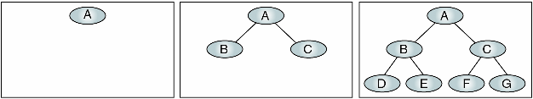
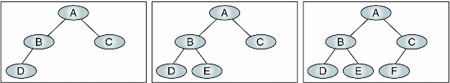
Complete Binary Tree (review)
Full binary tree: a tree with the maximum # of entries for its height
Complete binary tree: a tree that has minimum height for its nodes and all nodes in the last level are found on the left

Slide 10

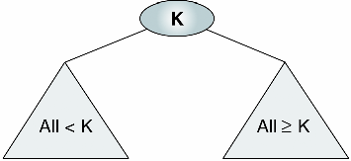

Heap
Heap vs. binary search tree
The lesser-valued nodes of a heap can be placed on either the right or the left subtree.
$$>$$
Heap
Binary search tree

Slide 11
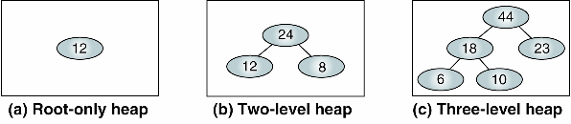
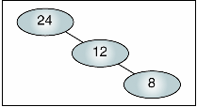
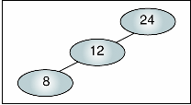
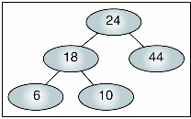
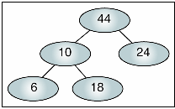
Examples of Heaps
Heaps
Invalid heaps (Why?)

Slide 12
Why Heap?
Heap is efficient for extraction of the largest (or smallest) element.
Compromise of sorted and unsorted structures
Sorted structures (array or linked-list)
Very efficient in extraction of largest (smallest) element
Inefficient in insertion
Unsorted structures (array or linked-list)
Inefficient in extraction of largest (smallest) element
Very efficient in insertion
Heap is efficient for both insertion and deletion

Slide 13
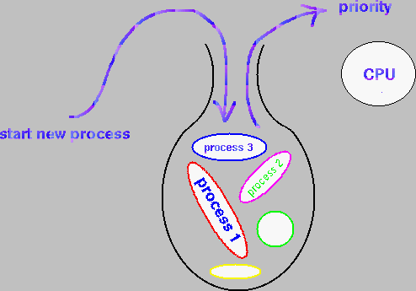
Heap and Priority Queue
Priority queue: a variation of queue
Add an element to the queue with an associated priority
Remove element with the highest priority and return it
Heap is an excellent structure to implement priority queue

Slide 14
Priority Queue ADT
∙Object : a collection of elements with a priority of type n elements
∙Operation :
▪ create() ::= create a priority queue
▪ init(q) ::= initialize a priority queue q
▪ is_empty(q) ::= check if a priority queue q is empty
▪ is_full(q) ::= check if a priority queue q is full.
▪ insert(q, x) ::= insert an element x in a priority queue q
▪ delete(q) ::= delete the highest priority element and return it
▪ find(q) ::= Return the highest priority element

Slide 15
Priority Queue ADT
The most important operation: insert, delete
Priority Queue
Min priority queue
Max priority queue

Slide 16
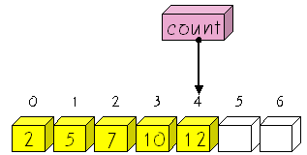

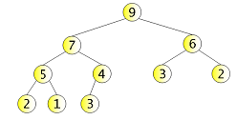
Representation for priority queue
Array
Linked list
Heap

Slide 17
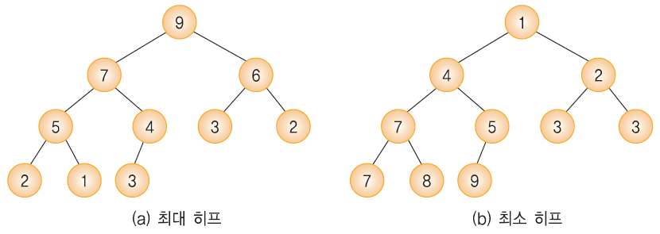
Heap
A heap is a complete binary tree in which the keys stored by the nodes satisfy the following properties:
Max heap
A complete binary tree where the key value of the parent node is greater than or equal to the key value of the child node
key(parent node) ≥ key(child node)
Min heap
A complete binary tree where the key value of the parent node is less than or equal to the key value of the child node
key(parent node) ≤ key(child node)
Max heap
Min heap

Slide 18
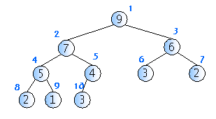
Heap
The height of heap with n nodes: O(logn)
Heap is a complete binary tree.
Except the last level, h, each i level has 2^{i-1} nodes.
Level the number of nodes
1 1=2⁰
2 2=2¹
3 4=2²
4 3

Slide 19
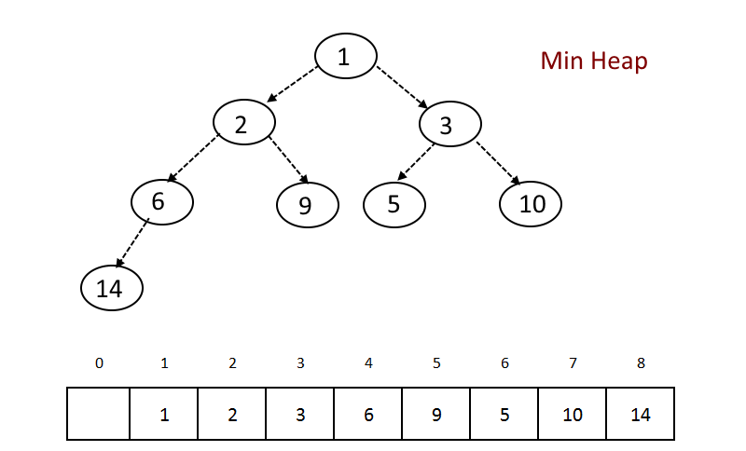

Binary heap as array
How to access parents/children?
First element of the array is empty
The i^{th} node: Left child will be 2i
Right child will be 2i+1
Parent will be $\left\lfloor i/2\right\rfloor$

Slide 20
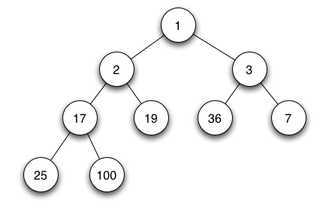
Binary Heap
Get the minimum element
Simply output the root node

Slide 21
Min-heap operation
Important operations
Insertion
Deletion
Problem: preserving conditions of min heap
1. Complete tree
2. Key value of each node should be no bigger than those of children

Slide 22
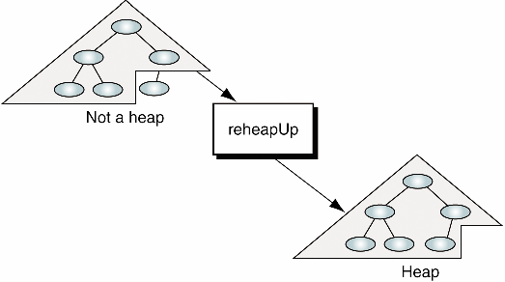
Insertion into heap
Inserting a node into heap
1. Insert the node to heap
To preserve 1st condition, the new node should be added at the last leaf level at the first empty position
2nd condition could be broken
2. Repair the structure so that 2nd condition is satisfied
ReheapUp

Slide 23
Binary Heap : Operations
Insert a new element
1. place it at the bottom level, as left as possible
(why?)
1
3
8
10
6
25
40
20
15
2

Slide 24
Binary Heap : Operations
Insert a new element
2. exchange the nodes until the minimum heap property is satisfied
1
1
3
2
10
2
10
3
20
15
6
20
15
6
Exchange 1
Exchange 2

Slide 25
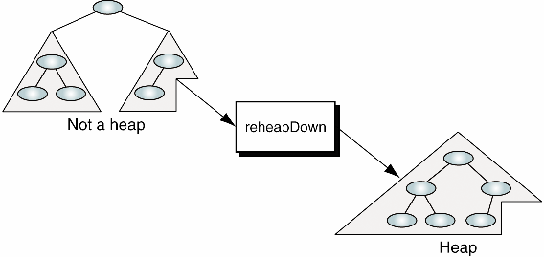
Deletion from heap
Deleting a node from heap
1. Deletion always occurs at the root
To preserve 1st condition, the last node should move to the root
2nd condition could be broken
2. Repair the structure so that 2nd condition is satisfied
ReheapDown

Slide 26
Binary Heap : Operations
Remove the minimum element
1. exchange the root with the right-most node in the bottom level (why?)
1
3
8
10
6
25
40
20
15
17

Slide 27
Binary Heap : Operations
Remove the minimum element
2. exchange the root with the minimum of its children
(why not the entire subtrees but the children?)
17
3
← 3 < 8 →
8
10
6
25
40
20
15

Slide 28
Binary Heap : Operations
Remove the minimum element
3. Repeat the process until the min-heap property is satisfied
3
3
17
6
10
← 10 > 6 →
6
10
17
20
15
20
15

Slide 29
Heap implementation
Heap can be represented as the one dimensional array.
Elements of heap: one dimensional array of structure
heap_size: the number of elements
#define MAX_ELEMENT 200
typedef struct {
int key;
} element;
typedef struct {
element heap[MAX_ELEMENT];
int heap_size;
} HeapType;

Slide 30
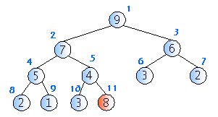
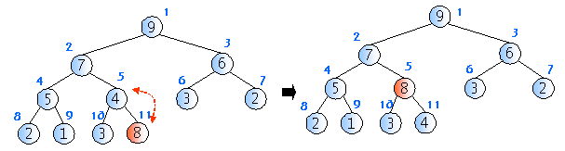
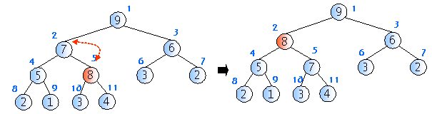
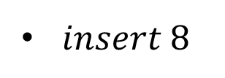
Example of insertion
$insert 8$
(1)
(2)
(3)

Slide 31
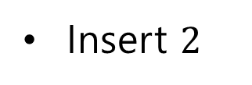
Example of insertion
Insert $2$
31

Slide 32
MAX-heap insertion
insert_max_heap(A, key)
heap_size ← heap_size + 1; //힙의 크기 증가
i ← heap_size; //증가된 힙 크기 위치에 새로운 노드삽입
A[i] ← key;
while i ≠ 1 and A[i] > A[PARENT(i)] do //i가 루트 노드가 아니고, i번째 노드
// 가 i의 부모 노드보다 크면
A[i] ↔ A[PARENT]; //i번째 노드와 부모노드 교환
i ← PARENT(i); // 한 레벨 위로 올라함

Slide 33
Max-heap insertion
// 현재 요소의 개수가 heap_size인 힙 h에 item을 삽입한다.
// 삽입 함수
void insert_max_heap(HeapType *h, element item)
{
int i;
i = ++(h->heap_size);
// 트리를 거슬러 올라가면서 부모 노드와 비교하는 과정
while((i != 1) && (item.key > h->heap[i/2].key)) {
h->heap[i] = h->heap[i/2];
i /= 2;
}
h->heap[i] = item; // 새로운 노드를 삽입
}

Slide 34
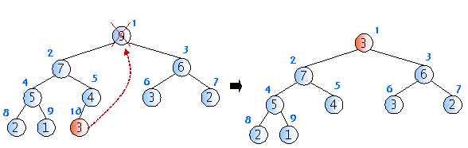
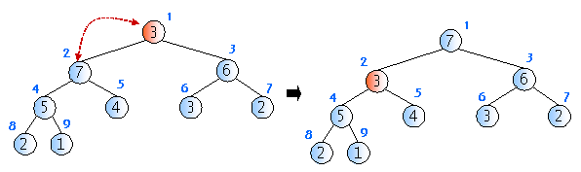
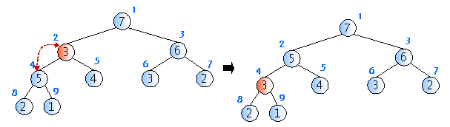
Heap delete
Time complexity of heap delete operation :
→ O(logn)

Slide 35
Heap delete
35

Slide 36
MAX-Heap delete
delete_max_heap(A)
item ← A[1];
A[1] ← A[heap_size];
heap_size←heap_size-1;
i ← 2;
while i ≤ heap_size do
if i < heap_size and A[i+1] > A[i] //(왼쪽자식과 오른쪽자식 비교)
then largest ← i+1; //오른쪽 자식이 더 크면
else largest ← i; // 왼쪽 자식이 더 크면
if A[PARENT(largest)] > A[largest]//largest의 부모 노드가
//largest보다 더 크면
then break;
A[PARENT(largest)] ↔ A[largest]; //서로 교환
i ← CHILD(largest); //한 레벨 밑으로 내려감
return item; // 최대값 반환

Slide 37
MAX-heap delete
// 삭제 함수
element delete_max_heap(HeapType *h)
{
int parent, child;
element item, temp;
item = h->heap[1];
temp = h->heap[(h->heap_size)--];
parent = 1;
child = 2;
while( child <= h->heap_size ) {
// 현재 노드의 자식노드중 더 작은 자식노드를 찾는다.
if( ( child < h->heap_size ) &&
(h->heap[child].key) < h->heap[child+1].key)
child++;
if( temp.key >= h->heap[child].key ) break;
// 한단계 아래로 이동
h->heap[parent] = h->heap[child];
parent = child;
child *= 2;
}
h->heap[parent] = temp;
return item;
}

Slide 38
Heap complexity
In the worst case of insert operations, we need to go up to the root node, so we need comparison and shift operations corresponding to the height of the tree. → O(logn)
In the worst case, the deletion also has to go down to the lowest level, so it takes time as much as the height of the tree. →O(logn)

Slide 39
Complexity Comparison
Fast max or min operation
Logarithmic complexity for other operations
 | Array (unsorted) | Linked list | Array (sorted) | Binary heap
Search | O(n) | O(n) | O(log n) | O(log n)
Insert | O(1) | O(1) | O(n) | O(log n)
Remove | O(n) | O(n) | O(n) | O(log n)
Max/min | O(n) | O(1) | O(n) | O(1)

