Slide 1
Java Security Manager Reloaded
Josef Cacek
Senior Quality Engineer
Red Hat / JBoss

Slide 2
Agenda
Java Security Manager
  quickstart
  issues
Reloaded
  there is an easier way
  pro-grade library

Slide 3
Do you run
?

Slide 4
Do you run
Java Applications
?

Slide 5
You should be affraid
You are treatened!

Slide 6

Threats
bugs in libraries
  lazy programmers
hidden features
  evil programmers
man-in-the-middle
  The Hackers

Slide 7
Java has a solution

Slide 8
Java Security Manager (JSM)
checks if the caller has permissions
to run protected actions.

Slide 9
Terminology
Sensitive code
Security Manager
extends java.lang.SecurityManager
Policy
extends java.security.Policy
Permissions
extends java.security.Permission
Notes:
JSM enforces permissions defined by you as an application administrator.

Slide 10
Example: Sensitive code calling JSM
SecurityManager sm = System.getSecurityManager();
if (sm != null)
sm.checkPermission(
new org.jboss.SimplePermission("getCache"));

Slide 11
Example: Sensitive code calling JSM
SecurityManager sm = System.getSecurityManager();
if (sm != null)
sm.checkPermission(
new org.jboss.SimplePermission("getCache"));
AccessControl
Exception

Slide 12
Policy
keeps which protected actions are allowed
  No action by default
defined in policy file
grant entries assigns Permissions to
  code path [codeBase]
  signed classes [signedBy]
  authenticated user [principal]

Slide 13
Example: Policy file
keystore "/opt/redhat.keystore";
grant {
permission java.io.FilePermission "/tmp/-", "read,write";
};
grant codeBase "file:${jboss.home.dir}/jboss-modules.jar" {
permission java.lang.RuntimePermission "getStackTrace";
permission java.util.PropertyPermission "*", "read,write";
};
grant signedBy "jboss" {
permission java.security.AllPermission;
};

Slide 14
Example: Policy file
keystore "/opt/redhat.keystore";
grant {
permission java.io.FilePermission "/tmp/-", "read,write";
};
grant codeBase "file:${jboss.home.dir}/jboss-modules.jar" {
permission java.lang.RuntimePermission "getStackTrace";
permission java.util.PropertyPermission "*", "read,write";
};
grant signedBy "jboss" {
permission java.security.AllPermission;
};

Slide 15
Example: Policy file
keystore "/opt/redhat.keystore";
grant {
permission java.io.FilePermission "/tmp/-", "read,write";
};
grant codeBase "file:${jboss.home.dir}/jboss-modules.jar" {
permission java.lang.RuntimePermission "getStackTrace";
permission java.util.PropertyPermission "*", "read,write";
};
grant signedBy "jboss" {
permission java.security.AllPermission;
};

Slide 16
Example: Policy file
keystore "/opt/redhat.keystore";
grant {
permission java.io.FilePermission "/tmp/-", "read,write";
};
grant codeBase "file:${jboss.home.dir}/jboss-modules.jar" {
permission java.lang.RuntimePermission "getStackTrace";
permission java.util.PropertyPermission "*", "read,write";
};
grant signedBy "jboss" {
permission java.security.AllPermission;
};

Slide 17
Permission
represents access right to a protected action
has a type and target
may have actions
java.lang.AllPermission
  unrestricted access to all resources
  automatically granted to system classes

Slide 18
Example: Read a file
App [app.jar] → Utils [app-lib.jar]→ FileReader(“/etc/passwd”)

Slide 19
Example: Read a file
App [app.jar] → Utils [app-lib.jar]→ FileReader(“/etc/passwd”)
Exception in thread "main" java.security.AccessControlException:
access denied ("java.io.FilePermission" "/etc/passwd" "read")
at java.security.AccessControlContext.checkPermission(AccessControlContext.java:372)
at java.security.AccessController.checkPermission(AccessController.java:559)
at java.lang.SecurityManager.checkPermission(SecurityManager.java:549)
at java.lang.SecurityManager.checkRead(SecurityManager.java:888)
at java.io.FileInputStream.<init>(FileInputStream.java:135)
at java.io.FileInputStream.<init>(FileInputStream.java:101)
at java.io.FileReader.<init>(FileReader.java:58)
at org.jboss.shared.Utils.getUserListInternal(Utils.java:36)
at org.jboss.shared.Utils.getUsersList(Utils.java:28)
at org.jboss.test.App.run(App.java:35)
at org.jboss.test.App.main(App.java:28)

Slide 20
Example: Read a file
App [app.jar] → Utils [app-lib.jar]→ FileReader(“/etc/passwd”)
Exception in thread "main" java.security.AccessControlException:
access denied ("java.io.FilePermission" "/etc/passwd" "read")
at java.security.AccessControlContext.checkPermission(AccessControlContext.java:372)
at java.security.AccessController.checkPermission(AccessController.java:559)
at java.lang.SecurityManager.checkPermission(SecurityManager.java:549)
at java.lang.SecurityManager.checkRead(SecurityManager.java:888)
at java.io.FileInputStream.<init>(FileInputStream.java:135)
at java.io.FileInputStream.<init>(FileInputStream.java:101)
at java.io.FileReader.<init>(FileReader.java:58)
at org.jboss.shared.Utils.getUserListInternal(Utils.java:36)
at org.jboss.shared.Utils.getUsersList(Utils.java:28)
at org.jboss.test.App.run(App.java:35)
at org.jboss.test.App.main(App.java:28)

Slide 21
Example: Read a file
App [app.jar] → Utils [app-lib.jar]→ FileReader(“/etc/passwd”)
Exception in thread "main" java.security.AccessControlException:
access denied ("java.io.FilePermission" "/etc/passwd" "read")
at java.security.AccessControlContext.checkPermission(AccessControlContext.java:372)
at java.security.AccessController.checkPermission(AccessController.java:559)
at java.lang.SecurityManager.checkPermission(SecurityManager.java:549)
at java.lang.SecurityManager.checkRead(SecurityManager.java:888)
at java.io.FileInputStream.<init>(FileInputStream.java:135)
at java.io.FileInputStream.<init>(FileInputStream.java:101)
at java.io.FileReader.<init>(FileReader.java:58)
at org.jboss.shared.Utils.getUserListInternal(Utils.java:36)
at org.jboss.shared.Utils.getUsersList(Utils.java:28)
at org.jboss.test.App.run(App.java:35)
at org.jboss.test.App.main(App.java:28)

Slide 22
Example: Read a file
App [app.jar] → Utils [app-lib.jar]→ FileReader(“/etc/passwd”)
Exception in thread "main" java.security.AccessControlException:
access denied ("java.io.FilePermission" "/etc/passwd" "read")
at java.security.AccessControlContext.checkPermission(AccessControlContext.java:372)
at java.security.AccessController.checkPermission(AccessController.java:559)
at java.lang.SecurityManager.checkPermission(SecurityManager.java:549)
at java.lang.SecurityManager.checkRead(SecurityManager.java:888)
at java.io.FileInputStream.<init>(FileInputStream.java:135)
at java.io.FileInputStream.<init>(FileInputStream.java:101)
at java.io.FileReader.<init>(FileReader.java:58)
at org.jboss.shared.Utils.getUserListInternal(Utils.java:36)
at org.jboss.shared.Utils.getUsersList(Utils.java:28)
at org.jboss.test.App.run(App.java:35)
at org.jboss.test.App.main(App.java:28)

Slide 23
JSM quickstart
set java.security.manager system property
  no value → default implementation
  class name → custom SecurityManager implementation
set java.security.policy system property
  path to text file with permission mappings
set java.security.debug system property (optional)

Slide 24
Example: Run Application with JSM enabled
java \
-Djava.security.manager \
-Djava.security.policy=/opt/jEdit/jEdit.policy \
-Djava.security.debug=access:failure \
-jar /opt/jEdit/jedit.jar /etc/passwd

Slide 25
Protect your systems
Use Java Security Manager!

Slide 26
However ...

Slide 27

JSM issues - #1 performance

Slide 28
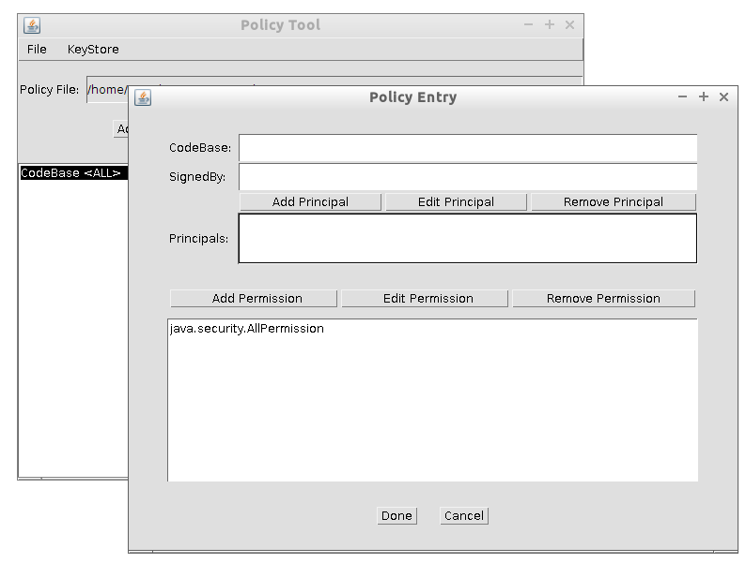
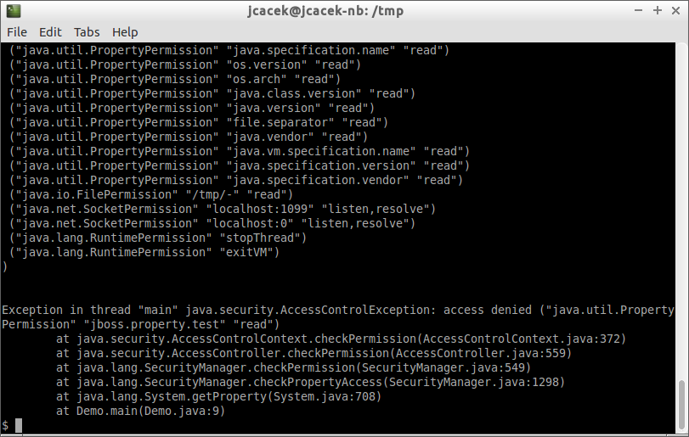
JSM issues - #2 policy file tooling

Slide 29
JSM Reloaded
pro-grade library
Set of SecurityManager
and Policy implementations.

Slide 30
pro-grade library
Java Security Manager made easy(ier)
authors
  Ondřej Lukáš
  Josef Cacek
Apache License
http://pro-grade.sourceforge.net/

Slide 31
pro-grade components
#1 policy with deny entries
#2 policy file generator
#3 missing permissions debugger

Slide 32
#1 pro-grade policy with deny rules
“subtracting” permissions from the granted ones
helps to decrease count of mapped permissions
Policy Rules Of Granting And DEnying
GRANT
DENY

Slide 33
#1 pro-grade policy with deny rules
“subtracting” permissions from the granted ones
helps to decrease count of mapped permissions
// grant full access to /tmp folder
grant {
permission java.io.FilePermission "/tmp/-", "read,write";
};
// deny write access to the static subfolder of /tmp
deny {
permission java.io.FilePermission "/tmp/static/-", "write";
};

Slide 34

#2 pro-grade policy file generator
policytool on (a)steroids
No GUI is better than any GUI!
doesn't throw the
AccessControlException

Slide 35
#3 pro-grade permissions debugger
prints info about missing permissions to error stream without stopping application
>> Denied permission java.io.FilePermission "/etc/passwd", "read";
>>> CodeSource: (file:/tmp/app-lib.jar <no signer certificates>)

Slide 36
Demo
Security policy for Java EE server
in 3 minutes.

Slide 37
Use Java Security Manager!

Slide 38
Use Java Security Manager!

Slide 39
Use Java Security Manager!
Make it easy with pro-grade

Slide 40
pro-grade fighting JSM issues
performance
→ deny rules helps
policy file tooling
→ generator – fully automated
→ debugger – quick check what's missing

Slide 41
Josef Cacek
@jckwart
josef.cacek@gmail.com
http://javlog.cacek.cz
Q & A
http://pro-grade.sourceforge.net
http://github.com/pro-grade/pro-grade
http://docs.oracle.com/javase/8/docs/technotes/guides/security/

Slide 42

Credits
public domain images
  pixabay.com
public domain drawings
  openclipart.org

