Slide 1
If you want to get the slides and code along…
https://github.com/kwartler/DR_DM_Biz
Caveats:
This is a 45minute lunch & learn…not a full course
This isn’t a DataRobot advertisement or DR specific training
Goals:
Learn how I’ve approached analytics in my career
Learn a new technique and often overlooked aspect of modeling sometimes applicable

Slide 2











Ted Kwartler, Field Chief Technology Officer
MBA
Work
Teaching
Advisory Roles

Slide 3
Agenda
Start | End | Item
 |  | General Framework for DM in Business
 |  | Modeling Bias R Code Example

Slide 4
Data Mining in this course briefing
Business Analytics – analyzing historical business data with basic math, SME rules, tallies, tables, summary statistics etc
Business Intelligence – what has happened or is happening that can help current business decisions, often done with visuals, powerpoint, dashboards i.e. tableau
Data Mining – includes machine learning (ML) & data science; applies more sophisticated methods to understand and predict business outcomes.
TBH I use terms interchangeably.

Slide 5


"Where a human-being has to make a judgement call or decision about something, where there is a long history of that type of decision being made, is an opportunity to look at to see if you can apply artificial intelligence.”
Loretta Ibanez, Ph.D. Innovation Senior Director

Slide 6
When can you embark on data-driven decisions?
1
2
3
Intelligent decision to be made (human or automated).
Historical results of the decision & outcome
Available data for exploration, explanation or prediction purposes.

Slide 7

Pitfalls
Without analytical rigor & discipline projects will have:
Have scope-creep or never end!
Be difficult to define success
Be difficult to implement or have a limited impact

Slide 8
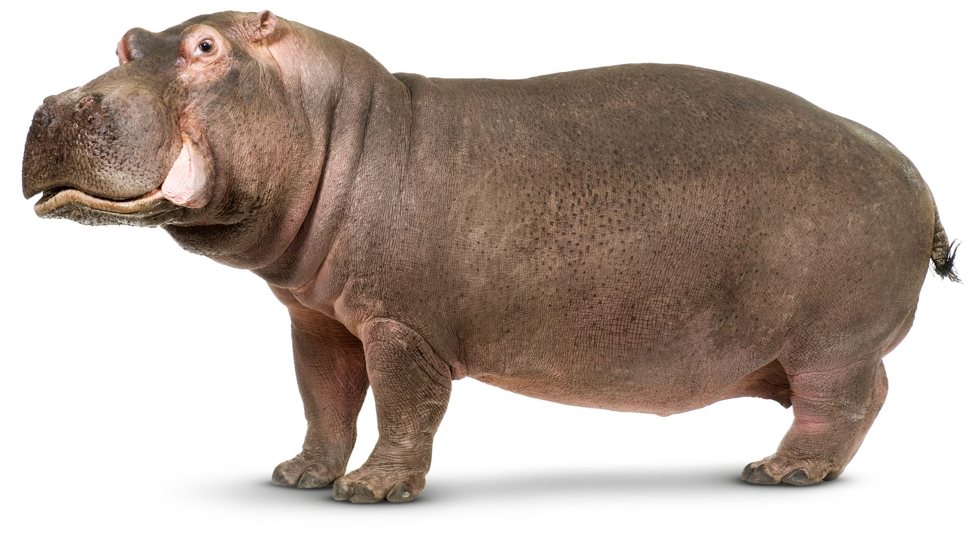
Avoid Hippos
Highest Paid Person’s Opinion
https://www.dkfindout.com/uk/animals-and-nature/hippopotamuses/

Slide 9

Let’s do this for real…
Meet Dale
Runs the analytics group at Busy-ness Corp a large conglomerate that makes, distributes corn dogs.
He looks miserable because senior leaders make his job harder than needed.
Let’s help Dale add some structure to his data mining projects.

Slide 10

Let’s do this for real
Hey Dale, its me…from OfficeSpace.
I read in the WSJ that everyone should be using LLMS and blockchain.
Should we?
Is this a biz analytics, intel or data mining problem?
What is the current state?
What are the possible outcomes of the business scenario?
How will the outcome of the data mining project be used?

Slide 11

Let’s do this for real
Your Daleness, I work in marketing (and apparently hate phones). I want to do a mailing to prospective corndog eaters. Can you identify how many postcards we should send & ROI?
Is this a biz analytics, intel or data mining problem?
What is the current state?
What are the possible outcomes of the business scenario?
How will the outcome of the data mining project be used?

Slide 12

Let’s do this for real
Dale-areno! I think we are getting a lot more calls than usual about defective corn dogs. Can you investigate whether that’s true?
Is this a biz analytics, intel or data mining problem?
What is the current state?
What are the possible outcomes of the business scenario?
How will the outcome of the data mining project be used?

Slide 13

Let’s do this for real
The Notorious DALE, let’s forecast how many of our current corn dog debtors will be delinquent. Is that getting better or worse over time?
Is this a biz analytics, intel or data mining problem?
What is the current state?
What are the possible outcomes of the business scenario?
How will the outcome of the data mining project be used?

Slide 14

Let’s do this for real
The East coast regional corn dog sales are up! I wonder if my region is worse than them.
Is this a biz analytics, intel or data mining problem?
What is the current state?
What are the possible outcomes of the business scenario?
How will the outcome of the data mining project be used?

Slide 15

Let’s do this for real
Despite that idiot in marketing selling defective dogs, we need a new warehouse in the East region. Which zip code should we build it in to support a strong workforce?
Is this a biz analytics, intel or data mining problem?
What is the current state?
What are the possible outcomes of the business scenario?
How will the outcome of the data mining project be used?

Slide 16

Dale is so happy!
https://www.motionelements.com/stock-video-3902092-successful-black-businessman

Slide 17
Data Mining Project Types
Exploratory
To understand a market or business opportunity more fully
Explanatory
Explain or simulate a phenomena seeking profit or decreasing expenses.
Predictive
Specific record prediction, often most accurate model matters over understanding

Slide 18
Type of Project
Persona
30k Foot Goal
Exploratory -To understand a market or business opportunity more fully
Senior Executives
Confirm their business understanding & expertise
Explanatory -Explain or simulate a phenomena seeking profit or decreasing expenses.
Middle Management
Learn complex interactions in their line of business for more efficient & easier operations
Predictive -Specific record prediction, often most accurate model matters over understanding
Data Scientists & Practitioners
Drive specific results & automated decision making for value.
Exploratory should inform strategic, explanatory should reduce cost/increase revenue and predictive should be narrowly focused, aligned to a single business use case delivering value.

Slide 19
Data Mining Project Framework: Project type by Biz Need
Cost Vs Benefit | Risk Vs Reward | Supply Vs Demand
 |  | ”
Exploratory
Explanatory
Predictive
The analytical tools, methods and consumption methods differ for each intersection.

Slide 20
Startups exist at these intersections & rarely do it all.
Cost Vs Benefit | Risk Vs Reward | Supply Vs Demand
Falcon.io: Social Media Monitoring “does social media indicate a product innovation X vs the cost to develop” | Redfin: Walkability Scoring “This house’s score explains something about the community” | MarketingEvolution: Marketing Spend Allocation Modeling “
Clickhole: Content Creation “Which content is most popular & best for paid traffic” | RobinTrack: “Tracking RobinHood investors explains retail investing patterns” | SensorTower: Market Intelligence Data “
DonorBureau: Direct Mail Modeling for non-profits “Which house will respond” | TrueCar: Used Car Price Modeling “Predict a fair price for this car” | OneClick: Automated Time Series Modeling “Predict a SKU for a retailer”
Exploratory
Explanatory
Predictive
The analytical tools, methods and consumption methods differ for each intersection.

Slide 21
Types of Methods/Tools
Retrospective- individual historical data facts
Descriptive- over time historical data facts
Data Science
Predictive
Supervised Learning
Classification
Binary
Multi-Class
Continuous
Forecasting
Unsupervised Learning
Associative System

Slide 22
Types of Methods and tools fill in the matrix
Retrospective
Descriptive
Data Science
Predictive
Supervised Learning
Classification
Binary
Multi-Class
Continuous
Forecasting
Unsupervised Learning
Associative System
How did we do last quarter?
Usually point in time and standalone information not over time.

Slide 23
Types of Problems
Retrospective
Descriptive
Data Science
Predictive
Supervised Learning
Classification
Binary
Multi-Class
Continuous
Forecasting
Unsupervised Learning
Associative System
What is the average number of donuts served each morning?
Retrospective but can be summary and/or in comparison to other data (days or weeks here).

Slide 24
Types of Problems
Retrospective
Descriptive
Data Science
Predictive
Supervised Learning
Classification
Binary
Multi-Class
Continuous
Forecasting
Unsupervised Learning
Associative System
Ask yourself is there an outcome variable that we want to predict.
Will the next person that calls accept the credit card offer?
The outcome is 1 = yes, 0=no

Slide 25
Types of Problems
Retrospective
Descriptive
Data Science
Predictive
Supervised Learning
Classification
Binary
Multi-Class
Continuous
Forecasting
Unsupervised Learning
Associative System
Ask yourself is there an outcome variable that we want to predict.
Will the next person that calls accept the credit card offer?
The outcome is 1 = yes, 0=no, they will accept.

Slide 26
Types of Problems
Retrospective
Descriptive
Data Science
Predictive
Supervised Learning
Classification
Binary
Multi-Class
Continuous
Forecasting
Unsupervised Learning
Associative System
Ask yourself is there an outcome variable that we want to predict.
Will the next patron purchase ProductA, ProductB or ProductC?
The outcome is one of three classes, A, B, C.

Slide 27
Types of Problems
Retrospective
Descriptive
Data Science
Predictive
Supervised Learning
Classification
Binary
Multi-Class
Continuous
Forecasting
Unsupervised Learning
Associative System
Ask yourself is there an outcome variable that we want to predict.
How many ice cream cones will we sell on an 85 degree, Saturday?
(the outcome is a continuous 0 to some number of cones)

Slide 28
Types of Problems
Retrospective
Descriptive
Data Science
Predictive
Supervised Learning
Classification
Binary
Multi-Class
Continuous
Forecasting
Unsupervised Learning
Associative System
Ask yourself is there an outcome variable that we want to predict.
How much corn meal will we need for our corn dogs this month?
(there is an outcome, and the data is time related)

Slide 29
Types of Problems
Retrospective
Descriptive
Data Science
Predictive
Supervised Learning
Classification
Binary
Multi-Class
Continuous
Forecasting
Unsupervised Learning
Associative System
Ask yourself is there an outcome variable that we want to predict.
Can our customer database be grouped in some meaningful way?
(there is no clear outcome to predict, we can observe and explore the clusters within the customer db)

Slide 30
Types of Problems
Retrospective
Descriptive
Data Science
Predictive
Supervised Learning
Classification
Binary
Multi-Class
Continuous
Forecasting
Unsupervised Learning
Associative System
Ask yourself is there an outcome variable that we want to predict.
What should we offer customers that bought the corn dog?
(There is not really a distinct outcome, only observed data similar to the unsupervised example. Should we offer additional dogs, condiments, orange soda, red wine, steak etc. Among all choices, how are items associated based on purchase history?)

Slide 31
Example – Project Goal By Biz Need By Methods/Tools
Cost Vs Benefit | Risk Vs Reward | Supply Vs Demand
How did we do last quarter? “Retrospective Exploratory” Summary Stats for historical costs/fraud/discounts etc
 |  | ”
Exploratory
Explanatory
Predictive
The analytical tools, methods and consumption methods differ for each intersection.

Slide 32
Example – Project Goal By Biz Need By Methods/Tools
Cost Vs Benefit | Risk Vs Reward | Supply Vs Demand
How did we do last quarter considering we ran a promotion? “Retrospective Explanatory” Summary Stats & visuals for historical costs/fraud/discounts w/macro-economic data, competitor information, promotion data etc
 |  | ”
Exploratory
Explanatory
Predictive
The analytical tools, methods and consumption methods differ for each intersection.

Slide 33
Example – Project Goal By Biz Need By Methods/Tools
Cost Vs Benefit | Risk Vs Reward | Supply Vs Demand
How will be do next quarter? “Predictive” Supervised model for cost expectations or buyer propensities |  | ”
Exploratory
Explanatory
Predictive
The analytical tools, methods and consumption methods differ for each intersection.

