Slide 1

Unsupervised Learning
Trying to find hidden structure in unlabelled data.
“Learn from observing”, “Look at my data and tell me about it”
Data Setup
Method
Business Examples
Application
Marketing-Find customer segments for specific marketing campaigns.
Operations-Identify locations for cell towers based on population density and area characteristics.
Text Analysis- Topic modeling of articles
Flat “Excel” file. Each row is a record or observation. Each column is an attribute of the record.
Clustering e.g. K-Means, Hierarchical Clustering etc
For new data assign to similar cluster

Slide 2

Your turn…
Methods
Scenario
Supervised or
Unsupervised
How many customers are complaining?

Slide 3

Your turn…
Methods
Scenario
Supervised or
Unsupervised
What is a typical profile of our customers and online shoppers?

Slide 4
ID 3 Clusters
Select US State Fuel Cost (x) vs Sales (y)

Slide 5
Intuition for 3 clusters…
Select US State Fuel Cost (x) vs Sales (y)
low cost &
high sales
Mid cost &
Mid sales
High cost &
low sales

Slide 6
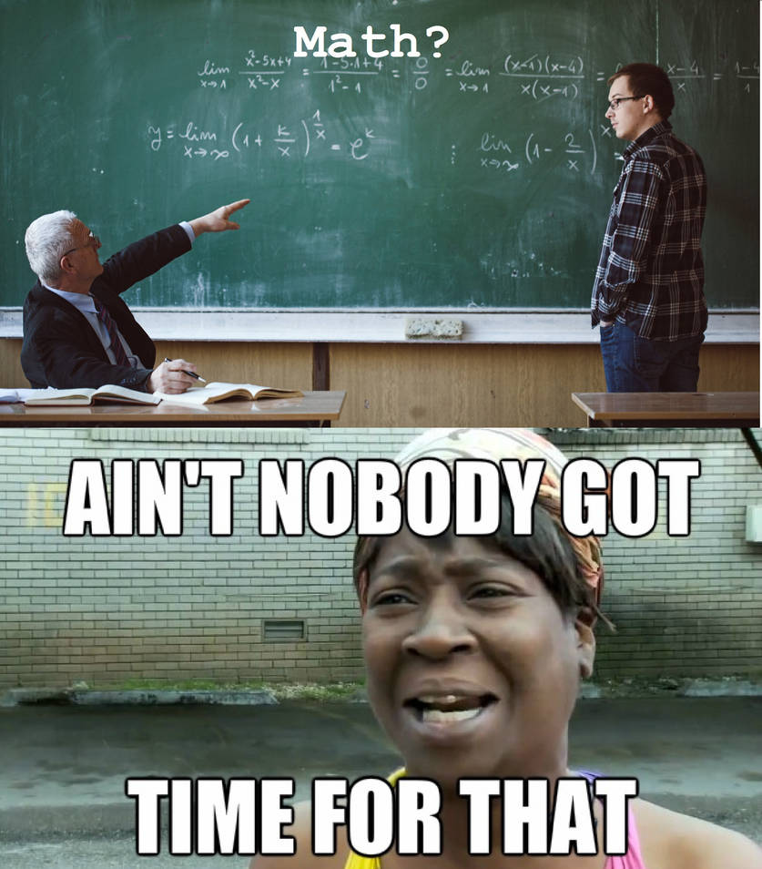
K-Means Unsupervised
Previous slide clustering was done by “eye”
“K” clusters are defined by practitioner
Need a defined distance measure between record
Euclidean Distance (common but not great for text)
Scale each vector to so one unit of measure doesn’t dominate ie # of rooms in a house vs sq-Meter of house

Slide 7
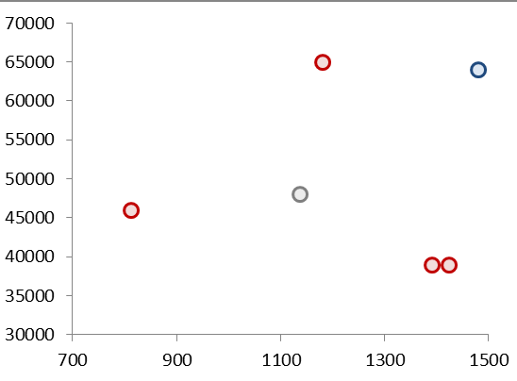
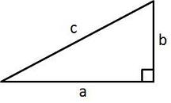
Quick Refresher
Remember Pythagorean Theorem?
Example Data
A²+B²=C²
b
c
a

Slide 8
K Means
Select US State Fuel Cost (x) vs Sales (y)
2
1
3
Random centroid placement

Slide 9
K Means
Select US State Fuel Cost (x) vs Sales (y)
2
1
3
Calculate the distance from each point to each centroid

Slide 10
K Means
Select US State Fuel Cost (x) vs Sales (y)
2
1
Cluster “3”
3
Cluster “1”
Pts assigned to closest centroid.

Slide 11
K Means
Select US State Fuel Cost (x) vs Sales (y)
2
1
Cluster “2”
Cluster “2”
Cluster “2”
Cluster “3”
3
Calculate the MEAN AVERAGE distance among assigned pts to centroid

Slide 12
K Means
Select US State Fuel Cost (x) vs Sales (y)
2
2
1
3
3
1
Move the centroid to the average distance among all assigned points

Slide 13
K Means
Select US State Fuel Cost (x) vs Sales (y)
2
Since “3” moved, this pt is assigned to “2”
3
1
Pt reassignment affects the avg distances so the process repeats…

Slide 14
K Means
Select US State Fuel Cost (x) vs Sales (y)
2
2
1
2
3
3
1
1
The new pt assignments again moves the centroid. The process repeats until no reassignments occur after moving the centroids (convergence).

Slide 15
K Means
Select US State Fuel Cost (x) vs Sales (y)
2
3
1
The new pt assignments again moves the centroid. The process repeats until no reassignments occur after moving the centroids (convergence).

Slide 16
K-Means Unsupervised
Previous slide clustering was done by “eye”
“K” clusters are defined by practitioner; multiple analytical methods can help
Need a defined distance measure between record
Euclidean Distance (common but not always great)
Scale each vector to so one unit of measure doesn’t dominate ie # of rooms in a house vs sq-Meter of house
Because it is the mean average all data attributes must be numeric (non factor ie what is the average of “blue eyes” or “medium” or “first”.

Slide 17
Choosing the optimal clusters
WSS
Within Cluster Sum of Squares
- value to be minimized measures the “compactness” of the cluster
Small WSS
2 clusters
Higher WSS
less compact
Small WSS
more compact
But you could keep adding clusters to reduce WSS which overfits. The elbow method lets you examine the tradeoff of WSS by number of clusters.

Slide 18
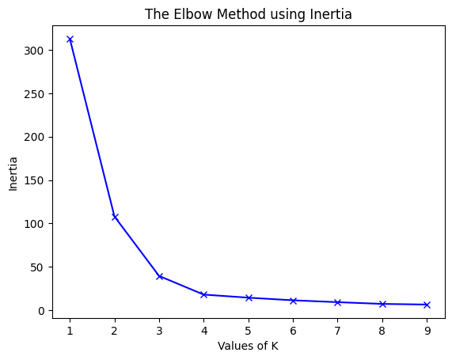
Choosing K with the Elbow Method
Big decease in WSS
“cluster compactness”
Decreasing rate of WSS decrease
Very little WSS change for each new cluster
Each new cluster decreases the WSS but at some point the changes in WSS decreases.

Slide 19
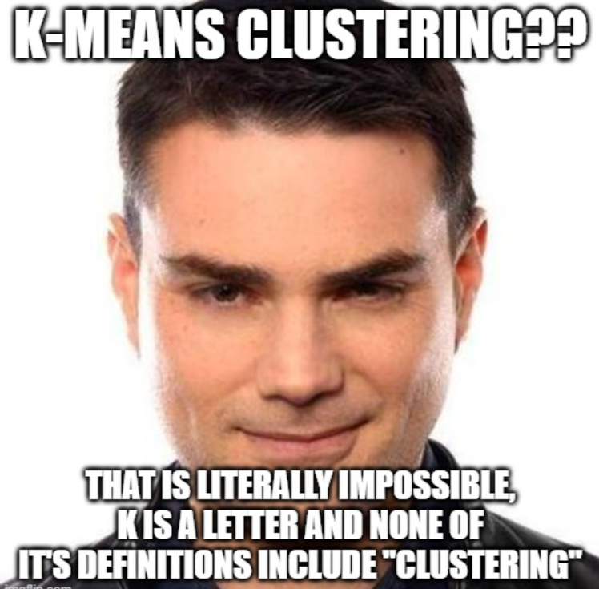
Open A_kmean_clustering.R
Use K-Means for customer segmentation
Use Elbow Method to choose the optimal K
Apply the cluster identities to new records by measuring new record distances to the identified cluster centroids.

Slide 20
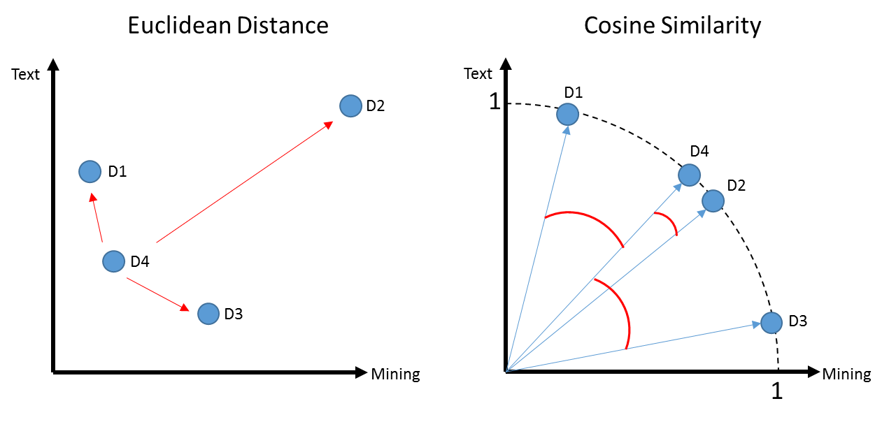
K-Means Problems
Computationally intensive (non-parametric)
Centroid will be greatly affected by an outlier
In this example a centroid would be “pulled” away from the actual cluster D1,D4 & D3

Slide 21

You can also try K- Mediod Clustering
Same steps as K-Means but instead of mean averages, uses the median distance to move centroids
Less impacted by outliers
Mean of 1,2,3,4,5,60 = 12.5
Median of 1,2,3,4,5,60 = 3.5 (closer to more points in vector space)

Slide 22
K Means Vs Spherical K-Means
D1 a book for aspiring authors referring to “text” a lot
D2 & D4 refer to “text” and “mining” in equal proportions like the course book
D3 refers to “mining” ie minerals
D1, D4, D3 probably appear as 1 cluster w/D2 standing alone

Slide 23
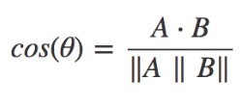
Another way to measure distance
Euclidean: How dissimilar are documents?
Cosine: How similar are documents?
 | Doc1 | Doc2
Term1 | 1 | 0
… | 0 | 1
… | 3 | 2
… | 6 | 6
… | 7 | 1
… | 0 | 0
Starting with a numeric Vector Representation from tokens
1. Calculate the “dot product” of the vectors:
(1*0) + (0*1) + (3*2) + (6*6) + (7*1) + (0*0)
0 + 0 + 6+ 36+ 7+ 0 = 49

Slide 24
Another way to measure distance
Euclidean: How dissimilar are documents?
Cosine: How similar are documents?
 | Doc1 | Doc2
Term1 | 1 | 0
… | 0 | 1
… | 3 | 2
… | 6 | 6
… | 7 | 1
… | 0 | 0
Starting with a numeric Vector Representation from tokens
Doc1: 1,0,3,6,7,0
Doc2: 0,1,2,6,1,0
Rearranged to follow more easily.
1. Calculate the “dot product” of the vectors:
(1*0) + (0*1) + (3*2) + (6*6) + (7*1) + (0*0)
0 + 0 + 6+ 36+ 7+ 0 = 49

Slide 25
Another way to measure distance
Euclidean: How dissimilar are documents?
Cosine: How similar are documents?
Starting with a numeric Vector Representation from tokens
Doc1: 1,0,3,6,7,0
Doc2: 0,1,2,6,1,0
Multiply each corresponding value
1. Calculate the “dot product” of the vectors:
(doc1: 1 * doc2: 0) + (doc1: 0 * doc2: 1) + (doc1: 3 * doc2: 2) +
(doc1: 6 * doc2: 6) + (doc1: 7 * doc2: 1) + (doc1: 0 * doc2: 0)
0 + 0 + 6+ 36+ 7+ 0 = 49

Slide 26
Cosine
1. Calculate the “dot product” of the vectors:
(1*0) + (0*1) + (3*2) + (6*6) + (7*1) + (0*0)
0 + 0 + 6+ 36+ 7+ 0 = 49
2. Calculate the magnitude for a documents
Doc1: 1,0,3,6,7,0
Doc2: 0,1,2,6,1,0
Multiply each value to itself; sum up each doc; get sqrt
Multiply each value to itself; sum up each doc; get sqrt
Multiply single vector value

Slide 27
Cosine
1. Calculate the “dot product” of the vectors:
(1*0) + (0*1) + (3*2) + (6*6) + (7*1) + (0*0)
0 + 0 + 6+ 36+ 7+ 0 = 49
2. Calculate the magnitude for a documents
Doc1: 1,0,3,6,7,0
Doc2: 0,1,2,6,1,0
Multiply each value to itself; sum up each doc; get sqrt
Multiply each value to itself; sum up each doc; get sqrt
Multiply single vector value
Doc1: (1*1) + (0*0 )+ (3*3) + (6*6) + (7*7 )+ (0*0)
1 + 0 + 9 + 36 + 49 + 0 = 95
Sqrt(95) = 9.7
Doc2: (0*0)+(1*1)+(2*2)+(6*6)+(1*1) + (0*0)
0 + 1 + 4 + 36 + 1 + 0 = 42
Sqrt(42) = 6.4
9.7 * 6.4 = 63.1

Slide 28
Cosine
1. Calculate the “dot product” of the vectors:
(1*0) + (0*1) + (3*2) + (6*6) + (7*1) + (0*0)
0 + 0 + 6+ 36+ 7+ 0 = 49
2. Calculate the magnitude for a documents
Doc1: (1*1) + (0*0 )+ (3*3) + (6*6) + (7*7 )+ (0*0)
1 + 0 + 9 + 36 + 49 + 0 = 95
Sqrt(95) = 9.7
Doc2: (0*0)+(1*1)+(2*2)+(6*6)+(1*1) + (0*0)
0 + 1 + 4 + 36 + 1 + 0 = 42
Sqrt(42) = 6.4
9.7 * 6.4 = 63.1
3. Distance Measure: 49 / 63.1 = 0.77
Value will always be between 0,1.

Slide 29
Spherical K-Means
Euclidean: How dissimilar are documents?
Cosine: How similar are documents?
Uses cosine similarity to calculate distance
Values are normalized to 0,1
Cosine is measuring similarity…so a value of 0 means orthogonal (independent)
These are similar docs i.e cosine similarity is closer to 1
Using cosines now D4, D2 represent a cluster as expected and you may have to declare add another K

Slide 30
Side by Side
Big distance D4 to D2 means they are dissimilar
Distance is between 0 to inf.
Higher value means bigger distance.
D4 to D2 Small angle distance means they are similar.
Distance is between 0 to 1.
Higher value means smaller distance.
i.e. 1 to 1 for division is a duplicate document!

Slide 31
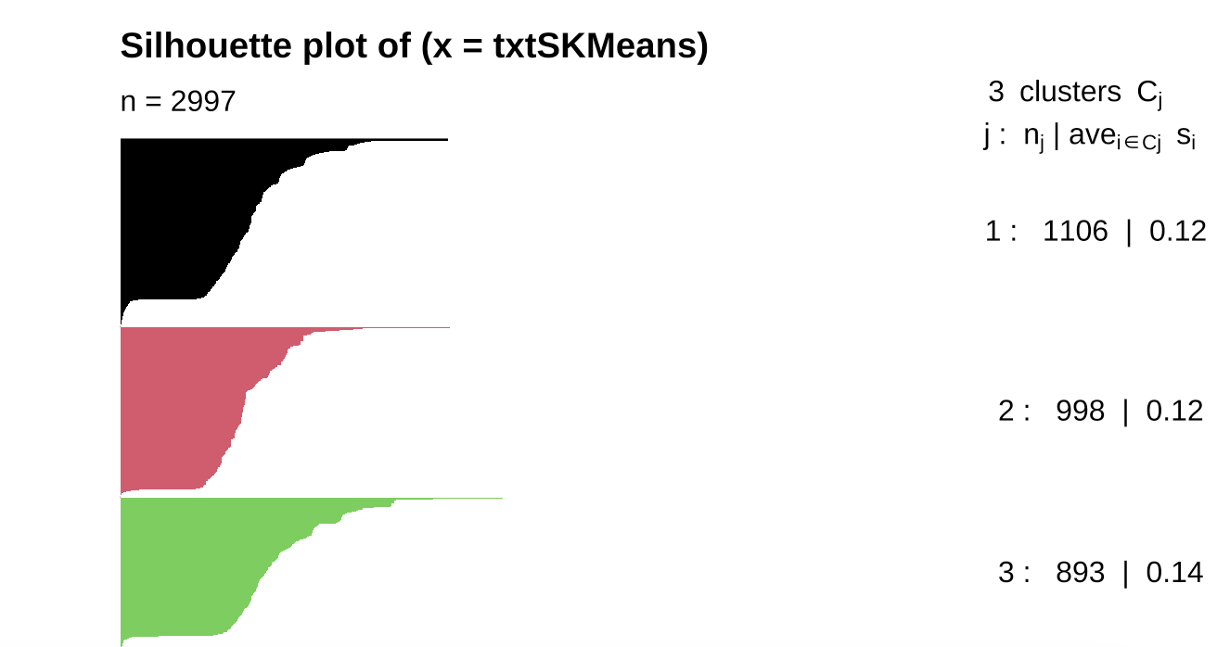
Evaluating a cluster
Silhouette plot: It is calculated using both the mean intra-cluster distance (a) and the mean nearest-cluster distance (b) for each sample.
The Silhouette Coefficient for a sample is (b - a) / max(a, b).
Silhouette plot: By looking at the silhouette plot, we can understand the structure of the clusters formed. A high average silhouette width indicates a good clustering. Silhouette values near +1 indicate that the observation is far from the neighboring clusters. A value of 0 indicates that the sample is on or very close to the neighboring cluster(s).

Slide 32
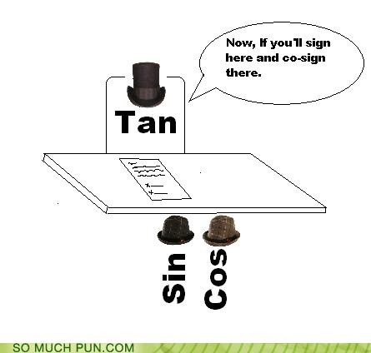
Open F_spherical_kmeans.R

