Slide 1

Bridging the AI Value Gap
Moving from Pilot to Scale in the Enterprise

Slide 2
Setting the Stage
1. Which AI Are We Talking About? Not chatbots. Not image generators. We're talking about AI that augments real business decisions: Claims processing Automating legal research Sales forecasting This is less about the GenAI wow-factor, and more about embedding predictive and generative tools into core workflows. | 2. Where Most Companies Get Stuck According to McKinsey and BCG: 85% of pilots don’t reach production Only 1% of companies say they’re AI-mature 74% struggle to scale value Misaligned incentives, getting started too early, poor data readiness, internal resistance to change. Organizational readiness trumps technical challenges. | 3. Why Scaling Matters AI pilots are easy. They’re safe, small, and often isolated. But the value lives in scale. This is when AI: Drives daily decisions Reaches the frontlines Reinvents how work is done A working model isn't success. A working system is.

Slide 3

Case Study – The Last Mile to Value
A Fortune 500 Retailer deployed an AI demand forecasting model (+18% accuracy)
ROI was minimal after deployment due to:
- Forecast not integrated into ordering system
- Store managers continued legacy processes
- Teams weren’t trained on the new system
- No accountability or incentives to use AI output
Lesson: Deployment isn’t the finish line, it’s mile 20 in a marathon. This is when the real work starts!

Slide 4
Moving from Pilot to Scale
🚦 Pilots are often safe-zone science projects. Scaling requires executive ownership, meaning AI must be embedded in strategic goals, resourced across functions, and measured like any other critical initiative.
🧩 Use cases must be traceable to business strategy — not just interesting data experiments
🧠 Models must be interpretable and integrated into real decisions, not dashboards nobody reads
🔐 Scale fails without risk governance and responsible AI built in — you need more than model accuracy
⚙️ Production readiness needs hardened MLOps, observability, security, and lifecycle management

Slide 5
Aligning Strategy with Data, Tools, and Teams
🎯 Start with business goals, not models Use cases must link to OKRs and real pain points
🧱 Build a data foundation: availability, quality, lineage, governance, or the model is doomed. Investing here is mission critical.
🧰 Avoid tool sprawl: choose tech that plays well together and scales across teams. Work backwards from the end state.
🧑‍🤝‍🧑 Form “fusion teams” — cross-disciplinary groups of product, engineering, data, ops, and risk. Staffed with people that know how to navigate bureaucracy.
🧭 AI Centers of Excellence can be the operating system to align efforts across the org

Slide 6
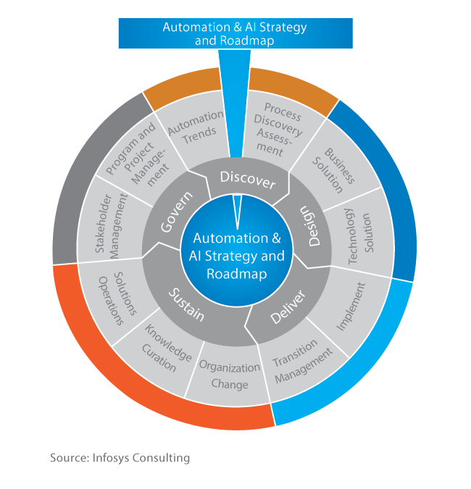
The Role of an AI Center of Excellence
Interdisciplinary hub aligning strategy, data, tools, and governance
Includes stakeholders from business, data, IT, compliance, and risk. Beyond cross-functional to cross-disciplinary
Enables reusable tooling, standardized frameworks, shared KPIs / OKRs
Ensures AI isn’t just experimentation, but embedded in operations

Slide 7
Lessons from the Field – What Works
🧪 Start with use cases that are visible, valuable, and verifiable: Focus on real-world impact that frontline teams and leadership feel, not just measure
🧭 Hard-code business ownership into every project: Have a business sponsor sign off on success metrics before a single line of code / tool is provisioned
♻️ Design for real-time iteration, not one-off delivery: Success comes from embedded learning loops, not model handoffs.
🧱 Build modular, reusable assets: Every project should leave behind building blocks for the next one
🚨 Fail publicly, fix fast: Make early-stage results transparent across functions to normalize iteration and reduce perfectionism

Slide 8
Use Case Prioritization
Low Effort
Technical Imperatives:
Sufficient Data Quality & Data Access
“Good Enough” Infrastructure to Scale On
Integration into Business Systems & Workflows
Governance & Observability
Quick Wins
Focus & Iterate
Questions to Ask:
Does the use case align with our established AI Ethics charter?
Does the use case align with our established data policies?
Have we analyzed the impact in terms of bias and fairness?
Low Value
High Value
Money Pit
Big Bets
Business Imperatives:
Strategic Relevance / Alignment
Quantifiable ROI / Measurable Impact (e.g. OKRs)
Business Ownership & Accountability
Trust & Communication
High Effort
Notes:
“Delivering real value from AI requires two tracks: technical excellence and business alignment. Miss either, and you stall.” Strategic Relevance: If it doesn’t tie to top-line growth or bottom-line savings, it’s a science project. The use case must clearly map to a priority business objective (e.g., reducing churn, improving underwriting accuracy, increasing sales conversion). Business Ownership & Accountability: No model should go live without a business owner who signs off on success. Someone on the business side — not just data science — must be accountable for defining success criteria, co-leading implementation, and adopting outcomes. This builds commitment, not just compliance.
Workflow Integration & Change Management: The most accurate model in the world is useless if it doesn’t change a decision. You must redesign how people work around the model’s output. That includes processes, KPIs, decision rights, and incentives. Trust & Communication: 💬 If the end user doesn’t trust it, they won’t use it — no matter how good it is.
So the takeaway here is this: AI success is not a data science function. It’s an organizational function. You need technical excellence and business alignment. Get one wrong, and the whole thing wobbles.

Slide 9
Change Management That Sticks
🥇 Turn early adopters into internal case studies: Reward high performers who integrate AI into their workflow, then tell their stories loudly. Nothing spreads adoption faster than peer credibility.
🧠 Instrument trust, not just usage: Track how often human decisions follow or override AI, and why
📘 Create AI “field guides”: Simple, practical references for what the model does, when to trust it, and how to override it
🫀 Link AI to mission, not just margin: Show how automation supports judgment, service, safety, or well-being
🎤 Make change participatory: Include skeptics in testing and feedback loops

Slide 10
Five Filters Before Scaling
Filter | Ask Yourself
🎯 Business-Aligned | Does it solve a real, urgent business problem?
🧠 Trusted | Will people understand and use the output?
⚙️ Operable | Can we maintain it in production?
🧩 Integrated | Is it embedded where decisions actually happen?
🔁 Repeatable | Will this use case leave behind reusable assets?
Notes:
“This isn’t about launching one great model. It’s about building an AI operating system — a reusable engine that turns strategic questions into scalable, trusted answers.”

Slide 11
This isn’t about launching one great model. It’s about building an AI operating system. It’s about building a reusable engine that turns strategic questions into scalable, trusted answers.
Notes:
“This isn’t about launching one great model. It’s about building an AI operating system — a reusable engine that turns strategic questions into scalable, trusted answers.”

Slide 12
Final Thoughts + Q&A
The barriers are shifting Data and AI infrastructure challenges still exist, but they’re shrinking. The real friction is organizational: misaligned strategy, unclear ownership, and broken workflows. One-off wins won’t scale. Systems will Each use case should leave behind something reusable — data, tools, playbooks. Repeatable patterns are how scale actually happens. | Change starts with trust, not code Success depends on behavior, not just predictions. Adoption happens when people understand, believe in, and act on the output. The real goal? A flywheel of value Each win should accelerate the next, from pain point to pilot to impact to reuse. When that loop sustains itself, AI becomes how the organization thinks.

Slide 13
APPENDIX

Slide 14
The AI Hype vs. Reality Gap
78% of companies use AI, but more than 80% report no EBIT impact
Only 1% of companies believe they are AI-mature
85% of AI pilots never reach production
Just 26% of firms have scaled AI beyond the pilot phase
Causes: Misaligned incentives, getting started too early, poor data readiness, internal resistance to change
McKinsey (2025). Superagency in the Workplace. Link
McKinsey (2025). The State of AI. Link
VentureBeat (2024). From Pilot to Profit. Link
BCG (2024). AI Adoption in 2024. Link

Slide 15
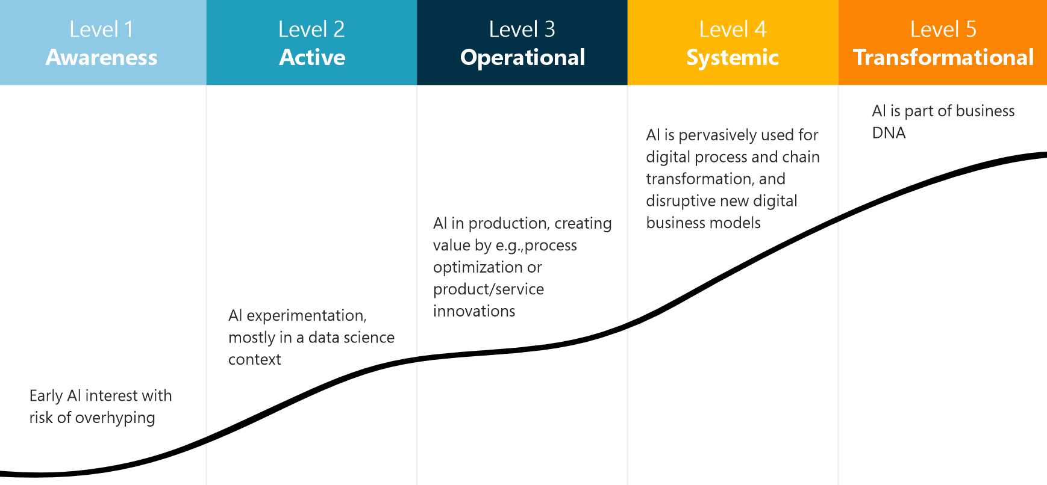
Assessing AI Maturity
Source: Gartner

Slide 16
Responsible AI in Practice
Bias testing (“red teaming”), guardrails, inclusive datasets, and explainability
Governance boards with teeth
Legal, compliance, and ethics teams at the table
Monitor outcomes, not just inputs
Document everything: assumptions, limitations, training data

Slide 17
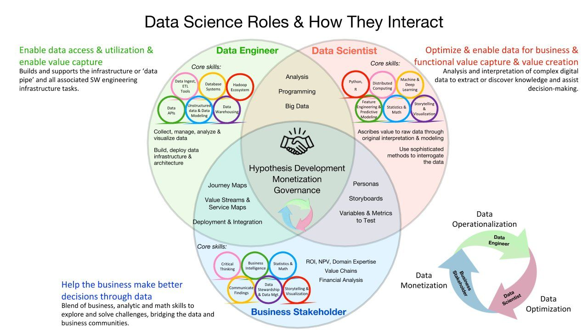
AI is a Team Sport

Slide 18
Using the Correct Tool for the Job
Artificial Intelligence (AI): Technology that enables machines and software to perform tasks requiring human-like intelligence, such as problem-solving, pattern recognition, and decision-making.
Machine Learning (ML): A subset of AI where systems learn from data to make predictions or decisions automatically using various algorithms.
Deep Learning: An advanced form of machine learning that uses deep neural networks to analyze complex data, particularly effective with text, images, and audio.
Generative AI (GenAI): A type of deep learning focused on creating new, realistic content from existing data, like text (e.g., ChatGPT) and images (e.g., DALL-E).
Predictive AI: AI techniques that analyze historical data to forecast future outcomes, commonly used in industries like finance and healthcare.
Artificial
Intelligence
Machine
Learning
Predictive AI
For example, using an algorithm trained on historical data to predict future performance
Deep
Learning
Generative AI
For example, using a model like GPT-4o to summarize text or create images in real-time

