Slide 1
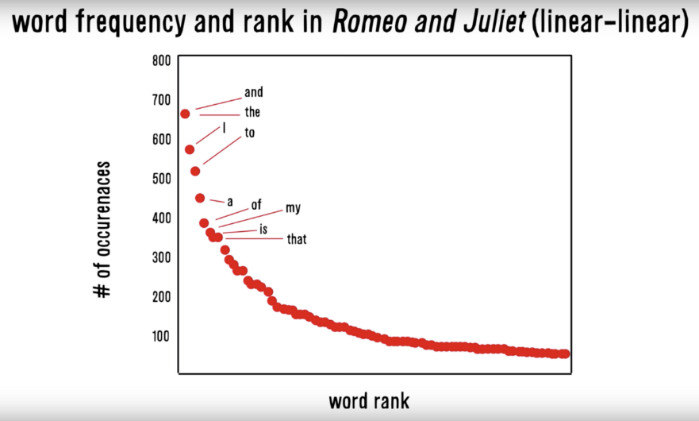
Zipf’s Law: Our words are less diverse than we think
Two very different contexts, channel, & messengers yet very similar pattern.
RT
I
Many words in natural language but also a steep decline in actual usage. Follows a predictable pattern.

Slide 2
Simple Sentiment Polarity
Zipf’s Law
Many words in natural language but there is steep decline in everyday usage. Follows a predictable pattern.

Slide 3
Polarity
To what extent is a document positive or negative.

Slide 4
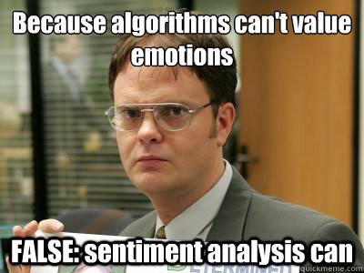
Let’s see if we can do it

Slide 5
How would you rate the polarity?
I loathe Aldi.
loathe
-1

Slide 6
How would you rate the polarity?
I love Coop. They are the best.
love
best
+2

Slide 7
How would you rate the polarity?
I like shopping at Migros but hate the location.
like
hate
0

Slide 8
How did you do that?
-1
I loathe Aldi.
I love Coop. They are the best.
I like shopping at Migros but hate the location.
+2
+1
-1
0
You know groups of positive and negative words. These could be called a polarity lexicon

Slide 9
Simple Sentiment Polarity
Lexicon
Because of Zipf’s Law you can have pos/neg lexicons that do not encompass all possible terms.
library(qdap)
polarity()
library(SentimentAnalysis)
analyzeSentiment()
library(sentimentr)
sentiment()
Sentiment_by()
library(tidytext) & library(dplyr)
inner_join()

Slide 10
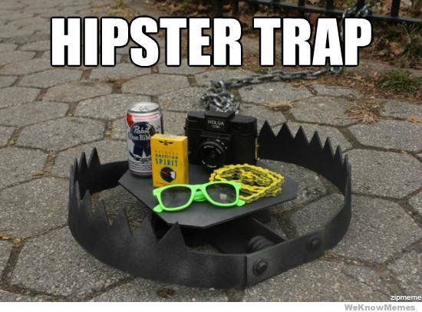
Differences between Polarity & Emotion
Polarity isn’t an emotion
Surprise is an emotion
Some emotions can be positive & negative
Surprise! You won the lottery!!

Slide 11
Differences between Polarity & Emotion
Polarity isn’t an emotion
Surprise is an emotion
Some emotions can be positive & negative
Surprise! You were hit by a bus!!

Slide 12
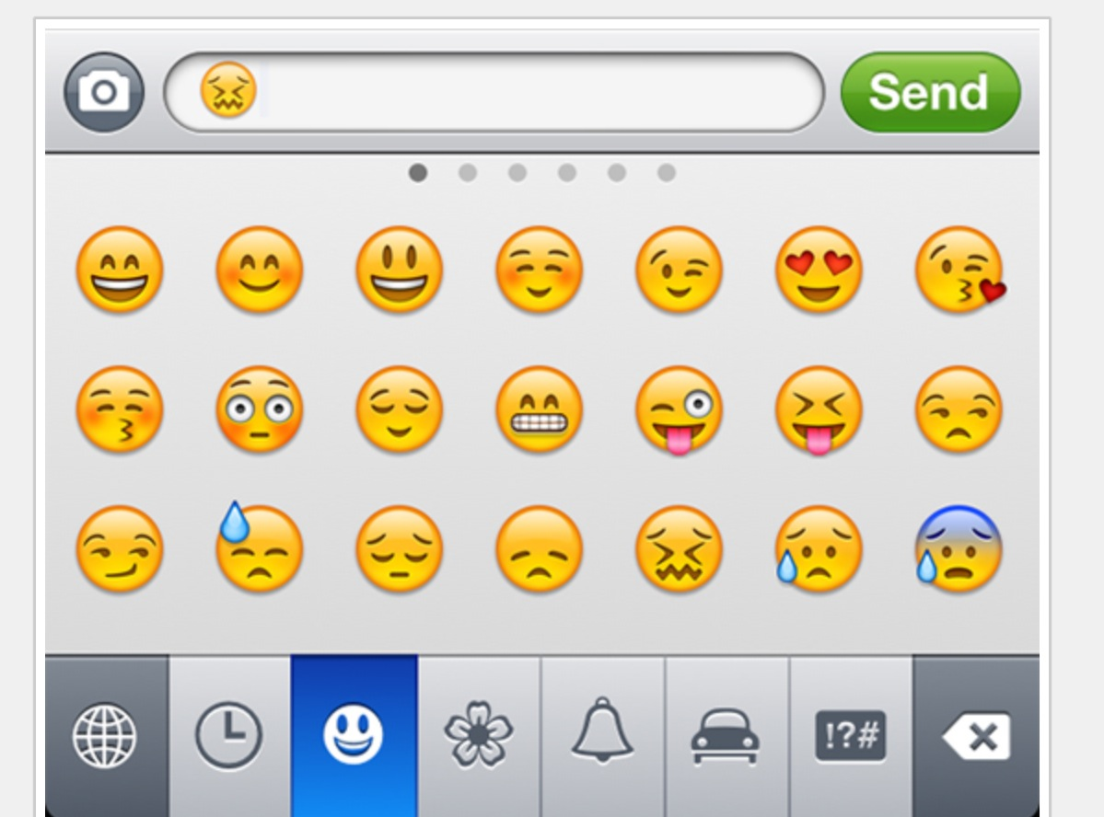
In reality sentiment is more complex.
Many Many Emoji

Slide 13
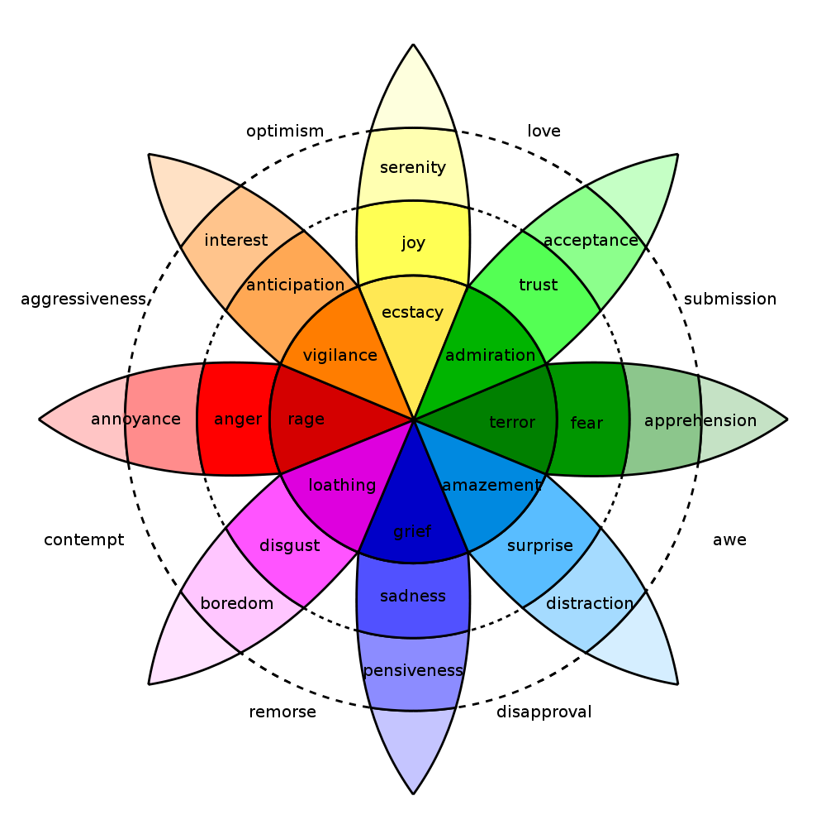
In reality sentiment is more complex.
Many Many Emoji

Slide 14
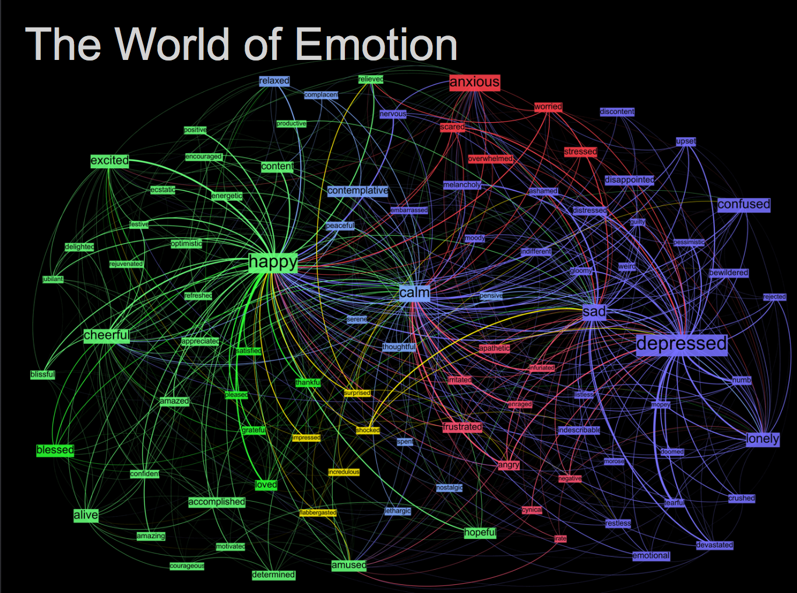
Kanjoya’s Experience Corpus

Slide 15
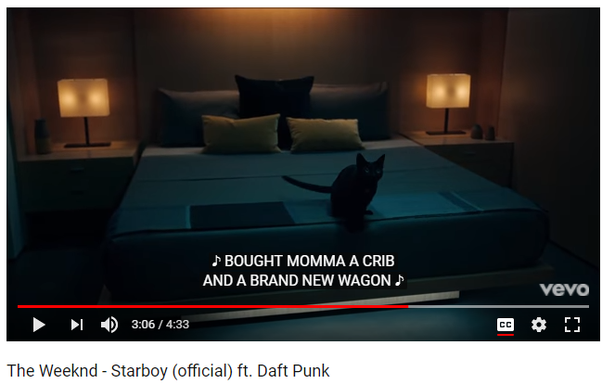
In this exercise we will examine song lyrics

Slide 16
But we will adjust the data format for joins
Tidy Form (Triplet, Dense Data)
Document Term Matrix
Document | Term | count
Tweet1 | Term2 | 1
Tweet1 | term3 | 1
Tweet2 | Term2 | 1
Tweet3 | Term… | 3
Tweet… | Term… | 1
Tweet… | Term_n | 1
Tweet_n | Term… | 1
 | Term1 | Term2 | Term3 | … | Term_n
Doc1 | 0 | 1 | 1 | 0 | 0
Doc2 | 0 | 1 | 0 | 0 | 0
Doc3 | 0 | 0 | 0 | 3 | 0
… | 0 | 0 | 0 | 1 | 1
Doc_n | 0 | 0 | 0 | 1 | 0
Sparse Data: Memory used to hold 0s
Dense Data: Efficient in Memory

Slide 17

And tidy programming uses the pipe operator…%>%

Slide 18
Tidy data uses %>% to forward objects
In the “tidyverse” code is structured so it is more easily read using the %>%. The data format is a tibble usually not a data frame.
mtcars
mtcars %>% group_by(cyl)
mtcars %>% group_by(cyl) %>% mutate(rank = min_rank(desc(mpg)))
This reads as “Using the mtcars object then group by the cyl vector then mutate a new variable called rank.

Slide 19
Tidy can seem complicated but not impossible.
The pipe operator
%>%
Forwards an object so the code is easy to understand & concise.
all.sentiment <- all.tidy %>%
inner_join(nrc.lexicon) %>%
count(tweet,sentiment) %>%
spread(tweet, n, fill = 0)
Sentiment
words
Song text
inner_join()

Slide 20
Starting with a DTM, its straightforward
cleanTibbles <- list()
for(i in 1:length(all)){
x <- VCorpus(VectorSource(all[i])) #declare as a corpus
x <- cleanCorpus(x, customStopwords) #clean each corpus
x <- DocumentTermMatrix(x) #make a DTM
x <- tidy(x) #change orientation
x$document <- documentTopics[i]
cleanTibbles[[documentTopics[i]]] <- x #put it into the list
}
# Get bing lexicon
# "afinn", "bing", "nrc", "loughran"
bing<-get_sentiments(lexicon = c("bing"))
# Perform the join
bingSent <- inner_join(allText,
bing,
by=c('term'='word'))
DTM is from the “tm” library
Easy way to make it into a tibble.
Weeknd Lyrics
Bing Lexicon

Slide 21
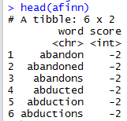
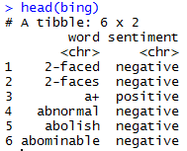
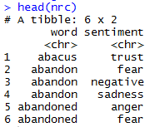
TidyText has other sentiment lexicons
Each can be used in an inner join to get different ways of assessing sentiment.
AFINN- Dutch researcher
Words scored -5 to 5
Bing- U of I-Chi Researcher
Words scored Pos/Neg
NRC – mTurk
Words classified into 8 primary & pos/neg
Weeknd Lyrics
Sentiment Lexicon

Slide 22
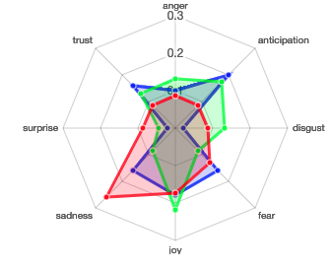
Remember Plutchik’s Wheel of emotion? Let’s mimic it!
The script drops positive & negative to focus on the explicit emotions.

Slide 23
Let’s practice sentiment analysis
Open 6_TidyText_Sentiment_revised.R
Open A_TidyText_Sentiment_song.R

Slide 24

Now let’s try it on more interesting data.
Open B_TidyText_Sentiment_complaint.R

Slide 25
Speaking of emoji…what should you do?
Open C_dealing_with_emoji.R
It’s a design choice, you can ignore them, remove them, substitute them to their name or even just sub to a single word like happy or sad.

Slide 26

There are multiple other packages to assess sentiment.
Open D_other_sentiment.R
Yes, you can have an LLM perform sentiment analysis but remember it’s often not necessarily repeatable compared to dictionary based approaches.

