Slide 1
Syntactic Parsing & Lemmatization

Slide 2
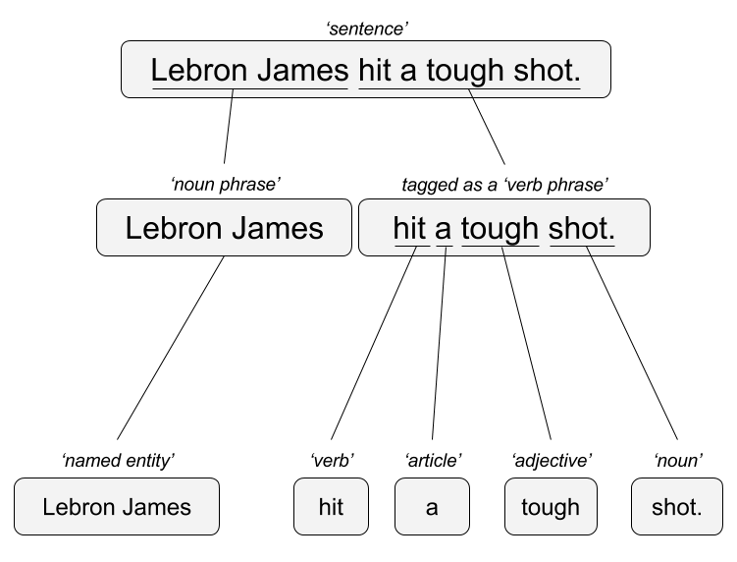

Remember this?!
“Lebron James hit a tough shot.”
Syntactic Parsing
Bag of Words
Lebron
a
James
hit
tough
shot
*There are other approaches usually based on DNN, that I refer to “abstractive”

Slide 3
Within Syntactic Parsing, 2 example methods.
Syntactic Parsing
Universal Dependencies
StanfordOpenNLP

Slide 4
Context Free Grammars
A phrase is made up of child or constituent words
Noun Phrase
The university

Slide 5
Context Free Grammars
A phrase is made up of child or constituent words
Noun Phrase
The university
Article constituent
Noun
the
the
university

Slide 6
Context Free Grammars
A phrase is made up of child or constituent words
Noun Phrase
The university has great coffee
Article constituent
Noun
Determiner constituent
the
university
has great coffee

Slide 7
Context Free Grammars
A phrase is made up of child or constituent words
Noun Phrase
The university has great coffee
Article constituent
Noun
Determiner constituent
the
university
has great coffee
article constituent
adjective constituent
Another noun constituent
has
great
coffee
The constituents are optional ie noun constituent starts the process over again…

Slide 8
Context Free Grammars
A phrase is made up of child or constituent words
Noun Phrase
The university has great hot coffee with cream.
Article constituent
Noun
Determiner constituent
the
university
has great coffee
article constituent
adjective constituent
Another noun constituent
has
great
coffee
hot
with cream
adj noun constituent
Another noun constituent
The constituents are optional ie noun constituent starts the process over again…

Slide 9
Dependency View
Which word is it dependent upon (modifier)?
Grab
the
large
coffee
on
the
counter
near
the
pot
Grab what? Coffee

Slide 10
Dependency View
Which word is it dependent upon (modifier)?
Grab
the
large
coffee
on
the
counter
near
the
pot
Grab what? Coffee
What about the coffee? It’s the large one

Slide 11
Dependency View
Which word is it dependent upon (modifier)?
Grab
the
large
coffee
on
the
counter
near
the
pot
Grab what? Coffee
What about the coffee? It’s the large one
What is on the counter? Coffee

Slide 12
Dependency View
Which word is it dependent upon (modifier)?
Grab
the
large
coffee
on
the
counter
near
the
pot
Grab what? Coffee
What about the coffee? It’s the large one
What is on the counter? Coffee
“On the” is context for what? Counter

Slide 13
Dependency View
Which word is it dependent upon (modifier)?
Grab
the
large
coffee
on
the
counter
near
the
pot
Grab what? Coffee
What about the coffee? It’s the large one
What is on the counter? Coffee
“On the” is context for what? Counter
What is near the pot? Coffee

Slide 14
Dependency View
Which word is it dependent upon (modifier)?
Grab
the
large
coffee
on
the
counter
near
the
pot
Grab what? Coffee
What about the coffee? It’s the large one
What is on the counter? Coffee
“On the” is context for what? Counter
What is near the pot? Coffee
“near the” is context for what? Pot
Notes:
Good explanation
www.youtube.com/watch?v=PVShkZgXznc
12:15

Slide 15
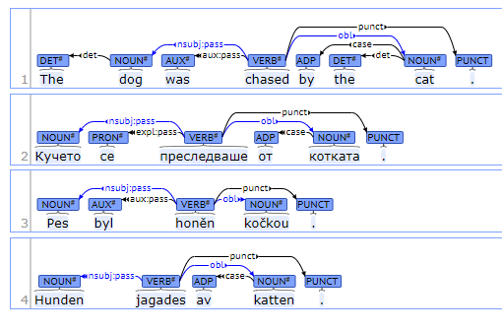
Universal Dependencies
Open Source Project w/200 Contributors
Uses annotated texts to parse to learn these tree structures
100 treebanks created
70 languages supported
“universal” in label types
Best interactive graphic: https://universaldependencies.org/introduction.html

Slide 16
Institute of formal & applies linguistics: UDPipe
Ported the use of UD into multiple software languages
UDPipe is a trainable pipeline for tokenization, tagging, lemmatization and dependency parsing of CoNLL-U (universal dependency format) files.
Most of the UD treebanks are supported
Multiple software languages: Linux, Window, OS X, C++, Python, Perl, Java, C#, API service and R
http://ufal.mff.cuni.cz/udpipe

Slide 17

Open E_UD_syntacticParsing.R
Great use of lemmatization as a preprocessing step even if you don’t use the POS tags
AI Generated Image

Slide 18
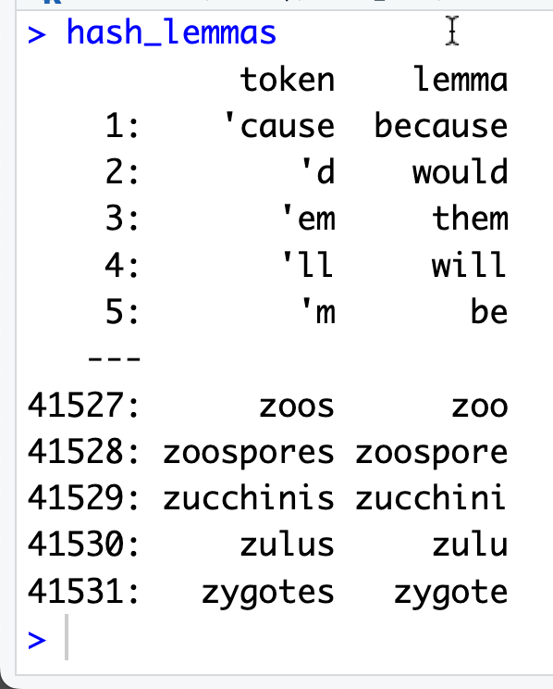
We can also do a dictionary based lemmatization
“While this is not a true morphological analysis this style of lemma replacement is fast and typically still robust.”
We have to protect our substitutions from inadvertent mistakes by using “anchors”.

Slide 19
Appendix – the less popular Stanford NLP project

Slide 20
Instead of manually annotated tree files…
Can you use machine learning to learn language heuristics?

Slide 21
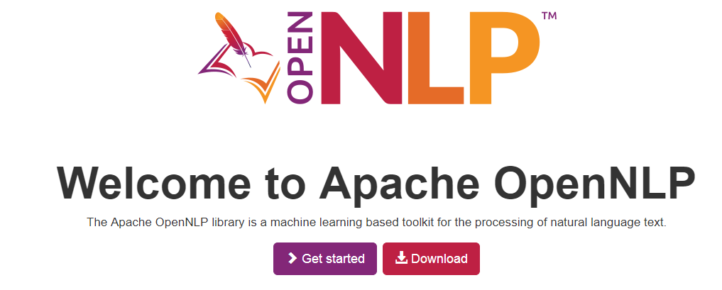
Apache NLP is a java ML open source project
R’s OpenNLP package wraps the Apache OpenNLP project. However, documentation & examples can be hard to come by.

Slide 22
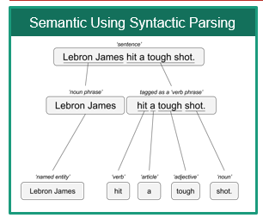
Annotation Models
Mix of Machine Learning &
Heuristics (2 words starting with capital letters may be a proper noun)
Annotations
Grammatical or POS (Part of Speech) Tagging
Sentence Tagging
Word Tagging
Named Entity Recognition
Persons
Locations
Organizations
Each Annotation is a model so this is slower than a treebank

Slide 23
Since each is a model, the output of 1 is used in the next.
His name is George. Washington is where he is from.
Without the “sentence” annotation “George Washington” could be incorrectly identified.

Slide 24
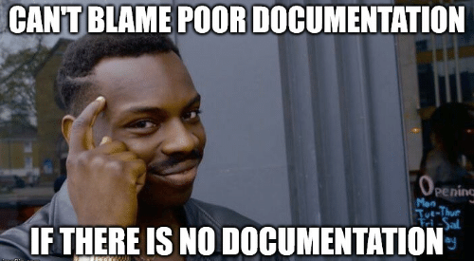
library(openNLP)
Examples are hard to come by
Documentation is not good either
https://rpubs.com/lmullen/nlp-chapter

Slide 25
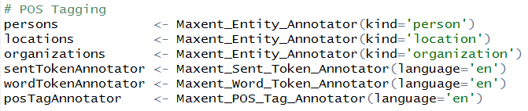
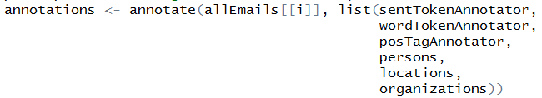
Nuances of openNLP
Load the ML models
A new class “String” (mind the caps)
Annotate the text with the models (mind the order)

Slide 26

Another TRAP!
Annotate is used in ggplot2 SO you must declare a namespace NLP::annotate(…) or ensure ggplot2 is not loaded in your environment!
p <- ggplot(mtcars, aes(x = wt, y = mpg)) + geom_point()
p + annotate("text", x = 4, y = 25, label = "Some text")
annotations <- annotate(allEmails[[i]],
list(sentTokenAnnotator,
wordTokenAnnotator,
posTagAnnotator,
persons,
locations,
organizations))

Slide 27
Let’s perform Named Entity Recognition
E_NER_syntaticParsing.R

