Slide 1

The future is “agentic”! Multiple LLMs will interact to solve subset tasks leading to a goal. Because it’s an emergent field, some define functionality that is a “prompt chain” while others have “LLM orchestration over LLMs”

Slide 2

There is a lot of promise & hype about LLMs talking to one another.
Agentic workflows may take us beyond the simple question-and-answer exchanges that have defined our initial forays into AI.
Instead, agentic workflows involve a cyclical process where AI systems continually refine their outputs, learn from interactions, and contribute more effectively over time
The next 24months may have “agentic” workflows, not bigger models.

Slide 3
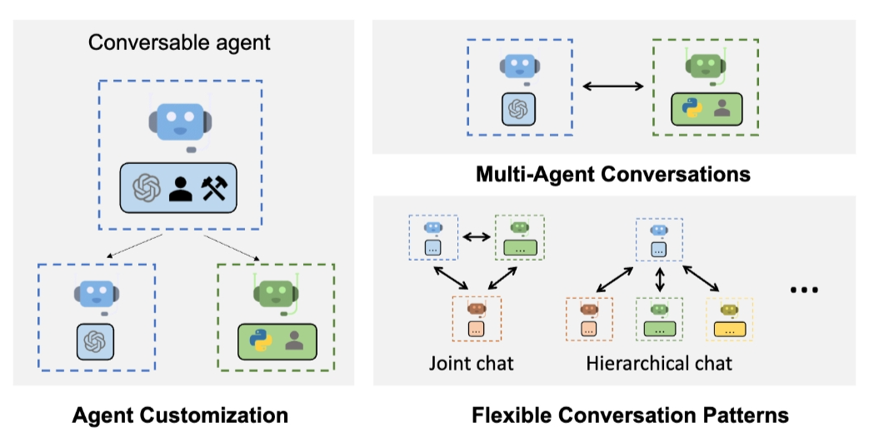
Problem solving agent workflows are emerging.
https://www.youtube.com/watch?v=sal78ACtGTc&ab_channel=SequoiaCapital

Slide 4

Open E_promptChainExample.R

Slide 5
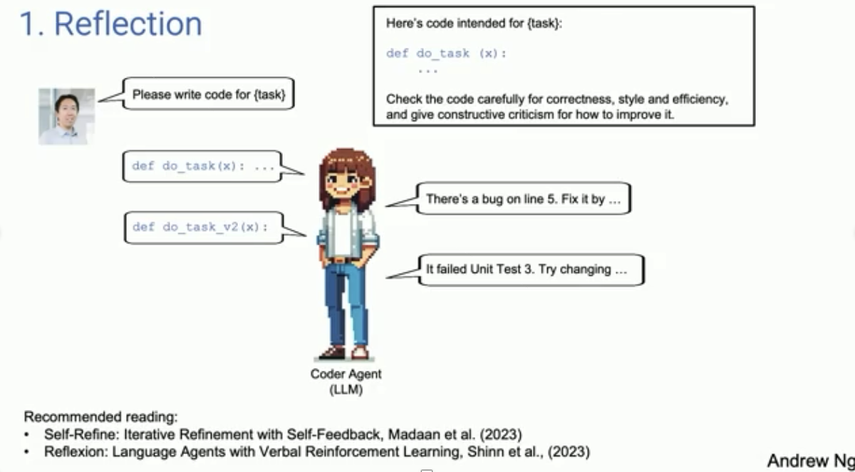
Primer on Agentic Systems – see bad quality in repo or YouTube video

Slide 6
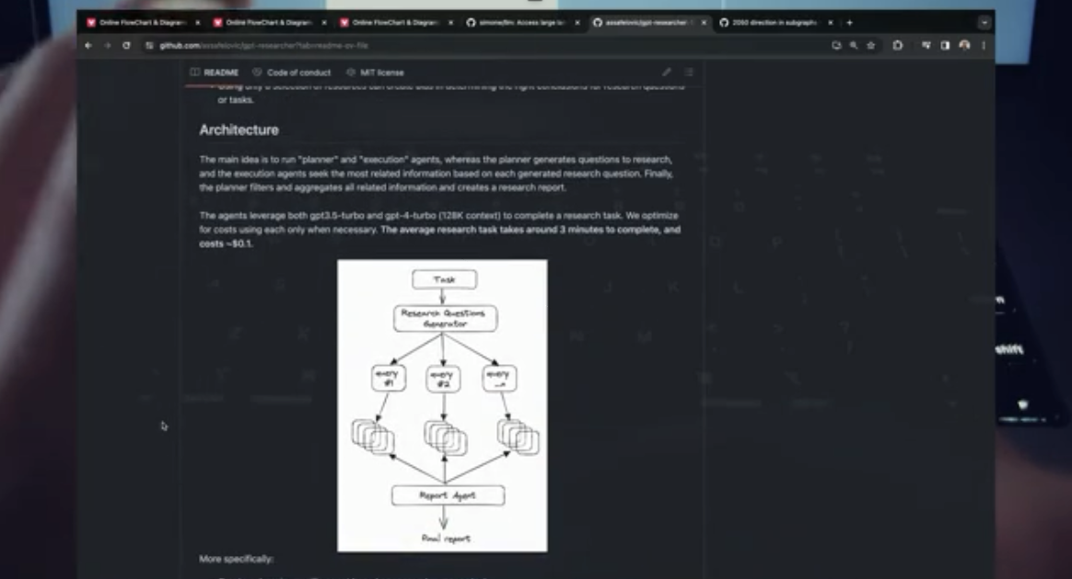
Chaining Workflows– see bad quality in repo or YouTube video

