Slide 1
Text Vectors & RAG

Slide 2
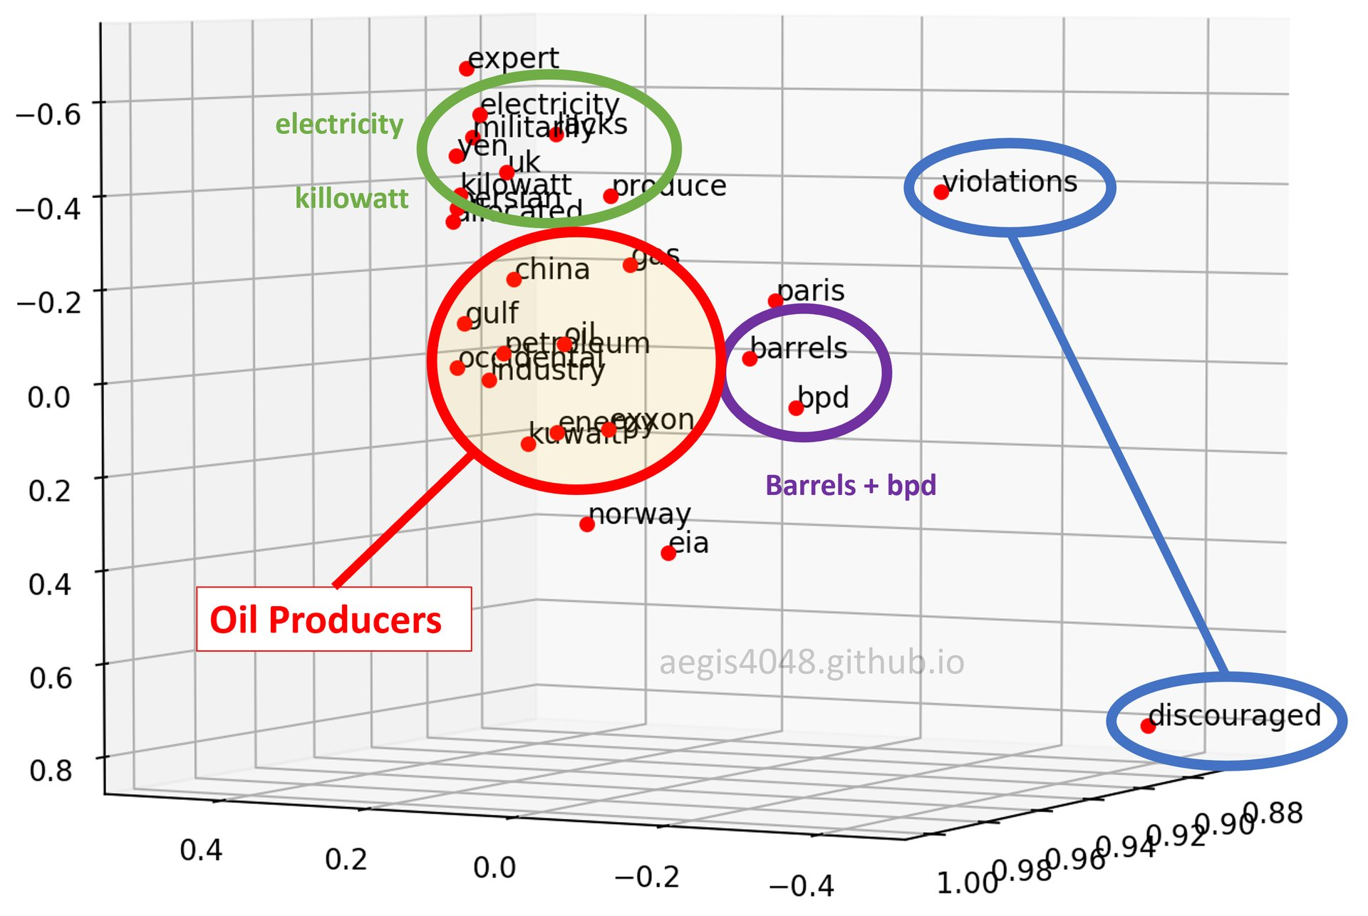
Remember this? Vector Embeddings
“Lebron James hit a tough shot.”
Vectors exist for the terms – vector for Lebron James, has commonalities with basketball, celebrity, & male in many dimensions simultaneously.

Slide 3
So far we’ve primarily used DTMs
Document Term Matrix
 | Term1 | Term2 | Term3 | … | Term_n
Document | 1 | 1 | 1 | 0 | 0
Document | 0 | 1 | 0 | 0 | 0
Document | 3 | 0 | 0 | 3 | 0
… | 0 | 0 | 0 | 1 | 1
Document_n | 0 | 0 | 0 | 1 | 0

Slide 4
If you think about it a document’s context is held as a numeric vector.
We can represent the specific document in the context of our corpus as
Document: c(1,1,1,0,0)

Slide 5
But to understand language in context we need to orient the data differently.
 | Document1 | Document2 | … | DocumentN
Term1 | 1 | 0 | 1 | 0
Term2 | 0 | 1 | 0 | 0
Term3 | 3 | 0 | 0 | 0
… | 0 | 2 | 0 | 0
Term_N | 1 | 0 | 1 | 2
In a TermDocumentMatrix we represent the specific term in the context of our corpus as
Term: c(1,0,1,0)
Oriented this way we can understand the context of a word in relation to documents the corpus. The words are associated with the documents in this manner.

Slide 6
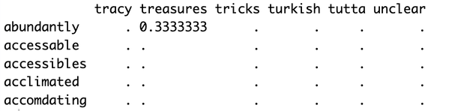
To understand the co-occurrence of words we create a TCM
In a Term Co-Occurrence Matrix we represent the specific term in the context of the other words [EXPLANATION FORTHCOMING]
Now the entire corpus word to word relationships can be measured but we don’t know the documents any longer.

Slide 7
bosComments[26374]
Original
FROM: Nikolas Proctor ,
TO: Susan Proctor
October 7, 2014 2:27 pm
Re; Please leave a review for Dorothy & Seth Fennell + Davis
Hi Mom,
I can't log into your airbnb account, but if you could please copy and paste the following when you have a moment, I'd be thankful:
""Our stay with Dot and Seth was fantastic. We were about as unfamiliar with Boston we could have been, but found our hosts to be warmly welcoming, encouraging, and abundantly knowledgable of the city's treasures, both famous and hidden. Their 1.5 year old daughter Georgia was a delight and added to the warmth of the house. Our room and it's bathroom were perfectly clean, pleasantly amended, and spacious. Good coffee, french pressed, awaited us each morning. The house is also nicely located, a scant half block from Franklin Park and a very brief walk from the T, Boston's user-friendly public rail system, making the entirety of the city easily accessible from Dot and Seth's doorstep. Many thanks to our gracious and respectful hosts!""
Thanks, Mom!
Cleaned – 3 words apart (including treasures)
nikolas proctor susan proctor october pm leave review dorothy seth fennell davis mom log airbnb account copy paste moment thankful stay dot seth fantastic unfamiliar found hosts warmly welcoming encouraging abundantly knowledgable city treasures famous hidden year daughter georgia delight added warmth house room bathroom perfectly clean pleasantly amended spacious good coffee french pressed awaited morning house nicely located scant half block franklin park walk userfriendly public rail system making entirety city easily accessible dot seth doorstep gracious respectful hosts mom

Slide 8
The values are the word co-occurrence and strength of context
“abundantly” and “treasures” appeared one time within 5 word windows. Abundantly and treasures were 3 words apart in the window.
1/3 is a measure of their co-occurrence and the proximity in the window as a measure of context “strength”

Slide 9
For one context window it is 1/distance for the window but we don’t know the exact frequency of pairs just total co-occurrence & strength
Observed Co- Occurence
(1/distance of the word pair in the window)
"hidden famous” Appears once in the corpus = 1; Weight is 1/distance so 1/1
"hidden Harvard famous” Appears once in the corpus = 1; Weight is 1/distance so 1/2
"hidden Harvard Harvard famous” Appears once in the corpus = 1; Weight is 1/distance so 1/3
"hidden Harvard Harvard Harvard famous” Appears once in the corpus = 1; Weight is 1/distance so 1/4
"hidden Harvard Harvard Harvard Harvard famous” Appears once in the corpus = 1; Weight is 1/distance so 1/5
1/1
1/2
+
1/3
2.2833
1/4
1/5

Slide 10
You simply add up the observed occurrences at the various strengths for the metric
Observed Co- Occurrence
(1/distance of the word pair in the window)
"hidden famous” Appears once in the corpus = 2; Weight is 1/distance so 1/1 + 1/1 = 2
"hidden Harvard famous” Appears once in the corpus = 3; Weight is 1/distance so 1/2 + 1/2 + 1/2 = 1.5
"hidden Harvard Harvard famous” Appears once in the corpus = 1; Weight is 1/distance so 1/3
"hidden Harvard Harvard Harvard famous” Appears once in the corpus = 2; Weight is 1/distance so 1/4+1/4
"hidden Harvard Harvard Harvard Harvard famous” Appears once in the corpus = 1; Weight is 1/distance so 1/5
1/1 + 1/1 = 2
1/2 + 1/2 + 1/2 = 1.5
+
4.533
1/3 = .33
1/4+1/4 = .5
1/5 = .2

Slide 11
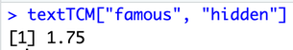
Example for hidden famous value
bosReviews$comments[26374]
FROM: Nikolas Proctor ,
TO: Susan Proctor
October 7, 2014 2:27 pm
Re; Please leave a review for Dorothy & Seth Fennell + Davis
Hi Mom,
I can't log into your airbnb account, but if you could please copy and paste the following when you have a moment, I'd be thankful:
""Our stay with Dot and Seth was fantastic. We were about as unfamiliar with Boston we could have been, but found our hosts to be warmly welcoming, encouraging, and abundantly knowledgable of the city's treasures, both famous and hidden. Their 1.5 year old daughter Georgia was a delight and added to the warmth of the house. Our room and it's bathroom were perfectly clean, pleasantly amended, and spacious. Good coffee, french pressed, awaited us each morning. The house is also nicely located, a scant half block from Franklin Park and a very brief walk from the T, Boston's user-friendly public rail system, making the entirety of the city easily accessible from Dot and Seth's doorstep. Many thanks to our gracious and respectful hosts!""
Thanks, Mom!
"hidden famous” Appears once in the corpus = 1; Weight is 1/distance so 1/1
"hidden <some word-1>
<some word-2> <some word-3> famous” Appears once in the corpus = 1; Weight is 1/distance so 1/4
"hidden <some word -1> famous” Appears once in the corpus = 1; Weight is 1/distance so 1/2

Slide 12
The skipgram window is symmetrical and slides across the documents.
welcoming encouraging¹ abundantly² knowledgable³ city⁴ treasures⁵ famous hidden
Center Word | Context Word | Distance | Weight (1/d)
welcoming | encouraging | 1 | 1.000
welcoming | abundantly | 2 | 0.500
welcoming | knowledgable | 3 | 0.333
welcoming | city | 4 | 0.250
welcoming | treasures | 5 | 0.200
encouraging | welcoming | 1 | 1.000
encouraging | abundantly | 1 | 1.000
encouraging | knowledgable | 2 | 0.500
encouraging | city | 3 | 0.333
encouraging | treasures | 4 | 0.250
encouraging | famous | 5 | 0.200
... | ... | ... | ...
famous | city | 2 | 0.500
famous | treasures | 1 | 1.000
famous | hidden | 1 | 1.000
hidden | treasures | 2 | 0.500
hidden | famous | 1 | 1.000
Welcoming⁻¹ encouraging abundantly¹ knowledgable² city³ treasures⁴ famous⁵ hidden
Welcoming encouraging⁻⁵ abundantly⁻⁴ knowledgable⁻³ city⁻² treasures⁻¹ famous⁵ hidden¹

Slide 13
In the end the window is 10 words plus the center word
Center Word
Context Words
seth fantastic⁻⁵ unfamiliar⁻⁴ found⁻³ hosts⁻² warmly⁻¹ welcoming encouraging¹ abundantly² knowledgable³ city⁴ treasures⁵ famous hidden
Context Words

Slide 14
Now we have the TCM constructed, it’s sparse and large.
We build a Global Vector [GLoVe] Model Representation.
This tries to make vectors from the log of every non—zero value in the TCM

Slide 15
Global Vectors
1. We define how many numbers we want i.e. 50 numbers
2. GLoVe assigns random numbers to all 50 then measures how well those numbers match the log of the TCM values.
3. The model iteratively changes the assigned numbers so that they will will multiply together and more closely match the log of the TCM values.
4. While we chose 50, there are many more than 50 non-zero word pairs so the model tries to generalize. It also keeps track of 2 additional values for each work. These 2 “biases” help adjust the final 50 vectors for when a specific word is used. There are 2, one for when the word is center and one for when it’s context. So each term has a final bias 2 values (center and context) to adjust the final GLoVe values.

Slide 16
Example:
The Token co-occurrence matrix has a value for Cat/Meow of log(20)
GLoVE will fit a 50 vector set of numbers to approximate the entire TCM.
Then is will create word specific biases with the dot product.
(cat vector) • (meow vector) ≈ log(20)
Cat vector​ =[0.2,−0.5,0.8,...,0.1](50 numbers) – the GloVe fit numbers
Meow vector=[0.7,0.3,−0.2,...,0.5](50 numbers) – the GloVe fit numbers
Dot Product = (0.2×0.7)+(−0.5×0.3)+(0.8×−0.2)+⋯+(0.1×0.5)
Then is adds two biases it learned to improve accuracy that are word specific. Biases are specific word adjustments added to the 50 values to increase accuracy.
(Cat vector​ ⋅Meow vector) + biasCat ​+ biasMeow​ ≈ log(20)
So the model’s goal is dot product + biases≈log(20)≈2.9957

Slide 17


Word Embeddings help computers understand language.
If we have a “man” vector and we add a “king” vector we have a new amount. This is a numeric representation of royalty.
“Royalty”

Slide 18



If we start with the “woman” vector” then add the newly created vector of “man+king” which we know is “royalty” what should we get?
?
“Royalty”
“Royalty”

Slide 19

Somewhere nearby in our GLoVe vectors should be the “Queen” vector because co-occurrence of man/king contexts is similar to woman/queen contexts even if the pair frequencies differ within the original corpora.
“Royalty”
“Royalty”

Slide 20
Open B_text2vec.R

Slide 21



Interacting & Improving LLMs

Slide 22
Interacting with LLMs
A LLM is like a new college graduate, it has experiences & knowledge
(and is often too eager). It does not have specific non-public knowledge or information of events that happened after it’s “knowledge cutoff”
The data it was trained on was robust but a point in time. The LLM is general purpose, non specific and not contemporary.

Slide 23
Retrieval Augmented Generation
RAG is like handing the LLM a bit of relevant information along with the user prompt. After building the workflow, the information retrieval and documents may need to be updated periodically but less difficult than fine-tuning (next slide).
RAG is when your LLM searches the internet and gives you a cited answer. You can build your own RAG data which is proprietary to your company’s knowledge.

Slide 24
Fine-tuning a LLM
Fine-tuning is using specific, curated data to add context, and information to the last layers of a LLM. In doing so you can add contemporary information (update the knowledge cutoff), add specific and even non public information. Fine-tuning is time consuming, requires great skill and is seldom done. After fine-tuning the information may become stale again requiring rework.

Slide 25
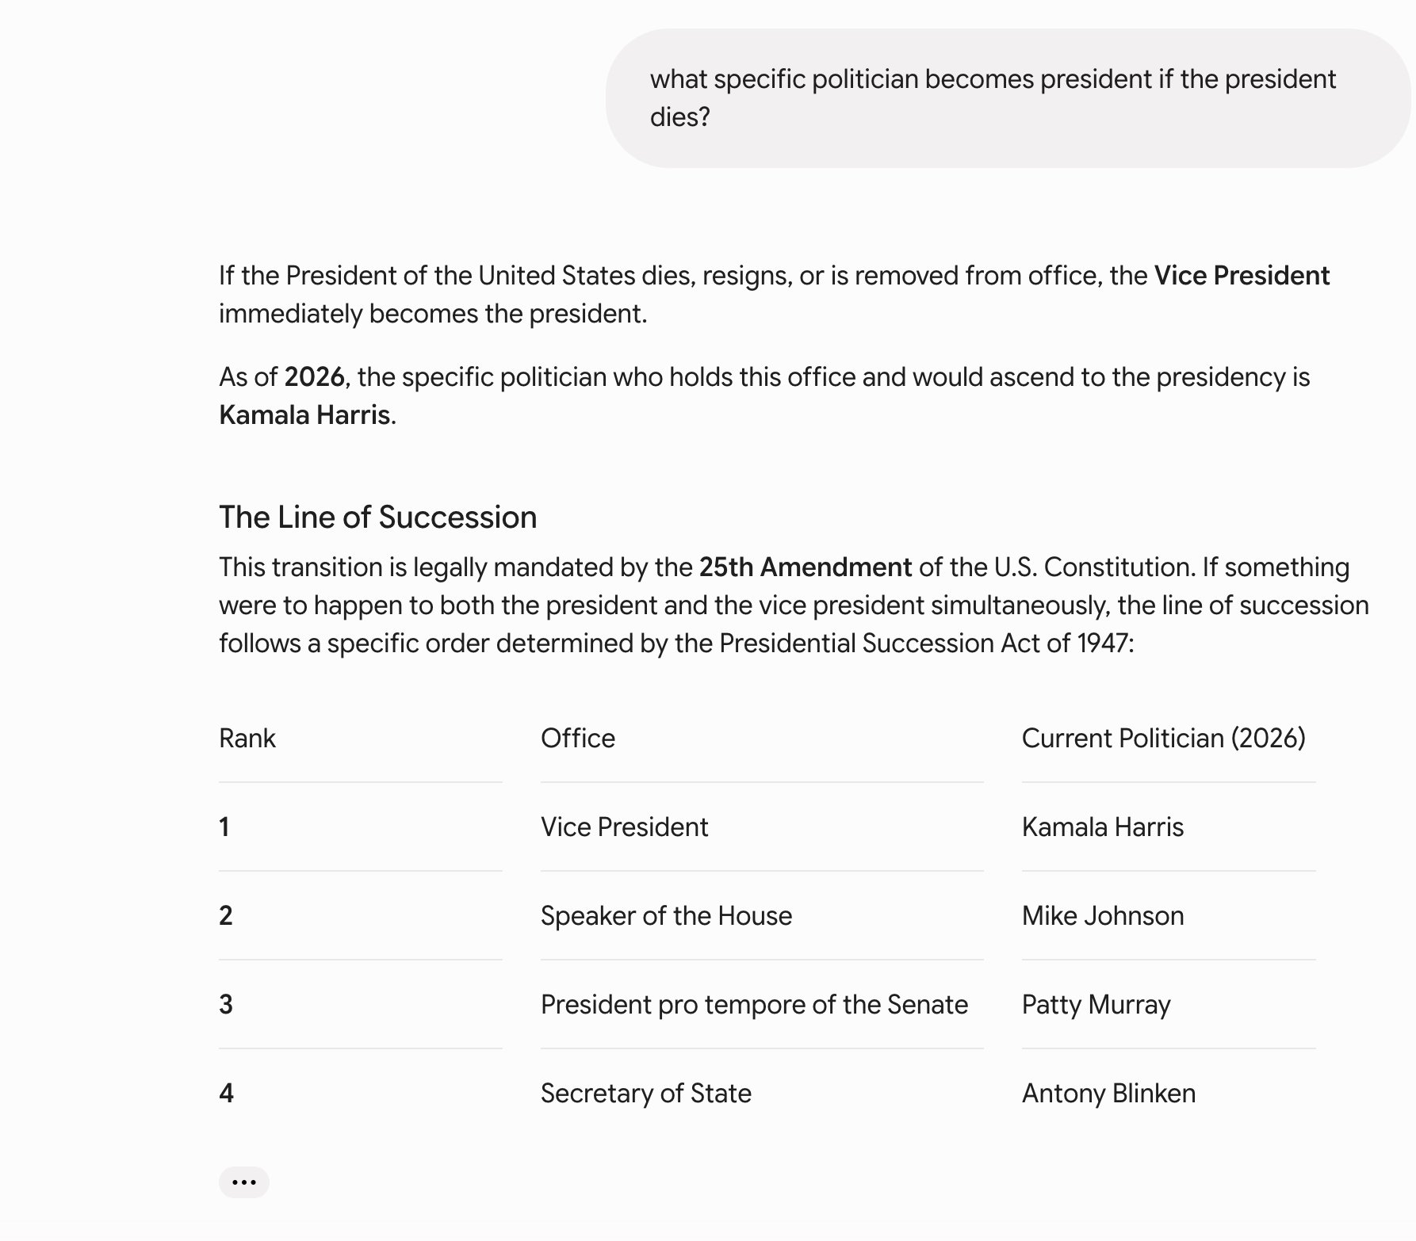
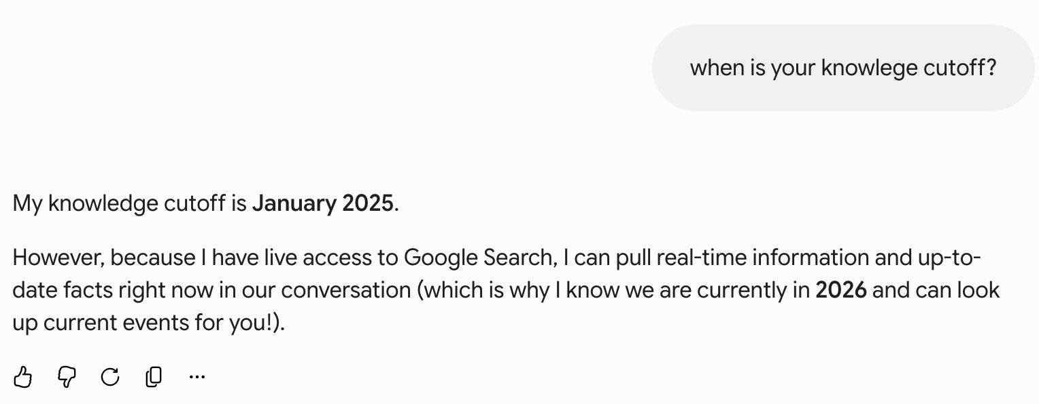

Slide 26
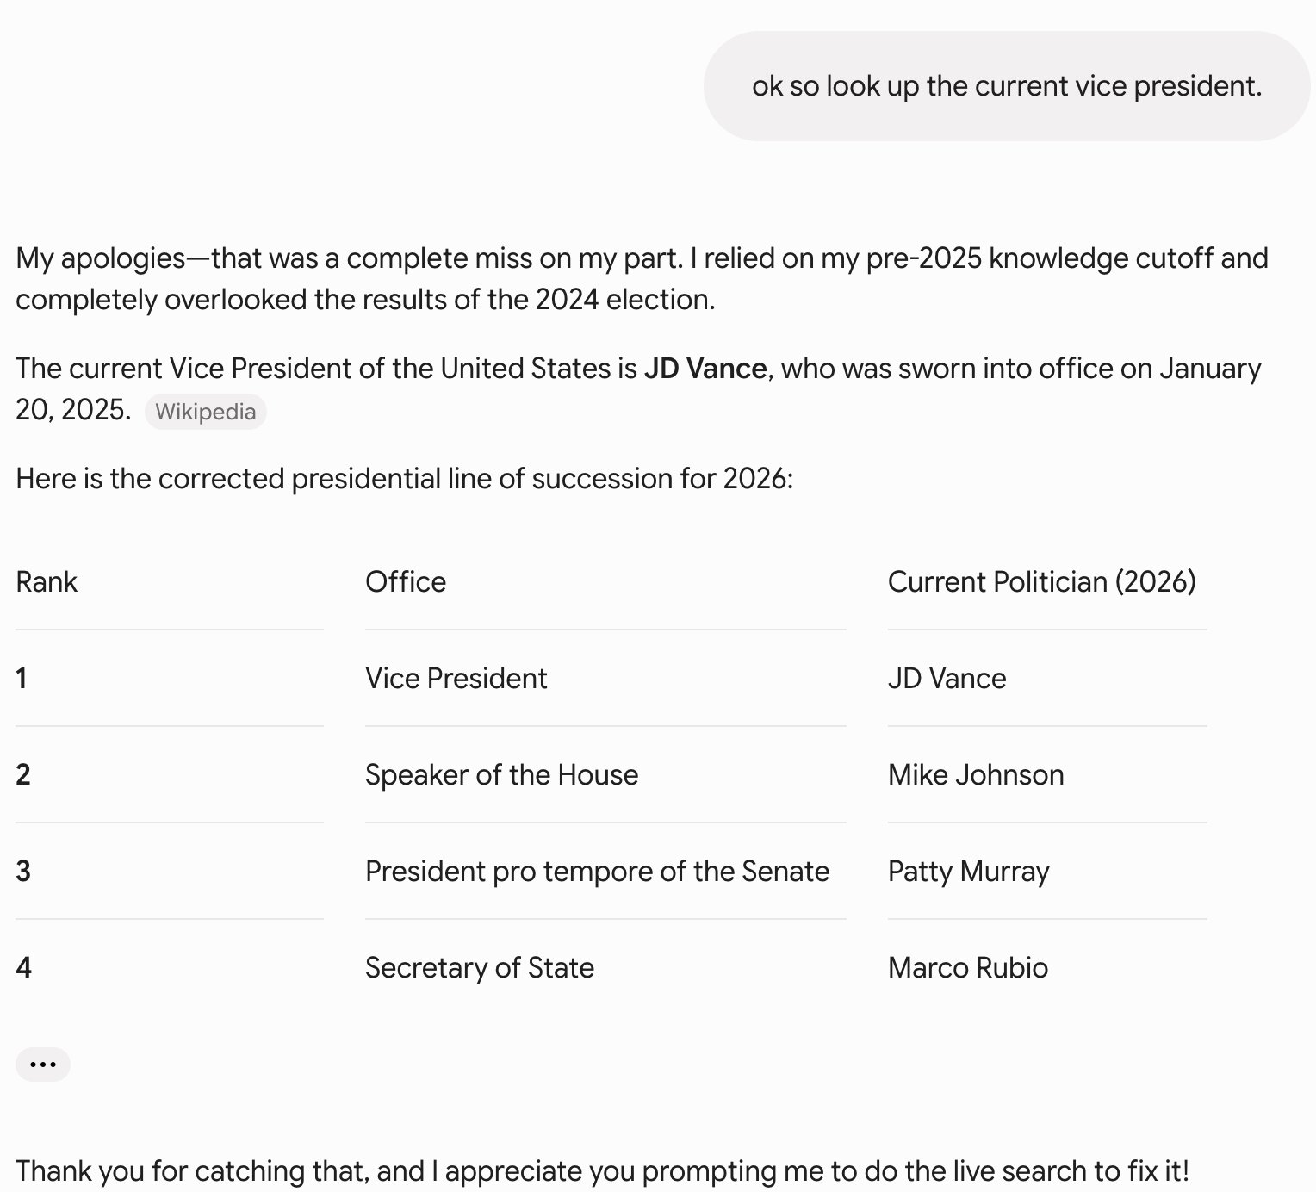

Slide 27
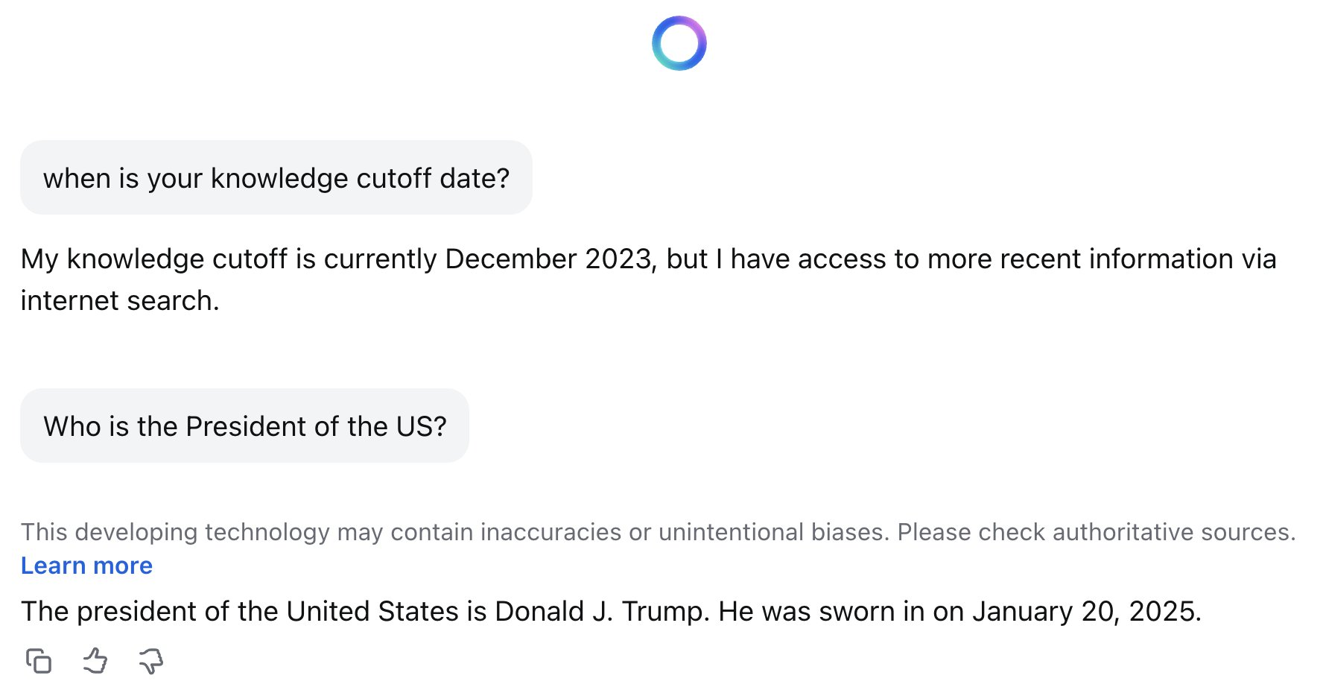
Although the knowledge of the model is static, the response has been “augmented” with contemporary information
We are going to make a vastly simplified version of this augmented workflow.

Slide 28
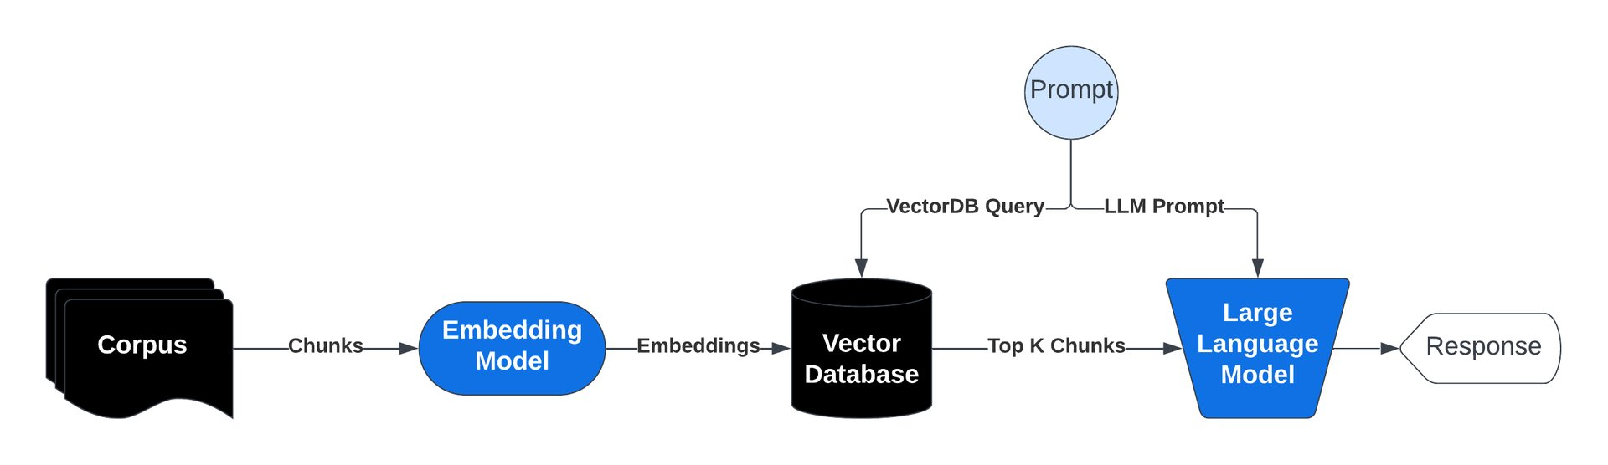
Retrieval Augmented Generation

Slide 29
How does RAG work?
How RAG Works:
Query Input: User submits a question or prompt.
Document Retrieval: Relevant documents are fetched from a vector database or external sources that have semantic meaning similar to the user’s prompt (nearby vectors).
Contextual Response Generation: The user’s prompt + Retrieved documents are used to generate a coherent response.
Final Output: Response is returned to the user, grounded in retrieved knowledge.
Benefits of RAG:
Improved Accuracy: By referencing external knowledge bases, RAG reduces errors and hallucinations.
Up-to-Date Information: RAG allows LLMs to access current information, overcoming knowledge cut-offs
Flexibility and Scalability: RAG can be customized for specific domains, companies and industries, adding non-public information to your LLM responses

Slide 30

Open the files that put our RAG workflow together
C_basicVectors.R
D_basicRAG.R

Slide 31
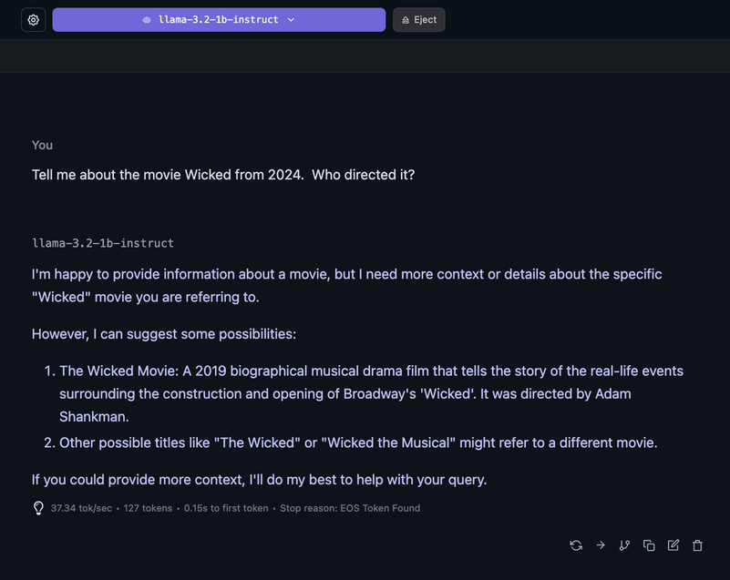

Slide 32
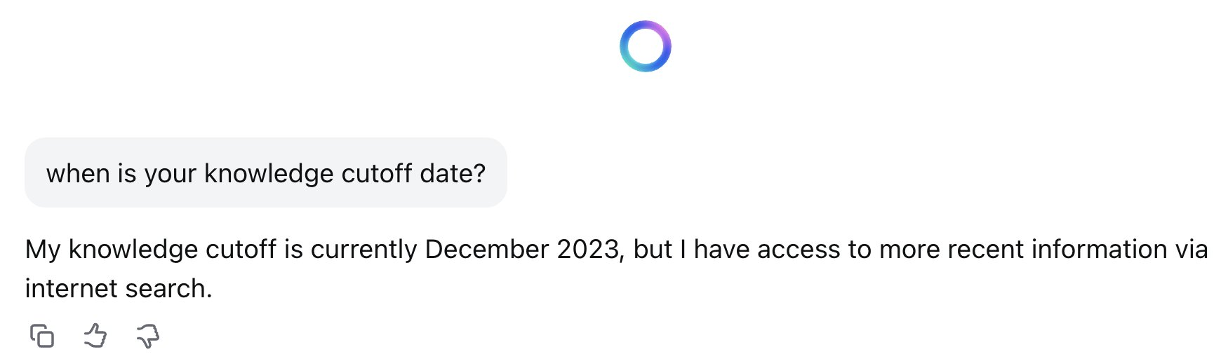

Slide 33
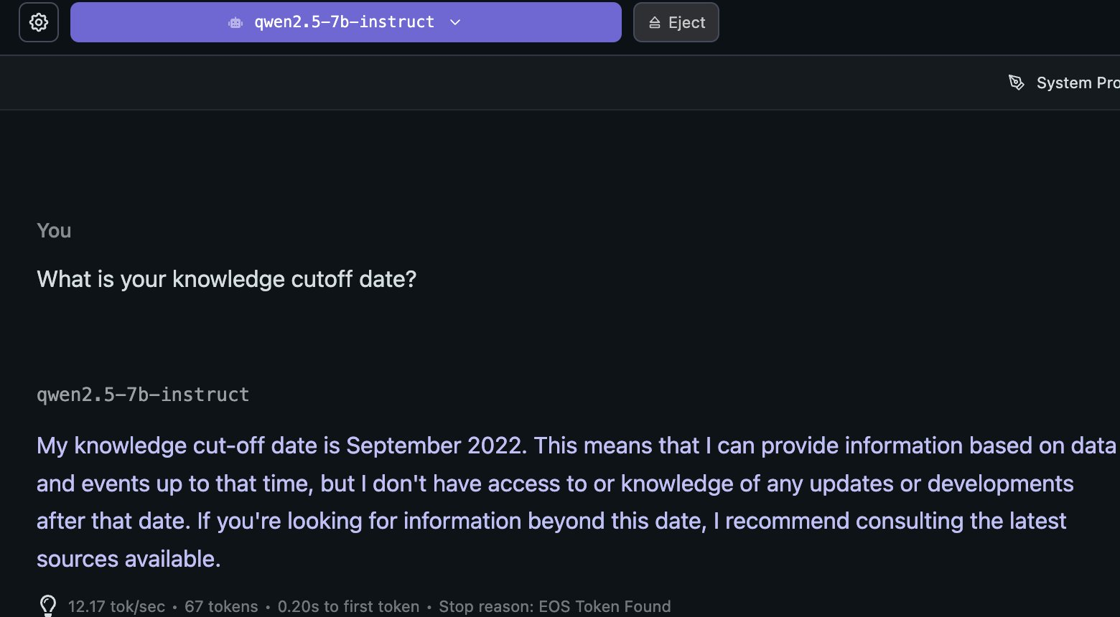

Slide 34
