Slide 1

The future is “agentic”! Multiple LLMs will interact to solve subset tasks leading to a goal. Because it’s an emergent field, some define functionality that is a “prompt chain” while others have “LLM orchestration over LLMs”

Slide 2

There is a lot of promise & hype about LLMs talking to one another.
Agentic workflows may take us beyond the simple question-and-answer exchanges that have defined our initial forays into AI.
Instead, agentic workflows involve a looping process where AI systems continually refine their outputs, learn from interactions, and contribute more effectively over time
The next 24months may have “agentic” workflows, not bigger models.

Slide 3
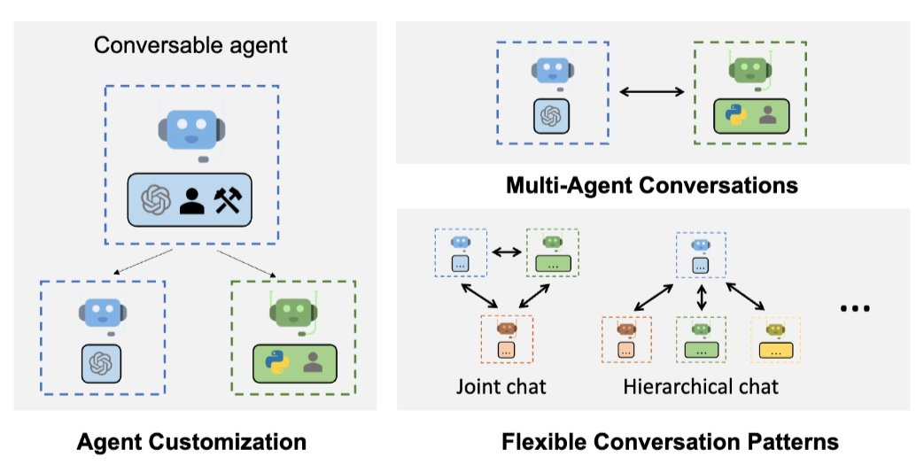
Problem solving agent workflows are emerging.

Slide 4

A prompt chain is a software team
Four specialist agents pass work down the line:
Product Owner → QC → Tech Writer → Programmer
In modern workflows, the order of the work has flipped.

Slide 5

The old way: code first
• A developer starts typing from a vague request “user story”.
• Spec and tests come later, if they come at all.
• “Done” means “it ran on my machine.”
Vague prompt in → inconsistent, often broken artifact out.

Slide 6

The new way: spec-first, test-first
1 Product Owner writes the functional spec because the prompt and described output is the code basis.
2 QC writes the regression checklist, before any code is written
3 Tech Writer documents the intended behavior
4 Programmer builds last, to pass the checklist
Success is defined before a line of code exists.

Slide 7
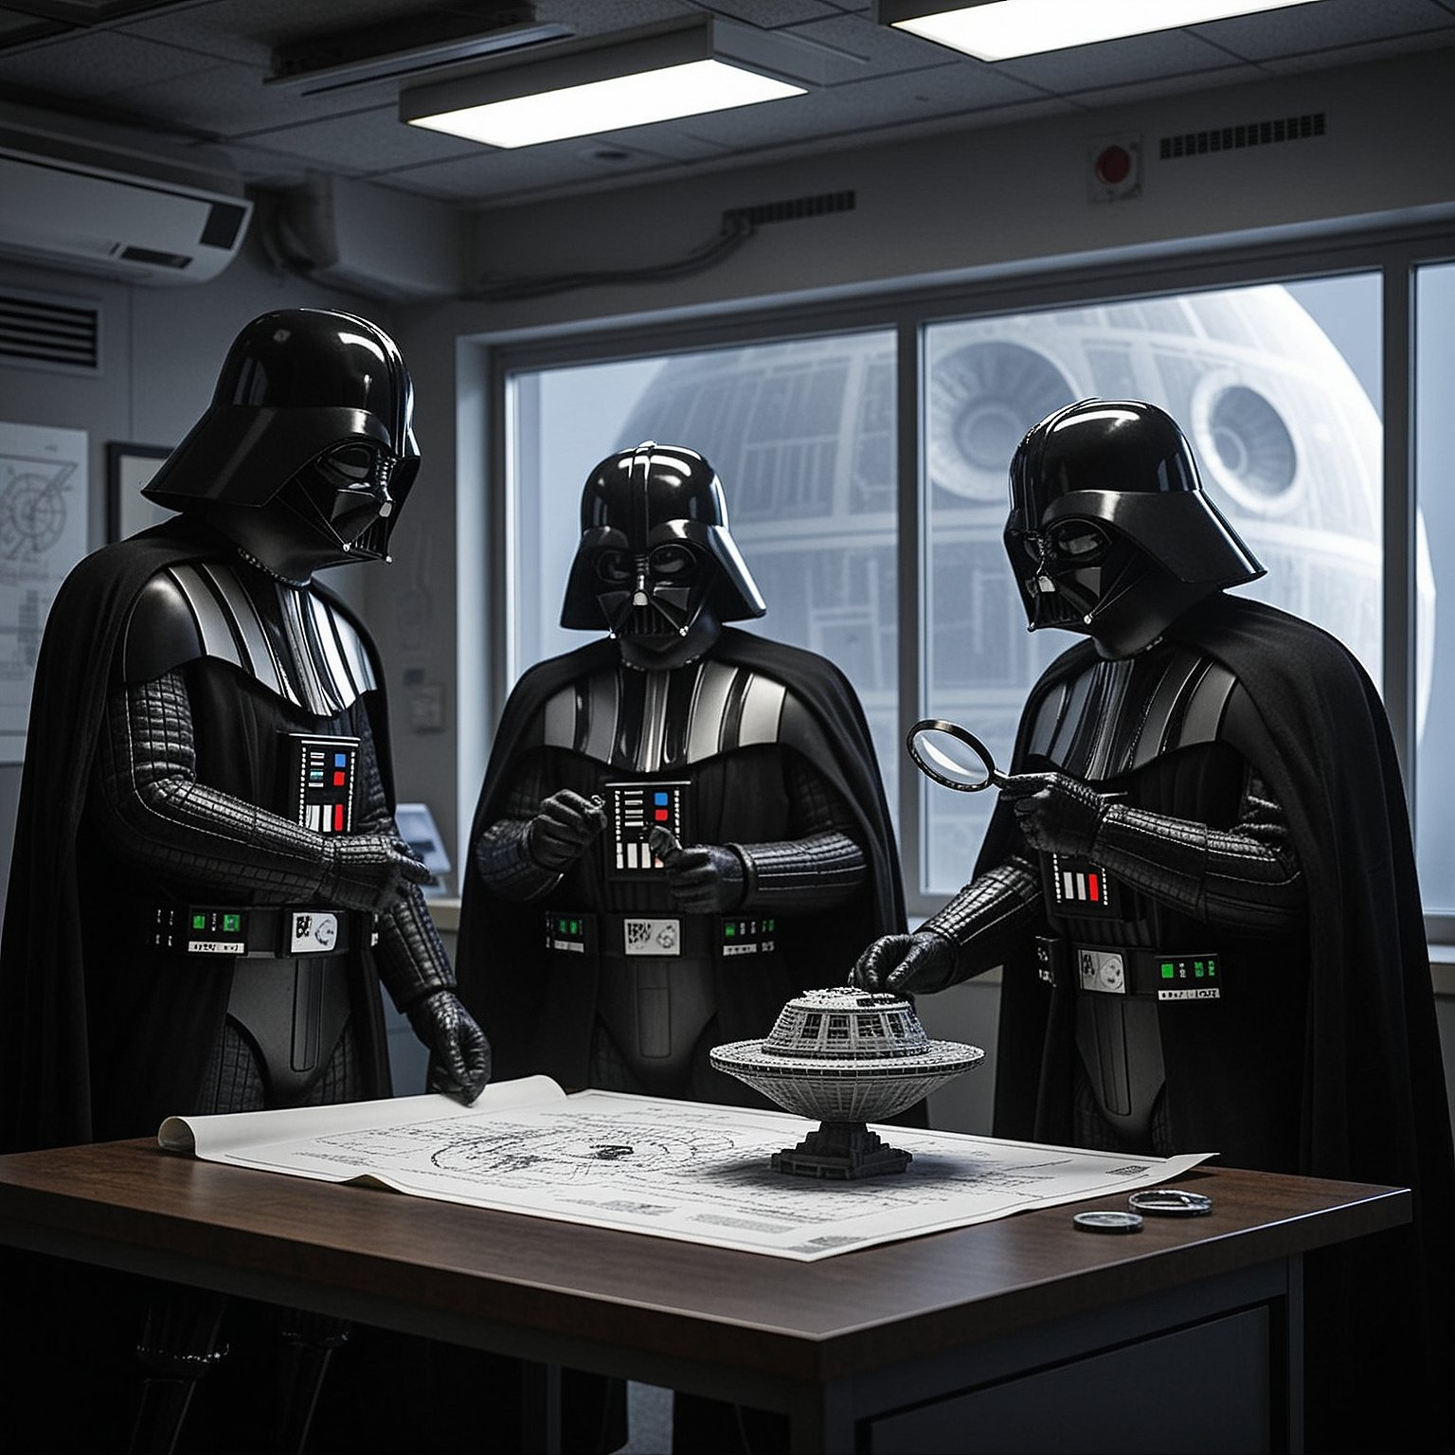
Why flip the order? Now you can test the prompts.
• Same model, same LLM agent chain, but swap the system-prompts and measure if the spec/tests are met.
• The QC checklist is a fixed regression suite across prompt versions.
Prompts are code. Code needs tests.

Slide 8
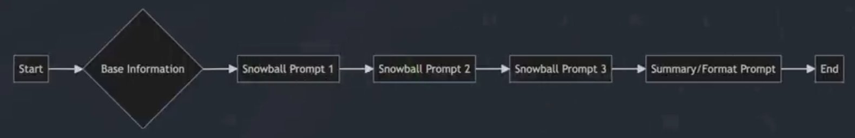
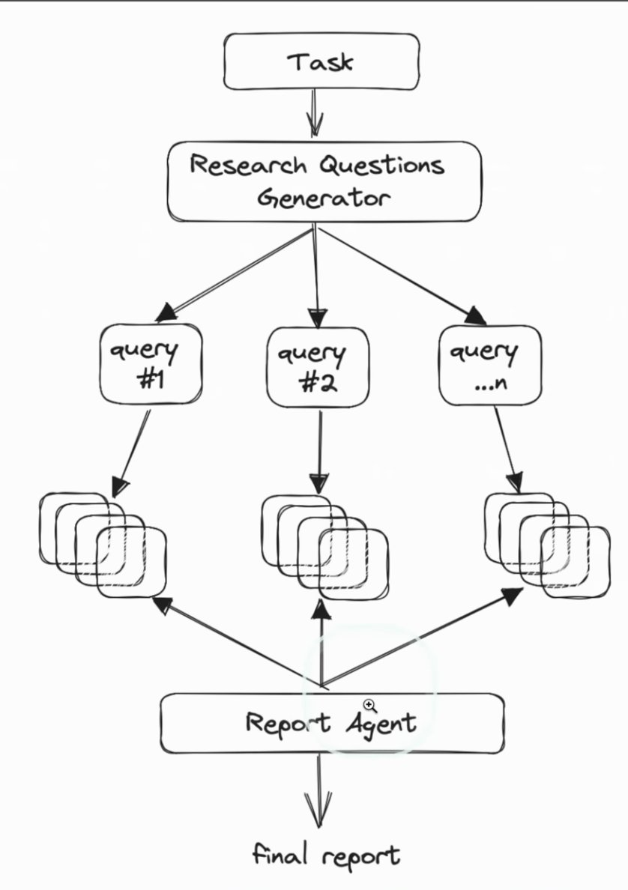
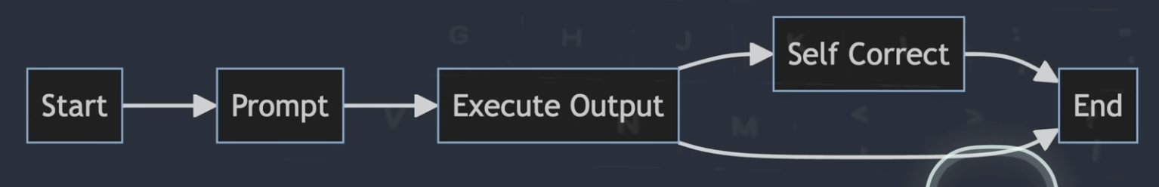
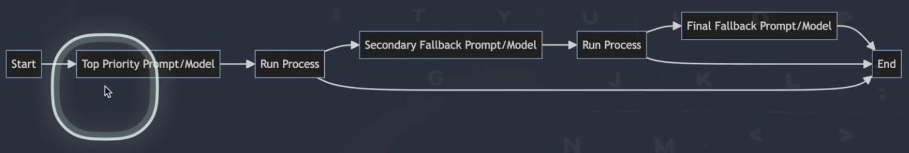
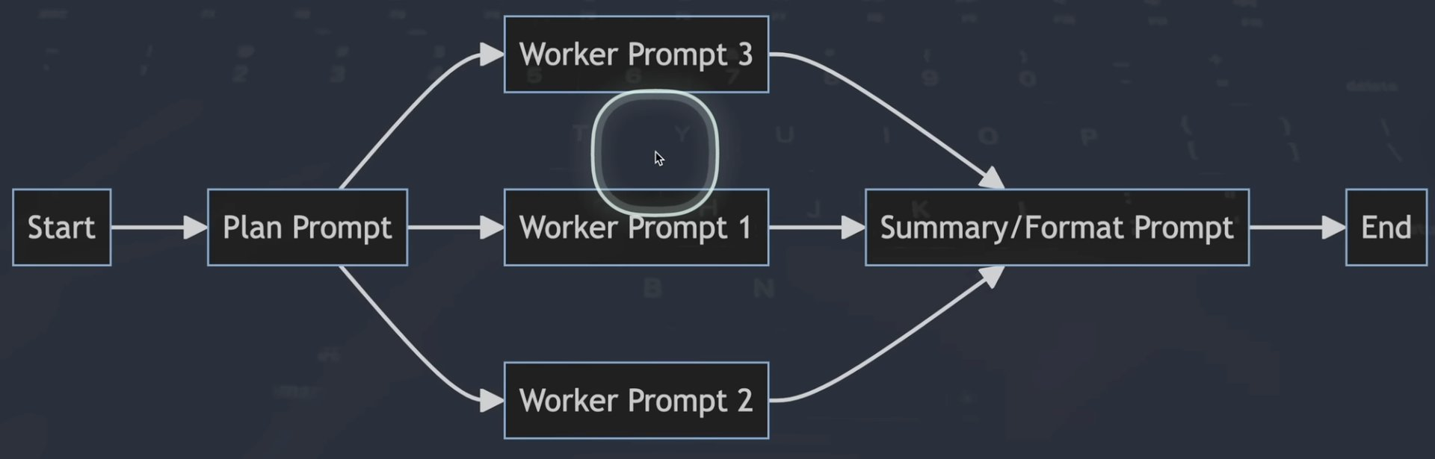
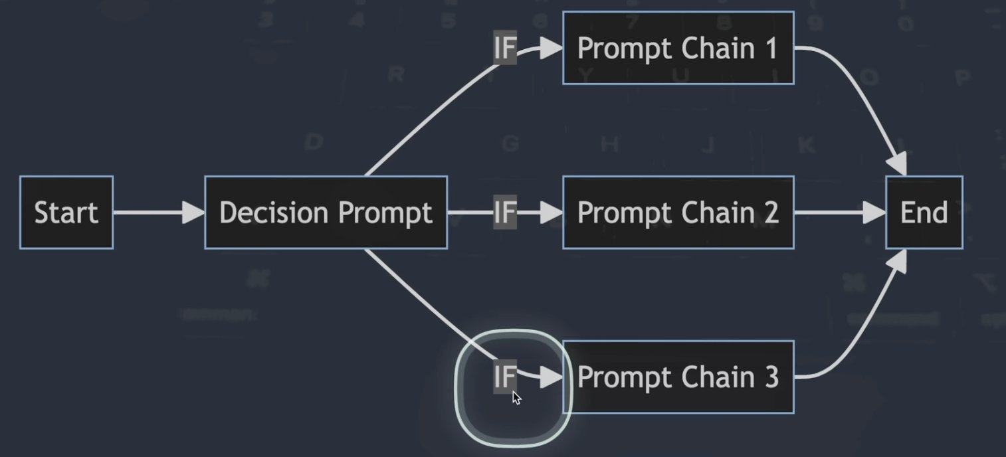
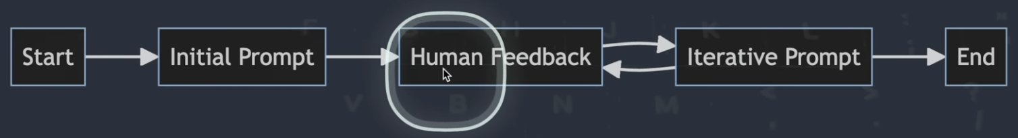
Chaining Workflows–E script or more complex on YouTube video
https://www.youtube.com/watch?v=QV6kaNFyoyQ&t=74s

Slide 9

Open E_promptChainExample.R

Slide 10
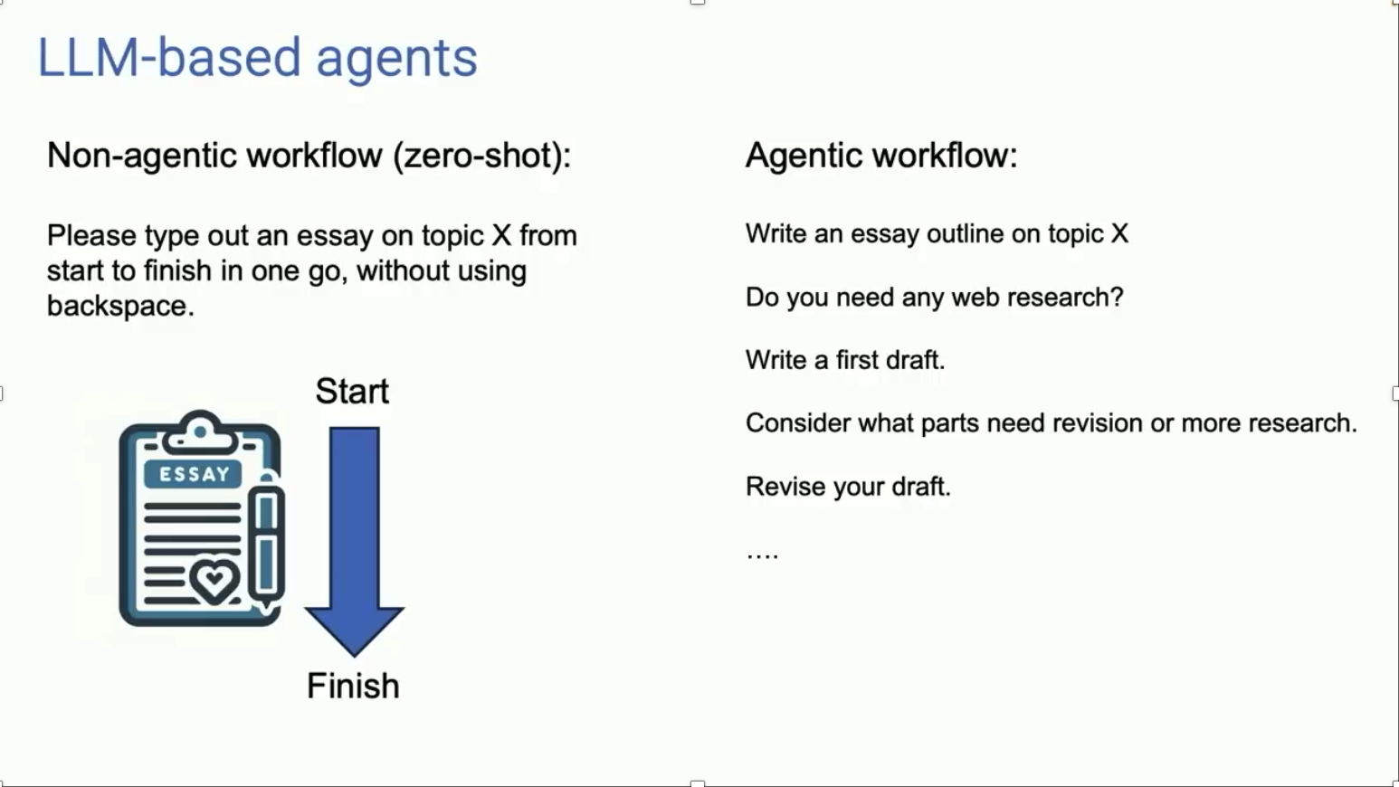
Primer on Agentic Systems – simplistic F script and primer on YouTube video
https://www.youtube.com/watch?v=sal78ACtGTc

Slide 11

Open F_agenticExample_w_agency.R

