Slide 1
GSERM: Text Mining & NLP Syntactic Parsing - openNLP
Ted Kwartler

Slide 2
Instead of manually annotated tree files…
Can you use machine learning to learn language heuristics?

Slide 3
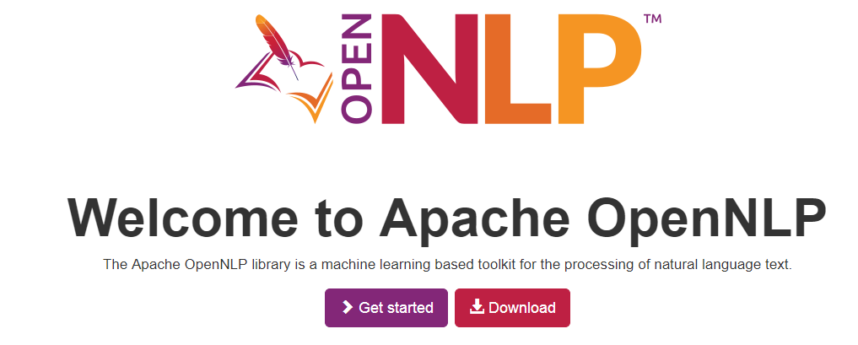
Apache NLP is a java ML open source project
R’s OpenNLP package wraps the Apache OpenNLP project. However, documentation & examples can be hard to come by.

Slide 4
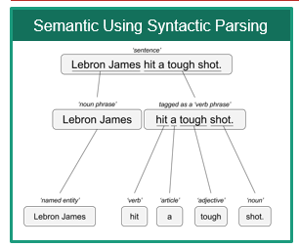
Annotation Models
Mix of Machine Learning &
Heuristics (2 words starting with capital letters may be a proper noun)
Annotations
Grammatical or POS (Part of Speech) Tagging
Sentence Tagging
Word Tagging
Named Entity Recognition
Persons
Locations
Organizations
Each Annotation is a model so this is slower than a treebank

Slide 5
Since each is a model, the output of 1 is used in the next.
His name is George. Washington is where he is from.
Without the “sentence” annotation “George Washington” could be incorrectly identified.

Slide 6
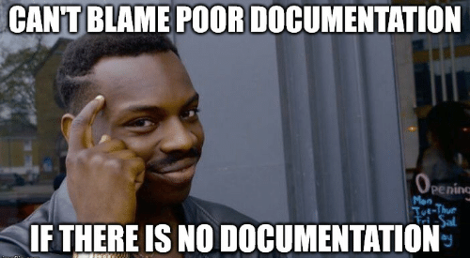
library(openNLP)
Examples are hard to come by
Documentation is not good either
https://rpubs.com/lmullen/nlp-chapter

Slide 7
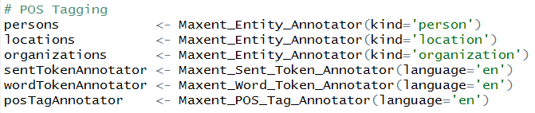
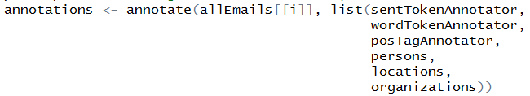
Nuances of openNLP
Load the ML models
A new class “String” (mind the caps)
Annotate the text with the models (mind the order)

Slide 8

Another TRAP!
Annotate is used in ggplot2 SO you must declare a namespace NLP::annotate(…) or ensure ggplot2 is not loaded in your environment!
p <- ggplot(mtcars, aes(x = wt, y = mpg)) + geom_point()
p + annotate("text", x = 4, y = 25, label = "Some text")
annotations <- annotate(allEmails[[i]],
list(sentTokenAnnotator,
wordTokenAnnotator,
posTagAnnotator,
persons,
locations,
organizations))

Slide 9
Let’s perform Named Entity Recognition
B_NER_syntaticParsing.R

