Slide 1
GSERM: Text Mining & NLP Data Science/NLP Ethics
Ted Kwartler

Slide 2
Definition of Ethics
ethics plural in form but singular or plural in construction : the discipline dealing with what is good and bad and with moral duty and obligation; a guiding philosophy
https://www.merriam-webster.com/dictionary/ethic

Slide 3
What about in the context of data, machine learning & AI?

Slide 4
What about in the context of data, machine learning & AI?
Does using data, text analysis and machine learning algorithms justify all actions since the underlying operations are just math?

Slide 5
What about in the context of data, machine learning & AI?
The use of data and text mining approaches can be audited, so are the outcomes of those efforts justified?

Slide 6
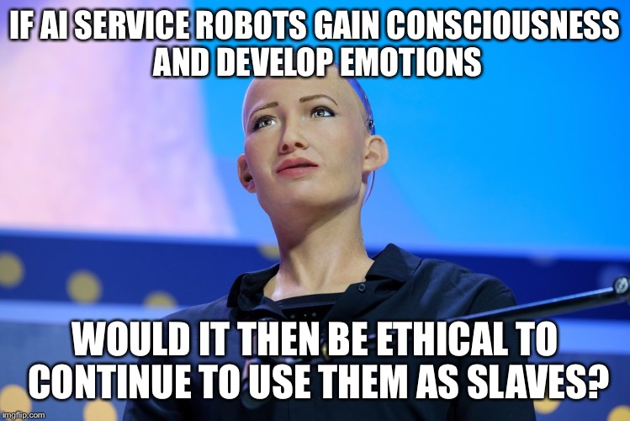
What about in the context of data, machine learning & AI?

Slide 7

IBM Watson

Slide 8
IBM Watson’s Cancer Recommendations
Is Watson’s seemingly amazing technology free from moral obligation?

Slide 9
IBM Watson’s Cancer Recommendations
Is there a business and data ethics question?

Slide 10
IBM Watson’s Cancer Recommendations
Is there bias in the textual data underlying the technology?

Slide 11
IBM Watson’s Cancer Recommendations
Who are the stakeholders?

Slide 12
IBM Watson’s Cancer Recommendations
Was it marketing ignorance, merely aspirational claims, or truly conscience deception? Does that matter to patients?
Do Technical researcher,s and machine learning engineers have a duty to inform others about the bias? Does the duty to inform shortcomings stop at management?
Do business leaders have a duty to question the choices and practices of technical creators?
What duty do the customers have to thoroughly review the underlying technology?

Slide 13

MSFT ML Research Team
The ML Research Team wanted to showcase conversational AI.

Slide 14
MSFT Tay
Is there a business and data ethics question? Who was impacted?

Slide 15
MSFT Tay
What did the technical practitioners and leaders miss?
What could have been done to mitigate the impact?

Slide 16
MSFT Tay
Harmless marketing stunt that turned ugly? As practitioners if we have to filter the training data and provide guardrails do we invite censorship & bias?

Slide 17
MSFT Tay
What if Tay was supposed to make cancer recommendations, pick stocks for your retirement, recommend purchases, or schedule an important appointment?

Slide 18
MSFT Tay
Is there a business and data ethics question? Who was impacted?
If so, what did the practitioners and leaders miss?
What could have been done to mitigate the impact?
Letting it loose with public info allowed the technology to be corrupted almost immediately. However, once the researcher/data scientist applies limitations to inputs, bias is introduced.

Slide 19

AMZN Alexa
What is alexa?
Is the technology helpful?

Slide 20
AMZN Alexa
In some cases, real humans are listening to Alexa utterances…
…
…
Is this a problem?

Slide 21
AMZN Alexa
In some cases, real humans are listening to Alexa utterances…
…
Audio
Phonemes Identified
&
matched to existing dictionary
Customer Intent
&
Response ID’ed
Audio Response
Alexa is a natural language understanding technology. Although unclear, it is likely mapping phonemes to text (speech to text) or numeric representations mapping ultimately to customer intent.

Slide 22
AMZN Alexa
Real humans are listening in some cases to Alexa utterances…
…
???
!@?
Hyderabad
Boston
No Match
to Phonemes or intent ID’ed
Text annotations
Audio transcription
Cu Intent Labeled
Added to training set
Buried Terms of Service? Do people know? Do people care? Is there an ethical consideration?

Slide 23
Researchers & Social Media

Slide 24

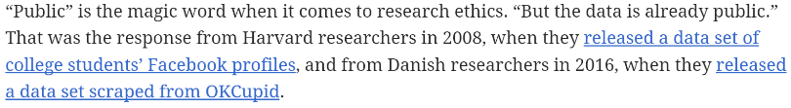
Researchers & Social Media
“for some researchers, whether the data is public is the only thing that matters”

Slide 25
Researchers & Social Media
Subject context: “breakfast” vs “medical” tweets
Amplification: to followers, to scientists, to academic papers, to journalists
Author context/Safety: “public” figures, at-risk populations (LGBTQ), political protesters
Researcher context: “spot the trans” person technology, state-sponsored spying/persecution
Is the sentiment “they should have known” good enough to meet an ethical threshold?

