Slide 1

Let’s make sure we’re all present.

Slide 2
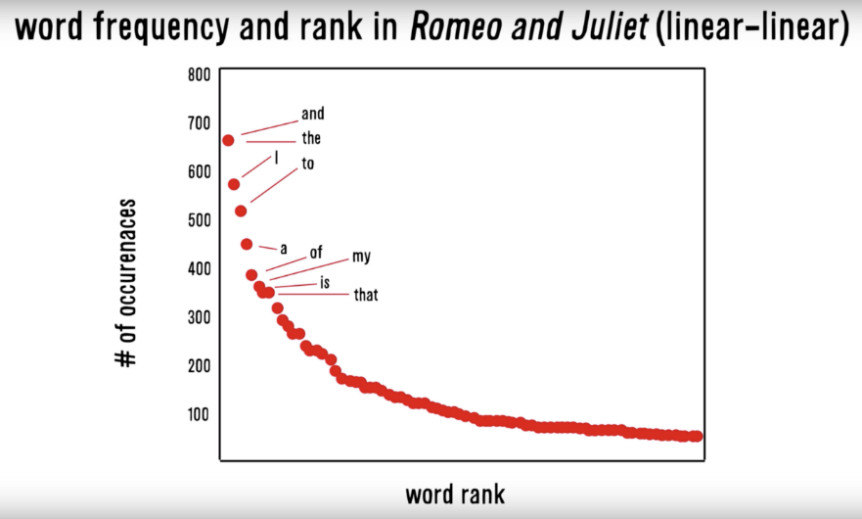
Zipf’s Law: Our words are less diverse than we think
Another Example
Many words in natural language but also a steep decline in actual usage.
Follows a predictable pattern.

Slide 3
Why do we see Zipf’s law in linguistics?
Principle of Least Effort Theory
Humans will choose a path of least resistance
Humans seek to minimize effort for a task
Therefore, even if we know 000s of words, we will use as few as possible to communicate.

Slide 4
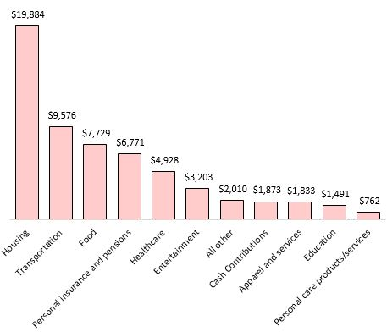
Where else do we see Zipf’s law?
Research in Personal Finance

Slide 5
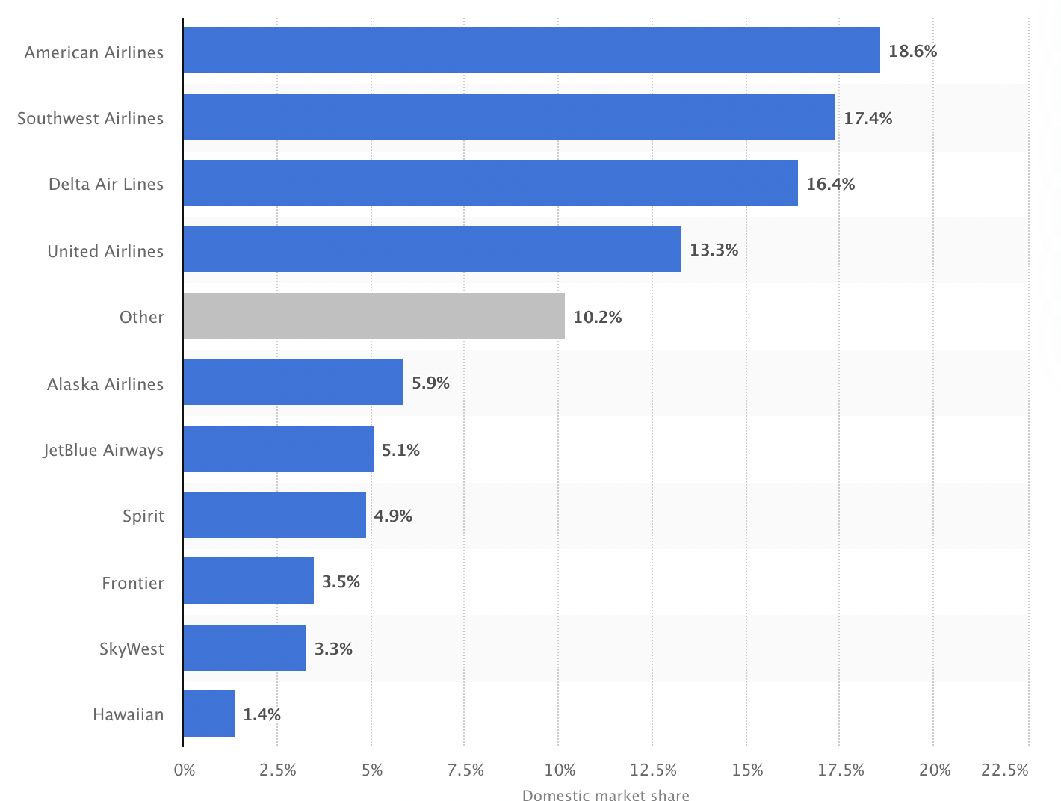
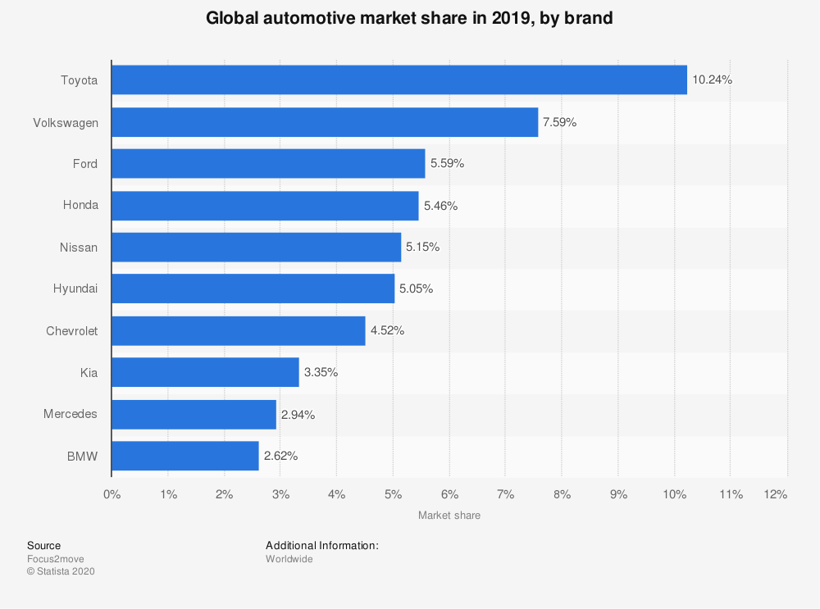
Not all industries reach this…hyper competitive!

Slide 6
A simple yet effective measure of polarity
Scoring
Identify a polarized word from a lexicon
Identify “context cluster”
ID Neutral Words
ID Amplifiers “very”
ID de-amplifiers i.e. “hardly”
ID Negators i.e. “not”
Assign Values
Neutral Words = 0
Amplifiers = 0.8
De-amplifiers = -0.8
ID Negators = -1 *
Sum Values
Divide Sum by sqrt of word count – accounts for length of document “how dense the polarity is”
Let’s open ﻿A_polarity_math.R to see it in action.

Slide 7
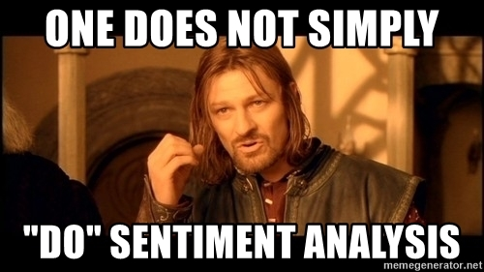
There are many other sentiment related packages
Open live_A_other_sentiment.R

Slide 8
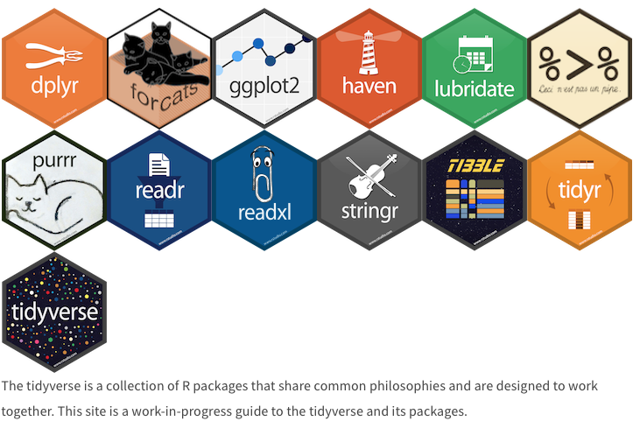
Tidyverse

Slide 9
Tidy Data Formats are structured differently
Tidy Form (Triplet, Dense Data)
Document Term Matrix
Document | Term | count
Tweet1 | Term2 | 1
Twee1 | term3 | 1
Tweet2 | Term2 | 1
Tweet3 | Term… | 3
Tweet… | Term… | 1
Tweet… | Term_n | 1
Tweet_n | Term… | 1
 | Term1 | Term2 | Term3 | … | Term_n
Tweet1 | 0 | 1 | 1 | 0 | 0
Tweet2 | 0 | 1 | 0 | 0 | 0
Tweet3 | 0 | 0 | 0 | 3 | 0
… | 0 | 0 | 0 | 1 | 1
Tweet_n | 0 | 0 | 0 | 1 | 0
Sparse Data: Memory used to hold 0s
Dense Data: Efficient in Memory

Slide 10

The pipe operator…%>%

Slide 11
Tidy data uses %>% to forward objects
In the “tidyverse” code is structured so it is more easily read using the %>%. The data format is a tibble usually not a data frame.
mtcars
mtcars %>% group_by(cyl)
mtcars %>% group_by(cyl) %>% mutate(rank = min_rank(desc(mpg)))
This reads as “Using the mtcars object then group by the cyl vector then mutate a new variable called rank.

Slide 12
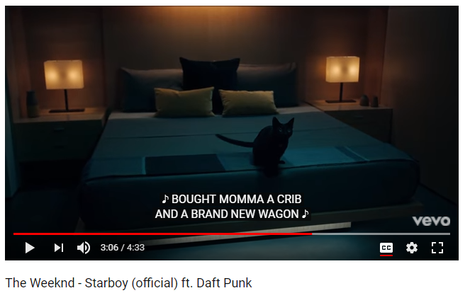
In this exercise we will examine song lyrics

Slide 13
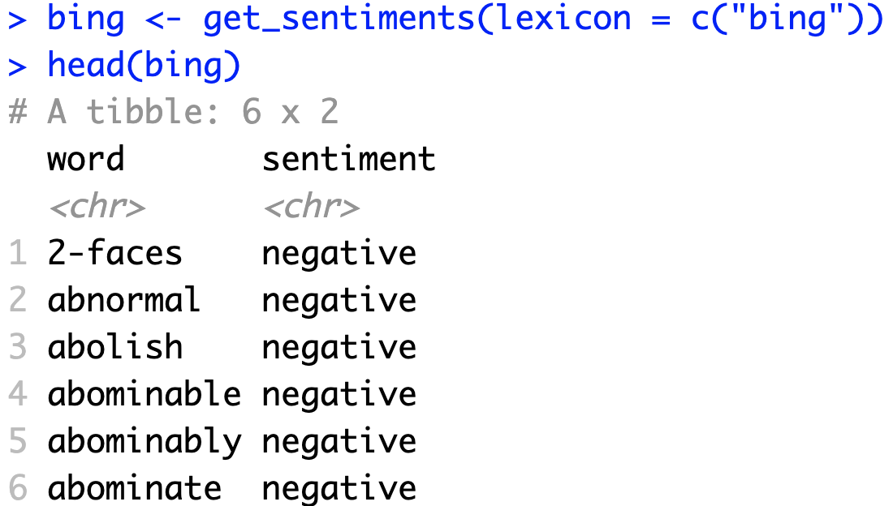
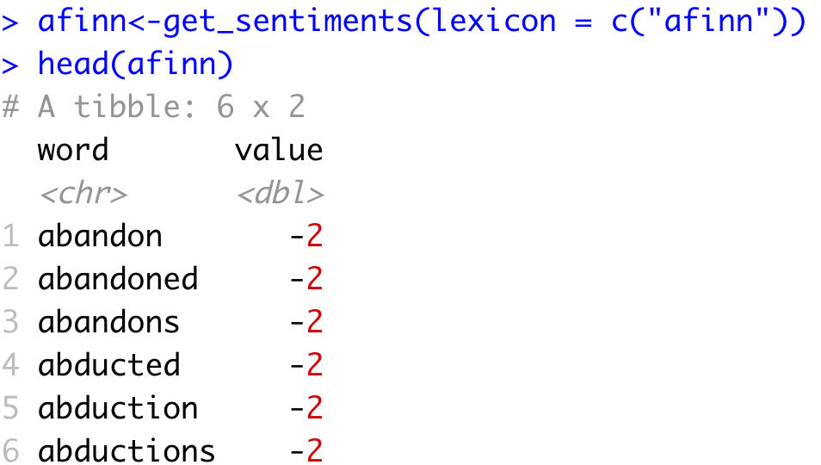
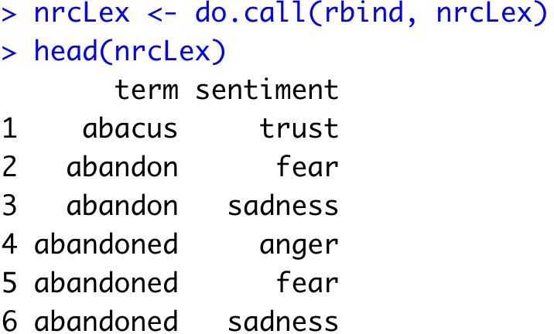
Sentiment the Tidy Way uses joins with existing lexicons
6782 Words
2477 Words
4463 Words

Slide 14
Tidy can seem complicated but not impossible.
The pipe operator
%>%
Forwards an object so the code is easy to understand & concise.
all.tidy <- all.tidy %>%
anti_join(stop_words)
Song text
Stop words
anti_join()
all.sentiment <- all.tidy %>%
inner_join(nrc.lexicon) %>%
count(tweet,sentiment) %>%
spread(tweet, n, fill = 0)
Sentiment
words
Song text
inner_join()

Slide 15
Starting with a DTM, its straightforward
# DTM
txtDTM <- DocumentTermMatrix(txtCorpus)
# Tidy
tidyCorp <- tidy(txtDTM)
# Get bing lexicon
bing <- get_sentiments(lexicon = c("bing"))
# Perform Inner Join
bingSent<-inner_join(tidyCorp,
bing, by=c('term'='word'))
DTM is from the “tm” library
Easy way to make it into a tibble.
Weeknd Lyrics
Bing Lexicon
* Due to some changes, the first time you use a sentiment lexicon, you will be asked to download. This is due to licensing.

Slide 16

Get in touch with our feelings…
Open B_sentimentAnalysis.R

Slide 17
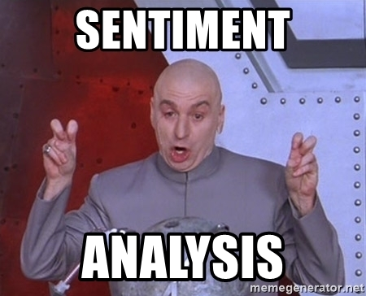
Now let’s use tidy text w/multiple corpora
Open
live_B_tidy_multipleFiles.R

