Slide 1


Slide 2
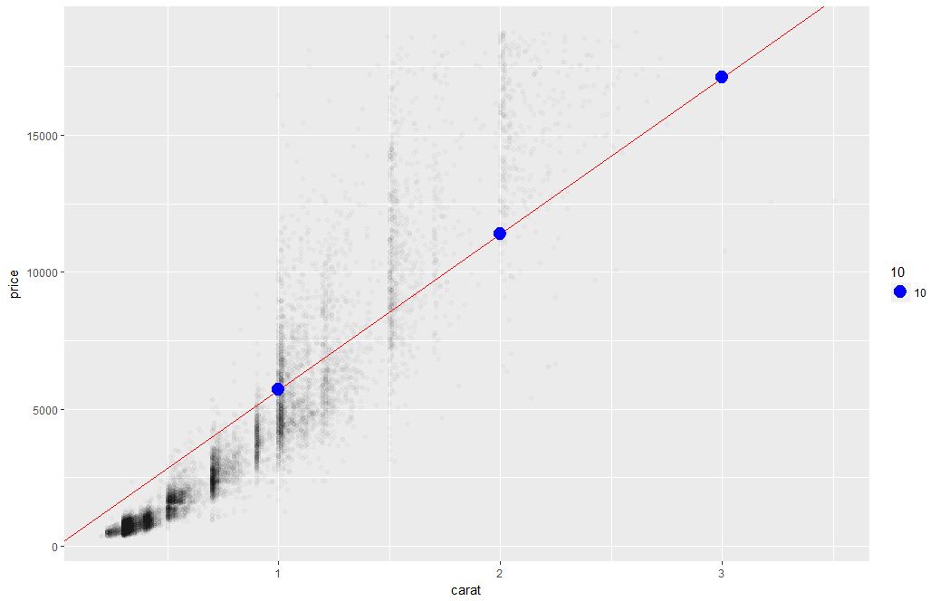
Linear Regression
The predictions is continuous…it continues forever.

Slide 3
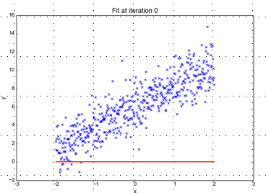
Minimizing the Sum of Ordinary Least Squared Errors
Blue points Y Values represent actual outcome.
MINUS
Red line is the predicted outcome
Equals the Error
Equation:
Y= 0 +(0*x)
Beta “Naught” = 0
Intercept is 0
X beta coefficient = 0
No slope

Slide 4
Big Errors
Blue points Y Values represent actual outcome.
MINUS
Red line is the predicted outcome
Equals the Error
Equation:
Y= 0 +(0*x)
Beta “Naught” = 0
Intercept is 0
X beta coefficient = 0
No slope

Slide 5
So what is really going on?
The algorithm is optimizing the inputs and weights (beta’s) to minimize the sum of squared errors.
This is called “ordinary least squares (OLS).

Slide 6
Open B_Regression_v1.R

Slide 7
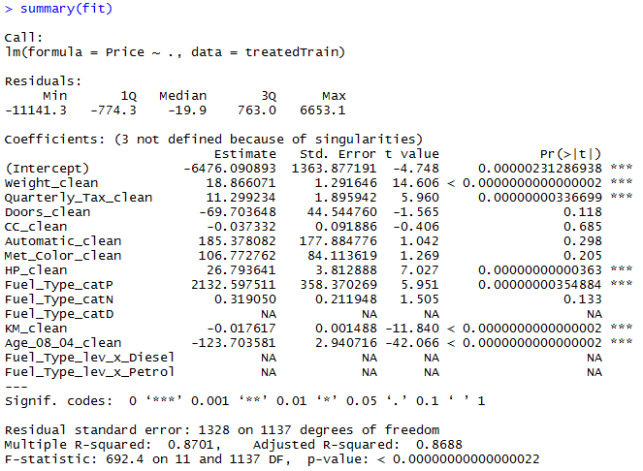
Highlights of a fit summary
Treated Variable Names i.e. informative features

Slide 8
Highlights of a fit summary
Coefficients or Beta values

Slide 9
Highlights of a fit summary
Another name for errors.
Summary stats for the errors.

