Slide 1
GSERM: Text Mining & NLP ElasticNet Regression
Ted Kwartler

Slide 2
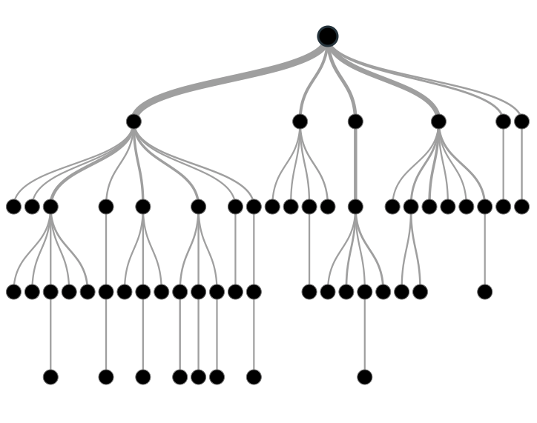

Supervised Learning
Inferring a function from labeled data.
“Learn from telling”, “Look at my data and I will tell you what to predict”
Data Setup
Method
Business Examples
Application
Marketing-Will a customer buy yes or no? How much will a customer spend?
Operations- Will an applicant default? When will a machine break?
Flat “Excel” file. Each row is a record or observation. Each column is an attribute of the record.
One column is the outcome, y or target attribute.
Modeling e.g. K-NN, linear regression, decision tree, random forest etc.
Make predictions for the target on the new data.

Slide 3
Modeling Process
SEMMA
In this course…
1. Sample
For elasticNet we will do random sampling
2. Explore
Very basic EDA to get familiar w/data but more needs to be done in reality
3. Modify
Bag of Words organization as a modeling matrix
4. Model
Other methods exist but we only use LASSO
5. Assess
Measure Accuracy but there are others

Slide 4
Sampling Step: Basic Partitioning Schema
Divide data into training portion and validation portion
Test model on the validation portion
Training Data
All Data
Test Data
Notes:
How do you want to “spend” data

Slide 5
Good for prod deployments
Divide data into training portion , validation & test portions
Tune a model and/or compare models with the a validation portion
The “true” way a model will behave when launched on new data.
Training Data
All Data
Validation
Data
Test Data
Notes:
How do you want to “spend” data

Slide 6
Best Practice when doing very robust analysis
If you have enough data and the model impact is large, this is a good partitioning schema
However, this much effort is seldom undertaken.
Feature Engineering
Data
Training Data
All Data
Validation Data
Test Data
Notes:
How do you want to “spend” data
For large data – production, 10% improvement = $500M; 10% overfitting = $-500m
Additional layer of partitionoing CV discussed later

Slide 7

Why perform sampling?

Slide 8
100% fit – not useful for new data
Notes:
8

Slide 9

Supervised Learning Example
Inferring a function from labeled data.
“Learn from telling”, “Look at my data and I will tell you what to predict”
What impacts ice cream sales?
#
=ƒ(…)

Slide 10
Linear Regression for continuous outcomes
Some linear combination of temperature values, day of the week dummy variables and price estimate the number of cones that will sell.
#
= $β$ + ($β$*temperature) + ($β$*day) + ($β$*price) + error
Notes:
What should we expect the beta signs to be? Whats the relationship the information has with ice cream sales?
Temp goes up? Sales go up. Temp goes down? Sales go down. Positive relationship
Price goes up? Sales go down. Price goes down? Sales go up. Negative relationship

Slide 11

The linear combination equation captures information
outcome
coefficients
constant
error (noise)
predictors

Slide 12
Regression Equation Review
Regression
How Many Cones?
#
= $β$ + $β$*temperature + $β$*day + $β$*price + error

Slide 13
#
= $6$ + 0.$25$*temperature + $3$*satudray_dummy + -0.5*price
Beta-Naught | Temperature | Saturday_dummy | Price
6 | 0.25 * 80 degrees | 3 * 1 | -0.5 * 5
6 | 0.25 * 88 | 3 * 0 | -0.5 * 2

Slide 14
#
= $6$ + 0.$25$*temperature + $3$*satudray_dummy + -0.5*price
Beta-Naught | Temperature | Satuday_dummy | Price | Best Fit Prediction
6 | 0.25 * 80 degrees | 3 * 1 | -0.5 * 5 | 26.5
6 | 0.25 * 88 | 3 * 0 | -0.5 * 2 | 27

Slide 15
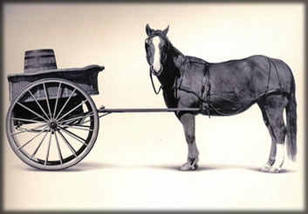
Let’s Practice
Open A_Regression.R
Predict Diamond Prices with linear regression.

Slide 16
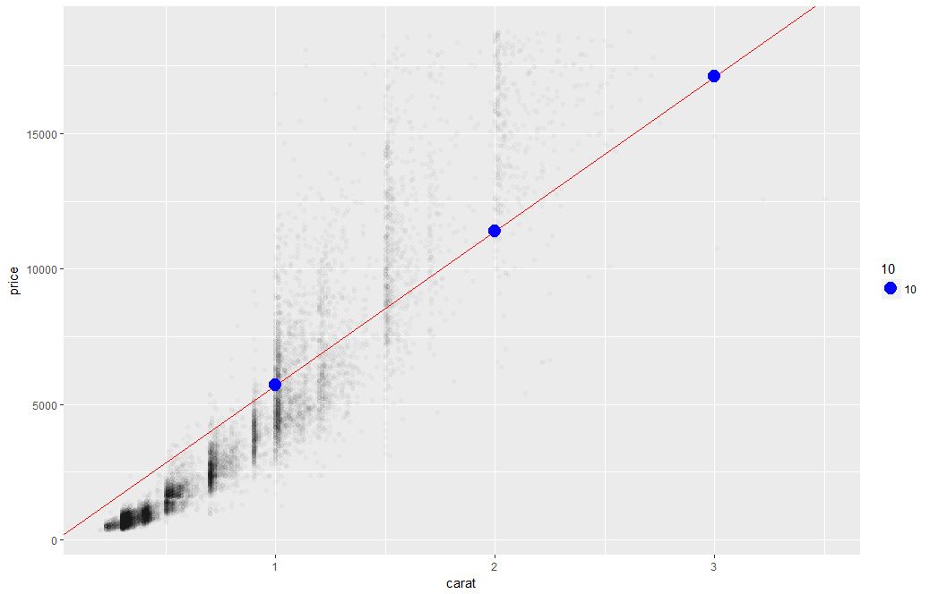
Linear Regression
The predictions is continuous…it continues forever.

Slide 17
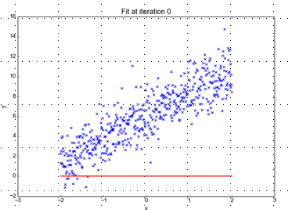
Minimizing the Sum of Ordinary Least Squared Errors
Blue points Y Values represent actual outcome.
MINUS
Red line is the predicted outcome
Equals the Error
Equation:
Y= 0 +(0*x)
Beta “Naught” = 0
Intercept is 0
X beta coefficient = 0
No slope

Slide 18
Big Errors
Blue points Y Values represent actual outcome.
MINUS
Red line is the predicted outcome
Equals the Error
Equation:
Y= 0 +(0*x)
Beta “Naught” = 0
Intercept is 0
X beta coefficient = 0
No slope

Slide 19
So what is really going on?
The algorithm is optimizing the inputs and weights (beta’s) to minimize the sum of squared errors.
This is called “ordinary least squares (OLS).

Slide 20
Open B_newCar.R

Slide 21
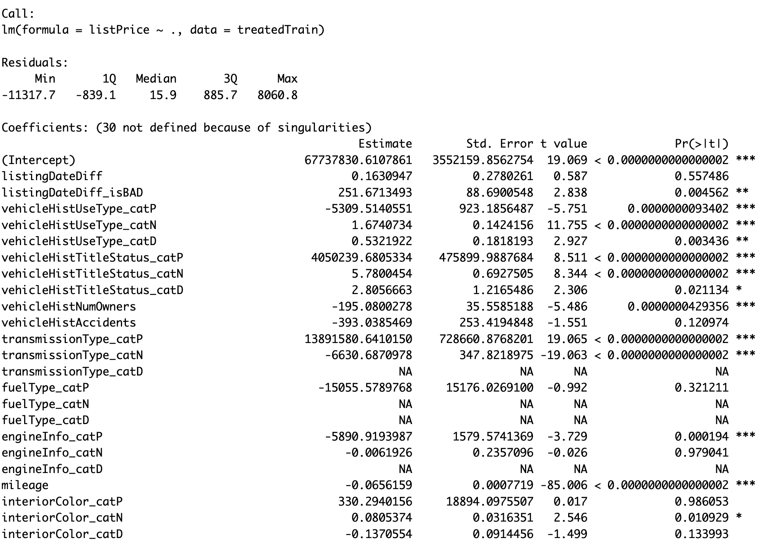
Highlights of a fit summary
Treated Variable Names i.e. informative features

Slide 22
Highlights of a fit summary
Coefficients or Beta values

Slide 23
Highlights of a fit summary
Another name for errors.
Summary stats for the errors.

Slide 24
Parsimonious Model
Parsimony or compactness is desirable in models. The more features in a model, the more complexity we introduce, data integrity, data interactions, time to fit and time to predict are all impacted.
Back to the script.
Notes:
We could drop yet another engineered variable but let’s continue. P =.175

Slide 25
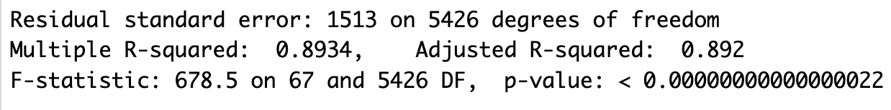
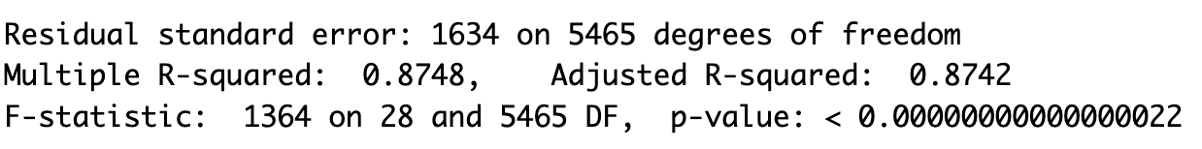
Compare the two models
Fit1 – 98 variables
Fit2 – 29 variables

Slide 26
Evaluating a Prediction Model
RMSE- Root Mean Squared Error
y
y-hat
Actual Values | Predicted/Forecasted
10 | 16
12 | 8
20 | 17
36 | 34
Besides P-Values which is a variable level KPI, and adjusted R-Sq there are two popular KPI for evaluating continuous model predictions.

Slide 27
RMSE
RMSE- Root Mean Squared Error
y
y-hat
ERROR
ERROR-SQ
Actual Values | Predicted/Forecasted | Errors | Squared Errors
10 | 16 | -6 | 36
12 | 8 | 4 | 16
20 | 17 | 3 | 9
36 | 34 | 2 | 4
Mean
36+16+9+4
4
To manually calculate RMSE, work the acronym backwards.

Slide 28
RMSE
RMSE- Root Mean Squared Error
ERROR
SQUARED
MEAN
ROOT
Actual Values | Predicted/Forecasted | Errors | Squared Errors
10 | 16 | -6 | 36
12 | 8 | 4 | 16
20 | 17 | 3 | 9
36 | 34 | 2 | 4
Mean
Square Root
36+16+9+4
$$\sqrt{16.25}$$
4
=4.03
In the same units being measured, tells you +/- the prediction error.

Slide 29
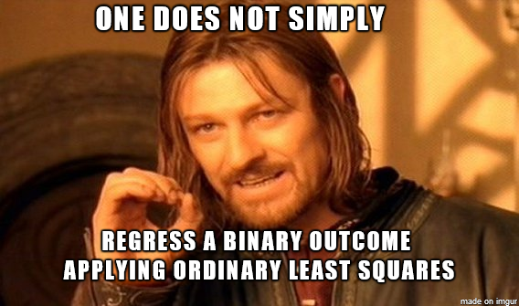
Open C_lm_for classes.R

Slide 30
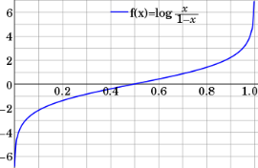
Step 1: Logistic Response Function
Regression
How Many Cones?
#
= $β$ + $β$*temperature + $β$*day + $β$*price + error
Logistic Regression
Will they buy a cone Y/N?
Logit of
= $β$ + $β$*temperature + $β$*day + $β$*price + error
We will let R handle calculating the equation output logOdds to the more understandable probability of an event.
Notes:
Logit = log odds = logarithm of the odds p/(1 − p)
Ln(p/(1-p) = b0 + b1 + b2 …e
P is defined as the probability that Y=1 then we take the log odds

Slide 31
Logistic Regression
Extends idea of linear regression to situation where outcome variable is categorical
Instead of ordinary least squares, β are derived through an iterative process called maximum likelihood estimation
We focus on binary classification
i.e. Y=0 or Y=1

Slide 32
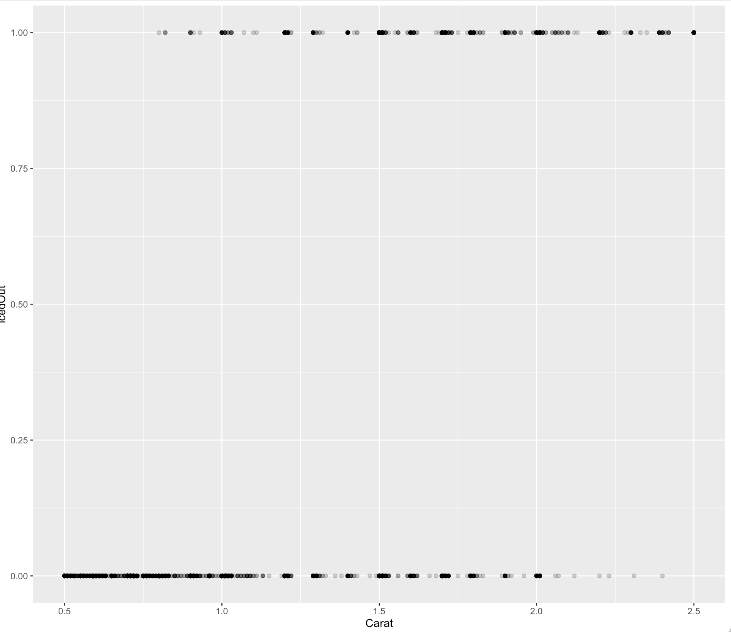
A binary relationship between carat and price
Diamonds above or below $11K

Slide 33
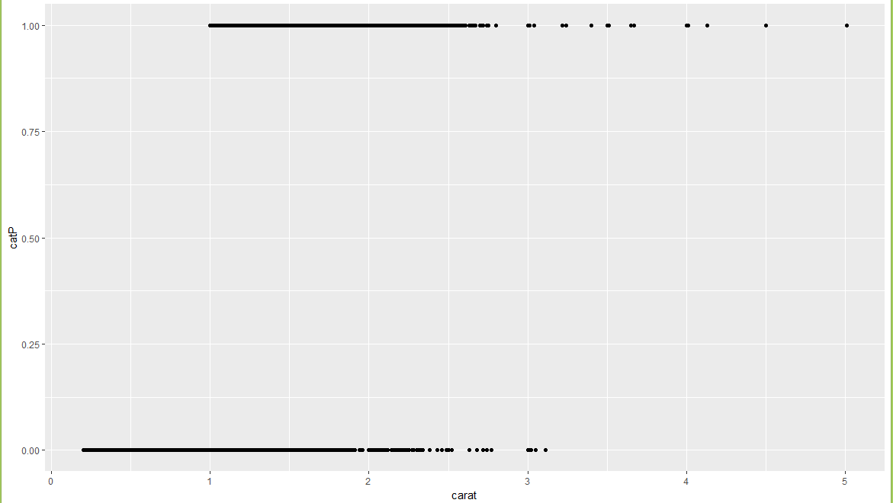
A binary relationship between carat and price
Diamonds above or below $11K
“is this diamond worth more than $11K or not.” Predicting 2 means 2 yes’es?

Slide 34
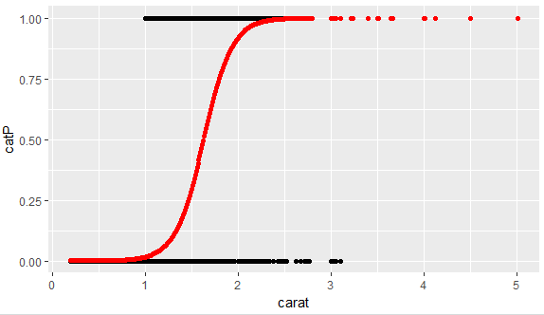
1.
What is the log-odds of the price above $11K? = Beta + Beta*Carat
2. Convert to probability with logistic response function (e^l / (1+e^l)
3. The probabilities are more intuitive than the log-odds from the equation.

Slide 35

NCAA Classification Madness
Objective: Identify the probability of a team winning in Round 1.
College Basketball
Annual 64 team tournament
Business Impact:
$1B wagered
$2B in lost productivity
Bragging Rights

Slide 36

My friend Mandy is next level.
https://fivethirtyeight.com/features/how-a-data-scientist-whod-never-heard-of-basketball-mastered-march-madness/

Slide 37
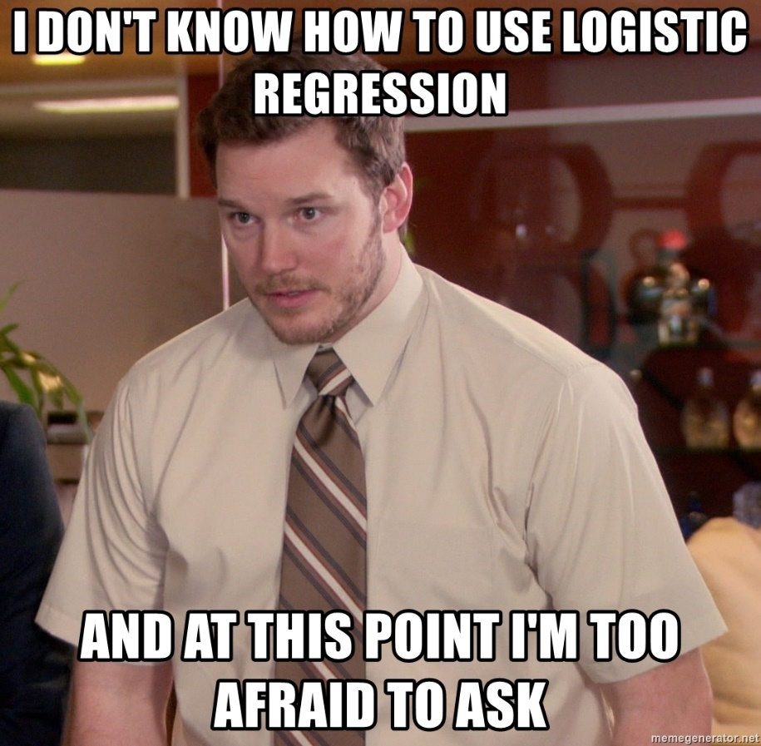
D_teamProbabilities.R

