Slide 1
GSERM: Text & Un-Supervised Learning
Ted Kwartler

Slide 2

Unsupervised Learning
Trying to find hidden structure in unlabelled data.
“Learn from observing”, “Look at my data and tell me about it”
Data Setup
Method
Business Examples
Application
Marketing-Find customer segments for specific marketing campaigns.
Operations-Identify locations for cell towers based on population density and area characteristics.
Text Analysis- Topic modeling of articles
Flat “Excel” file. Each row is a record or observation. Each column is an attribute of the record.
Clustering e.g. K-Means, Hierarchical Clustering etc
For new data assign to similar cluster

Slide 3

Your turn…
Methods
Scenario
Supervised or
Unsupervised
How many customers are complaining?

Slide 4

Your turn…
Methods
Scenario
Supervised or
Unsupervised
What is a typical profile of our customers and online shoppers?

Slide 5
Unsupervised Learning: Latent Dirichlet Allocation
Observe term frequency within documents
Identify “k” topics or clusters with similar frequency
A document may be more than one topic and is assigned to a cluster topic by probability
If K= 4, each document would get 4 probabilities

Slide 6

Unsupervised: Latent Dirichlet Allocation (LDA)
Latent – identify concealed topics e.g. not explicitly declared
Dirichlet – used in stats to represent multi-variate (multi-word) distributions
Instead of actual values it’s a “beta” distribution of probabilities 0-1
No “tails” values include 0 and 1
Beta distributions do not have to be symmetrical
Dirichlet will give k probabilities from beta distributions that generalize and sum to 1
Don’t worry about it!

Slide 7
K = 3: Three vectors & Three corresponding probabilities
{1,0,0 }
{0,0,1 }
{0,1,0 }

Slide 8
K = 3: vectors & 3 corresponding probabilities
{0.33, 0.33, 0.33}
{0.50,0.50,0 }

Slide 9
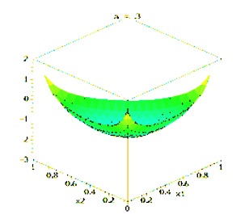
Dirichlet Function…
{0.33,0.33,0.33} each of the 3 vectors have equal likelihood among K represented as lowest point in the center of the triangle
K can be more than 3 but can’t be visualized

Slide 10
Dirichlet Function…
Alpha is a parameter adjusts the probability distribution, adjusted through observed frequencies

Slide 11
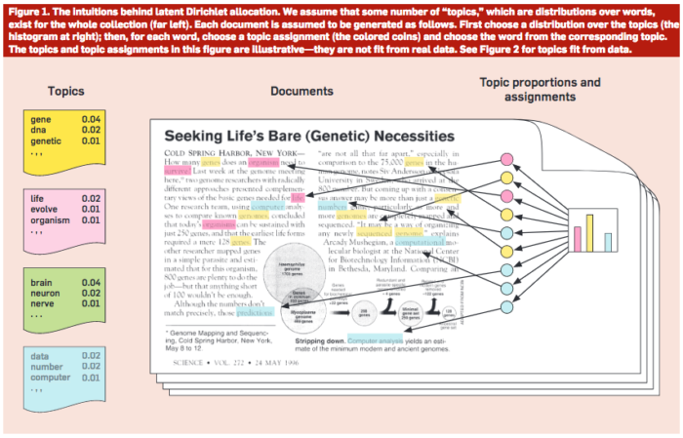
Common Sense Explanation
http://www.cs.columbia.edu/~blei/papers/Blei2012.pdf

Slide 12

Topic Modeling!

Slide 13
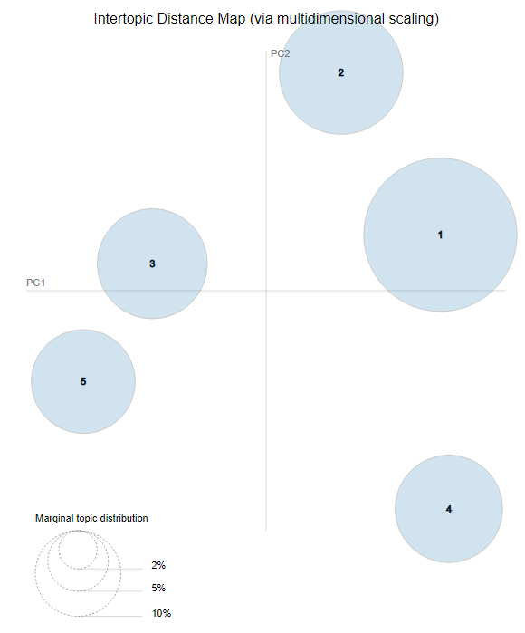
LDAvis: PCA of topics need to be interpreted
England-ness?
Non-Cricket
Cricket
Pakistan-ness?

Slide 14
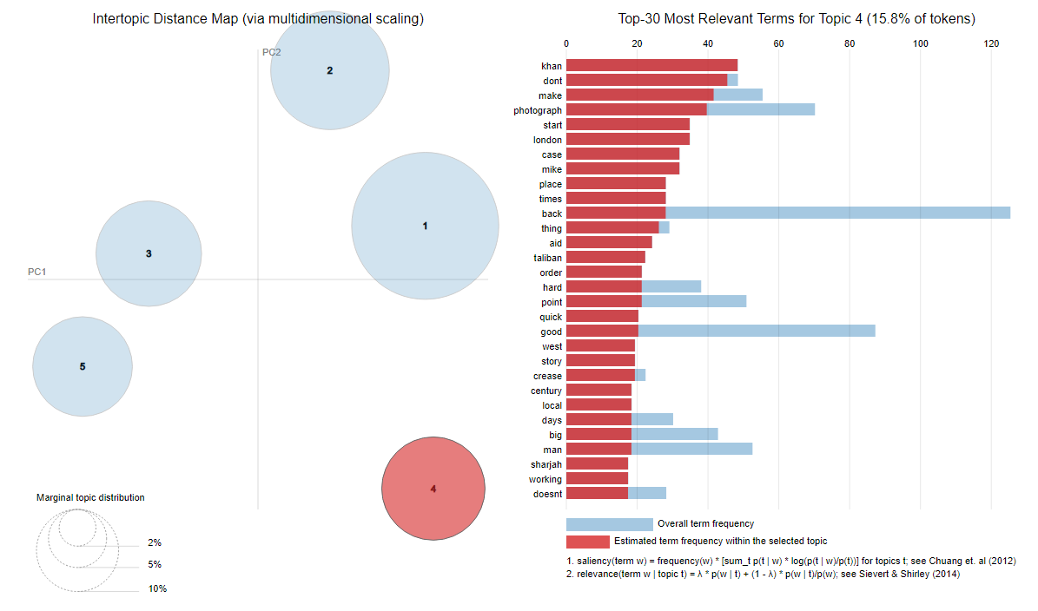
LDAvis: Interactive to show term distribution

Slide 15
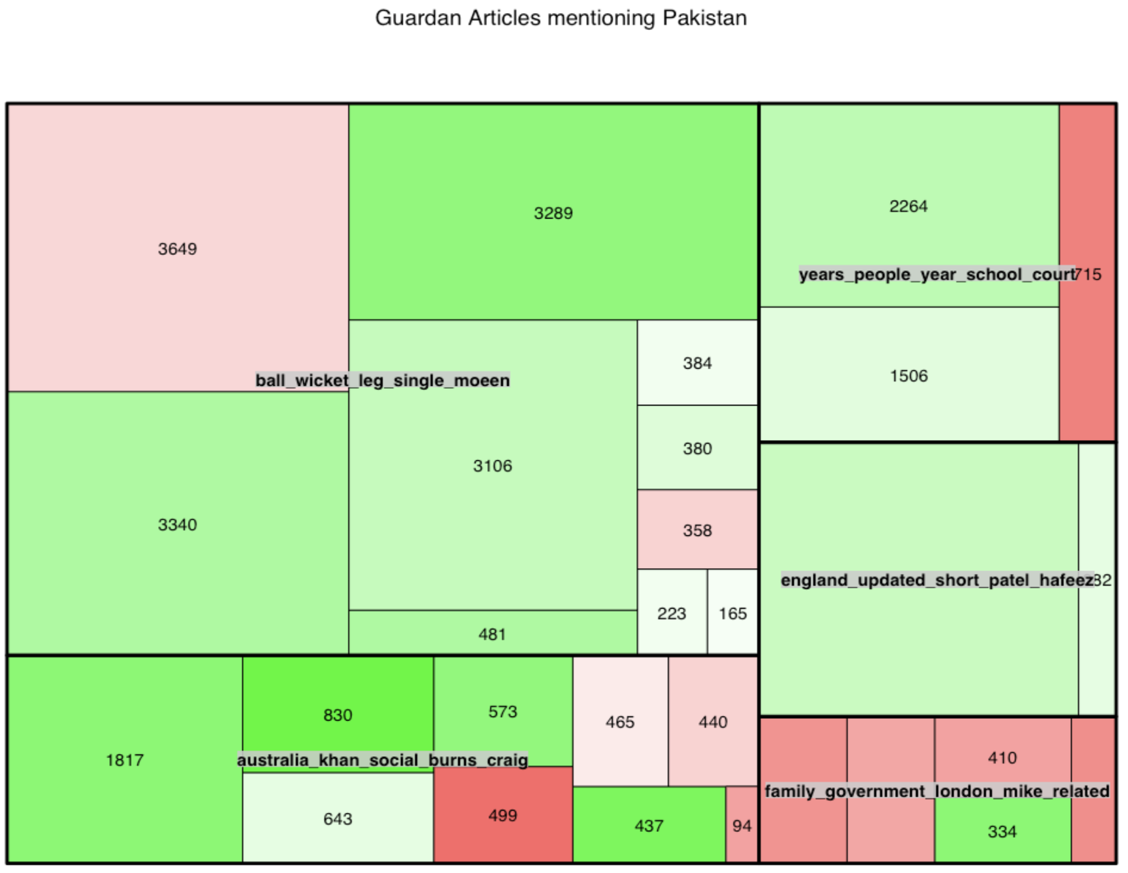
Interpreting a TreeMap: Multi-dimensional
Thick black lines: LDA defined Topic; named by 5 most typical words
Color: Polarity
Area: individual doc area is proportional to number of words
This shows the Guardian write positive and longer articles about Pakistan related to cricket than other topics.

Slide 16
Open E_topicmodeling.R

Slide 17
Next up…Clustering!

Slide 18
Intuition for 3 clusters…
Select US State Fuel Cost (x) vs Sales (y)
low cost &
high sales
Mid cost &
Mid sales
High cost &
high sales

Slide 19

K-Means Unsupervised
Previous slide clustering was done by “eye”
“K” clusters are defined by practitioner
Need a defined distance measure between record
Euclidean Distance (common but not great for text)
Scale each vector to so one unit of measure doesn’t dominate ie # of rooms in a house vs sq-Meter of house

Slide 20
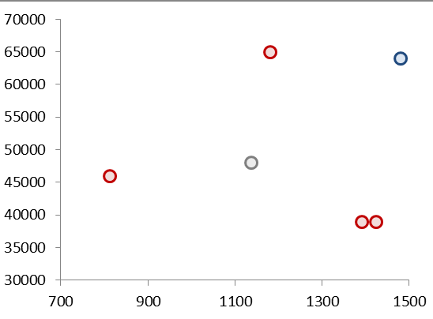
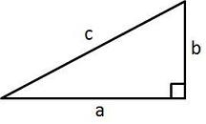
Quick Refresher
Remember Pythagorean Theorem?
Example Data
A²+B²=C²
b
c
a

Slide 21
K Means
Select US State Fuel Cost (x) vs Sales (y)
2
1
3
Random centroid placement

Slide 22
K Means
Select US State Fuel Cost (x) vs Sales (y)
2
1
3
Calculate the distance from each point to each centroid

Slide 23
K Means
Select US State Fuel Cost (x) vs Sales (y)
2
1
Cluster “3”
3
Cluster “1”
Pts assigned to closest centroid.

Slide 24
K Means
Select US State Fuel Cost (x) vs Sales (y)
2
1
Cluster “2”
Cluster “2”
Cluster “2”
Cluster “3”
3
Calculate the MEAN AVERAGE distance among assigned pts to centroid

Slide 25
K Means
Select US State Fuel Cost (x) vs Sales (y)
2
2
1
3
3
1
Move the centroid to the average distance among all assigned points

Slide 26
K Means
Select US State Fuel Cost (x) vs Sales (y)
2
Since “3” moved, this pt is assigned to “2”
3
1
Pt reassignment affects the avg distances so the process repeats…

Slide 27
K Means
Select US State Fuel Cost (x) vs Sales (y)
2
2
1
2
3
3
1
1
The new pt assignments again moves the centroid. The process repeats until no reassignments occur after moving the centroids (convergence).

Slide 28
K Means
Select US State Fuel Cost (x) vs Sales (y)
2
3
1
The new pt assignments again moves the centroid. The process repeats until no reassignments occur after moving the centroids (convergence).

Slide 29
K-Means Unsupervised
Previous slide clustering was done by “eye”
“K” clusters are defined by practitioner
Need a defined distance measure between record
Euclidean Distance (common but not great for text)
Scale each vector to so one unit of measure doesn’t dominate ie # of rooms in a house vs sq-Meter of house
Because it is the mean average all data attributes must be numeric (non factor ie what is the average of “blue eyes” or “medium” or “first”. Luckily w/text this is not an issue!

Slide 30

Try it out!
Open F_kmeans.R

Slide 31
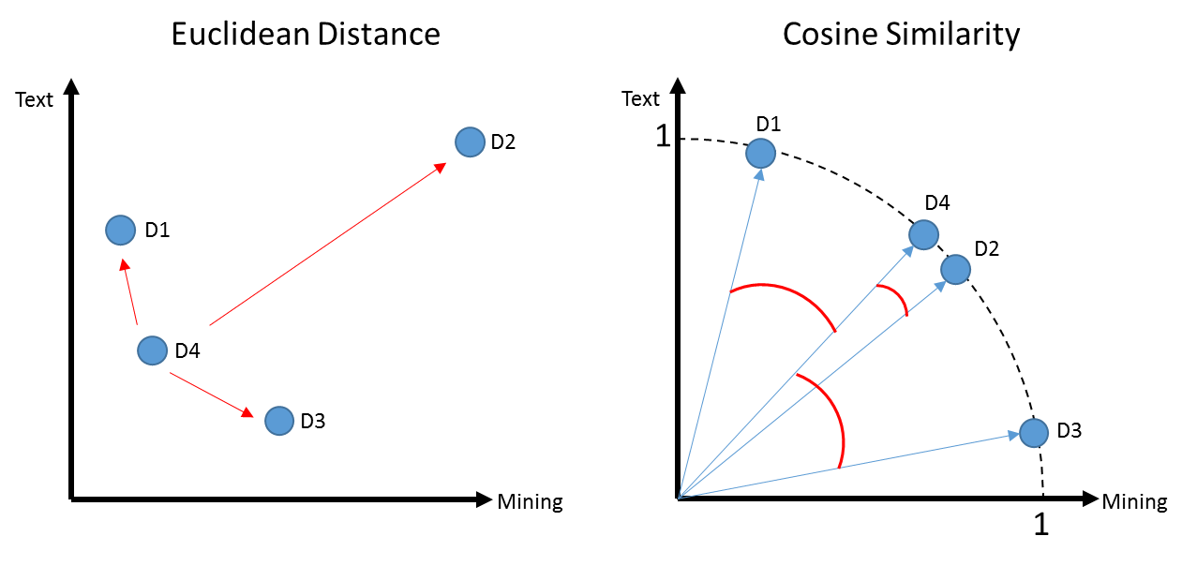
K-Means Problems
Computationally intensive (non-parametric)
Centroid will be greatly affected by an outlier
In this example a centroid would be “pulled” away from the actual cluster D1,D4 & D3

Slide 32

K- Mediod Clustering
Same steps as K-Means but instead of mean averages, uses the median distance to move centroids
Less impacted by outliers
Mean of 1,2,3,4,5,60 = 12.5
Median of 1,2,3,4,5,60 = 3.5 (closer to more points in vector space)
Open G_kmediods.R

Slide 33
K Means Vs Spherical K-Means
D1 a book for aspiring authors referring to “text” a lot
D2 & D4 refer to “text” and “mining” in equal proportions like the course book
D3 refers to “mining” ie minerals
D1, D4, D3 probably appear as 1 cluster w/D2 standing alone

Slide 34
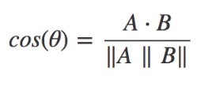
Another way to measure distance
Euclidean: How dissimilar are documents?
Cosine: How similar are documents?
 | Doc1 | Doc2
Term1 | 1 | 0
… | 0 | 1
… | 3 | 2
… | 6 | 6
… | 7 | 1
… | 0 | 0
Starting with a numeric Vector Representation from tokens
1. Calculate the “dot product” of the vectors:
(1*0) + (0*1) + (3*2) + (6*6) + (7*1) + (0*0)
0 + 0 + 6+ 36+ 7+ 0 = 49

Slide 35
Another way to measure distance
Euclidean: How dissimilar are documents?
Cosine: How similar are documents?
 | Doc1 | Doc2
Term1 | 1 | 0
… | 0 | 1
… | 3 | 2
… | 6 | 6
… | 7 | 1
… | 0 | 0
Starting with a numeric Vector Representation from tokens
Doc1: 1,0,3,6,7,0
Doc2: 0,1,2,6,1,0
Rearranged to follow more easily.
1. Calculate the “dot product” of the vectors:
(1*0) + (0*1) + (3*2) + (6*6) + (7*1) + (0*0)
0 + 0 + 6+ 36+ 7+ 0 = 49

Slide 36
Another way to measure distance
Euclidean: How dissimilar are documents?
Cosine: How similar are documents?
Starting with a numeric Vector Representation from tokens
Doc1: 1,0,3,6,7,0
Doc2: 0,1,2,6,1,0
Multiply each corresponding value
1. Calculate the “dot product” of the vectors:
(doc1: 1 * doc2: 0) + (doc1: 0 * doc2: 1) + (doc1: 3 * doc2: 2) +
(doc1: 6 * doc2: 6) + (doc1: 7 * doc2: 1) + (doc1: 0 * doc2: 0)
0 + 0 + 6+ 36+ 7+ 0 = 49

Slide 37
Cosine
1. Calculate the “dot product” of the vectors:
(1*0) + (0*1) + (3*2) + (6*6) + (7*1) + (0*0)
0 + 0 + 6+ 36+ 7+ 0 = 49
2. Calculate the magnitude for a documents
Doc1: 1,0,3,6,7,0
Doc2: 0,1,2,6,1,0
Multiply each value to itself; sum up each doc; get sqrt
Multiply each value to itself; sum up each doc; get sqrt
Multiply single vector value

Slide 38
Cosine
1. Calculate the “dot product” of the vectors:
(1*0) + (0*1) + (3*2) + (6*6) + (7*1) + (0*0)
0 + 0 + 6+ 36+ 7+ 0 = 49
2. Calculate the magnitude for a documents
Doc1: 1,0,3,6,7,0
Doc2: 0,1,2,6,1,0
Multiply each value to itself; sum up each doc; get sqrt
Multiply each value to itself; sum up each doc; get sqrt
Multiply single vector value
Doc1: (1*1) + (0*0 )+ (3*3) + (6*6) + (7*7 )+ (0*0)
1 + 0 + 9 + 36 + 49 + 0 = 95
Sqrt(95) = 9.7
Doc2: (0*0)+(1*1)+(2*2)+(6*6)+(1*1) + (0*0)
0 + 1 + 4 + 36 + 1 + 0 = 42
Sqrt(42) = 6.4
9.7 * 6.4 = 63.1

Slide 39
Cosine
1. Calculate the “dot product” of the vectors:
(1*0) + (0*1) + (3*2) + (6*6) + (7*1) + (0*0)
0 + 0 + 6+ 36+ 7+ 0 = 49
2. Calculate the magnitude for a documents
Doc1: (1*1) + (0*0 )+ (3*3) + (6*6) + (7*7 )+ (0*0)
1 + 0 + 9 + 36 + 49 + 0 = 95
Sqrt(95) = 9.7
Doc2: (0*0)+(1*1)+(2*2)+(6*6)+(1*1) + (0*0)
0 + 1 + 4 + 36 + 1 + 0 = 42
Sqrt(42) = 6.4
9.7 * 6.4 = 63.1
3. Distance Similarity Measure: 49 / 63.1 = 0.77
Value will always be between 0,1.

Slide 40
Spherical K-Means
Euclidean: How dissimilar are documents?
Cosine: How similar are documents?
Uses cosine similarity to calculate distance
Values are normalized to 0,1
Cosine is measuring similarity…so a value of 0 means orthogonal (independent)
These are similar docs i.e cosine similarity is closer to 1
Using cosines now D4, D2 represent a cluster as expected and you may have to declare add another K

Slide 41
Side by Side
Big distance D4 to D2 means they are dissimilar
Distance is between 0 to inf.
Higher value means bigger distance.
D4 to D2 Small angle distance means they are similar.
Distance is between 0 to 1.
Higher value means smaller distance.
i.e. 1 to 1 for division is a duplicate document!

Slide 42
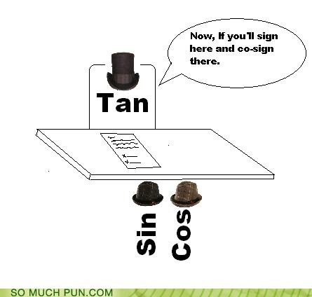
Open H_spherical_kmeans.R

Slide 43
Intersecting multiple methods
The methods you have learned are not exclusive and can interact to help you uncover more novel insights.
Use unsupervised to define clusters and assign each document to a cluster.
Example: document1 is in cluster1 i.e. “Fashion”
Apply sentiment analysis to each document.
Example: Document 1 is mostly “joy”
Intersect the meta data, clusters and sentiment
Example: Document 1 is from cluster 1, has “joy” words and is from the Washington Post.
Subset all documents to a single cluster.
Subset documents to a single source like Washington Post

Slide 44

Along the way plot the tables & findings…
Open I_Clustering_Sentiment.R

Slide 45
Lab/Homework
Apply 1 sentiment lexicon or polarity analysis to news.csv data.
Perform 1 clustering method with the news.csv data.
Considerations:
The title, description and content columns are all ok to use as well as the combined title_description_content column.
There is a column called newsSite with sources cnn, fox-news, msnbc, the-american-conservative. You may analyze each news source individually for your analysis (full credit) or individually as a single document set regardless of the source (-3 pts because its easiest)

