Slide 1
GSERM: Text Mining & NLP ElasticNet Regression
Ted Kwartler

Slide 2
Agenda – all times are suggested
Start | End | Thursday
8:45 | 9:15 | Coffee
9:15 | 10:15 | Ethics
10:15 | 10:45 | Personal Reflection Time – start your reflection paper
10:45 | 12:00 | Regression
12:00 | 1:30 | Lunch
1:30 | 2:30 | Classifications methods for text
2:30 | 3:15 | Lab

Slide 3
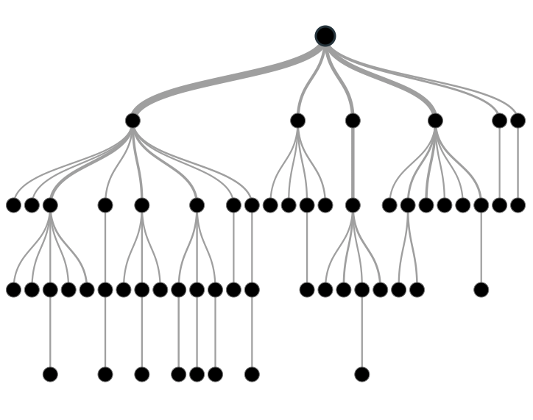

Supervised Learning
Inferring a function from labeled data.
“Learn from telling”, “Look at my data and I will tell you what to predict”
Data Setup
Algorithm
Business Context
Application
Marketing-Will a customer buy yes or no? How much will a customer spend?
Operations- Will an applicant default? When will a machine break?
Sports Analytics- How many points will the Bears’ QB score? What is the Bears’ probability of winning?
Requires expertise and stakeholder buy in
Flat “Excel” file. Each row is a record or observation. Each column is an attribute of the record.
One column is the outcome, y or target attribute.
Modeling e.g. K-NN, linear regression, decision tree, random forest etc.
Use the model to make predictions for the target label on the new data.

Slide 4
Modeling Process
SEMMA
In this course…
1. Sample
For elasticNet we will do random sampling
2. Explore
3. Modify
4. Model
5. Assess

Slide 5
Modeling Process
SEMMA
In this course…
1. Sample
For elasticNet we will do random sampling
2. Explore
Very basic EDA to get familiar w/data but more needs to be done in reality
3. Modify
4. Model
5. Assess

Slide 6
Modeling Process
SEMMA
In this course…
1. Sample
For elasticNet we will do random sampling
2. Explore
Very basic EDA to get familiar w/data but more needs to be done in reality
3. Modify
Bag of Words organization as a modeling matrix
4. Model
5. Assess

Slide 7
Modeling Process
SEMMA
In this course…
1. Sample
For elasticNet we will do random sampling
2. Explore
Very basic EDA to get familiar w/data but more needs to be done in reality
3. Modify
Bag of Words organization as a modeling matrix
4. Model
Other methods exist but we only use LASSO regression
5. Assess

Slide 8
Modeling Process
SEMMA
In this course…
1. Sample
For elasticNet we will do random sampling
2. Explore
Very basic EDA to get familiar w/data but more needs to be done in reality
3. Modify
Bag of Words organization as a modeling matrix
4. Model
Other methods exist but we only use LASSO regression
5. Assess
We will use simple accuracy but there are other KPI covered in more traditional ML courses

Slide 9
Sampling Step: Basic Partitioning Schema
Divide data into training portion and validation portion
Test model on the validation portion
Training Data
All Data
Test Data
Notes:
How do you want to “spend” data

Slide 10
Good for prod deployments
Divide data into training portion , validation & test portions
Tune a model and/or compare models with the a validation portion
The “true” way a model will behave when launched on new data.
Training Data
All Data
Validation
Data
Test Data
Notes:
How do you want to “spend” data

Slide 11
Best Practice when doing very robust analysis
If you have enough data and the model impact is large, this is a good partitioning schema
However, this much effort is seldom undertaken.
Feature Engineering
Data
Training Data
All Data
Validation Data
Test Data
Notes:
How do you want to “spend” data
For large data – production, 10% improvement = $500M; 10% overfitting = $-500m
Additional layer of partitionoing CV discussed later

Slide 12
Why perform sampling?

Slide 13
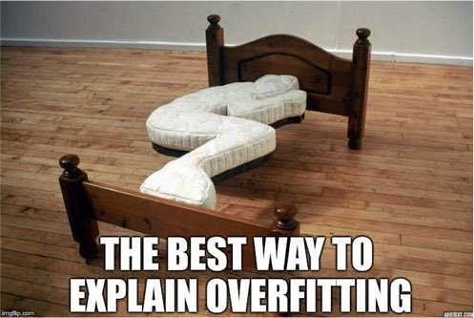

Slide 14
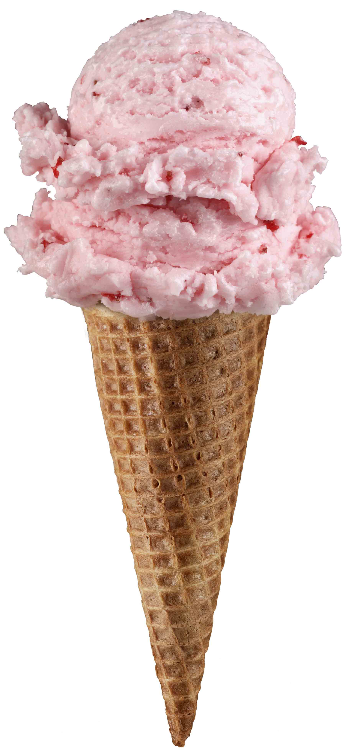
Supervised Learning Example
Inferring a function from labeled data.
“Learn from telling”, “Look at my data and I will tell you what to predict”
What impacts ice cream sales?
#
=ƒ(…)

Slide 15
Linear Regression for continuous outcomes
#
= $β$ + ($β$*temperature) + ($β$*day) + ($β$*price) + error
Some linear combination of temperature values, day of the week dummy variables and price estimate the number of cones that will sell.
Notes:
What should we expect the beta signs to be? Whats the relationship the information has with ice cream sales?
Temp goes up? Sales go up. Temp goes down? Sales go down. Positive relationship
Price goes up? Sales go down. Price goes down? Sales go up. Negative relationship

Slide 16

The linear combination equation captures information
outcome
coefficients
constant
error (noise)
predictors

Slide 17
Regression Equation Review
Regression
How Many Cones?
#
= $β$ + $β$*temperature + $β$*day + $β$*price + error

Slide 18
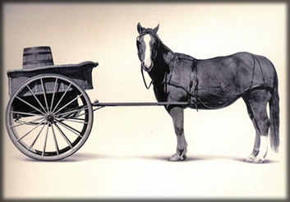
Let’s Practice
Open A_Regression.R
Predict Diamond Prices with linear regression.

Slide 19


Slide 20
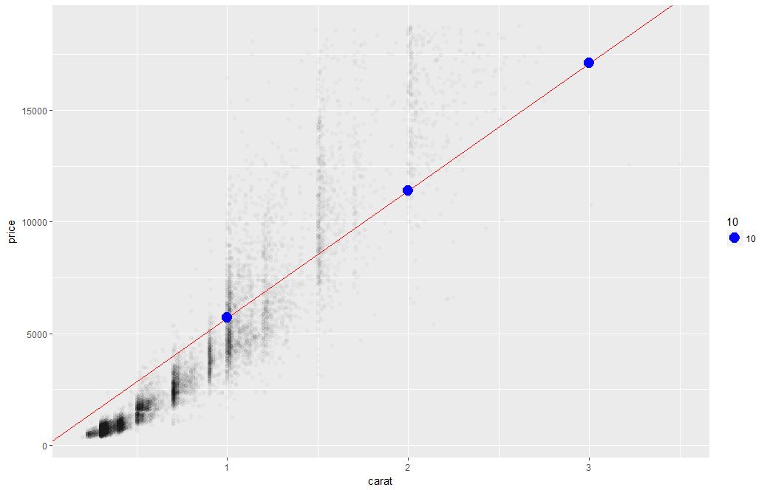
Linear Regression
The predictions is continuous…it continues forever.

Slide 21
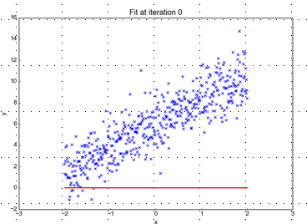
Minimizing the Sum of Ordinary Least Squared Errors
Equation:
Y= 0 +(0*x)
Beta “Naught” = 0
Intercept is 0
X beta coefficient = 0
No slope
Blue points Y Values represent actual outcome.
MINUS
Red line is the predicted outcome
Equals the Error

Slide 22
Big Errors
Equation:
Y= 0 +(0*x)
Beta “Naught” = 0
Intercept is 0
X beta coefficient = 0
No slope
Blue points Y Values represent actual outcome.
MINUS
Red line is the predicted outcome
Equals the Error

Slide 23
So what is really going on?
The algorithm is optimizing the inputs and weights (beta’s) to minimize the sum of squared errors.
This is called “ordinary least squares (OLS).

Slide 24
Open B_Regression_v1.R

Slide 25
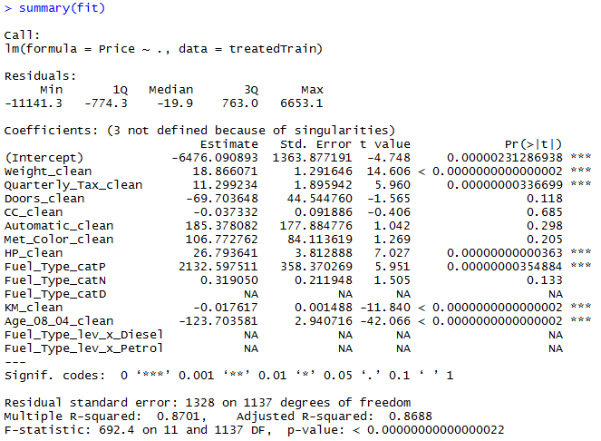
Highlights of a fit summary
Treated Variable Names i.e. informative features

Slide 26
Highlights of a fit summary
Coefficients or Beta values

Slide 27
Highlights of a fit summary
Another name for errors.
Summary stats for the errors.

Slide 28
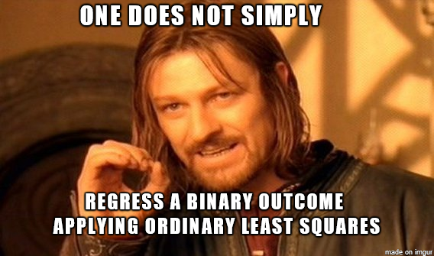
Open C_lm_for classes.R

Slide 29
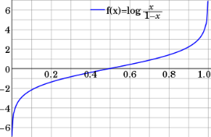
Step 1: Logistic Response Function
Regression
How Many Cones?
#
= $β$ + $β$*temperature + $β$*day + $β$*price + error
Logistic Regression
Will they buy a cone Y/N?
Logit of
= $β$ + $β$*temperature + $β$*day + $β$*price + error
We will let R handle calculating the equation output logOdds to the more understandable probability of an event.
Notes:
Logit = log odds = logarithm of the odds p/(1 − p)
Ln(p/(1-p) = b0 + b1 + b2 …e
P is defined as the probability that Y=1 then we take the log odds

Slide 30
Logistic Regression
Extends idea of linear regression to situation where outcome variable is categorical
Instead of ordinary least squares, β are derived through an iterative process called maximum likelihood estimation
We focus on binary classification
i.e. Y=0 or Y=1

Slide 31
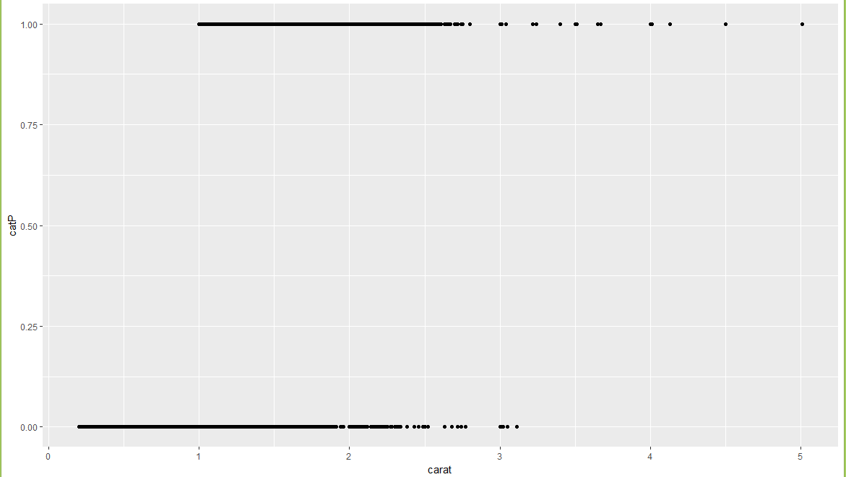
A binary relationship between carat and price
Diamonds above or below $11K

Slide 32
A binary relationship between carat and price
Diamonds above or below $11K
If the data only has two values, 0/1 but the regression equation goes to infinity.
This makes no sense!
“is this diamond worth more than $11K or not.” Predicting 2 means 2 yes’es?

Slide 33
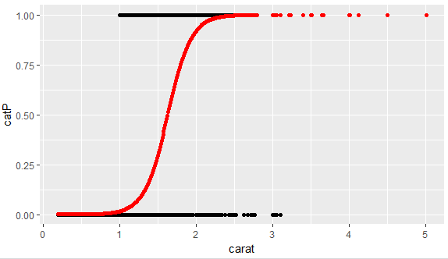
1.
What is the log-odds of the price above $11K? = Beta + Beta*Carat
2. Convert to probability with logistic response function (e^l / (1+e^l)
3. The probabilities are more intuitive than the log-odds from the equation.

Slide 34
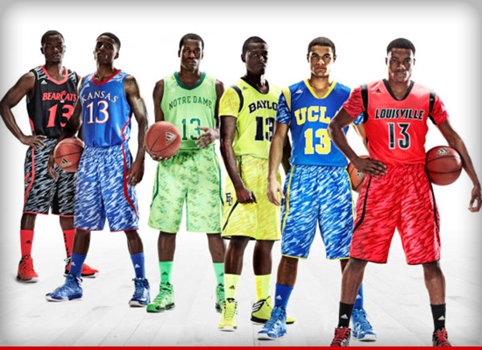
NCAA Classification Madness
College Basketball
Annual 64 team tournament
Business Impact:
$1B wagered
$2B in lost productivity
Bragging Rights
Objective: Identify the probability of a team winning in Round 1.

Slide 35

My friend Mandy is next level.
https://fivethirtyeight.com/features/how-a-data-scientist-whod-never-heard-of-basketball-mastered-march-madness/

Slide 36
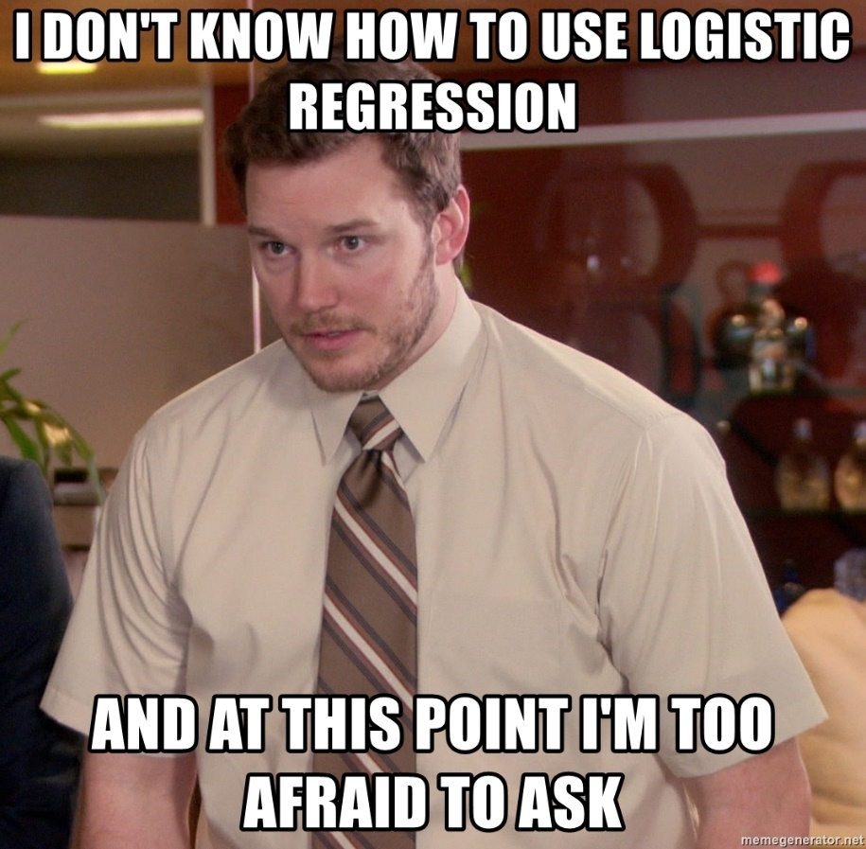
D_fullyMarchMadnessREVISED.R

Slide 37
Agenda – all times are suggested
Start | End | Thursday
8:45 | 9:15 | Coffee
9:15 | 10:15 | Ethics
10:15 | 10:45 | Personal Reflection Time – start your reflection paper
10:45 | 12:00 | Regression
12:00 | 1:30 | Lunch
1:30 | 2:30 | Classifications methods for text
2:30 | 3:15 | Lab

Slide 38
Applying these concepts to text
Spam vs non-spam
Using forum posts to predict stock/bitcoin prices
Online reviews to predict online sales
Text to classify fraud/non-fraud
Text to classify hospital readmission

Slide 39
Hospital Readmissions is a problem
$41B spent annually treating patients within 30 days of their initial discharge
Government programs Medicare/Medicaid fine hospitals for readmissions driving up costs
Additional patient hardship, stress & strain

Slide 40
Ridge Regression
Ridge –
With high variance data (few data points or in our case sparse language) we introduce a bias when fitting a line
Increasing Bias will decrease the accuracy of the least squared line fit
Increasing Bias will reduce the variance
Instead of minimizing squared error:
Minimizes sum of squared errors + (“lambda” * slope^2)
slope^2 = penalty
Lambda = severity of penalty
“L2” penalty: alpha = 0
Biased Fit generalizes to new data points better therefore less variance
Ordinary Least Sq Fit = 0 Error
Test Data Pt
Test Data Pt
Notes:
The key difference between these two is the penalty term.

Slide 41
Lasso Regression
LASSO – Least Absolute Shrinkage Selection Operator
Sum of beta coefficients less than a fixed amount, forcing some coefficients to 0
Instead of minimizing squared error:
Minimizes sum of squared errors + (“lambda” * |slope|)
|slope| = penalty
Lambda = severity of penalty
“L1” penalty: alpha = 1
Higher lambda will reduce slope to 0
If the penalty is high enough, the bias is increased & some betas will have 0 slope, ie no impact on the model (beta = 0 * xValue)
Test Data Pt
Notes:
The key difference between these two is the penalty term.

Slide 42
Lasso/Ridge Regression slide
Ridge
LASSO
(“lambda” * slope^2)
(“lambda” * |slope|)
Higher lambda will shrink slopes but not remove them
Higher lambda will reduce slope to 0 for some variables
Test Data Pt
Test Data Pt
In both cases, the algorithm will try multiple lambda for you and choose the best one that maintains reasonable accuracy but has the highest penalty.
Notes:
The key difference between these two is the penalty term.

Slide 43
Matrix Matching
Training set will have a vocabulary of X terms
New records & test set could have less than full X terms and/or new terms Y
Identify terms in new
records shared in the training set.
Fill in 0s for terms in
training not in new records
New Words
Training Words
New Words
Training Words
A model will expect the same matrix X-variables ie same number of columns as the training set.

Slide 44
The confusion matrix
 | Actual 1 | Actual 0
Predicted 1 | True Positives | False Positives
Predicted 0 | False Negatives | True Negatives
Probabilities are 0-1 so a “cutoff threshold” is used to classify into 1 or 0 in the matrix.

Slide 45
The confusion matrix
Cutoff 0.01
Cutoff 0.50
 | Actual 1 | Actual 0
Predicted 1 | 3 | 2
Predicted 0 | 0 | 0
 | Actual 1 | Actual 0
Predicted 1 | 2 | 1
Predicted 0 | 1 | 1
Actual | Probability
1 | .45
1 | .55
0 | .95
1 | .75
0 | .25
Cutoff 0.75
Cutoff 0.99
 | Actual 1 | Actual 0
Predicted 1 | 1 | 1
Predicted 0 | 2 | 1
 | Actual 1 | Actual 0
Predicted 1 | 0 | 0
Predicted 0 | 3 | 2
Adjusting the cutoff impacts the numbers in the confusion matrix.

Slide 46
True/False Positive Rates
 | Actual 1 | Actual 0
Predicted 1 | True Positives | False Positives
Predicted 0 | False Negatives | True Negatives
TruePosRate
FalsePosRate
Sensitivity or
True Positive Rate = TruePos / (TruePos + FalseNeg)
This is the proportion of the correct “1” classifications among all “1” actuals
Specificity or
False Positive Rate = FalsePos / (FalsePos + TrueNeg)
This is the proportion of the correct “0” classifications among all “0” actuals.

Slide 47
Plotting the different cutoff thresholds
 | Actual 1 | Actual 0
Predicted 1 | 2 | 1
Predicted 0 | 1 | 1
True Positive Rate = 2/ 3
False Positive Rate = 1/2
More balanced, optimizing accuracy
1,1
 | Actual 1 | Actual 0
Predicted 1 | 0 | 0
Predicted 0 | 3 | 2
.5, .66
True Positive Rate
True Positive Rate = 0/ 3
Not sensitive or specific
False Positive Rate = 0/2
 | Actual 1 | Actual 0
Predicted 1 | 3 | 2
Predicted 0 | 0 | 0
0,0
False Positive Rate
*not proportional
True Positive Rate = 3/ 3
Highly Sensitive not specific
False Positive Rate = 2/2

Slide 48
Conceptually ROC & AUC
Diagonal Line: flipping a coin 50/50
Model “lift” better than random chance w/different cutoffs
In binary classification the AUC (area under the curve) is a KPI

Slide 49
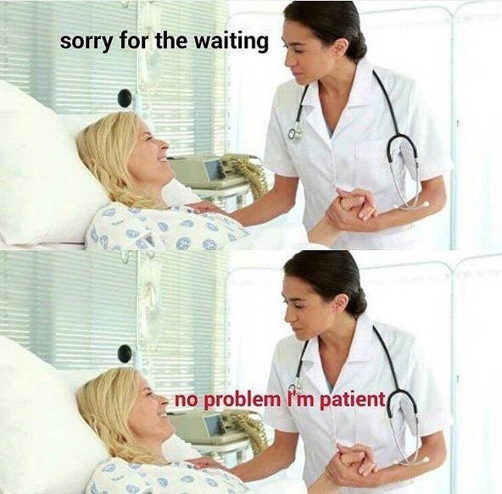
E_ElasticNetExample.R

Slide 50
In reality you would likely make an ensemble
Male/Female
Best Possible Model
Patient Factor Information
Numeric Information
Information from text
DR notes “patient exhibits…”
Height, wgt

Slide 51
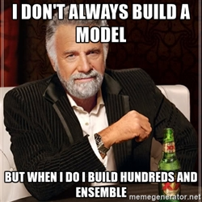
F_ElasticNetExample_ensemble.R

Slide 52
Lab/Homework
Lab:
Continue your ethics reflection paper or
Build a clickbait classifier with “all_3k_headlines.csv”
Homework:
Study for the final
You may handwrite a notecard as a refresher, no phones, books etc
Sections:
30 multiple choice ; 2pts ea = 60pts
4 short response (1-2 sentences); 5pts ea = 20pts
1 Code review sections (code is done, you explain steps being taken) = 20pts

