Slide 1
GSERM: Text Mining & NLP Sentiment Analysis
Ted Kwartler

Slide 2
Agenda – all times are suggested
Start | End | Wednesday
8:45 | 9:15 | Coffee
9:15 | 9:30 | Review Q/A from yesterday
9:30 | 10:45 | Polarity & Sentiment
10:45 | 11:00 | Break
11:00 | 12:00 | Topic Modeling
12:00 | 1:30 | Lunch
1:30 | 2:30 | K-Means, Spherical K-Mean, K-Mediod Clustering
2:30 | 3:15 | Lab

Slide 3
Machine Learning Supervised Learning
Goal: Predict a single “target” or “outcome” variable
Training data, where target value is known
Score to data where value is not known
Methods: Classification and Prediction

Slide 4
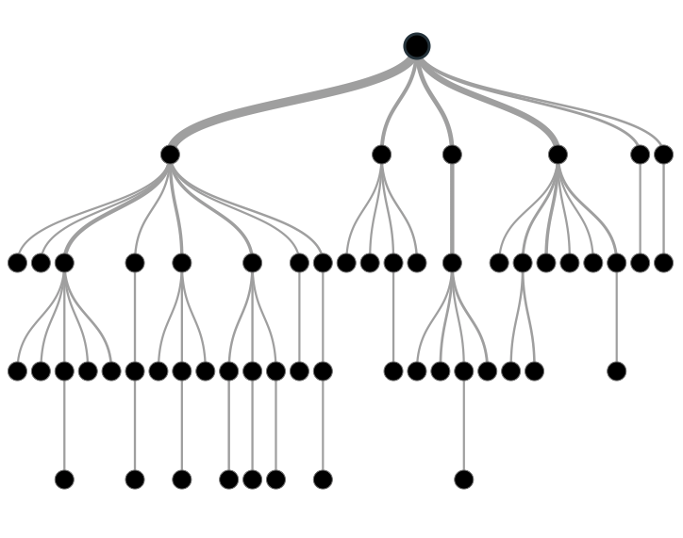

Supervised Learning
Inferring a function from labeled data.
“Learn from telling”, “Look at my data and I will tell you what to predict”
Data Setup
Method
Business Examples
Application
Marketing-Will a customer buy yes or no? How much will a customer spend?
Operations- Will an applicant default? When will a machine break?
Flat “Excel” file. Each row is a record or observation. Each column is an attribute of the record.
One column is the outcome, y or target attribute.
Modeling e.g. K-NN, linear regression, decision tree, random forest etc.
Use the model to make predictions for the target label on the new data.

Slide 5
Supervised Learning in NLP
Is this email SPAM Vs non-Spam?
Is this document making fraudulent claims or not?
Using tweet mentions or financial documents predict a company’s revenue?

Slide 6
Machine Learning: Unsupervised Learning
Goal: Segment data into meaningful segments; detect patterns
There is no target (outcome) variable to predict or classify
Methods: Association rules, clustering, data reduction & exploration, visualization

Slide 7
Unsupervised Learning
Trying to find hidden structure in unlabelled data.
“Learn from observing”, “Look at my data and tell me about it”
Data Setup
Method
Business Examples
Application
Marketing-Find customer segments for specific marketing campaigns.
Operations-Identify locations for cell towers based on population density and area characteristics.
Text Analysis- Topic modeling of articles
Flat “Excel” file. Each row is a record or observation. Each column is an attribute of the record.
Clustering e.g. K-Means, Hierarchical Clustering etc
In new data find the customers/observations that most likely are part of a particular cluster.

Slide 8
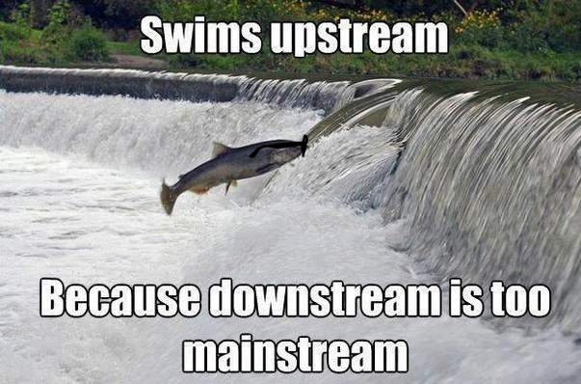
Your turn…
Methods
Scenario
How many fish did each vessel catch?
Supervised or
Unsupervised

Slide 9

Your turn…
Methods
Scenario
What observed customer personas exist in our customer data?
Supervised or
Unsupervised

Slide 10

Your turn…
Methods
Scenario
How many patients should we expect in the urgent care tomorrow?
Supervised or
Unsupervised

Slide 11
Unsupervised Learning: Latent Dirichlet Allocation
Observe term frequency within documents
Identify “k” topics or clusters with similar frequency
A document may be more than one topic and is assigned to a cluster topic by probability
If K= 4, each document would get 4 probabilities

Slide 12

Unsupervised: Latent Dirichlet Allocation (LDA)
Latent – identify concealed topics e.g. not explicitly declared
Dirichlet – used in stats to represent multi-variate (multi-word) distributions
Instead of a actual values it’s a “beta” distribution of probabilities 0-1
No “tails” values include 0 and 1
Beta distributions do not have to be symmetrical
Dirichlet will give k probabilities from beta distributions that generalize and sum to 1
Don’t worry about it!

Slide 13
K = 3: Three vectors & Three corresponding probabilities
{1,0,0 }
{0,0,1 }
{0,1,0 }

Slide 14
K = 3: vectors & 3 corresponding probabilities
{0.33, 0.33, 0.33}
{0.50,0.50,0 }

Slide 15
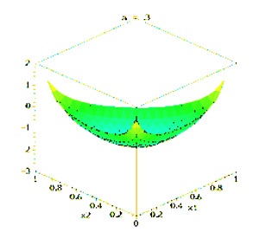
Dirichlet Function…
{0.33,0.33,0.33} each of the 3 vectors have equal likelihood among K represented as highest points
K can be more than 3 but can’t be visualized

Slide 16
Dirichlet Function…
Alpha is a parameter adjusts the probability distribution, adjusted through observed frequencies

Slide 17
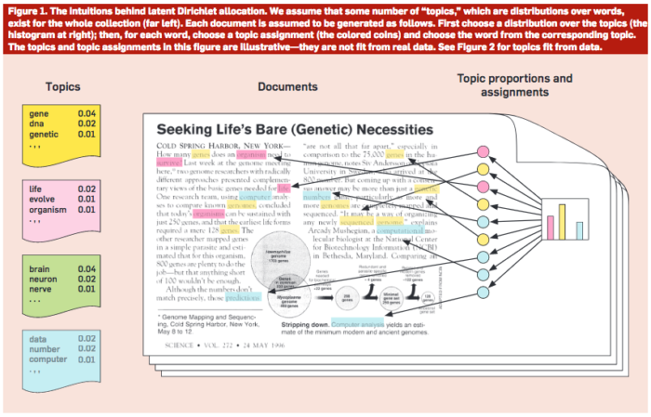
Common Sense Explanation
http://www.cs.columbia.edu/~blei/papers/Blei2012.pdf

Slide 18

Open C_topicModeling.R

Slide 19
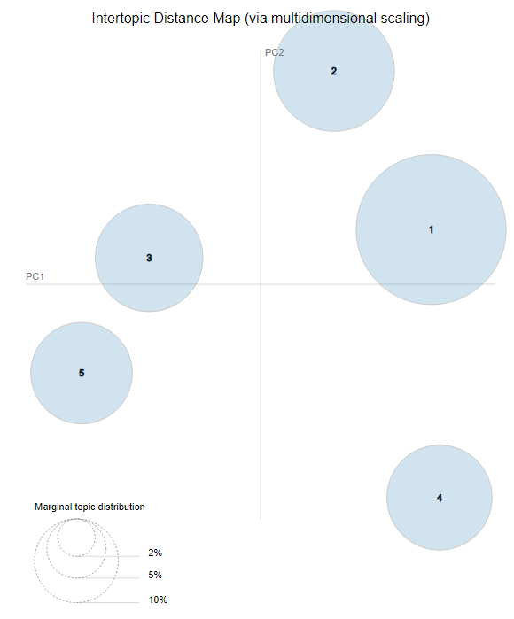
LDAvis: PCA of topics need to be interpreted
England-ness?
Non-Cricket
Cricket
Pakistan-ness?

Slide 20
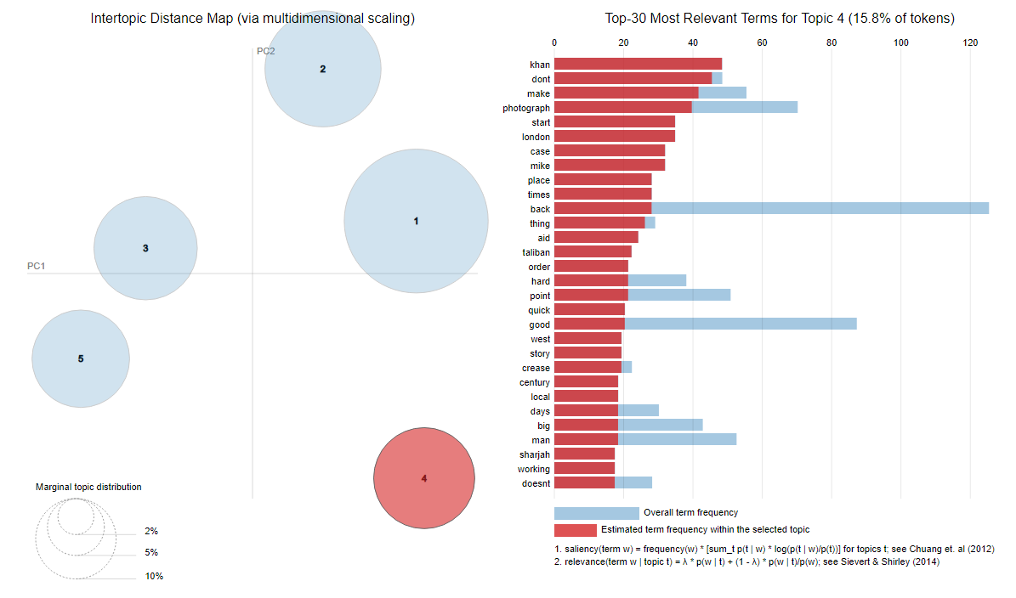
LDAvis: Interactie to show term distribution

Slide 21
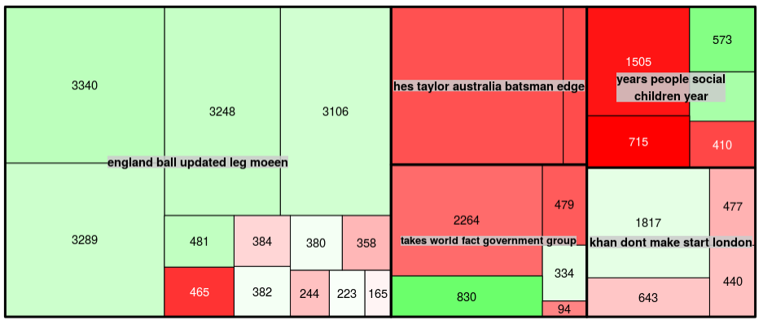
Interpreting a TreeMap: Multi-dimensional
Thick black lines: LDA defined Topic; text is top 5 typical terms in each topic
Color: Polarity
Area: individual doc area is proportional to number of words
This shows the Guardian write positive and longer articles about Pakistan related to cricket than other topics.

Slide 22
Agenda – all times are suggested
Start | End | Wednesday
8:45 | 9:15 | Coffee
9:15 | 9:30 | Review Q/A from yesterday
9:30 | 10:45 | Polarity & Sentiment
10:45 | 11:00 | Break
11:00 | 12:00 | Topic Modeling
12:00 | 1:30 | Lunch
1:30 | 2:30 | K-Means, Spherical K-Mean, K-Mediod Clustering
2:30 | 3:15 | Lab

Slide 23


Slide 24
ID 3 Clusters
Select US State Fuel Cost (x) vs Sales (y)

Slide 25
Intuition for 3 clusters…
Select US State Fuel Cost (x) vs Sales (y)
low cost &
high sales
Mid cost &
Mid sales
High cost &
high sales

Slide 26

K-Means Unsupervised
Previous slide clustering was done by “eye”
“K” clusters are defined by practitioner
Need a defined distance measure between record
Euclidean Distance (common but not great for text)
Scale each vector to so one unit of measure doesn’t dominate ie # of rooms in a house vs sq-Meter of house

Slide 27
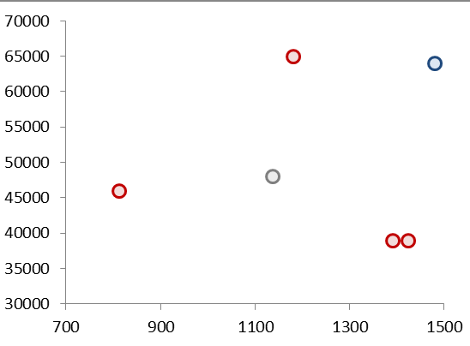
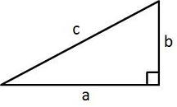
Quick Refresher
Remember Pythagorean Theorem?
Example Data
A²+B²=C²
b
c
a

Slide 28
K Means
Select US State Fuel Cost (x) vs Sales (y)
2
1
3
Random centroid placement

Slide 29
K Means
Select US State Fuel Cost (x) vs Sales (y)
2
1
3
Calculate the distance from each point to each centroid

Slide 30
K Means
Select US State Fuel Cost (x) vs Sales (y)
2
1
Cluster “3”
3
Cluster “1”
Pts assigned to closest centroid.

Slide 31
K Means
Select US State Fuel Cost (x) vs Sales (y)
2
1
Cluster “2”
Cluster “2”
Cluster “2”
Cluster “3”
3
Calculate the MEAN AVERAGE distance among assigned pts to centroid

Slide 32
K Means
Select US State Fuel Cost (x) vs Sales (y)
2
2
1
3
3
1
Move the centroid to the average distance among all assigned points

Slide 33
K Means
Select US State Fuel Cost (x) vs Sales (y)
2
Since “3” moved, this pt is assigned to “2”
3
1
Pt reassignment affects the avg distances so the process repeats…

Slide 34
K Means
Select US State Fuel Cost (x) vs Sales (y)
2
2
1
2
3
3
1
1
The new pt assignments again moves the centroid. The process repeats until no reassignments occur after moving the centroids (convergence).

Slide 35
K Means
Select US State Fuel Cost (x) vs Sales (y)
2
3
1
The new pt assignments again moves the centroid. The process repeats until no reassignments occur after moving the centroids (convergence).

Slide 36
K-Means Unsupervised
Previous slide clustering was done by “eye”
“K” clusters are defined by practitioner
Need a defined distance measure between record
Euclidean Distance (common but not great for text)
Scale each vector to so one unit of measure doesn’t dominate ie # of rooms in a house vs sq-Meter of house
Because it is the mean average all data attributes must be numeric (non factor ie what is the average of “blue eyes” or “medium” or “first”. Luckily w/text this is not an issue!

Slide 37

Try it out!
Open D_kmeans.R

Slide 38
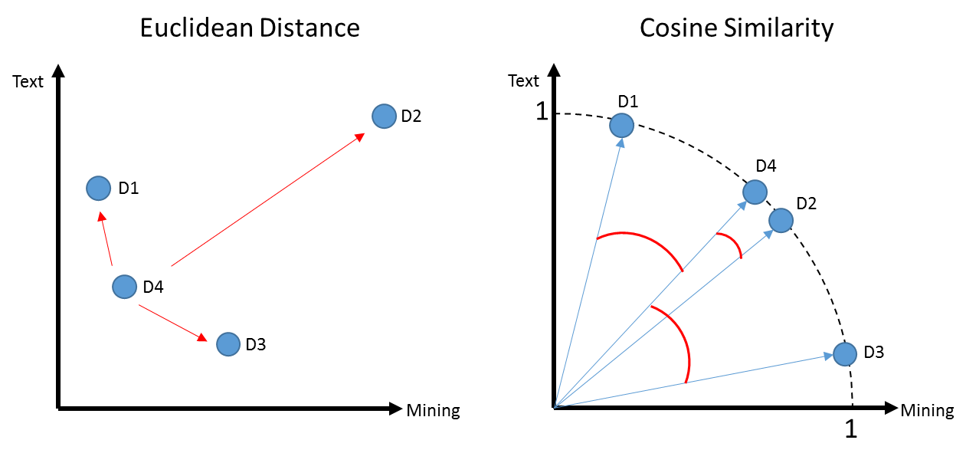
K-Means Problems
Computationally intensive (non-parametric)
Centroid will be greatly affected by an outlier
In this example a centroid would be “pulled” away from the actual cluster D1,D4 & D3

Slide 39

K- Mediod Clustering
Same steps as K-Means but instead of mean averages, uses the median distance to move centroids
Less impacted by outliers
Mean of 1,2,3,4,5,60 = 12.5
Median of 1,2,3,4,5,60 = 3.5 (closer to more points in vector space)
Open E_kmediods.R

Slide 40
K Means Vs Spherical K-Means
D1 a book for aspiring authors referring to “text” a lot
D2 & D4 refer to “text” and “mining” in equal proportions like the course book
D3 refers to “mining” ie minerals
D1, D4, D3 probably appear as 1 cluster w/D2 standing alone

Slide 41
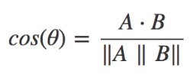
Another way to measure distance
Euclidean: How dissimilar are documents?
Cosine: How similar are documents?
Starting with a numeric Vector Representation from tokens
 | Doc1 | Doc2
Term1 | 1 | 0
… | - | 1
… | 3 | 2
… | 6 | 6
… | 7 | 1
… | 0 | 0
1. Calculate the “dot product” of the vectors:
(1*0) + (0*1) + (3*2) + (6*6) + (7*1) + (0*0)
0 + 0 + 6+ 36+ 7+ 0 = 49

Slide 42
Another way to measure distance
Euclidean: How dissimilar are documents?
Cosine: How similar are documents?
Starting with a numeric Vector Representation from tokens
 | Doc1 | Doc2
Term1 | 1 | 0
… | - | 1
… | 3 | 2
… | 6 | 6
… | 7 | 1
… | 0 | 0
Doc1: 1,0,3,6,7,0
Doc2: 0,1,2,6,1,0
Rearranged to follow more easily.
1. Calculate the “dot product” of the vectors:
(1*0) + (0*1) + (3*2) + (6*6) + (7*1) + (0*0)
0 + 0 + 6+ 36+ 7+ 0 = 49

Slide 43
Another way to measure distance
Euclidean: How dissimilar are documents?
Cosine: How similar are documents?
Starting with a numeric Vector Representation from tokens
Doc1: 1,0,3,6,7,0
Doc2: 0,1,2,6,1,0
Multiply each corresponding value
1. Calculate the “dot product” of the vectors:
(doc1: 1 * doc2: 0) + (doc1: 0 * doc2: 1) + (doc1: 3 * doc2: 2) + (doc1: 6 * doc2: 6) + (doc1: 7 * doc2: 1) + (doc1: 0 * doc2: 0)
0 + 0 + 6+ 36+ 7+ 0 = 49

Slide 44
Cosine
1. Calculate the “dot product” of the vectors:
(1*0) + (0*1) + (3*2) + (6*6) + (7*1) + (0*0)
0 + 0 + 6+ 36+ 7+ 0 = 49
2. Calculate the magnitude for a documents
Doc1: 1,0,3,6,7,0
Doc2: 0,1,2,6,1,0
Multiply each value to itself; sum up each doc; get sqrt
Multiply each value to itself; sum up each doc; get sqrt
Multiply single vector value

Slide 45
Cosine
1. Calculate the “dot product” of the vectors:
(1*0) + (0*1) + (3*2) + (6*6) + (7*1) + (0*0)
0 + 0 + 6+ 36+ 7+ 0 = 49
2. Calculate the magnitude for a documents
Doc1: 1,0,3,6,7,0
Doc2: 0,1,2,6,1,0
Multiply each value to itself; sum up each doc; get sqrt
Multiply each value to itself; sum up each doc; get sqrt
Multiply single vector value
Doc1: (1*1) + (0*0 )+ (3*3) + (6*6) + (7*7 )+ (0*0)
1 + 0 + 9 + 36 + 49 + 0 = 95
Sqrt(95) = 9.7
Doc2: (0*0)+(1*1)+(2*2)+(6*6)+(1*1) + (0*0)
0 + 1 + 4 + 36 + 1 + 0 = 42
Sqrt(42) = 6.4
9.7 * 6.4 = 63.1

Slide 46
Cosine
1. Calculate the “dot product” of the vectors:
(1*0) + (0*1) + (3*2) + (6*6) + (7*1) + (0*0)
0 + 0 + 6+ 36+ 7+ 0 = 49
2. Calculate the magnitude for a documents
Doc1: (1*1) + (0*0 )+ (3*3) + (6*6) + (7*7 )+ (0*0)
1 + 0 + 9 + 36 + 49 + 0 = 95
Sqrt(95) = 9.7
Doc2: (0*0)+(1*1)+(2*2)+(6*6)+(1*1) + (0*0)
0 + 1 + 4 + 36 + 1 + 0 = 42
Sqrt(42) = 6.4
9.7 * 6.4 = 63.1
3. Distance Measure: 49 / 63.1 = 0.77
Value will always be between 0,1.

Slide 47
Spherical K-Means
Euclidean: How dissimilar are documents?
Cosine: How similar are documents?
Uses cosine similarity to calculate distance
Values are normalized to 0,1
Cosine is measuring similarity…so a value of 0 means orthogonal (independent)
These are similar to the cosine similarity is closer to 1
Using cosines now D4, D2 represent a cluster as expected and you may have to declare add another K

Slide 48
Side by Side
Big distance D4 to D2 means they are far apart.
D4 to D2 Small angle distance means they are similar.
Distance is between 0 to inf.
Higher value means bigger distance.
Distance is between 0 to 1.
Higher value means smaller distance.
i.e. 1 to 1 for division is a duplicate document!

Slide 49
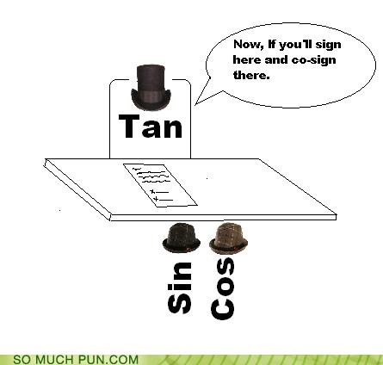
Open F_spherical_kmeans.R

Slide 50

Lab/Homework
Prework, you should have read the ethics articles provided but if you haven’t please do!
30Min : Perform a clustering technique on Jeopardy data & construct one visual
30Min: Read chapter 6 on document classification using elastic net.

