Slide 1
Time Series Forecasting

Slide 2
Agenda
Start | End | Item
 |  | What is Forecasting?
 |  | Naïve Forecasting Methods
 |  | Time Series Decomposition
 |  | HoltWinters Forecasting
 |  | Appendix

Slide 3
Main ideas
Forecast future values of a time series
Distinction between forecasting (main focus) and describing/explaining
Before forecasting understand “periodicity”
Four components of time series (meta-data):
Level
Trend
Seasonality
Noise
Time series data is great for enrichment and engineering e.g. “event flags” but can be modeled as a standalone vector due to the meta data “inside” the vector.

Slide 4
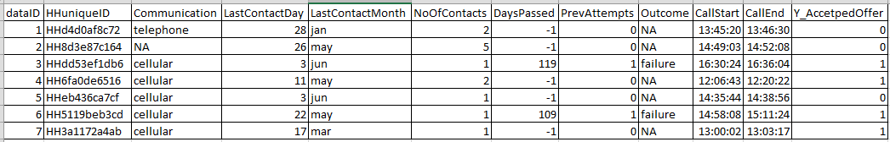
Difference between ML Data Setup & Time Series Data
ML Data Frame
Observations
Attributes for each observation
Each record is a standalone observation of a phenomena you are trying to predict, classify or cluster.
Records have defined attributes for each data row.
Notice time is not interacting between rows (or it had not better be) but is present at the observational row.

Slide 5
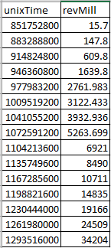
Difference between ML Data Setup & Time Series Data
Time Series Data
Data is typically (not always) in a single vector with each value being in sequence to the next.
Attributes may not be present because temporal information is held “within” the vector due to the relatedness of each record.
Attribute
Time Related Observations

Slide 6
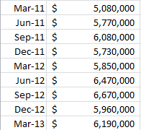
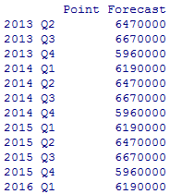

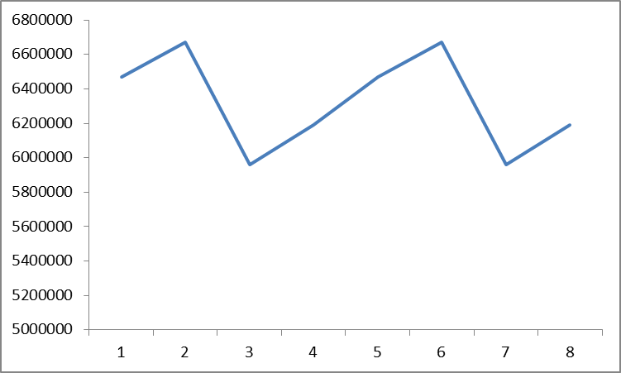
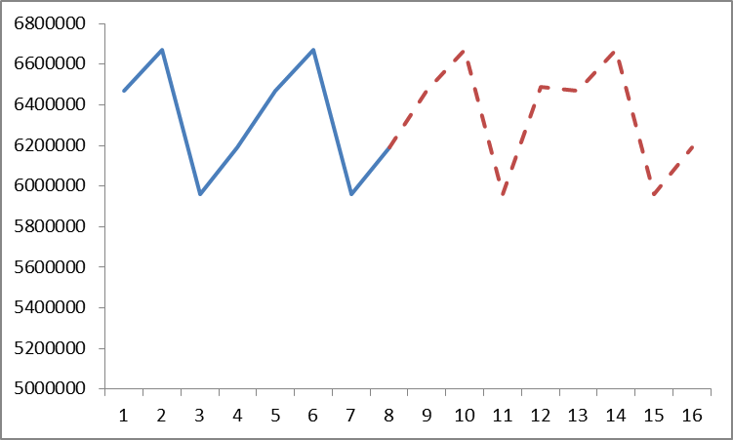
What is forecasting?
Forecasting is the process of applying mathematical tools on time series data to create future time series values, doesn’t have to explain the reason for observed changes.
Actual Time Series
Future Forecasted Values
Times Series Data > Forecast Methodology> Future Values

Slide 7
Explain Vs. Predict
Explanation is the goal of “time series analysis”
Models are based on causal argument
Models are not “black-box”
Example Explanations:
“The housing crisis reduced the expected bank revenue over a 2yr period”
“Inclement weather negatively affected holiday shopping at Target by 5%.”
Forecasting seeks to predict future values
Example outcomes:
“Next quarter bank revenue is forecasted to rise to $XYZ”
“Wal-Mart’s 3rd quarter revenue will be $130B.”

Slide 8
The data inside the time series data
Level – an average of the observations “steady state”
Trend – are values increasing, decreasing or stationary
Seasonality – is there a repeating pattern in the periodicity
Noise – unexplained values or “residuals” from adding “trend”, “seasonality” and “level” together. Basically its what left, and unaccounted for.

Slide 9
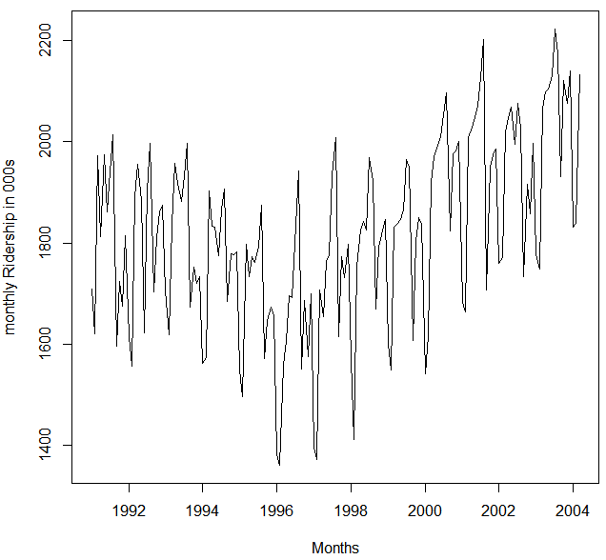

Amtrak Actual Riders
What do we observe?
Level?
Trend?
Seasonality?
Noise?
Notes:
Level - about 1,800,000 passengers per month
Appears to have U-shaped trend

Slide 10
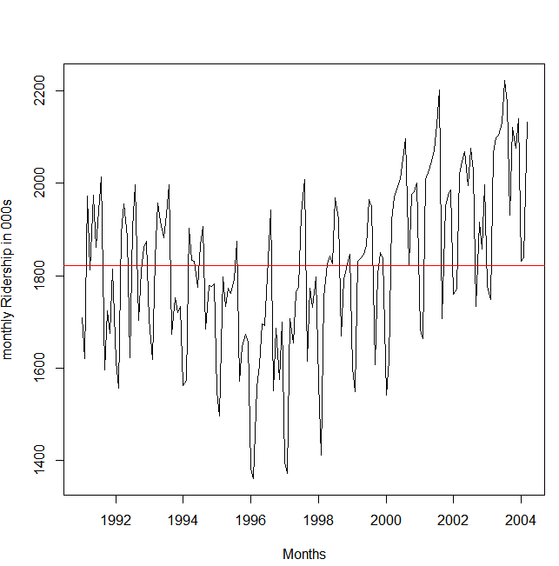
Amtrak Actuals
What do we observe?
What do we observe?
Level?
Trend?
Seasonality?
Noise?

Slide 11
Amtrak Actuals
What do we observe?
What do we observe?
Level?
Trend?
Seasonality?
Noise?

Slide 12
Zoom to 3 years (1997-1999)
Seasonality* appears when zoomed in:
Each year traffic peaks in summer
Noise:
Departure from the general level that is neither trend nor seasonality
Put another way, if you add (sometimes multiply) the seasonal, trend and level values, the difference is the “noise”
* Don’t confuse the time series term “season,” which is the period over which a cyclical pattern repeats (e.g. a year), with the standard English seasons of the year (fall, winter, etc.)

Slide 13
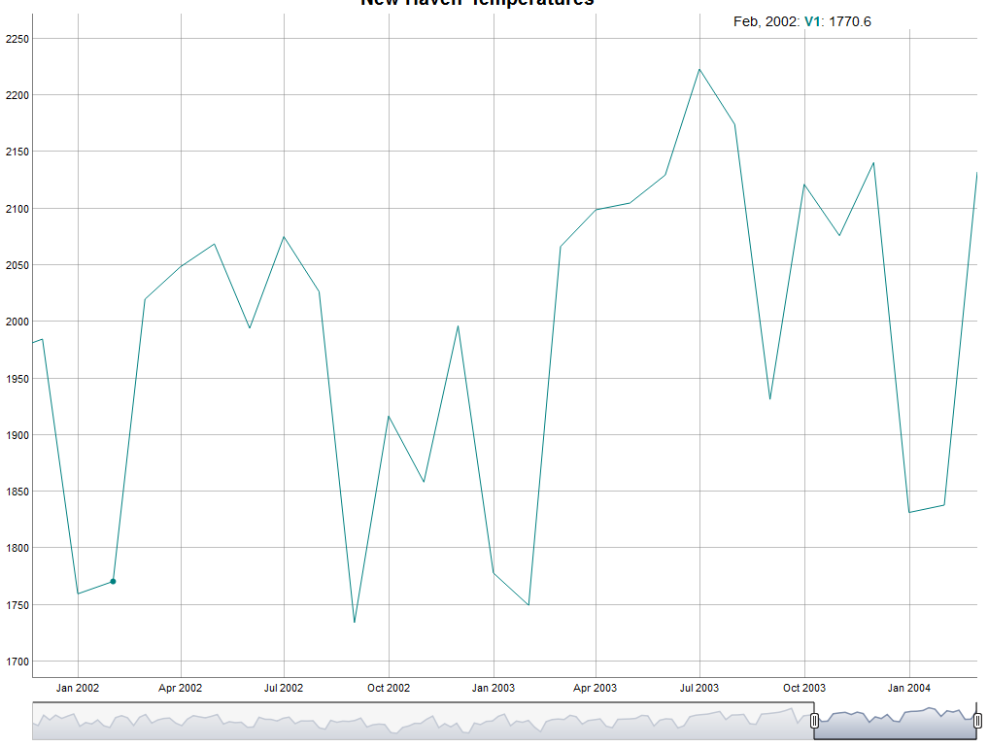
Zoom to 3 years (1997-1999)
Decline in Jan/Feb

Slide 14
Zoom to 3 years (1997-1999)
Increase in Mar

Slide 15
Zoom to 3 years (1997-1999)
Sustained increase until Aug

Slide 16
Zoom to 3 years (1997-1999)
Drops after August

Slide 17
Open A_amtrak.R
Let’s Practice!
Time Series Basics
Dynamic Plotting
Lubridate Functions

Slide 18
Machine Learning Partitioning
Divide data into training portion and validation portion
Test model on the validation portion
Training Data
All Data
Test Data

Slide 19
Time Series Partitioning is not random
Random partitioning would leave holes in the data, which causes problems
Forecasting methods assume regular sequential data
Instead of random selection, divide data into two parts
Train on early data
Validate on later data
Performance can be assessed against the “naïve benchmark” & historical accuracy naïve forecast is simply the most recent value in the time series
Validation
Training Data
Temporal Data Points
Sub-setting data with regard to time is called “out of time” sampling.

Slide 20
Summary
Focus is to predict (not describe/explain)
Four components
Level
Trend
Seasonality
Noise
Partition data by dividing into early/late

Slide 21
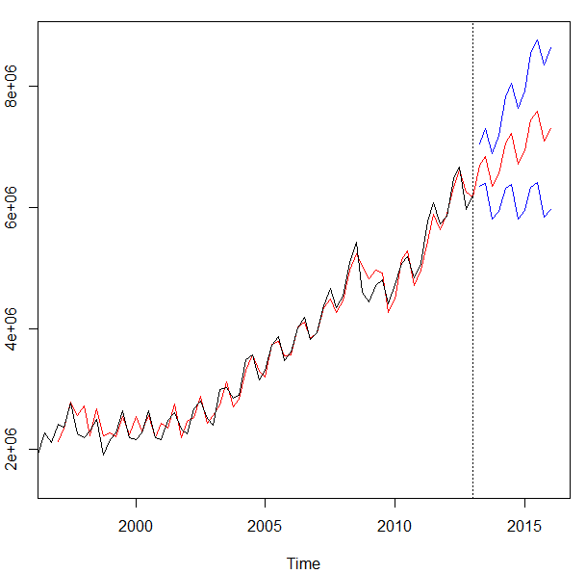
What types of business problems can be forecasted?
We will cover a set of common forecasting tools to make predictions. The goal is to create accurate future values and provide ranges of accuracy in real contexts.
Amazon’s Quarterly Revenue
Black is the actual through 2013
Red is the fit and after the dateline, the best fit-forecast.
Blue represents confidence intervals
Notes:
Other forecasts in business:
Supply management
Sales
Product life cycles
Call centers
…

Slide 22
Open B_getRevenueData.R
Let’s recent real time series and plot it.

Slide 23
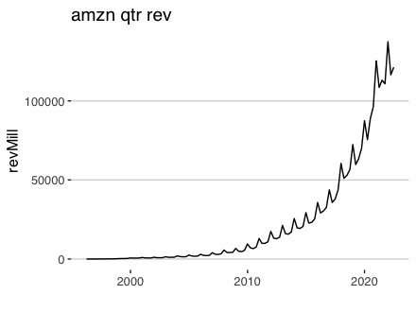
Inspecting meta data.
What is the meta data for AMZN?
Does the meta data exhibit a discernable pattern?
Do you think historical values are a basis for future values?
Notes:
Level?
Trend?
Pattern?

Slide 24
Agenda
Start | End | Item
 |  | What is Forecasting?
 |  | Naïve Forecasting Methods
 |  | Time Series Decomposition
 |  | HoltWinters Forecasting
 |  | Appendix

Slide 25
5 Common Methods
We will cover 3 common methods to forecasting.
Naive
Holt Winters
TSD
ARIMA
Linear Modeling
Most common
Easy/Fast
Usually not very accurate
Exponential Smoothing
Good w/Seasonality
Decomposes into meta-data components
Good for de-seasoning & investigating
Not really forecasting future
Accurate
Good with trends/trend reversals
Good with noisy series
Good w/Seasonality
”black box”
Essentially linear regression
Requires additional data manipulation & effort
ARIMA & Linear Model Forecasting is in the Appendix presentation & book.

Slide 26
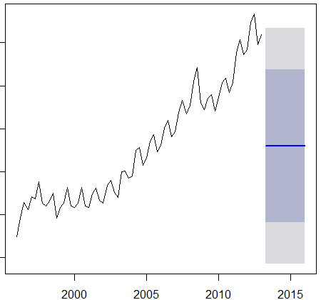
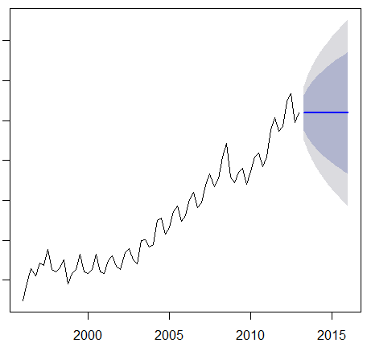
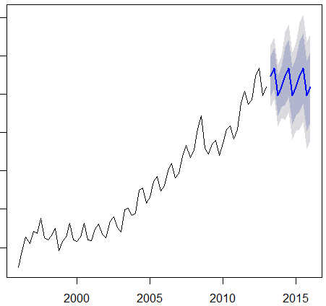
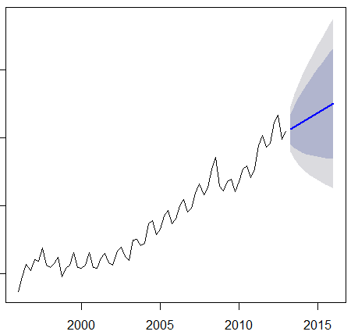
4 Methods of Naïve Forecasting
MEAN
Naïve
Seasonal
Naïve
Drift

Slide 27
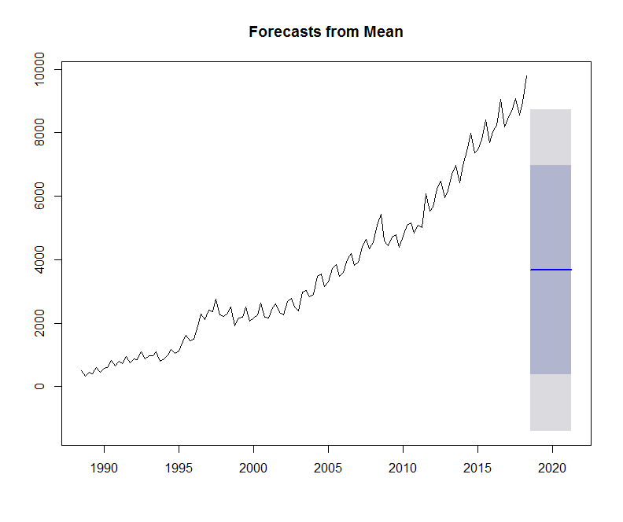
Naïve Forecast - Mean
Takes the mean for the series and repeats as future forecasts.
Does this look accurate?

Slide 28
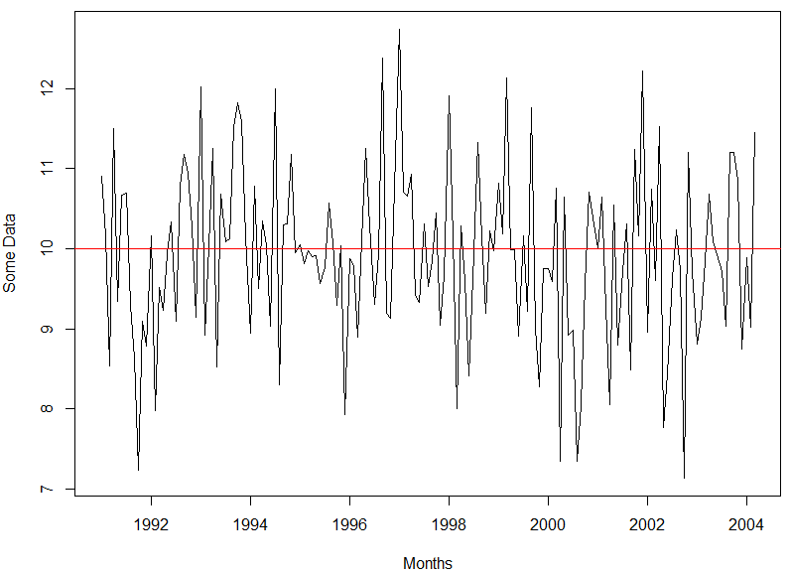
Naïve Forecast - Mean
Takes the mean for the series and repeats as future forecasts.
Does this look accurate?
When would this be appropriate?

Slide 29
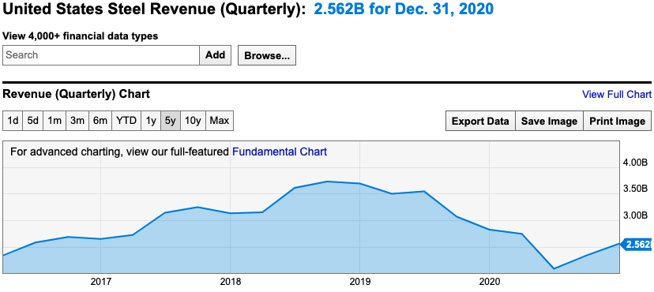
Naïve Mean doesn’t look good but sometimes is relevant.
Series in a range with some underlying stability
(steel producers are usually a stable business)

Slide 30
Revisiting Naïve Forecast - Mean
Takes the mean for the series and repeats as future forecasts.

Slide 31
Naïve Forecast - Drift
Average rate of change is added from the last known value.
Often more accurate than mean with strong trend.
Accuracy hurt by seasonality but is appropriate when there is a strong trend and non–repeating pattern.

Slide 32
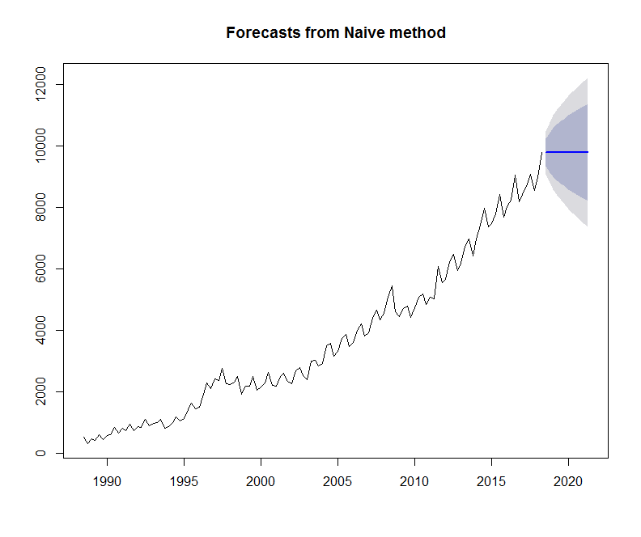
Naïve Forecast – Naïve (true)
Uses last value as future.
Does this look accurate?
Accuracy hurt by trend and seasonality. Use when you see a plateau in the data, meaning diminishing trend.

Slide 33
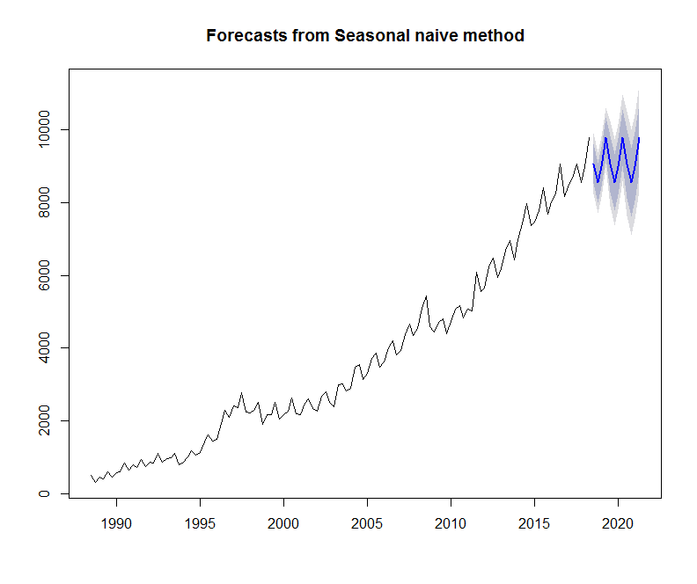
Naïve Forecast – Naïve Seasonal
Uses last corresponding seasonal values in a repeating pattern. Good if no trend.
Does this look accurate?
When would this be appropriate? When the series is flat (no trend) but has a repeating pattern.

Slide 34
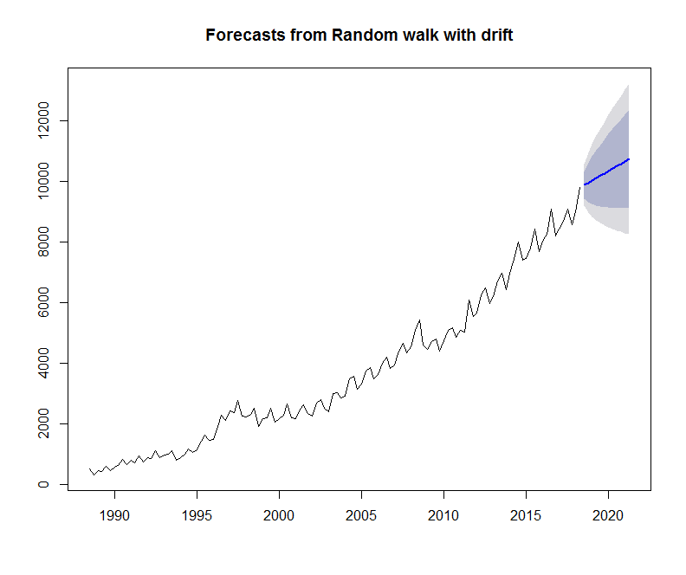
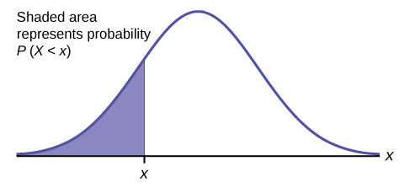
Shaded Forecast Area?
Independent and identically distributed random variables
Represents Prediction Intervals
Returns a value for each interval
Lo 80
Hi 80
Lo 95
Hi 95
Each period increases standard deviation; stretching out the distribution.
As time progresses uncertainty increases
Mu:
Avg of population
Frequency
Values

Slide 35
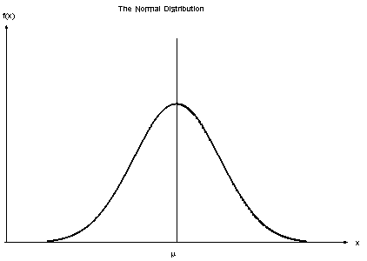
Shaded Forecast Area?
Laying the normal distribution onto the forecast you get a probability centered at the forecast.
Green is the “point estimate”
Lo 80
Hi 80
Lo 95
Hi 95

Slide 36
Open C_NaiveNike.R

Slide 37
Agenda
Start | End | Item
 |  | What is Forecasting?
 |  | Naïve Forecasting Methods
 |  | Time Series Decomposition
 |  | HoltWinters Forecasting
 |  | Appendix

Slide 38
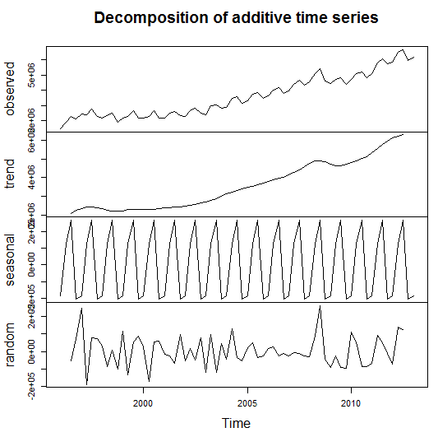
Time Series Decomposition
Decompose a time series into
Trend
Seasonal
Random (noise)
De-Season Data
Helps understand the underlying characteristics of a time series
Sometimes applying a forecast or model to the random component can improve accuracy

Slide 39
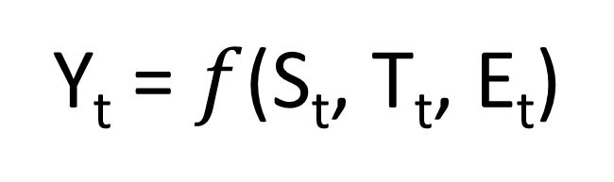
Time Series Decomposition
Y_{t} = $f$(S_{t}, T_{t}, E_{t})
Data at a specific time period (t) is equal to a mix* of seasonal values, trend values and whatever is left at the same time period.
Where (Math-speak version):
Y_{t} = data at period t
S_{t} = seasonal component at period t
T_{t} = trend component at period t
E_{t} = remainder or residual component at period t

Slide 40
Time Series Decomposition
Y_{t} = $f$(S_{t}, T_{t}, E_{t})
Data at a specific time period (t) is equal to a mix* of seasonal values, trend values and whatever is left at the same time period.
Additive – Y_{t}= Seasonal effect + Trend + Residual
An additive model assumes that the difference between each time period is approximately the same
For example, Jan trend is +100, so next Jan trend would add another +100.
Multiplicative - Y_{t}= Seasonal effect X Trend X Residual
A multiplicative model assumes changes are proportional and not constant.
For example Jan season is +100 as part of a 1,000 total (10%). The next Jan the total is 1500, and the seasonal adjustment would be 150 (10%).
Notes:
Additive – Every quarter the business grows by $10M
Multiplicative – Every quarter the business grows by 10%

Slide 41
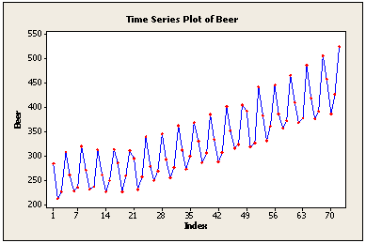
Time Series Decomposition
Additive
Use additive models if the seasonality (repeating pattern) is similar.
Peak to trough looks the same, so additive is ok.
Notes:
Amplitude changes

Slide 42
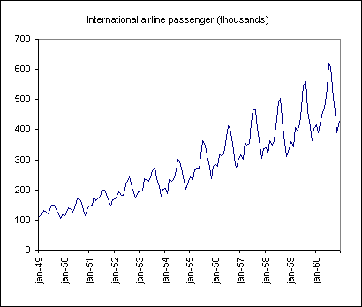
Time Series Decomposition
Multiplicative
Use multiplicative if the seasonality grows larger over time but is still the same proportion of the total
The peak to trough looks exaggerated over time
Notes:
Amplitude changes

Slide 43
Time Series Decomposition – Side by Side
Additive
Multiplicative
Use additive models if the seasonality (repeating pattern) is similar.
Use multiplicative if the seasonality grows larger over time but is still the same proportion of the total
Notes:
Amplitude changes

Slide 44
Summary – Time Series Decomposition
Separates Trend, Seasonal and Random components of a time series
Components are combined by
Additive – adding components is appropriate if the seasonal pattern is consistent
Multiplicative – multiplying components is appropriate if the seasonal pattern changes over time but it proportional to the time series.
TSD can help you understand the data and can be done as part of EDA
Each component can be forecasted separately to (sometimes) improve accuracy then each forecast can be combined to arrive at a final forecast
De-seasoning data is possible by subtracting (additive TSD) or dividing (multiplicative TSD) it out of the time series – see the impact of an event from expected seasonal or trend changes; quantifies impact

Slide 45
Open D_TimeSeriesDecompositionAMZN.R

Slide 46
Agenda
Start | End | Item
 |  | What is Forecasting?
 |  | Naïve Forecasting Methods
 |  | Time Series Decomposition
 |  | Appendix
 |  | HoltWinters Forecasting

Slide 47
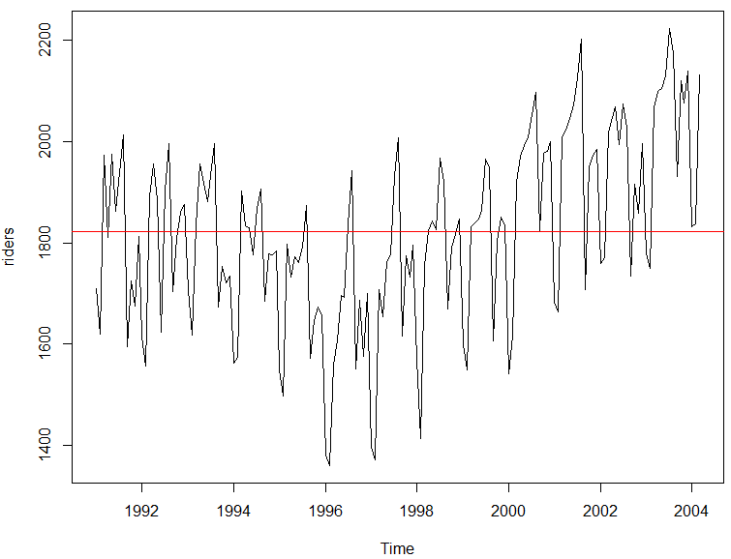
But first averages…
Mean Average – good for population summary
Add all values and divide by population
mean(riders)
[1] 1822.197
Each record has the same weight.
Number | Value
1 | 10
2 | 20
3 | 30
4 | 40
5 | 50
10+20+30+40+50
=30
5

Slide 48
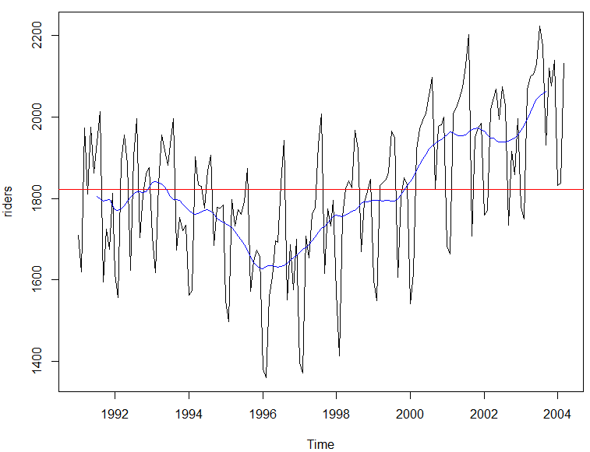
But first averages…
Centered Moving Average – smooths seasonality
Add all values and divide by population in the window
ma(riders, order =12)
Records in the window have the same weight.
Number | Value
1 | 10
2 | 20
3 | 30
4 | 40
5 | 50
t = 3
10+20+30
=15
3
…
30+40+50
=40
3
Descriptive because it uses values from the future so not good for forecasting.

Slide 49
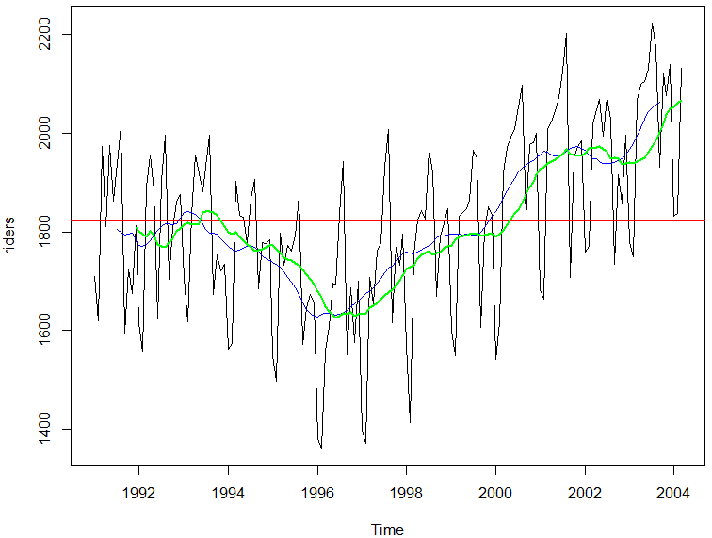
But first averages…
Trailing Moving Average – smooths seasonality
Add all values and divide by population in the window
rollmean(riders, k = 12, align = 'right'
Records in the window have the same weight.
Number | Value
1 | 10
2 | 20
3 | 30
4 | 40
5 | 50
t = 3
10+20+30
=20
3
20+30+40
=30
3
Uses preceding window values so ok for forecasts but lags for trend and seasonal.

Slide 50
But first averages…
Exponential Smoothing
Older records in the window have the diminishing weight
α is a parameter between 0 and 1.
0 = more weight is given to observations from the more distant past
Approaching 1= more weight given to recent
1 = all weight given to the most recent (same as a true Naïve forecast)
Values are weighted so their impact diminishes in the average the farther back.

Slide 51
Open E_HoltWintersWMT.R
HW applies exponential smoothing to level, trend and seasonality individually then combines them.

