Slide 1

Captain Obvious, you know functions…
library(ggplot2)
data("mtcars")
head(mtcars)
sample(1:nrow(mtcars),10)
Stable Diffusion w/portrait+1:
captain obvious, photorealistic, , Realistic, Realistic, Canon50, Dynamic Lighting

Slide 2
Remember…R uses functions, libraries & objects
Function
Input
Output
R uses predefined functions to accomplish things.

Slide 3


Remember…R uses functions, libraries & objects
halfBanana <- cutinhalf(banana )
Output
Function
(
Input
)

Slide 4
R functions have 3 components
Function:
Body- the code inside
Formals - parameters/inputs
Environment- where the function “lives”

Slide 5
Call a function without parenthesis in console
> read.csv
function (file, header = TRUE, sep = ",", quote = "\"", dec = ".",
fill = TRUE, comment.char = "", ...)
read.table(file = file, header = header, sep = sep, quote = quote,
dec = dec, fill = fill, comment.char = comment.char, ...)
<bytecode: 0x7f9e51673ec8>
<environment: namespace:utils>
Formals - inputs

Slide 6
Call a function without parenthesis in console
> read.csv
function (file, header = TRUE, sep = ",", quote = "\"", dec = ".",
fill = TRUE, comment.char = "", ...)
read.table(file = file, header = header, sep = sep, quote = quote,
dec = dec, fill = fill, comment.char = comment.char, ...)
<bytecode: 0x7f9e51673ec8>
<environment: namespace:utils>
Body-
the code inside

Slide 7
Call a function without parenthesis in console
> read.csv
function (file, header = TRUE, sep = ",", quote = "\"", dec = ".",
fill = TRUE, comment.char = "", ...)
read.table(file = file, header = header, sep = sep, quote = quote,
dec = dec, fill = fill, comment.char = comment.char, ...)
<bytecode: 0x7f9e51673ec8>
<environment: namespace:utils>
Environment- package

Slide 8
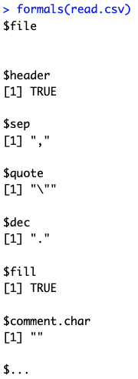
You can check these components with functions

Slide 9

You can check these components with functions

Slide 10

You can check these components with functions

Slide 11
There is an exception. “primitive” functions
Primitive Function:
They call C to be FAST.

Slide 12
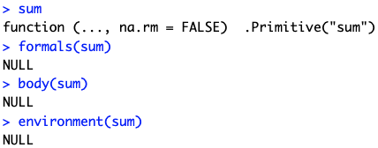

Slide 13
There are a lot of supporting functions that aren’t that helpful IMHO.
# Get all information from a package
bjs <- mget(ls("package:base"), inherits = TRUE)
# Filter down to just function class objects
funs <- Filter(is.function, objs)
It’s easier to look at package documentation.

Slide 14
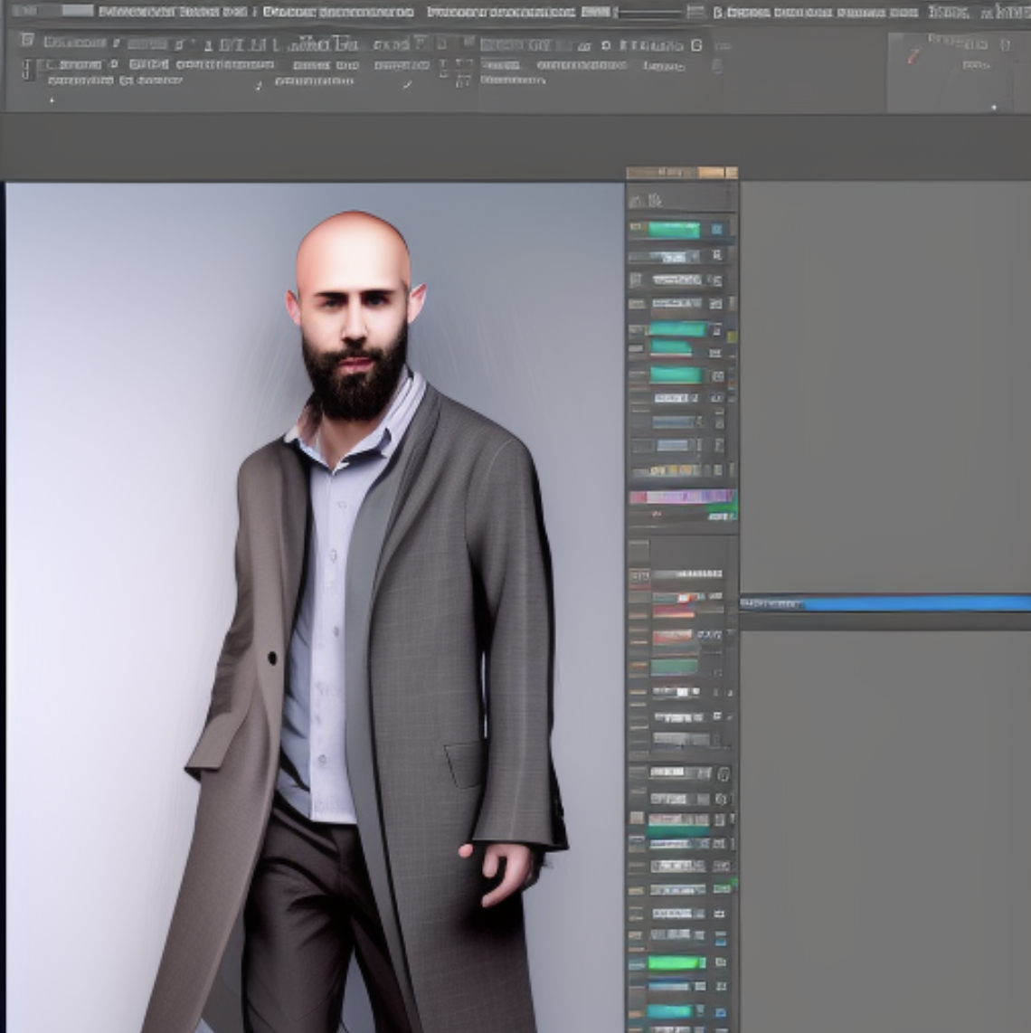
As you get more advanced you will need to make custom functions
Makes code reusable
More robust/less error prone because code is consistently applied –no more copy/paste
Readability/auditing is easier
Stable Diffusion w/inkpunk
computer wizard data scientist, photorealistic, , Realistic, Realistic, Canon50, Dynamic Lighting, funny

Slide 15
Components to make a function
1. Name it
<-
Best practices:
Use a verb for the action its doing.
Use something descriptive/non-generic.

Slide 16
Declare it as a function with inputs
1. Name it
<-
2. function(…)
Best practices:
Non-generic input names
Add defaults when appropriate.

Slide 17
Declare it as a function with inputs
1. Name it
<-
2. function(…)
3. Open/Close Curly Brackets
{
}

Slide 18
Declare it as a function with inputs
1. Name it
<-
2. function(…)
3. Open/Close Curly Brackets
{
4. Add execution code
}
Best practices:
Provide comments for yourself
Add data and output checks when appropriate
Use return() on the object to ensure the correct output is defined.

Slide 19
Declare it as a function with inputs
1. Name it
<-
2. function(…)
3. Open/Close Curly Brackets
{
4. Add execution code
}
<- function(numOne, numbTwo)
addTwoNum
{
response <- numOne + numTwo
return(response)
}

