Slide 1
R uses functions, libraries & objects
Function
Input
Output
R uses predefined functions to accomplish things.

Slide 2


R uses functions, libraries & objects
halfBanana <- cutinhalf(banana )
Output
Function
(
Input
)
“ <- ” is the assignment operator

Slide 3


R uses functions, libraries & objects
setwd(“ted/fruit/basket”)
library(knife)
library(peel)
banana <- read.fruit(“Banana.csv”)
halfBanana <- cutinhalf(banana )
halfBanana <- peel ( halfBanana)
Output
Function
(
Input
)
Results of an object can be used in the next function.

Slide 4
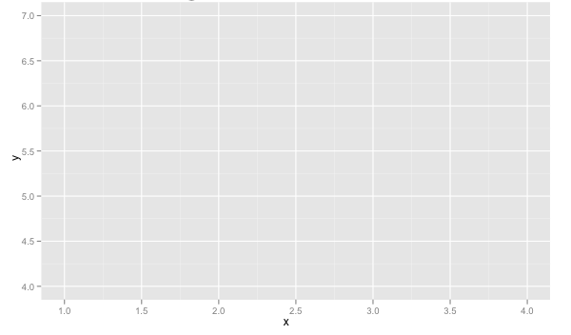
R uses functions, libraries & objects
setwd(“ted/fruit/basket”)
library(knife)
library(peel)
banana <- read.fruit(“Banana.csv”)
halfBanana <- cutinhalf(banana)
halfBanana <- peel(halfBanana)
plot(halfBanana)
Function
(
Input
)
You don’t always have to declare an output object & you can also save items to disk.

Slide 5






Workflow review
1
Use setwd() to point to your files & where to save outputs.
2
Load some customized libraries with library() for your specific analysis and methodology. Sometimes we will also create customized functions not in a library to aid our analysis.
3
Read in the file so the object is “in-memory” with read.csv() or similar.
4
Apply a function(s) from a library to adjust or create new objects in memory. The pseudo code for this is:
object<-function(applied to object)
5
Consume the results by saving, plotting etc.

Slide 6
R objects come in many types, and you can make your own!

Slide 7
Lists, a little bit more complex
Now operations are applied to each element not just 1 data frame.
30 Songs in a “list”
LIST
Song
Song
Song
Song
…
…
…
Song
Song
Don’t worry if this is intimidating…at this point I don’t expect you to really know how to do this. Merely get into R, run some code, and conceptually understand the flow.

Slide 8
Lists, a little bit more complex
Now operations are applied to each element not just 1 data frame.
30 Songs in a “list”
LIST
2500 total lines analyzed among 30 songs
Song 1: At 4 seconds, 7 words were spoken
Song 1: At 10 seconds 12 total words (7+5)
…
Song 30: At 4.6 min, 862 total words spoken
Functions applied in series
function()
Song
Song
Song
Song
…
Grab the last line total for each song
30 songs
Song 1: ends at 3m with 709 total words spoken
…
Song30: ends at 4.6m with 862 words
…
…
Song
Song
Don’t worry if this is intimidating…at this point I don’t expect you to really know how to do this. Merely get into R, run some code, and conceptually understand the flow.

Slide 9
A safe/supportive learning environment
We will be using lyrics from popular hip-hop songs late in the lesson. There is a censored version of the data if someone finds it objectionable.

Slide 10
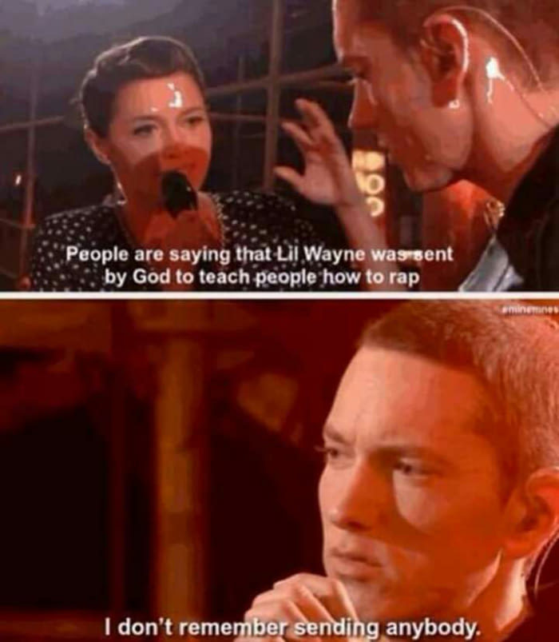
Let’s practice with a list!
30 Songs in a “list”
LIST
Song
Song
Song
Song
…
…
…
Song
Song
Open B_RapSongs.R
Learning Outcome: Efficient R Scripting!

Slide 11
Housekeeping , Reading & Homework, recommended
Make sure you have R Studio Installed
Sign up at RStudio Cloud
If local, Recommended to install Git locally for “git pull”
Connect your local to the class repo
Chapter 1 & Chapter 2
1. Piazza introduction post (slide 7, assigned as part of class participation)…assuming we can get piazza working
2. C2.1 Data Mining Techniques
3. C2.2 Data Partition
4. C2.3 Data Sample
5. C2.4 Modeling Steps

