Slide 1
R uses functions, libraries & objects
Function
Input
Output
R uses predefined functions to accomplish things.

Slide 2


R uses functions, libraries & objects
halfBanana <- cutinhalf(banana )
Output
Function
(
Input
)
“ <- ” is the assignment operator

Slide 3


R uses functions, libraries & objects
setwd(“ted/fruit/basket”)
library(knife)
library(peel)
banana <- read.fruit(“Banana.csv”)
halfBanana <- cutinhalf(banana )
halfBanana <- peel ( halfBanana)
Output
Function
(
Input
)
Results of an object can be used in the next function.

Slide 4
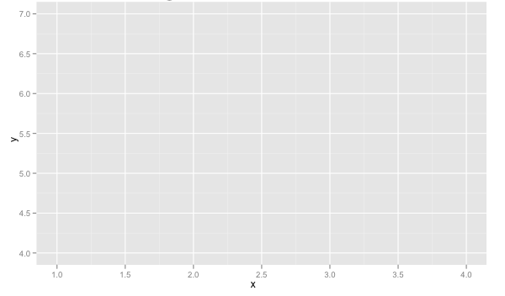
R uses functions, libraries & objects
setwd(“ted/fruit/basket”)
library(knife)
library(peel)
banana <- read.fruit(“Banana.csv”)
halfBanana <- cutinhalf(banana)
halfBanana <- peel(halfBanana)
plot(halfBanana)
Function
(
Input
)
You don’t always have to declare an output object & you can also save items to disk.

Slide 5






Workflow review
1
Use setwd() to point to your files & where to save outputs.
2
Load some customized libraries with library() for your specific analysis and methodology. Sometimes we will also create customized functions not in a library to aid our analysis.
3
Read in the file so the object is “in-memory” with read.csv() or similar.
4
Apply a function(s) from a library to adjust or create new objects in memory. The pseudo code for this is:
object<-function(applied to object)
5
Consume the results by saving, plotting etc.

Slide 6
R objects come in many types, and you can make your own!

Slide 7



Common R Object Types - Vectors
Objects in R can be various forms and even made to be “custom” types.
Numeric/Integer
Factors (Distinct Classes)
as.factor(c('MALE','FEMALE','FEMALE'))
Cardinality
2
1
10
12
3.47
82
MALE
FEMALE
FEMALE
Unordered
c(1,10,12,3.47)
[1] MALE FEMALE FEMALE
Levels: FEMALE MALE
High
Med
Low
as.factor(c(‘High',‘Med',‘Low'))
Cardinality
3
Ordinal
Boolean
STRING (just text)
TRUE
TRUE
FALSE
TRUE
FALSE
c('MALE','FEMALE','FEMALE')
c(T, T, F, T, F)
c(TRUE,TRUE, FALSE, TRUE,FALSE)
c(T,TRUE, F, TRUE,FALSE)
[1] "MALE" "FEMALE" "FEMALE"
In R, a vector can be numeric, Boolean (T/F), factors, or contain strings.
Notes:
Ordinal – is there an order to the factor, how does that factor level relate to other levels
Cardinality – number of distinct factor levels, the number of elements in a set

Slide 8
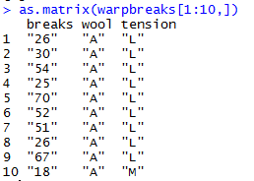
More Complex Common R Object Types - Matrix
Matrices are 2 dimensional data (rows/columns). Each column must be the same type.
RowID | breaks | wool | tension
1 | 26 | A | L
2 | 30 | A | L
3 | 54 | A | L
4 | 25 | A | L
5 | 70 | A | L
6 | 52 | A | L
7 | 51 | A | L
8 | 26 | A | L
9 | 67 | A | L
10 | 18 | A | M
All strings
Matrices are organized into rows and columns. In R, the row names are not actually a vector of the matrix but are an attribute of the matrix. In excel you would need a standalone vector to capture that information.

Slide 9
More Complex Common R Object Types – List
Lists are multi-dimensional objects that can contain different data types of different lengths.
ListA
single value
Single data frame or matrix
single vector
Nested list
Nested data frame
Nested matrix
Lists are useful for data organization but can be complex and difficult to navigate to get specific information.

Slide 10
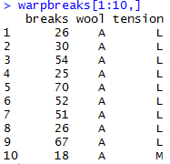
More Complex Common R Object Types – Data Frame
Data Frames are like 2 dimensional data objects but can have mixed data types.
A data frame is actually a named list but with equal length elements. Being a list lets it contain mixed data types.
RowID | breaks | wool | tension
1 | 26 | A | L
2 | 30 | A | L
3 | 54 | A | L
4 | 25 | A | L
5 | 70 | A | L
6 | 52 | A | L
7 | 51 | A | L
8 | 26 | A | L
9 | 67 | A | L
10 | 18 | A | M
Integers
Factor
Factor
Data frames are used often because they can hold different types of vectors, but can be switched back and forth with as.matrix() and as.data.frame(). Remember that the vector classes could change!!

Slide 11
When should you use a specific data type?
Number of Dimensions >1
No
Yes
Use a Vector
Data Types >1
No
Yes
Matrix or Array
Data Frame or List
Most analyses start with a data frame, and change classes as needed.

Slide 12
Lists, a little bit more complex
Now operations are applied to each element not just 1 data frame.
30 Songs in a “list”
LIST
Song
Song
Song
Song
…
…
…
Song
Song
Don’t worry if this is intimidating…at this point I don’t expect you to really know how to do this. Merely get into R, run some code, and conceptually understand the flow.

Slide 13
Lists, a little bit more complex
Now operations are applied to each element not just 1 data frame.
30 Songs in a “list”
LIST
2500 total lines analyzed among 30 songs
Song 1: At 4 seconds, 7 words were spoken
Song 1: At 10 seconds 12 total words (7+5)
…
Song 30: At 4.6 min, 862 total words spoken
Functions applied in series
function()
Song
Song
Song
Song
…
Grab the last line total for each song
30 songs
Song 1: ends at 3m with 709 total words spoken
…
Song30: ends at 4.6m with 862 words
…
…
Song
Song
Don’t worry if this is intimidating…at this point I don’t expect you to really know how to do this. Merely get into R, run some code, and conceptually understand the flow.

Slide 14
A safe/supportive learning environment
We will be using lyrics from popular hip-hop songs late in the lesson. There is a censored version of the data if someone finds it objectionable.

Slide 15
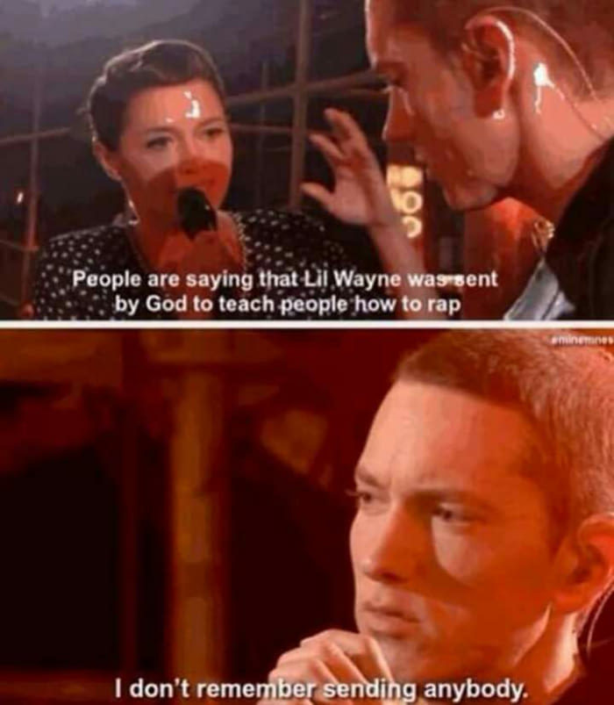
Let’s practice with a list!
30 Songs in a “list”
LIST
Song
Song
Song
Song
…
…
…
Song
Song
Open B_RapSongs.R
Learning Outcome: Efficient R Scripting!

Slide 16
Housekeeping , Reading & Homework, recommended
Make sure you have R Studio Installed
Sign up at RStudio Cloud
If local, Recommended to install Git locally for “git pull”
Connect your local to the class repo
Chapter 1 & Chapter 2
1. Piazza introduction post (slide 7, assigned as part of class participation)…assuming we can get piazza working
2. C2.1 Data Mining Techniques
3. C2.2 Data Partition
4. C2.3 Data Sample
5. C2.4 Modeling Steps

