Slide 1
Text & Un-Supervised Learning
Ted Kwartler

Slide 2
Machine Learning Supervised Learning
Goal: Predict a single “target” or “outcome” variable
Training data, where target value is known
Score to data where value is not known
Methods: Classification and Prediction

Slide 3
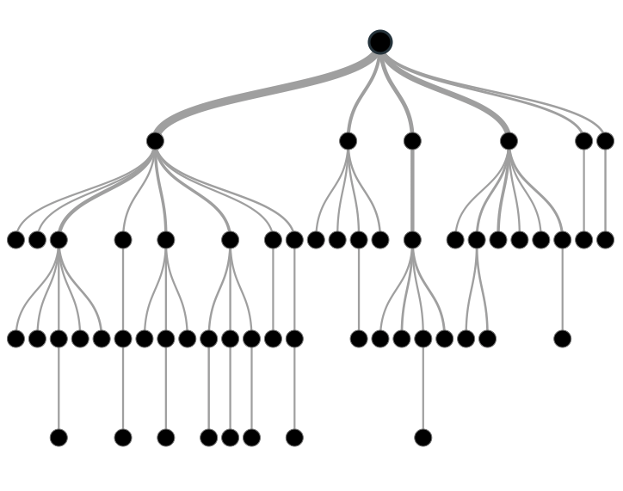

Supervised Learning
Inferring a function from labeled data.
“Learn from telling”, “Look at my data and I will tell you what to predict”
Data Setup
Method
Business Examples
Application
Marketing-Will a customer buy yes or no? How much will a customer spend?
Operations- Will an applicant default? When will a machine break?
Flat “Excel” file. Each row is a record or observation. Each column is an attribute of the record.
One column is the outcome, y or target attribute.
Modeling e.g. K-NN, linear regression, decision tree, random forest etc.
Make predictions for the target on the new data.

Slide 4
Supervised Learning in NLP
Is this email SPAM Vs non-Spam?
Is this document making fraudulent claims or not?
Using tweet mentions or financial documents predict a company’s revenue?

Slide 5
Machine Learning: Unsupervised Learning
Goal: Segment data into meaningful segments; detect patterns
There is no target (outcome) variable to predict or classify
Methods: Association rules, clustering, data reduction & exploration, visualization

Slide 6
Unsupervised Learning
Trying to find hidden structure in unlabelled data.
“Learn from observing”, “Look at my data and tell me about it”
Data Setup
Method
Business Examples
Application
Marketing-Find customer segments for specific marketing campaigns.
Operations-Identify locations for cell towers based on population density and area characteristics.
Text Analysis- Topic modeling of articles
Flat “Excel” file. Each row is a record or observation. Each column is an attribute of the record.
Clustering e.g. K-Means, Hierarchical Clustering etc
For new data assign to similar cluster

Slide 7
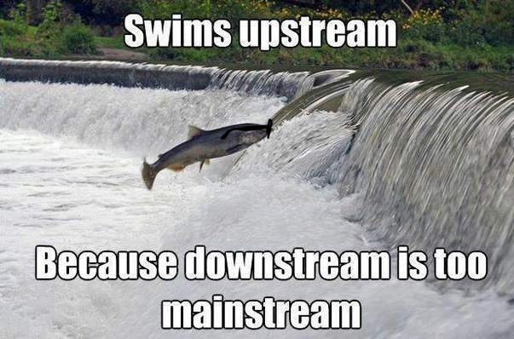
Your turn…
Methods
Scenario
Supervised or
Unsupervised
How many fish did each vessel catch?

Slide 8

Your turn…
Methods
Scenario
Supervised or
Unsupervised
What observed customer personas exist in our customer data?

Slide 9

Your turn…
Methods
Scenario
Supervised or
Unsupervised
How many patients should we expect in the urgent care tomorrow?

Slide 10
Unsupervised Learning: Latent Dirichlet Allocation
Observe term frequency within documents
Identify “k” topics or clusters with similar frequency
A document may be more than one topic and is assigned to a cluster topic by probability
If K= 4, each document would get 4 probabilities

Slide 11

Unsupervised: Latent Dirichlet Allocation (LDA)
Latent – identify concealed topics e.g. not explicitly declared
Dirichlet – used in stats to represent multi-variate (multi-word) distributions
Instead of actual values it’s a “beta” distribution of probabilities 0-1
No “tails” values include 0 and 1
Beta distributions do not have to be symmetrical
Dirichlet will give k probabilities from beta distributions that generalize and sum to 1
Don’t worry about it!

Slide 12
K = 3: Three vectors & Three corresponding probabilities
{1,0,0 }
{0,0,1 }
{0,1,0 }

Slide 13
K = 3: vectors & 3 corresponding probabilities
{0.33, 0.33, 0.33}
{0.50,0.50,0 }

Slide 14
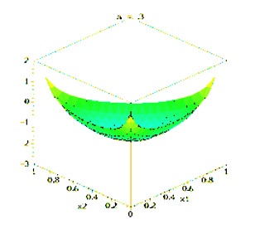
Dirichlet Function…
{0.33,0.33,0.33} each of the 3 vectors have equal likelihood among K represented as highest points
K can be more than 3 but can’t be visualized

Slide 15
Dirichlet Function…
Alpha is a parameter adjusts the probability distribution, adjusted through observed frequencies

Slide 16
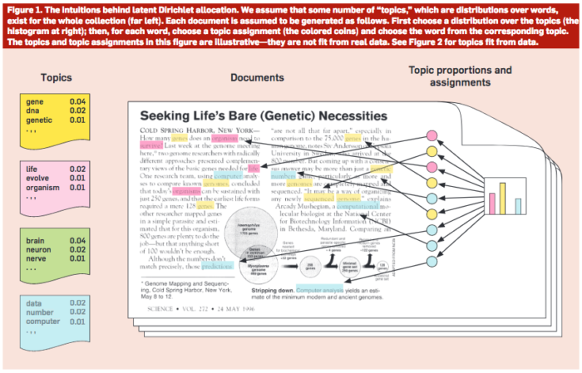
Common Sense Explanation
http://www.cs.columbia.edu/~blei/papers/Blei2012.pdf

Slide 17

Open J_topicModeling.R

Slide 18
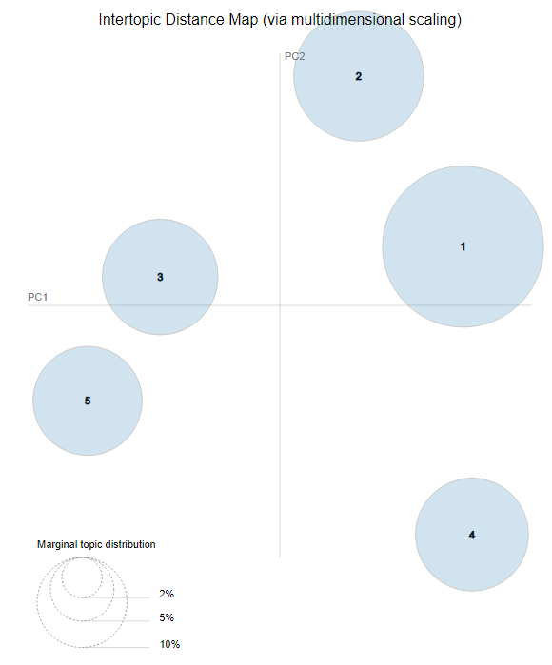
LDAvis: PCA of topics need to be interpreted
England-ness?
Non-Cricket
Cricket
Pakistan-ness?

Slide 19
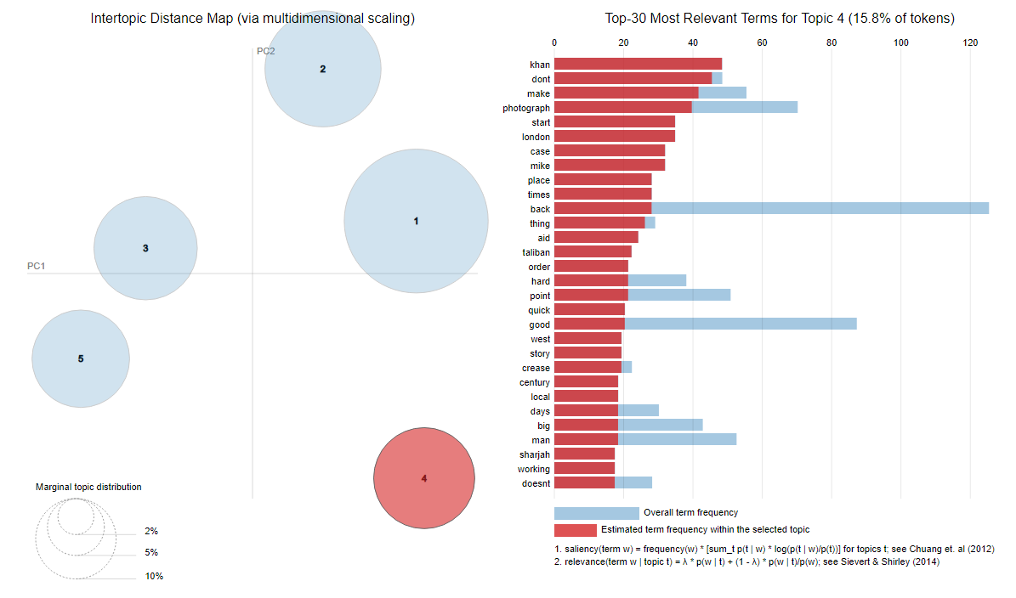
LDAvis: Interactive to show term distribution

Slide 20
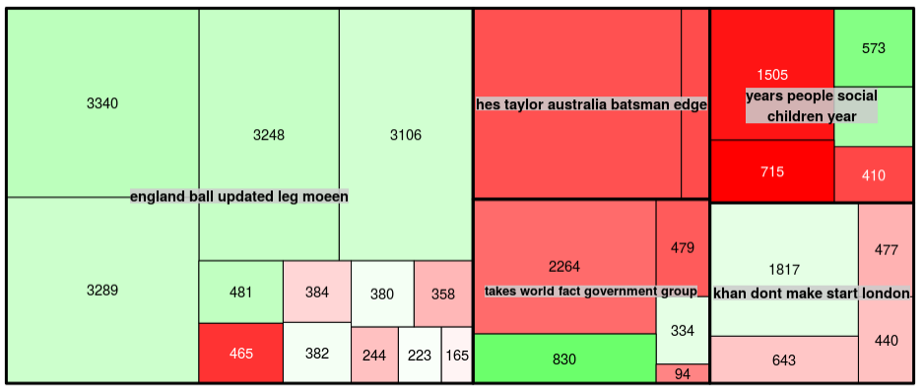
Interpreting a TreeMap: Multi-dimensional
Thick black lines: LDA defined Topic; named by 5 most typical words
Color: Polarity
Area: individual doc area is proportional to number of words
This shows the Guardian write positive and longer articles about Pakistan related to cricket than other topics.

Slide 21
ID 3 Clusters
Select US State Fuel Cost (x) vs Sales (y)

Slide 22
Intuition for 3 clusters…
Select US State Fuel Cost (x) vs Sales (y)
low cost &
high sales
Mid cost &
Mid sales
High cost &
high sales
You’re measuring by the perceived distance. Kmeans & Kmediods cluster this way.

Slide 23
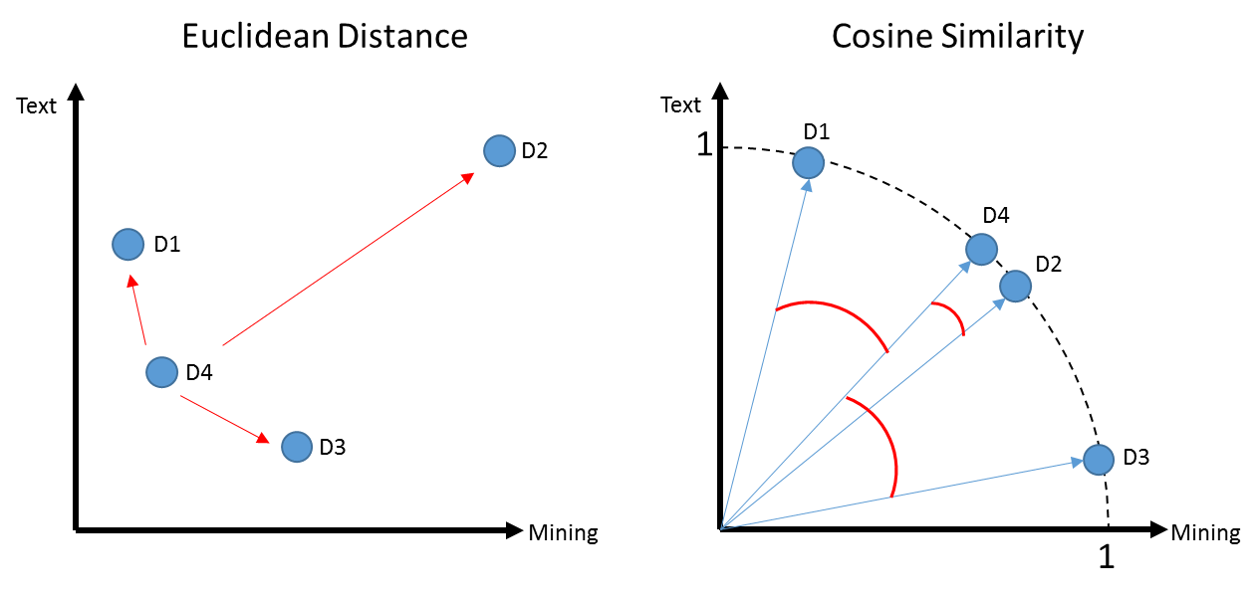
K-Means Problems
Computationally intensive (non-parametric)
Centroid will be greatly affected by an outlier

Slide 24
K Means Vs Spherical K-Means
D1 a book for aspiring authors referring to “text” a lot
D2 & D4 refer to “text” and “mining” in equal proportions like the course book
D3 refers to “mining” ie minerals
D1, D4, D3 probably appear as 1 cluster w/D2 standing alone

Slide 25
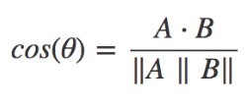
Another way to measure distance
Euclidean: How dissimilar are documents?
Cosine: How similar are documents?
 | Doc1 | Doc2
Term1 | 1 | 0
… | 0 | 1
… | 3 | 2
… | 6 | 6
… | 7 | 1
… | 0 | 0
Starting with a numeric Vector Representation from tokens
1. Calculate the “dot product” of the vectors:
(1*0) + (0*1) + (3*2) + (6*6) + (7*1) + (0*0)
0 + 0 + 6+ 36+ 7+ 0 = 49

Slide 26
Another way to measure distance
Euclidean: How dissimilar are documents?
Cosine: How similar are documents?
 | Doc1 | Doc2
Term1 | 1 | 0
… | 0 | 1
… | 3 | 2
… | 6 | 6
… | 7 | 1
… | 0 | 0
Starting with a numeric Vector Representation from tokens
Doc1: 1,0,3,6,7,0
Doc2: 0,1,2,6,1,0
Rearranged to follow more easily.
1. Calculate the “dot product” of the vectors:
(1*0) + (0*1) + (3*2) + (6*6) + (7*1) + (0*0)
0 + 0 + 6+ 36+ 7+ 0 = 49

Slide 27
Another way to measure distance
Euclidean: How dissimilar are documents?
Cosine: How similar are documents?
Starting with a numeric Vector Representation from tokens
Doc1: 1,0,3,6,7,0
Doc2: 0,1,2,6,1,0
Multiply each corresponding value
1. Calculate the “dot product” of the vectors:
(doc1: 1 * doc2: 0) + (doc1: 0 * doc2: 1) + (doc1: 3 * doc2: 2) +
(doc1: 6 * doc2: 6) + (doc1: 7 * doc2: 1) + (doc1: 0 * doc2: 0)
0 + 0 + 6+ 36+ 7+ 0 = 49

Slide 28
Cosine
1. Calculate the “dot product” of the vectors:
(1*0) + (0*1) + (3*2) + (6*6) + (7*1) + (0*0)
0 + 0 + 6+ 36+ 7+ 0 = 49
2. Calculate the magnitude for a documents
Doc1: 1,0,3,6,7,0
Doc2: 0,1,2,6,1,0
Multiply each value to itself; sum up each doc; get sqrt
Multiply each value to itself; sum up each doc; get sqrt
Multiply single vector value

Slide 29
Cosine
1. Calculate the “dot product” of the vectors:
(1*0) + (0*1) + (3*2) + (6*6) + (7*1) + (0*0)
0 + 0 + 6+ 36+ 7+ 0 = 49
2. Calculate the magnitude for a documents
Doc1: 1,0,3,6,7,0
Doc2: 0,1,2,6,1,0
Multiply each value to itself; sum up each doc; get sqrt
Multiply each value to itself; sum up each doc; get sqrt
Multiply single vector value
Doc1: (1*1) + (0*0 )+ (3*3) + (6*6) + (7*7 )+ (0*0)
1 + 0 + 9 + 36 + 49 + 0 = 95
Sqrt(95) = 9.7
Doc2: (0*0)+(1*1)+(2*2)+(6*6)+(1*1) + (0*0)
0 + 1 + 4 + 36 + 1 + 0 = 42
Sqrt(42) = 6.4
9.7 * 6.4 = 63.1

Slide 30
Cosine
1. Calculate the “dot product” of the vectors:
(1*0) + (0*1) + (3*2) + (6*6) + (7*1) + (0*0)
0 + 0 + 6+ 36+ 7+ 0 = 49
2. Calculate the magnitude for a documents
Doc1: (1*1) + (0*0 )+ (3*3) + (6*6) + (7*7 )+ (0*0)
1 + 0 + 9 + 36 + 49 + 0 = 95
Sqrt(95) = 9.7
Doc2: (0*0)+(1*1)+(2*2)+(6*6)+(1*1) + (0*0)
0 + 1 + 4 + 36 + 1 + 0 = 42
Sqrt(42) = 6.4
9.7 * 6.4 = 63.1
3. Distance Measure: 49 / 63.1 = 0.77
Value will always be between 0,1.

Slide 31
Spherical K-Means
Euclidean: How dissimilar are documents?
Cosine: How similar are documents?
Uses cosine similarity to calculate distance
Values are normalized to 0,1
Cosine is measuring similarity…so a value of 0 means orthogonal (independent)
These are similar docs i.e cosine similarity is closer to 1
Using cosines now D4, D2 represent a cluster as expected and you may have to declare add another K

Slide 32
Side by Side
Big distance D4 to D2 means they are dissimilar
Distance is between 0 to inf.
Higher value means bigger distance.
D4 to D2 Small angle distance means they are similar.
Distance is between 0 to 1.
Higher value means smaller distance.
i.e. 1 to 1 for division is a duplicate document!

Slide 33
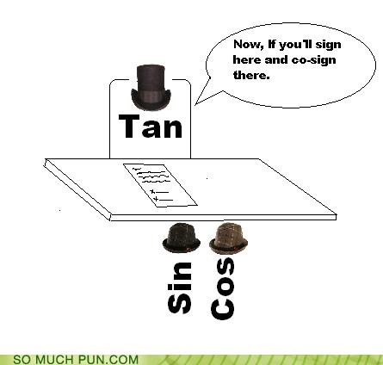
Open K_spherical_kmeans.R

