Slide 1
Text Mining & NLP Intros
Ted Kwartler

Slide 2
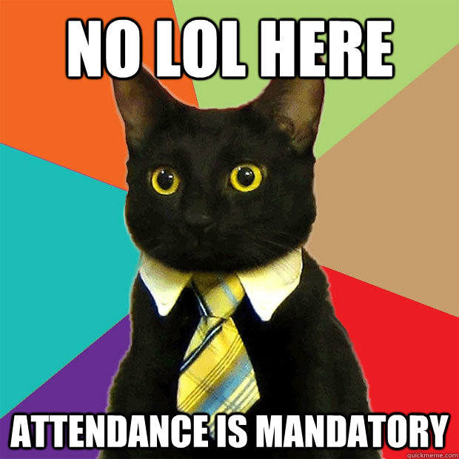

Slide 3
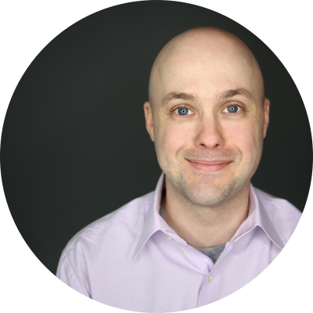









Ted Kwartler
MBA
Work
Teaching
Advisory Roles

Slide 4
Dates Review
https://github.com/kwartler/Hult_NLP_student_intensive
Date | Time (EST) | Topic
Jan 20, 2022, Thursday | 1-4pm | Administrative What is NLP? Git setup R, R-studio set up R for text basics & R basics
Jan 21, 2022, Friday | 10-5pm | Transform & mine a text file String manipulation, text processing DTM/TDM, WFM, visuals
Jan 22, 2022, Saturday | 10-5pm | Statistical Models Unsupervised methods Supervised methods
Jan 23, 2022, Sunday | 10-5pm | ESG, Responsible AI APIs & Google NLP API Web scraping basics

Slide 5
Assignments Review
https://github.com/kwartler/Hult_NLP_student_intensive
Assignment | Due Date 5pm EST | %
1. NLP EDA & Visuals | Jan 22 (after class, all day Saturday to work on it) | 20%
2. Press Release Case | Jan 31 (Sunday Jan 23, all week, next Sat/Sun & all day 31) | 80%

Slide 6
Community Learning Expectations
I expect:
Kindness > Cleverness
Active learning & participation
To make adjustments along the way so learning will be engaging & fun
Academic rigor
My goal for your learning experience is that the topics are:
Interesting
Applicable as a future business leader
Perspective building as a consumer affected by these methods

Slide 7
My style
You learn from being challenged
This is a intensive 4 class course requiring programing.
It can be uncomfortable learning something new.
Discomfort means you are applying/challenging yourself. It’s ok and expected.
The professor doesn’t give everyone the top scores & no extra credit.
You earn the actual grade but I am fair and reasonable
“Homework/reading is taking hours & I want to go to social activities.”
You are a graduate student at a top business school. Socialize later.

Slide 8
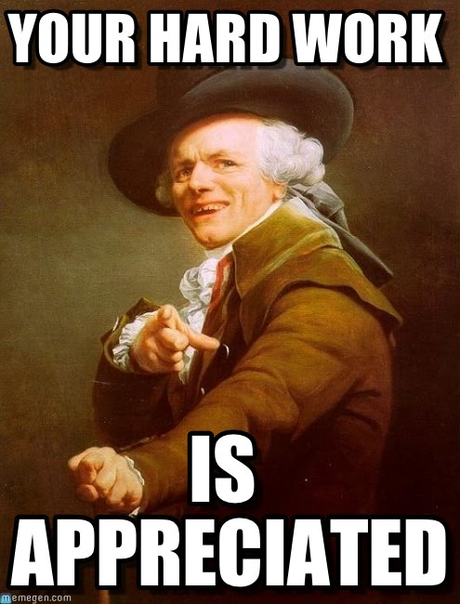
Some motivation
If you are struggling, ask Prof help, evening labs, lunchtime office hours, email or even smoke signals, whatever it takes to succeed.
Focus on your learning outcomes
Don’t focus on your grade

