Slide 1
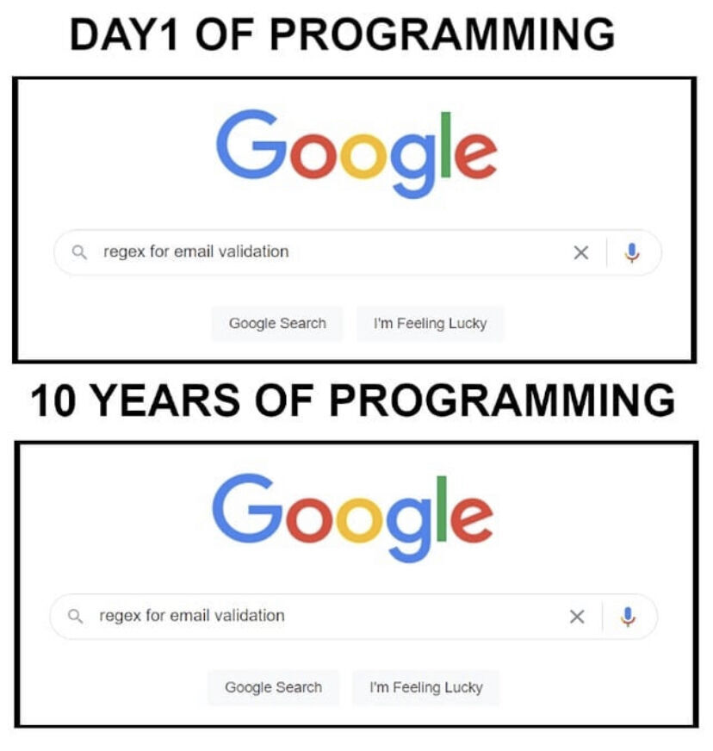

Slide 2
Data Structure for Analysis & Modeling
Often the 1st Column is a unique identifier but the identifier could also be a row attribute (not actually a vector)
name | mfr | type | calories | protein | fat | sodium | fiber | carbo | sugars | potass | vitamins | shelf | weight | cups | rating
100%_Bran | N | C | 70 | 4 | 1 | 130 | 10 | 5 | 6 | 280 | 25 | 3 | 1 | 0.33 | 68.40297
100%_Natural_Bran | Q | C | 120 | 3 | 5 | 15 | 2 | 8 | 8 | 135 | 0 | 3 | 1 | 1 | 33.98368
All-Bran | K | C | 70 | 4 | 1 | 260 | 9 | 7 | 5 | 320 | 25 | 3 | 1 | 0.33 | 59.42551
All-Bran_with_Extra_Fiber | K | C | 50 | 4 | 0 | 140 | 14 | 8 | 0 | 330 | 25 | 3 | 1 | 0.5 | 93.70491
Almond_Delight | R | C | 110 | 2 | 2 | 200 | 1 | 14 | 8 |  | 25 | 3 | 1 | 0.75 | 34.38484
Apple_Cinnamon_Cheerios | G | C | 110 | 2 | 2 | 180 | 1.5 | 10.5 | 10 | 70 | 25 | 1 | 1 | 0.75 | 29.50954
Apple_Jacks | K | C | 110 | 2 | 0 | 125 | 1 | 11 | 14 | 30 | 25 | 2 | 1 | 1 | 33.17409
Basic_4 | G | C | 130 | 3 | 2 | 210 | 2 | 18 | 8 | 100 | 25 | 3 | 1.33 | 0.75 | 37.03856
Bran_Chex | R | C | 90 | 2 | 1 | 200 | 4 | 15 | 6 | 125 | 25 | 1 | 1 | 0.67 | 49.12025
Bran_Flakes | P | C | 90 | 3 | 0 | 210 | 5 | 13 | 5 | 190 | 25 | 3 | 1 | 0.67 | 53.31381
Cap'n'Crunch | Q | C | 120 | 1 | 2 | 220 | 0 | 12 | 12 | 35 | 25 | 2 | 1 | 0.75 | 18.04285
Generally we will use data frames to avoid complexity but you will be exposed to other data types.

Slide 3
Data Structure for Analysis & Modeling
Informative features are usually independent & do not lend information to other rows (auto-correlation). Can be called informative columns, independent variables, or features.
Remember in a DF, these can be mixed with decimals, integers, factors, strings, T/F.
name | mfr | type | calories | protein | fat | sodium | fiber | carbo | sugars | potass | vitamins | shelf | weight | cups | rating
100%_Bran | N | C | 70 | 4 | 1 | 130 | 10 | 5 | 6 | 280 | 25 | 3 | 1 | 0.33 | 68.40297
100%_Natural_Bran | Q | C | 120 | 3 | 5 | 15 | 2 | 8 | 8 | 135 | 0 | 3 | 1 | 1 | 33.98368
All-Bran | K | C | 70 | 4 | 1 | 260 | 9 | 7 | 5 | 320 | 25 | 3 | 1 | 0.33 | 59.42551
All-Bran_with_Extra_Fiber | K | C | 50 | 4 | 0 | 140 | 14 | 8 | 0 | 330 | 25 | 3 | 1 | 0.5 | 93.70491
Almond_Delight | R | C | 110 | 2 | 2 | 200 | 1 | 14 | 8 |  | 25 | 3 | 1 | 0.75 | 34.38484
Apple_Cinnamon_Cheerios | G | C | 110 | 2 | 2 | 180 | 1.5 | 10.5 | 10 | 70 | 25 | 1 | 1 | 0.75 | 29.50954
Apple_Jacks | K | C | 110 | 2 | 0 | 125 | 1 | 11 | 14 | 30 | 25 | 2 | 1 | 1 | 33.17409
Basic_4 | G | C | 130 | 3 | 2 | 210 | 2 | 18 | 8 | 100 | 25 | 3 | 1.33 | 0.75 | 37.03856
Bran_Chex | R | C | 90 | 2 | 1 | 200 | 4 | 15 | 6 | 125 | 25 | 1 | 1 | 0.67 | 49.12025
Bran_Flakes | P | C | 90 | 3 | 0 | 210 | 5 | 13 | 5 | 190 | 25 | 3 | 1 | 0.67 | 53.31381
Cap'n'Crunch | Q | C | 120 | 1 | 2 | 220 | 0 | 12 | 12 | 35 | 25 | 2 | 1 | 0.75 | 18.04285
Generally we will use data frames to avoid complexity but you will be exposed to other data types.

Slide 4
Data Structure for Analysis & Modeling
If we are doing supervised learning, there is a dependent variable.
This is the outcome and is “dependent” on the informative columns. An analysis with this vector can be binary, classification, or predictive.
name | mfr | type | calories | protein | fat | sodium | fiber | carbo | sugars | potass | vitamins | shelf | weight | cups | rating
100%_Bran | N | C | 70 | 4 | 1 | 130 | 10 | 5 | 6 | 280 | 25 | 3 | 1 | 0.33 | 68.40297
100%_Natural_Bran | Q | C | 120 | 3 | 5 | 15 | 2 | 8 | 8 | 135 | 0 | 3 | 1 | 1 | 33.98368
All-Bran | K | C | 70 | 4 | 1 | 260 | 9 | 7 | 5 | 320 | 25 | 3 | 1 | 0.33 | 59.42551
All-Bran_with_Extra_Fiber | K | C | 50 | 4 | 0 | 140 | 14 | 8 | 0 | 330 | 25 | 3 | 1 | 0.5 | 93.70491
Almond_Delight | R | C | 110 | 2 | 2 | 200 | 1 | 14 | 8 |  | 25 | 3 | 1 | 0.75 | 34.38484
Apple_Cinnamon_Cheerios | G | C | 110 | 2 | 2 | 180 | 1.5 | 10.5 | 10 | 70 | 25 | 1 | 1 | 0.75 | 29.50954
Apple_Jacks | K | C | 110 | 2 | 0 | 125 | 1 | 11 | 14 | 30 | 25 | 2 | 1 | 1 | 33.17409
Basic_4 | G | C | 130 | 3 | 2 | 210 | 2 | 18 | 8 | 100 | 25 | 3 | 1.33 | 0.75 | 37.03856
Bran_Chex | R | C | 90 | 2 | 1 | 200 | 4 | 15 | 6 | 125 | 25 | 1 | 1 | 0.67 | 49.12025
Bran_Flakes | P | C | 90 | 3 | 0 | 210 | 5 | 13 | 5 | 190 | 25 | 3 | 1 | 0.67 | 53.31381
Cap'n'Crunch | Q | C | 120 | 1 | 2 | 220 | 0 | 12 | 12 | 35 | 25 | 2 | 1 | 0.75 | 18.04285
Generally we will use data frames to avoid complexity but you will be exposed to other data types.

Slide 5
Modeling Process
SEMMA (from SAS)
In this course…
1. Sample
In this course, most data sets are curated for you.
2. Explore
As part of your case analysis you perform basic exploratory data analysis (EDA)
3. Modify
Data cleanup, Dimension Reduction, Feature Engineering & Feature Enrichment
4. Model
Regression, Logistic Regression, Decision Trees, Random Forest etc.
5. Assess
There are many ways to evaluate a model. We will cover specific KPI and business implications.
The first day we discussed data mining and structure. Week 2 was devoted to basics of R then how to sample, explore and visualize data. Now we will modify data for modeling!

Slide 6
Modeling Process
SEMMA (from SAS)
In this course…
1. Sample
In this course, most data sets are curated for you.
2. Explore
As part of your course analysis you perform basic exploratory data analysis (EDA)
3. Modify
Data cleanup, Dimension Reduction, Feature Engineering & Feature Enrichment
4. Model
Regression, Logistic Regression, KNN, Decision Trees, Random Forest etc.
5. Assess
There are many ways to evaluate a model. We will cover specific KPI and business implications.
Often data is sampled from a large database so you can more quickly explore, apply methods and prototype before reassessing on full data.

Slide 7
PreProcessing
Many algorithms cannot accept the data directly.
Thus you must preprocess your data before training.
Common Pre-Processing
Categorical Variables
Common Pre-Processing
Numeric Variables
Dummy Variables
Binning Low Frequency Levels
Changing to Numeric for Ordinal
Deal with Missing Levels
Deal with Missing
Outlier Detection
Binning
We will use an easy method called variable treatment (vtreat).

Slide 8
Dummy Variables
Dummy Variables represent category levels as 1/0 within new vectors. For some approaches, this lets the algorithm understand the information.
Consider this data:
CuID | Gender | Profession | Affiliation
CU43E439 | Male | Nurse | Democrat
CU36E506 | Male | Teacher | Independent
CU91E65 | Female | Manager | Republican
CU17E255 | Male | Student | Democrat
CU27E792 | Female | Executive
CU74E430 | Female | Manager | Republican
CU25E466 | Female | Teacher | Democrat
CuID | Gender__Male | Profession_Nurse | Profession_Teacher | Profession_Manager | Profession_Student | Affiliation_D | Affiliation_I | Affiliation_Missing
CU43E439 | 1 | 1 | 0 | 0 | 0 | 1 | 0 | 0
CU36E506 | 1 | 0 | 1 | 0 | 0 | 0 | 1 | 0
CU91E65 | 0 | 0 | 0 | 1 | 0 | 0 | 0 | 0
CU17E255 | 1 | 0 | 0 | 0 | 1 | 1 | 0 | 0
CU27E792 | 0 | 0 | 0 | 0 | 0 | 0 | 0 | 1
CU74E430 | 0 | 0 | 0 | 1 | 0 | 0 | 0 | 0
CU25E466 | 0 | 0 | 1 | 0 | 0 | 1 | 0 | 0
Kwartler
Notes:
Multicolinearity – counting things twice, algo understands all 0’s represents a piece of information.
Missing “flag” - often has a hidden meaning such as data integrity or data collection. Sometimes these issues are systematic & informative

Slide 9
Numeric Variables
Numeric variables need to be examined, corrected and missing flags need to be created.
Consider this data:
With domain expertise you realize:
Model | mpg | cyl | disp | hp | drat | wt | qsec
Mazda RX4 | 21 | 6 | 160 | 110 | 3.9 | 2.62
Mazda RX4 Wag | 21 | 6 | 160 | -110 | 3.9 | 2.875 | 17.02
Datsun 710 | 122.8 | NA | 108 | 93 | 3.85 | 2.32 | 18.61
Hornet 4 Drive | 21.4 | 6 | 258 | 110 | 3.08 | 3.215 | 19.44
Hornet Sportabout | 18.7 | 8 | ? | 175 | 3.15 | 3.44 | 17.02
Valiant | 18.1 | 6 | 225 | 105 | 2.76 | NA | 20.22
Duster 360 | 14.3 | 8 | 360 | 245 | 3.21 | 3.57 | 15.84
Merc 240D | 24.4 | 4 | 146.7 | 62 | 3.69 | 3.19
Merc 230 | 22.8 | 4 | 140.8 | 95 | 3.92 | 3.15 | 22.9
Merc 280 | 19.2 | 6 | 167.6 | 123 | 3.92 | 3.44 | 18.3
Its unlikely a car has 122mpg
No way -110 horsepower!
Through EDA you realize:
Missing values are blank, NA, and “?”
Kwartler

Slide 10
Outlier Numeric Variables
Outliers can be removed or the values can be replaced with imputation.
Consider this data:
Drop a row if:
You have many other records for training
The record contains multiple integrity issues
Model | mpg | cyl | disp | hp | drat | wt | qsec
Mazda RX4 | 21 | 6 | 160 | 110 | 3.9 | 2.62
Mazda RX4 Wag | 21 | 6 | 160 | -110 | 3.9 | 2.875 | 17.02
Datsun 710 | 122.8 | NA | 108 | 93 | 3.85 | 2.32 | 18.61
Hornet 4 Drive | 21.4 | 6 | 258 | 110 | 3.08 | 3.215 | 19.44
Hornet Sportabout | 18.7 | 8 | ? | 175 | 3.15 | 3.44 | 17.02
Valiant | 18.1 | 6 | 225 | 105 | 2.76 | NA | 20.22
Duster 360 | 14.3 | 8 | 360 | 245 | 3.21 | 3.57 | 15.84
Merc 240D | 24.4 | 4 | 146.7 | 62 | 3.69 | 3.19
Merc 230 | 22.8 | 4 | 140.8 | 95 | 3.92 | 3.15 | 22.9
Merc 280 | 19.2 | 6 | 167.6 | 123 | 3.92 | 3.44 | 18.3
Impute (use a method to change the value):
Hotdeck – choose a random value in the vector i.e. 19.2
Mean Imputation – mean avg of vector
Median Imputation – median avg
Train an algorithm to fill in the values (like KNN but that takes a long time)
Kwartler
Notes:
Document document document!!

Slide 11
Detecting Outliers
An outlier is an observation that is “extreme”, being distant from the rest of the data (definition of “distant” is deliberately vague)
Outliers can have disproportionate influence on models
An important step in data pre-processing/EDA is detecting outliers
Once detected, domain knowledge is required to determine if it is an error, or truly extreme.
Correct them to a more normal (avg) value?
Remove the record altogether?
Kwartler

Slide 12
Detecting Outliers
In some contexts, finding outliers is the purpose of the DM exercise (airport security screening). This is called “anomaly detection”.
Kwartler

Slide 13
Missing Numeric Variables
Imputation is a best practice over to fill in for missing numeric values. Usually start with an easy method like median or hotdeck.
Drop a row if:
You have many other records for training
The record contains multiple integrity issues
Model | mpg | FixMPG
Mazda RX4 | 21 | 0
Mazda RX4 Wag | 21 | 0
Datsun 710 | 20.1 | 1
Hornet 4 Drive | 21.4 | 0
Hornet Sportabout | 18.7 | 0
Valiant | 18.1 | 0
Duster 360 | 14.3 | 0
Merc 240D | 24.4 | 0
Merc 230 | 22.8 | 0
Merc 280 | 19.2 | 0
Impute (use a method to change the value):
Hotdeck
Mean
Median
Algorithm (KNN)
Kwartler
Notes:
Changed mpg to mean avg
Document document document
add flag

Slide 14
Original Data
Imputation through domain expertise can be VERY time consuming but is sometimes worth it though not often.
Model | mpg | cyl | disp | hp | drat | wt | qsec
Mazda RX4 | 21 | 6 | 160 | 110 | 3.9 | 2.62
Mazda RX4 Wag | 21 | 6 | 160 | -110 | 3.9 | 2.875 | 17.02
Datsun 710 | 122.8 | NA | 108 | 93 | 3.85 | 2.32 | 18.61
Hornet 4 Drive | 21.4 | 6 | 258 | 110 | 3.08 | 3.215 | 19.44
Hornet Sportabout | 18.7 | 8 | ? | 175 | 3.15 | 3.44 | 17.02
Valiant | 18.1 | 6 | 225 | 105 | 2.76 | NA | 20.22
Duster 360 | 14.3 | 8 | 360 | 245 | 3.21 | 3.57 | 15.84
Merc 240D | 24.4 | 4 | 146.7 | 62 | 3.69 | 3.19
Merc 230 | 22.8 | 4 | 140.8 | 95 | 3.92 | 3.15 | 22.9
Merc 280 | 19.2 | 6 | 167.6 | 123 | 3.92 | 3.44 | 18.3
Drop a row if:
You have many other records for training
The record contains multiple integrity issues
Impute (use a method to change the value):
Hotdeck
Mean
Median
Algorithm (KNN)
Kwartler
Notes:
Document document document!!

Slide 15
Missing Numeric Variables
Imputation through domain expertise can be VERY time consuming but is sometimes worth it though not often.
Consider this data:
Model | mpg | cyl | disp | hp | drat | wt | qsec
Mazda RX4 | 21 | 6 | 160 | 110 | 3.9 | 2.62 | 17.02
Mazda RX4 Wag | 21 | 6 | 160 | 110 | 3.9 | 2.875 | 17.02
Datsun 710 | 20.1 | 8 | 108 | 93 | 3.85 | 2.32 | 18.61
Hornet 4 Drive | 21.4 | 6 | 258 | 110 | 3.08 | 3.215 | 19.44
Hornet Sportabout | 18.7 | 8 | 146.7 | 175 | 3.15 | 3.44 | 17.02
Valiant | 18.1 | 6 | 225 | 105 | 2.76 | 3.15 | 20.22
Duster 360 | 14.3 | 8 | 360 | 245 | 3.21 | 3.57 | 15.84
Merc 240D | 24.4 | 4 | 146.7 | 62 | 3.69 | 3.19 | 22.9
Merc 230 | 22.8 | 4 | 140.8 | 95 | 3.92 | 3.15 | 22.9
Merc 280 | 19.2 | 6 | 167.6 | 123 | 3.92 | 3.44 | 18.3
Impute (use a method to change the value):
-110 looks like a data entry issue & other Mazda has 110.
Mean Imputation
146.7 is the average for the column
…
Kwartler
Notes:
Hotdeck for disp hp and wt
Document document document
add flag

Slide 16
Missing Flags
Add missing indicator dummy variables similar to the categorical exercise.
Consider this data:
Model | mpg | cyl | disp | hp | drat | wt | qsec | missingMPG | missingCyl | missingDisp | Adjust_HP | missingWT | missingQSec
Mazda RX4 | 21 | 6 | 160 | 110 | 3.9 | 2.62 | 17.02 | 0 | 0 | 0 | 0 | 0 | 1
Mazda RX4 Wag | 21 | 6 | 160 | 110 | 3.9 | 2.875 | 17.02 | 0 | 0 | 0 | 1 | 0 | 0
Datsun 710 | 20.1 | 8 | 108 | 93 | 3.85 | 2.32 | 18.61 | 1 | 1 | 0 | 0 | 0 | 0
Hornet 4 Drive | 21.4 | 6 | 258 | 110 | 3.08 | 3.215 | 19.44 | 0 | 0 | 0 | 0 | 0 | 0
Hornet Sportabout | 18.7 | 8 | 146.7 | 175 | 3.15 | 3.44 | 17.02 | 0 | 0 | 1 | 0 | 0 | 0
Valiant | 18.1 | 6 | 225 | 105 | 2.76 | 3.15 | 20.22 | 0 | 0 | 0 | 0 | 1 | 0
Duster 360 | 14.3 | 8 | 360 | 245 | 3.21 | 3.57 | 15.84 | 0 | 0 | 0 | 0 | 0 | 0
Merc 240D | 24.4 | 4 | 146.7 | 62 | 3.69 | 3.19 | 22.9 | 0 | 0 | 0 | 0 | 0 | 1
Merc 230 | 22.8 | 4 | 140.8 | 95 | 3.92 | 3.15 | 22.9 | 0 | 0 | 0 | 0 | 0 | 0
Merc 280 | 19.2 | 6 | 167.6 | 123 | 3.92 | 3.44 | 18.3 | 0 | 0 | 0 | 0 | 0 | 0
Kwartler
Notes:
Hotdeck for disp hp and wt
Document document document
add flag

Slide 17
Why is Feature Engineering Effective?
Using qualitative or technical expertise to derive new features for machine learning.
$$f\left(Modeling Results\right)=the Algo+Parameters+Data provided$$
Better data features means flexibility.
less than optimal algos can still yield good results
Better data features means simpler models.
less than optimal parameters can still yield good results
Better data features means better results.
“The algorithms we used are very standard for Kagglers. We spent most of our efforts in feature engineering.” Xavier Conort describing his winning “Flight Quest” submission for $250,000 prize
Way to differentiate & squeeze out more accuracy
Kwartler

Slide 18
Example Feature Engineering Methods
library(vtreat)
Automatic variable treatment functions
library(acepack)
Alternating conditional expectations for feature importance
Hand-Coded Variables
Subject Matter Experts tell you which variables to interact
Dimension Reduction - PCA
Principle component analysis
Grey not covered but still common
Kwartler

Slide 19
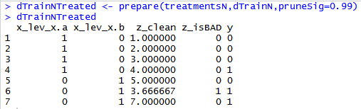

Variable Treatment: library(vtreat)
Vtreat automates some data cleaning, imputation and engineers specific response encoded variables.
treatmentsN <- designTreatmentsC(...)
Step 3
treatmentsN <- designTreatmentsN(...)
“Prepare” Data into a treated Modeling Matrix
Step 2
“Design Treatment” - Categorical or Numeric outcome
Step 1
Organize Informative Data
Kwartler

Slide 20

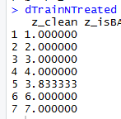
Mean Imputation - PreProcessing
Most of the time we will use vtreat to clean data…its faster and easier.
Vtreat Actions | Common Name
NA, NAN, and Infinity replaced with mean | Mean imputation
When a numeric value is missing
Replace that value with the mean average
Not applicable for categorical variables
Design a treatment plan and apply it.
Kwartler

Slide 21
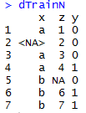
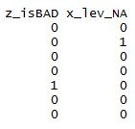
Missing Flags- PreProcessing
Vtreat Actions | Common Name
Indicator | Missing indicator
When a numeric value is missing
Add a missing flag variable
When a factor level is missing
Add a missing flag variable
Design a treatment plan and apply it.
Kwartler

Slide 22
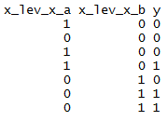
Dummy Variables - PreProcessing
Vtreat Actions | Common Name
Indicator variables | Dummy variable
Not applicable for numeric values
For each factor level, will create dummy variables.
Design a treatment plan and apply it.
Kwartler

Slide 23
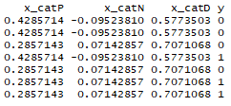

Vtreat Engineered CAT Variables Example
Simple Calculations
CatN (Numeric):
X equals A & Y equals 1: (1/3) minus
Overall Y value equals 1: (3/7)
= -0.0952381
CatD (Deviation):
Level B sd(c(0,1)) = 0.7071068
Cat P (Prevalence):
Level C Occurred (2/7) = 0.2857143
Step 3*
“Prepare” Data into a treated Modeling Matrix
*abridged data shown
Step 2
“Design Treatment” - Categorical or Numeric
treatmentsN <- designTreatmentsN(...)
Step 1
Organize a Modeling Matrix
treatmentsN <- designTreatmentsC(...)
Kwartler

Slide 24

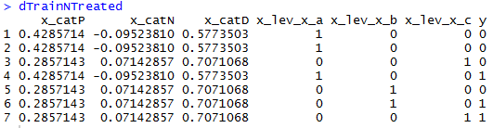
Non-Informative Check
Vtreat Actions | Common Name
Constant/Near Constant | Suppress uninformative variables
Z is automatically dropped.
In this fake example, since z contains a constant value an algorithm can’t learn from it.
Kwartler

Slide 25
Why is Feature Enrichment Effective?
Using qualitative or technical expertise to derive new features for machine learning.
$$f\left(Modeling Results\right)=the Algo+Parameters+Data provided$$
Better features means flexibility.
less than optimal models can still yield good results
Betters features means simpler models.
less than optimal parameters can still yield good results
Better features means better results.
“The algorithms we used are very standard for Kagglers. We spent most of our efforts in feature engineering.” Xavier Conort describing his winning “Flight Quest” submission
Way to differentiate & squeeze out more accuracy
Kwartler

Slide 26
Data Enrichment aids Model Performance
Feature Enrichment is the act of adding new information to your dataset. You are enriching your existing data, often with public or 3rd party data.
Existing Data
New Data
There are limits to what an organization has internally for data.
Companies exist solely to enrich data sources.
Kwartler

Slide 27
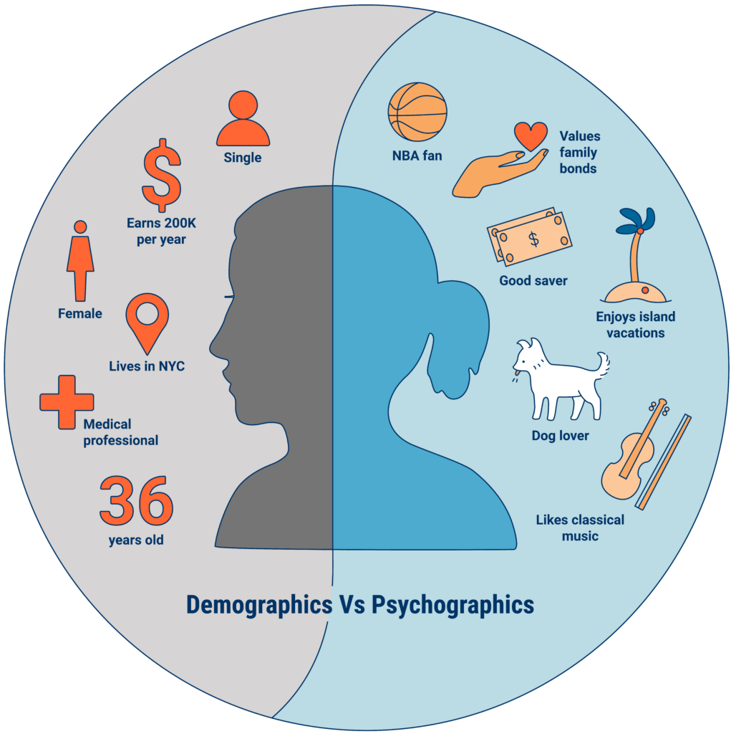
An example of Data Enrichment
They could buy data about employees to have a more complete picture.
An organization may collect some information about employees during interactions.
https://www.cbinsights.com/research/what-is-psychographics/
Kwartler

Slide 28


Modeling with Feature Enrichment is Widespread
Used social media information of individual and friends to model voting tendencies
Uses 3rd party data to predict if a household member has diabetes for marketing.
Most consumers are not aware the type and amount of data that is available about them.
Kwartler

Slide 29

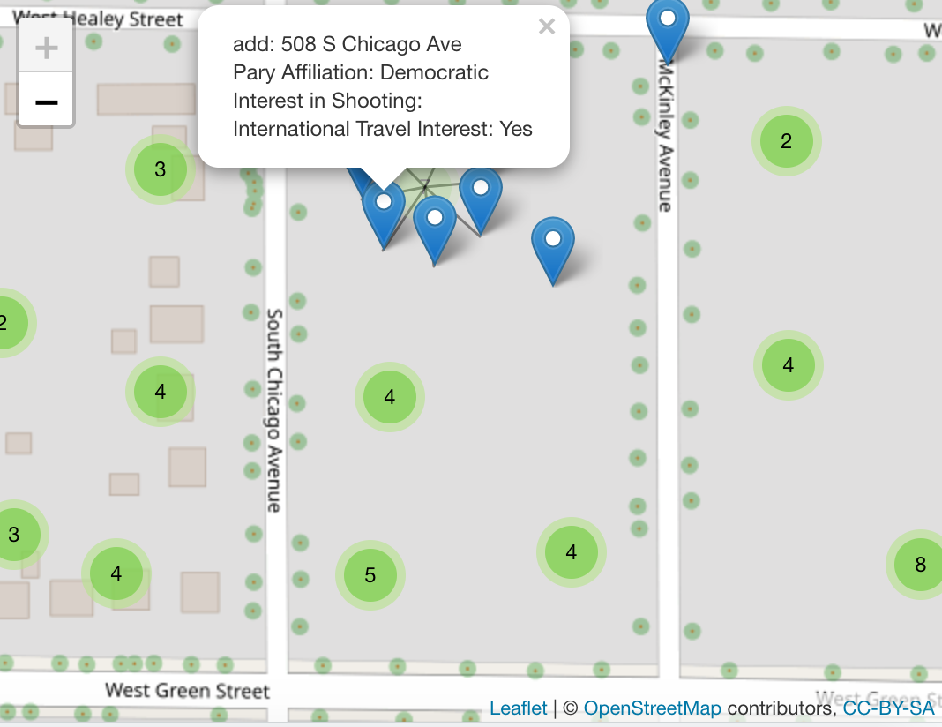
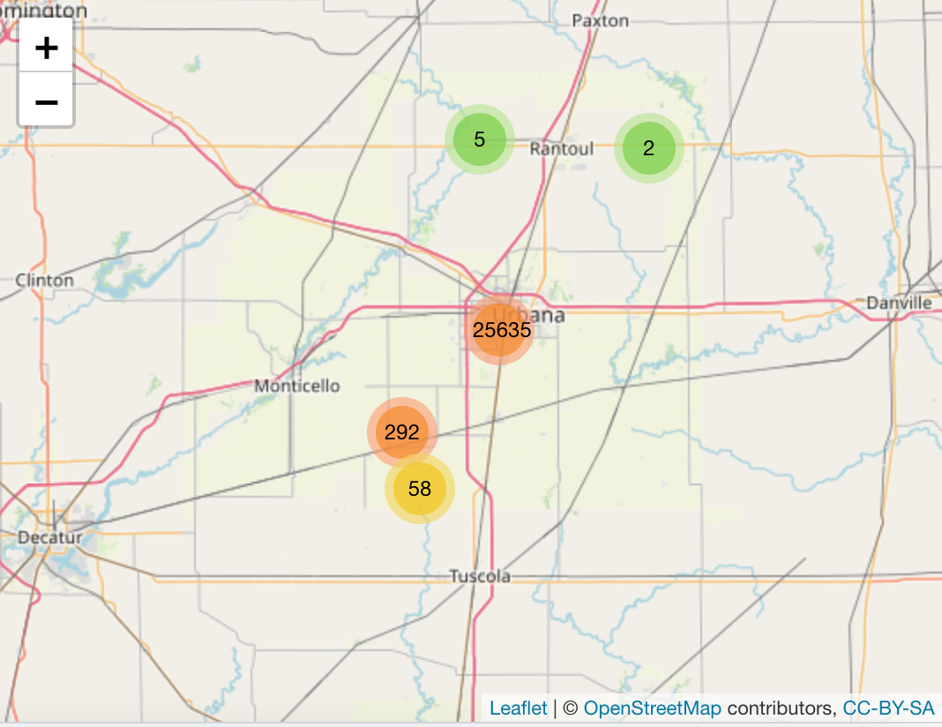
Additional Examples
26000 households in 1 Congressional District
550+ variables
$2500
Dynamic Map with any fields==10 lines of code!

Slide 30

Meet Donor Bureau
Kwartler

Slide 31
Company Overview
Founded in 2011
DonorBureau spun out of a direct mail agency
Works with non-profits to optimize their direct mail fundraising
Data Stats:
900M past mail transactions
140M past donations
40M individuals
Kwartler

Slide 32
Modeling Problem
Two modeling problems
What acquisition targets should NOT get mail?
What donor cultivation targets should get mail?
Acquisition modeling
Drop bottom 20% of list to be mailed
Goal is to have the top 80% gross twice as much as the bottom 20%
Cultivation modeling:
Add names to the monthly 10k piece cultivation mailings
Find 2k additional names per month to mail from a 40k donor file
Kwartler

Slide 33
Let’s Practice
Open A_DataPreProcessingEngineering:
Variable | Description
rowID | Appended Row ID - noninformative
uniqueID | Unique Identifier – noninformative
Zip | Zip code group to anonymize
Homeowner | Y/N if they own a hom
NUMCHLD | Number of children in house
Income | Household Income
Gender | M/F
Wealth | Wealth rating uses median family income and population statistics from each area to index relative wealth within each state. The segments are denoted 0-9, with 9 being the highest wealth group and zero being the lowest. Each rating has a different meaning within each state.
Variable | Description
HV | Avg Home Value in potential donor's neighborhood in hundreds of dollars.
Icmed | Median Income in potential donor's neighborhood in hundreds of dollars.
Icavg | Avg Family Income in potential donor's neighborhood in hundreds of dollars.
IC15 | % earning less than $15K in potential donor's neighborhood.
NUMPROM | Lifetime # of promotions received to date
RAMNTALL | Dollar amount of lifetime gifts to date.
MAXRAMNT | Dollar amount of largest gift to date.
LASTGIFT | Dollar amount of most recent gift.
TOTALMONTHS | Number of months from last donation
TIMELAG | Number of months between first and second gift.
AVGGIFT | Average dollar amount of gifts to date.
Y1_Donation | Y/N did they donate
Y2_DonatedAmt | Dollar Amt of donation
Kwartler
Notes:
2 identifier col
2 y binary and continuous

