Slide 1
The Wisdom of the Crowd
1907 Vox Populi by Sir Francis Galton created the notion of “wisdom of crowds” as a phenomenon. It is the basis of modern search engines and crowdsourcing.

Slide 2
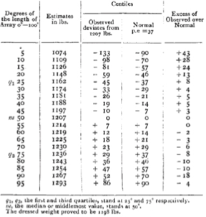
The Wisdom of the Crowd
Prevailing wisdom at the time was that crowds acted irrationally
Riots, mobs, cults
Galton wanted to explore trustworthiness and peculiarities of popular judgment
Galton attended an Ox weight guessing competition at a cattle exhibition
Participants individually guessed a very wide weight range
The median weight was 9lbs (0.8%) off and was better than individual cattle experts.

Slide 3
Conditions for Wisdom of Crowds
Some machine learning methods behave like the cattle weight guessing participants.
For people:
Each individual member or voter must have an independent source of information (examine the cattle for themselves)
Make an individual guess not swayed by others (avoid group think or be blind to others’ guesses)
Mechanism must be in place to collate and organize the diverse votes.
For algorithms:
Each individual method needs to be blind to the others in construction
Each individual classification or vote is therefore independent
Aggregation/tabulation is easy in an computerized environment.
Many of today’s best algorithms mimic a weak learner approach.

Slide 4
Random Forests
Each mini tree acts as a voter from the mob. Each voter is allowed to look at a random group of variables e.g. a mini data set to make its splits.
East
West
East
West
East
East
Vote Tally
East | West
4 | 2

Slide 5
Random Forests
This toy example shows 2 decision points were selected for each voter from among beds, baths, sqft and price.
The model parameters determine the number of variables used, and decision cutoff values
An individual tree may choose beds/baths while another may get beds/sqft and still another gets sqft/price.
A random forest grows many many classification trees
Variable combinations are selected randomly to create the forests but the number of variables or attributes needs to be specified
Each unknown value is then put through every tree to provide a final classification
Each “dumb” learner gets a vote that is tabulated so the wisdom of the mob can be identified.
East
West
East
West
East
East
Since each tree focuses on a random combination of variables and random rows (bootstrap), some trees will be more accurate, others less so. In total the splits will identify most informative variables, the ones that are usually split upon and with enough trees the group wisdom is found.

Slide 6
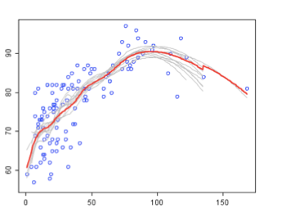
Random Forests
Fictitious Visual
Data Science Considerations
Group
Consensus
How many trees/voters?
How many decision points (nodes)?
How many features are allowed to be used in each tree build?
How to account for missing values?
Imputation fills in but a tree can split on records that are missing. Thus vtreat’s imputation with missing indicator as an appended variable may be a good alternative.
Class A
Weak
Learners
Class B
In this example, each decision tree tries to separate the data and by taking the most numerous outcome (tally) the best outcome is often found. Since they are weak learners (not a lot of depth and with fewer variables) among hundreds, overfitting is usually less of a concern.

Slide 7

Bootstrapping
How many bags? ntree

Slide 8
Bootstrapping > A tree is grown
Random Rows
Weak Learner
Parameters
How many variables do you want to build from is determined with mtry. The variables are randomly selected for each tree.
East
How many terminal nodes should be used (complexity of the tree)
nodesize is the minimum number vs maxnode

Slide 9
Parameter Review
How many bags/trees to make is in ntree.
I run a few hundred then review the OOB visual and choose as part of evaluation.
How many variables do you want to build from is determined with mtry. The variables are randomly selected for each tree.
I leave this small, and prefer to have more trees. This is my preference.
How many terminal nodes should be used (complexity of the tree)
nodesize is the minimum number vs maxnode
I accept the minimum default classification nodesize = 1, and regression/continuous nodesize = 5.
Maxnode default is NULL.
You are encouraged to explore these and other parameters of the random forest to learn your own preferences.

Slide 10
How a random forest is really grown.
Draw many re-samples of cases from the data (bootstrap)
For each re-sampled set use a random subset of predictor variables to produce a tree. Some parameters include
Number of trees to grow – dictates the number of re-sampled sets
Number of predictor variables for each tree
Combine the predictions/classifications from all the trees (the entire forest)
Votes are tallied for classification problems
Predictions are averaged for continuous problems
Since it has many weak learners, overfitting is less of a concern. Some trees will get the unlikely outlier value while most won’t.
Since its fitting many hundreds of trees, it takes some time to train a model.

Slide 11
Open C_Bank Loans RandomForest_woRanger.R
This data has been oversampled, because it is an “unbalanced” data set.
The result is that training is ~50% success and failure classes instead of 88% failures.

Slide 12
Open D_Bank Loans RandomForest_wRanger.R
This data has been oversampled, because it is an “unbalanced” data set.
The result is that training is ~50% success and failure classes instead of 88% failures.
In many cases you get very similar results much faster using library(ranger) but the mechanics are slightly different.

Slide 13


Your Data Mining Toolbox
Previous Lessons
Some R Programming (R-studio)
EDA (summaries, column and row exploration)
Knowledge of Data Preparation (vtreat)
Basic Visualization (plot, ggplot)
Linear Regression (continuous)
Logistic Regression (Binary Classification)
Decision Tree (classification, continuous)
Now
RandomForest (classification, continuous)
RF is a standard and popular starting point for many modeling projects.

