Slide 1
Logistic Regression
Extends idea of linear regression to situation where outcome variable is categorical
Instead of ordinary least squares, β are derived through an iterative process called maximum likelihood estimation
We focus on binary classification
i.e. Y=0 or Y=1

Slide 2

Regression Equation Review
Regression
How Many Cones?
#
= $β$ + $β$*temperature + $β$*day + $β$*price + error

Slide 3
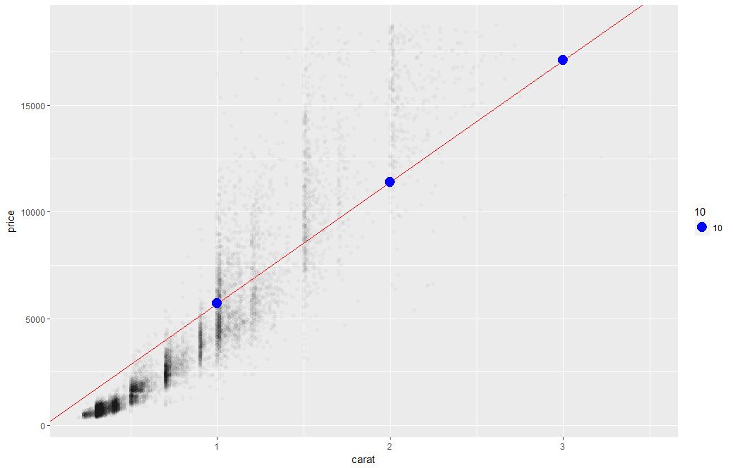
Linear Regression
The predictions is continuous…it continues forever.

Slide 4
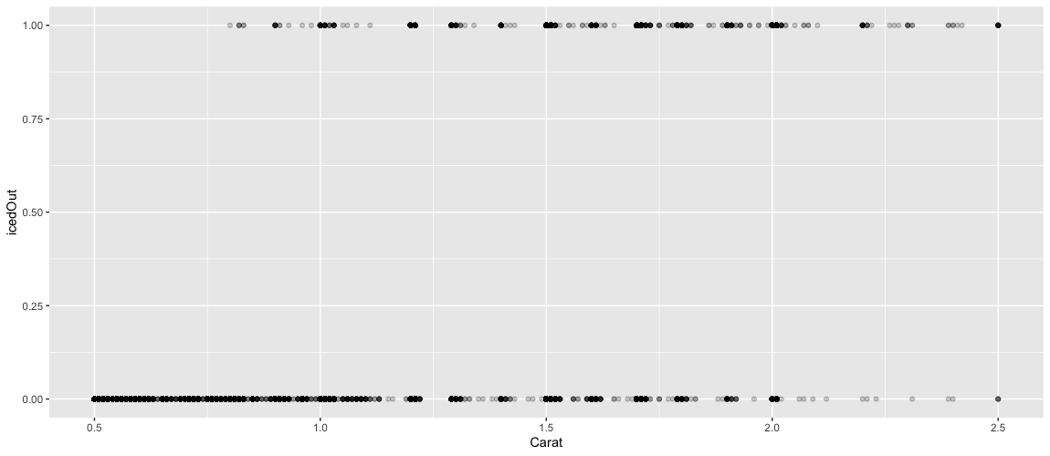
A binary relationship between carat and price
Diamonds above or below $11K
Yes, the diamond
is more than $11K
No, the diamond
isn’t more than $11K

Slide 5
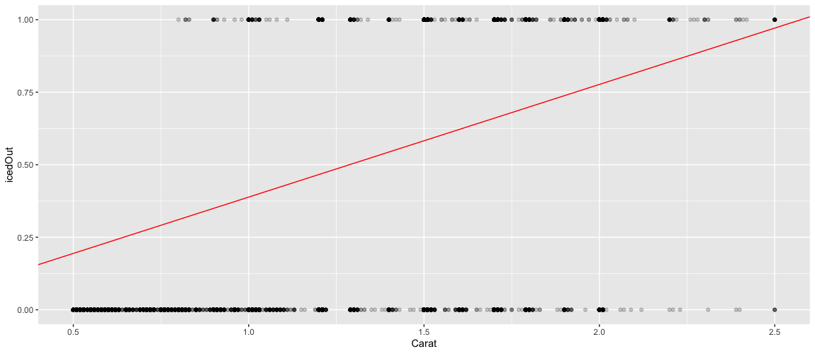
WRONG tool! This line goes on forever
Yes, the diamond
is more than $11K
No, the diamond
isn’t more than $11K
The line goes on forever so a linear model could say YES, but also reach a value of 2?! That’s two YES? Makes no sense.

Slide 6
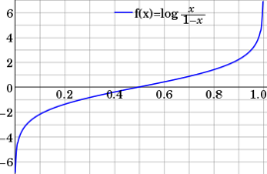
Step 1: Logistic Response Function
Regression
How Many Cones?
#
= $β$ + $β$*temperature + $β$*day + $β$*price + error
Logistic Regression
Will they buy a cone Y/N?
Logit of
= $β$ + $β$*temperature + $β$*day + $β$*price + error
We will let R handle calculating the equation output logOdds to the more understandable probability.

Slide 7
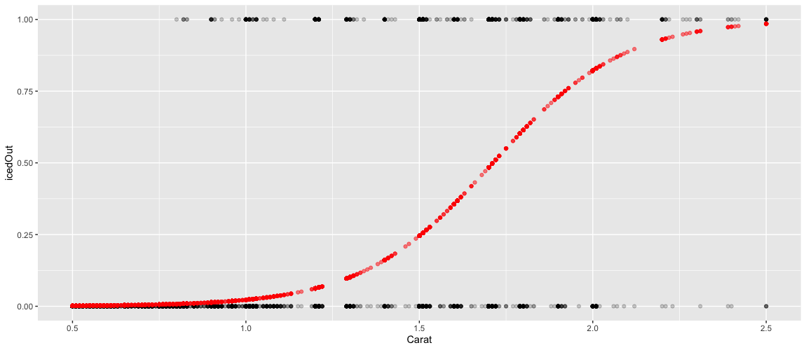
1.
What are the log-odds of the price above $11K? = Beta + Beta*Carat
2. Convert to probability with logistic response function (e^l / (1+e^l))
3. The probabilities are more intuitive than the log-odds from the equation.

Slide 8
From probability to class, define a cutoff threshold.
0.50 is popular initial choice
Additional considerations
Maximize classification accuracy
Maximize sensitivity (subject to min. level of specificity)
Minimize false positives (subject to max. false negative rate)
Minimize expected cost of misclassification (need to specify costs)
If a team has a probability of .25 classify them as a loser.
If a team has .50 or more classify them as a winner

Slide 9

NCAA Classification Madness
College Basketball
Annual 64 team tournament
Business Impact:
$1B wagered
$2B in lost productivity
Bragging Rights
Objective: Identify the probability of a team winning in Round 1.

Slide 10

My friend Mandy is next level.
https://fivethirtyeight.com/features/how-a-data-scientist-whod-never-heard-of-basketball-mastered-march-madness/

Slide 11
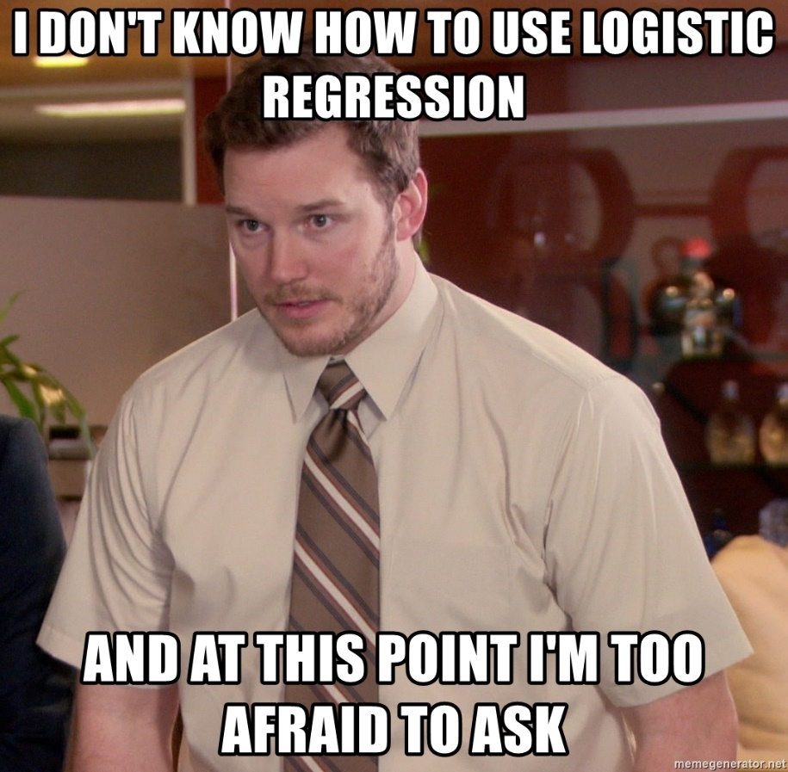
Let’s practice
Open C_newMarchMadness_noPrep.R

Slide 12

Evaluating a Classification Model (validation set)
Confusion Matrix
The model predicted 118 (87 + 29) losers
The model was correct 87 times among the losers
The model predicted 103 winners (31 + 72)
The model was correct 72 times among the winners
As you progress in your data science education, learning other KPI (Recall, Precision, AUC etc). In this course we stick with the basic accuracy.

Slide 13
The confusion matrix
 | Actual 1 | Actual 0
Predicted 1 | True Positives | False Positives
Predicted 0 | False Negatives | True Negatives
Probabilities are 0-1 so a “cutoff threshold” is used to classify into 1 or 0 in the matrix.

Slide 14
The confusion matrix
Cutoff 0.01
Cutoff 0.50
 | Actual 1 | Actual 0
Predicted 1 | 3 | 2
Predicted 0 | 0 | 0
 | Actual 1 | Actual 0
Predicted 1 | 2 | 1
Predicted 0 | 1 | 1
Actual | Probability
1 | .45
1 | .55
0 | .95
1 | .75
0 | .25
Cutoff 0.75
Cutoff 0.99
 | Actual 1 | Actual 0
Predicted 1 | 1 | 1
Predicted 0 | 2 | 1
 | Actual 1 | Actual 0
Predicted 1 | 0 | 0
Predicted 0 | 3 | 2
Adjusting the cutoff impacts the numbers in the confusion matrix.

Slide 15
Logistic Regression Summary
Logistic regression is similar to linear regression, except that it is used with a categorical response
The predictors are related to the response Y via a nonlinear function called the logit
As in linear regression, reducing predictors can be done via variable selection
Logistic regression can be generalized to more than two classes
libray(nnet)
multiNomialLogit <- multinom(y ~ ., df)

Slide 16
Back to the script
Open C_newMarchMadness_noPrep.R

Slide 17


Your Data Mining Toolbox
Previous Lessons
Some R Programming (R-studio)
EDA (summaries, column and row exploration)
Knowledge of Data Preparation (vtreat)
Basic Visualization (plot, ggplot)
Regression (continuous predictions)
Added
Binary Classification (logistic regression)
Regression & Logistic Regression are two good starting algorithms . Both put you on a path to more complex machine learning but more importantly you can start to frame business problems in terms algorithms can understand.

