Slide 1
Quick Webscraping
Ted Kwartler

Slide 2
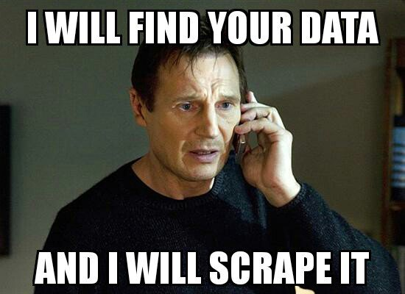
Web Scraping
R and other languages let you extract information from websites. This is called “web scraping”.

Slide 3
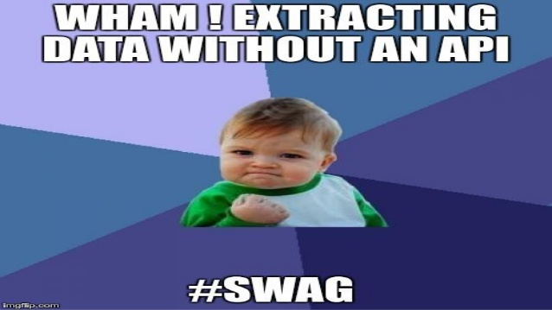
Questionable Practice
Websites don’t like you taking information for various reasons. Always respect terms of service and any blocking software.

Slide 4
Web-scraping
Everything in a webpage is “client” side (interpreted by your computer), therefore you can get anything you see.
Each scrape is literally custom software
Webpages have different styles, object names, and complexity…always check for an API first.

Slide 5
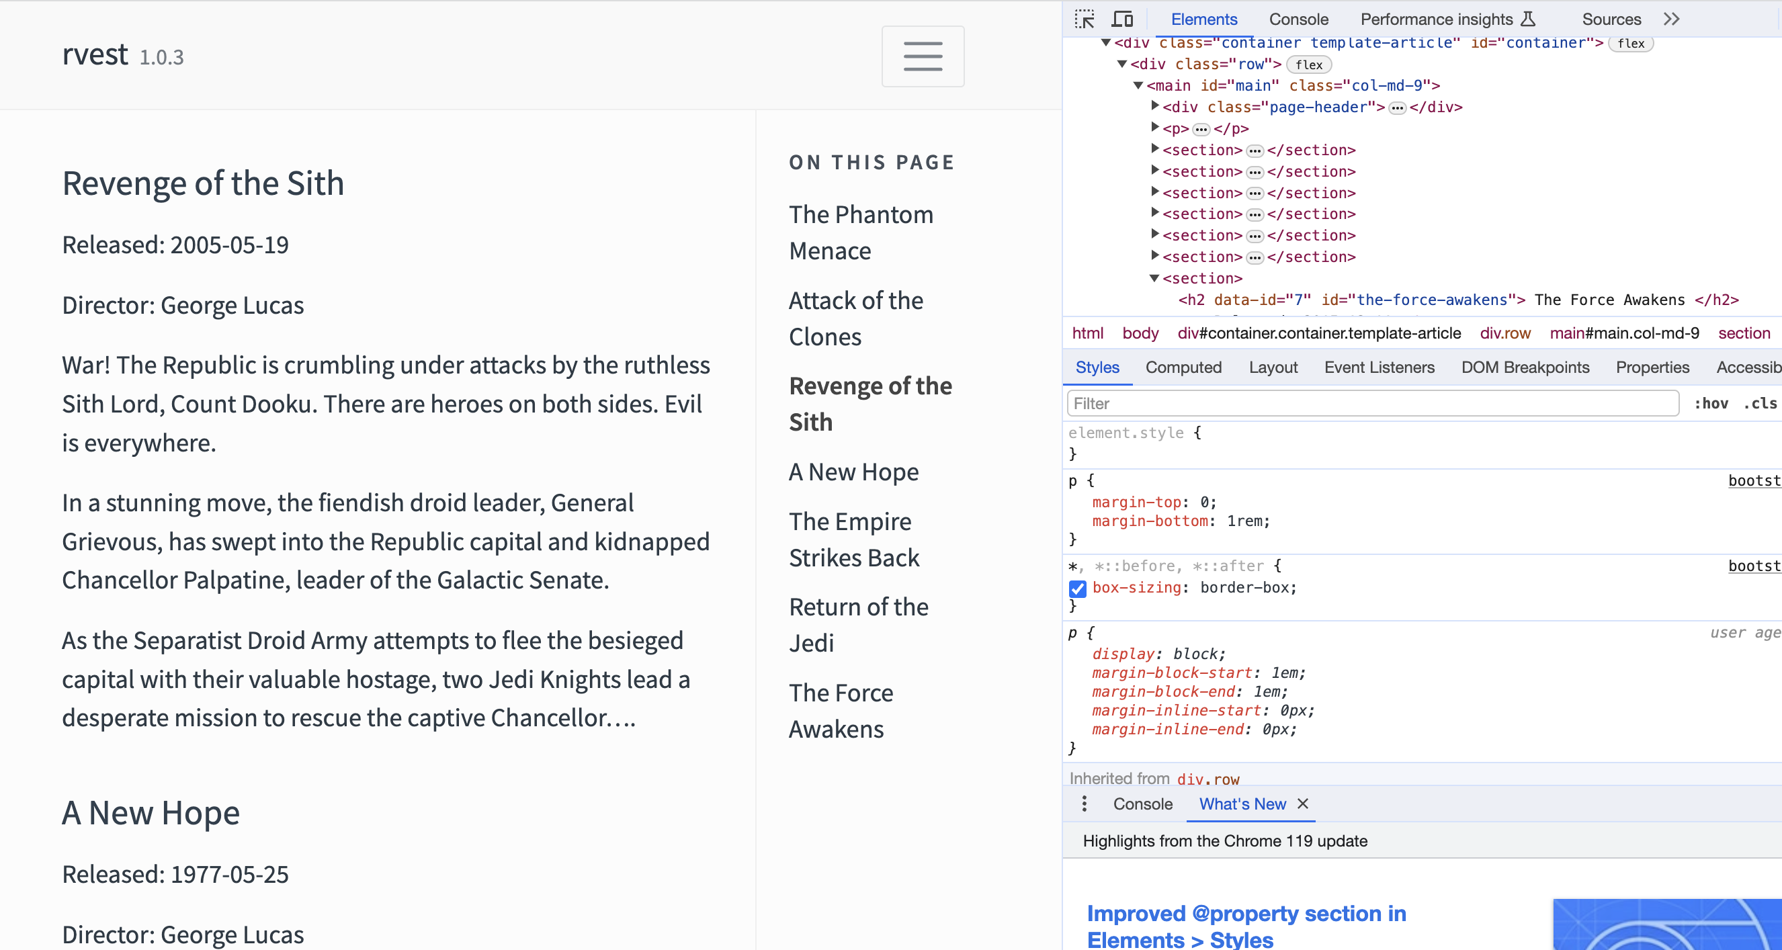
Web Scraping Example – using xpath & css ID

Slide 6
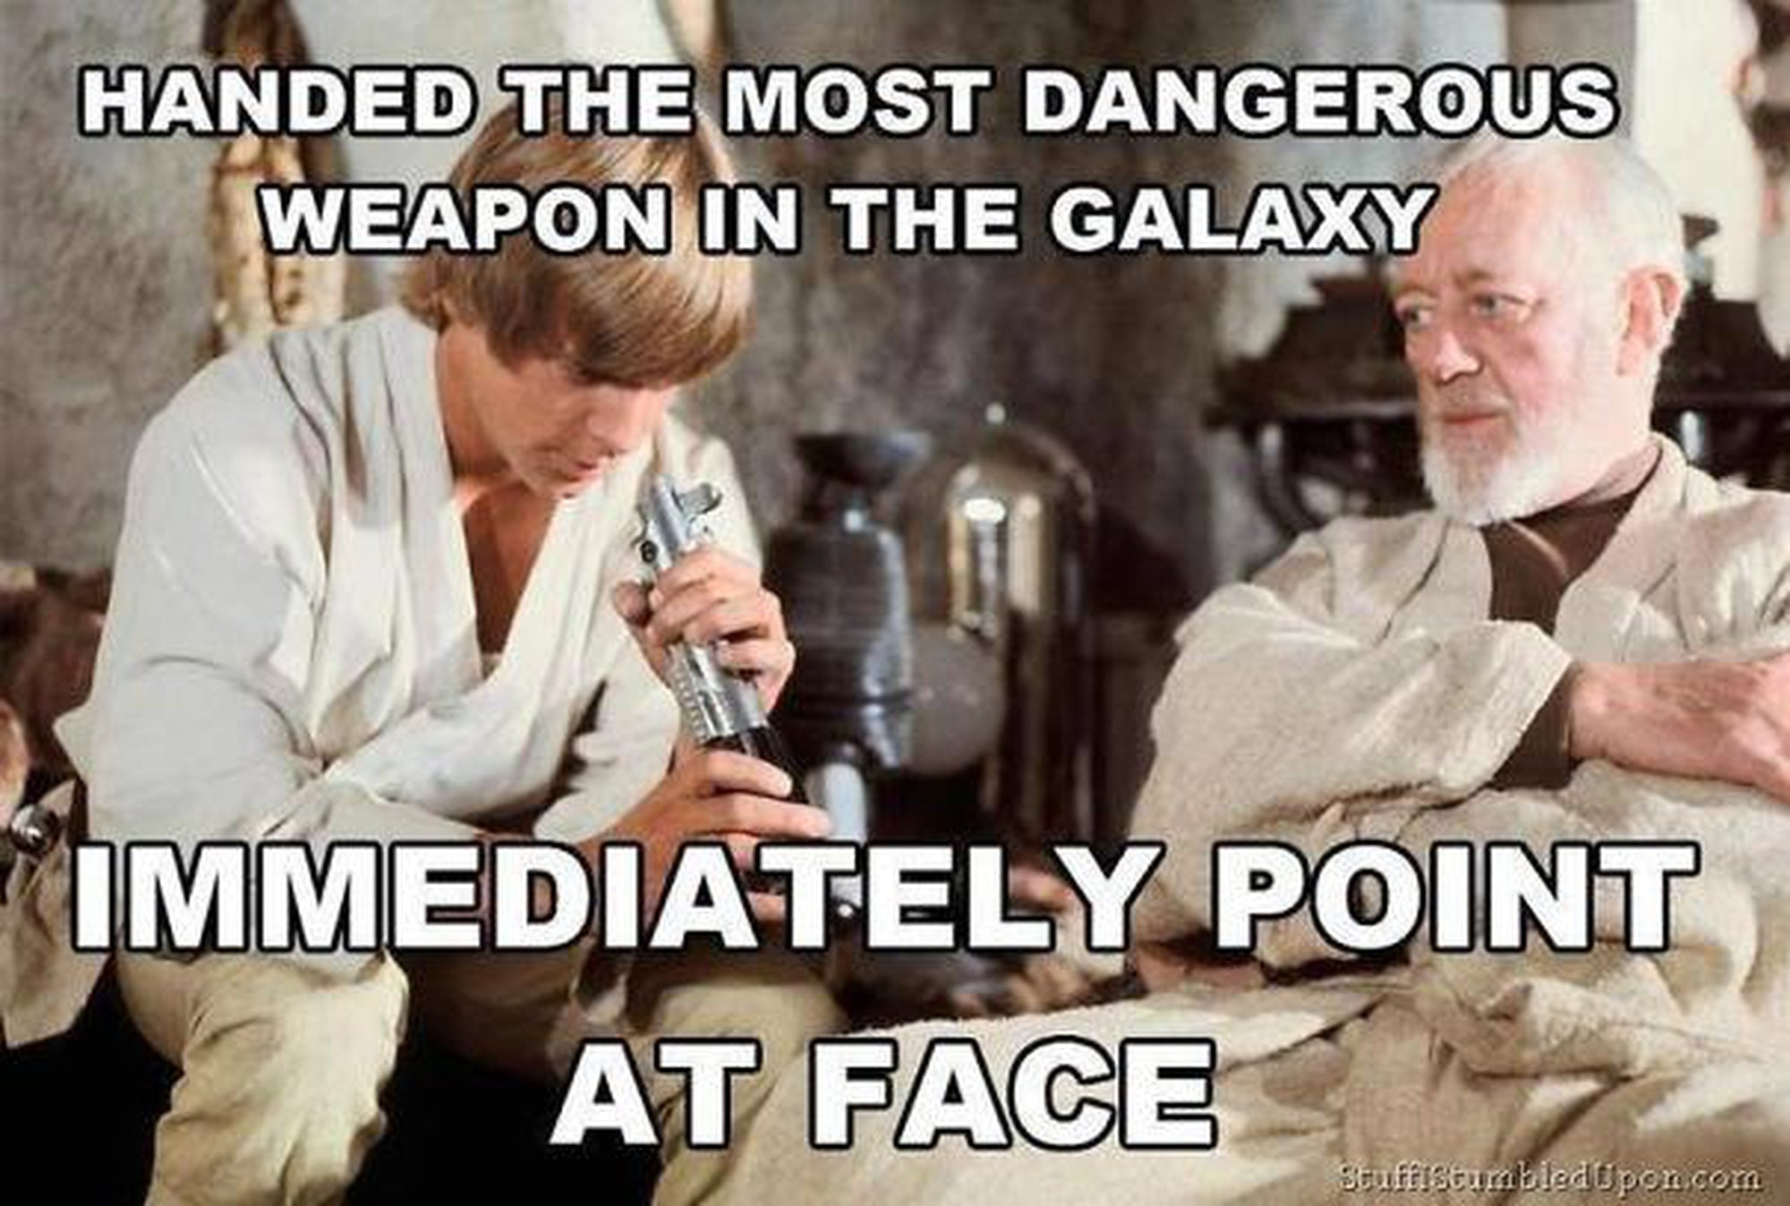
Getting some data
D_webScraping2.R

Slide 7
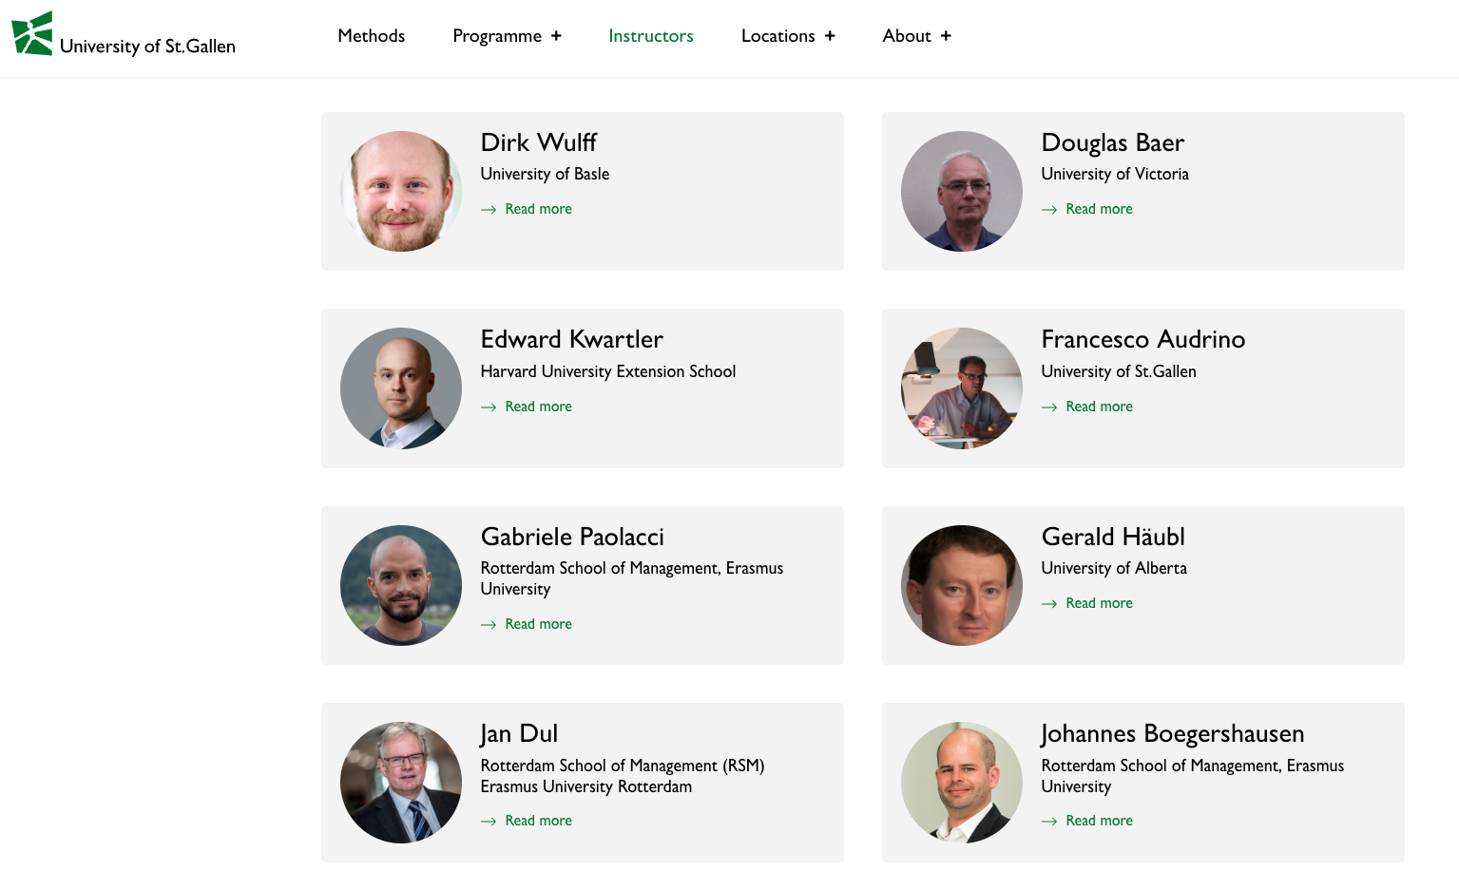
Let’s get the dirt on University of St Gallen profs.
Open a “headless” browser to the instructor page. Programatically find all appropriate URLS which is represented by each picture.

Slide 8

After ID’ing the links go to each bio
Open a “headless” browser to the instructor page. Find all appropriate URLS which is represented by each picture.
Loop through all ID’ed URLs to get the bio of each professor.
…
…

Slide 9
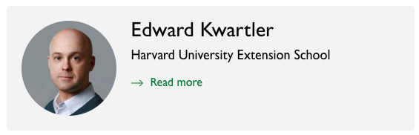
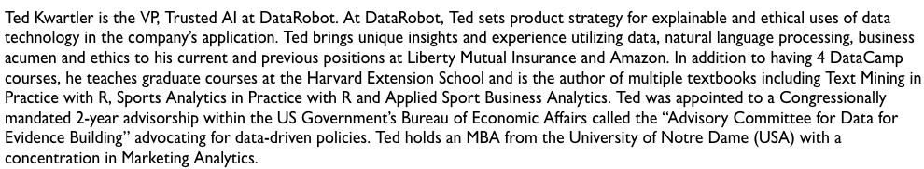
Let’s get the dirt on our profs.
E_webScraping_multipleURLS.R
Page1 Get the “Read more” Link
Open a “headless” browser to the instructor page. Find all appropriate URLS which is represented by each picture.
Loop through all ID’ed URLs to get the bio of each professor.
Extract the bio text from each page and organize
Navigate to Page 2 & scrape the text

