Slide 1
Quick Webscraping
Ted Kwartler

Slide 2

Web Scraping
R and other languages let you extract information from websites. This is called “web scraping”.

Slide 3
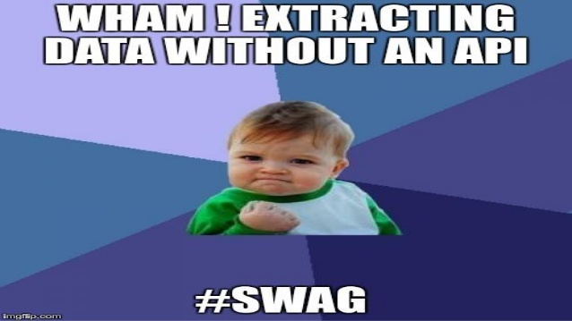
Questionable Practice
Websites don’t like you taking information for various reasons. Always respect terms of service and any blocking software.

Slide 4
Web-scraping
Everything in a webpage is “client” side (interpreted by your computer), therefore you can get anything you see.
Each scrape is literally custom software
Webpages have different styles, object names, and complexity…always check for an API first.

Slide 5

Let’s get the dirt on University of St Gallen profs.
Open a “headless” browser to the instructor page. Programatically find all appropriate URLS which is represented by each picture.

Slide 6

After ID’ing the links go to each bio
Open a “headless” browser to the instructor page. Find all appropriate URLS which is represented by each picture.
ID all the URLs using HTML tags, identify the ones that are relevant
Loop through all ID’ed URLs opening another headless browser, one for each prof, then scrape the XPATH for the
Bio
Image url
…
…

Slide 7
Navigating an HTML document
The Extensible Markup Language (XML) is a simple text-based format for representing structured information: documents, data, configuration, books, transactions, invoices, etc.
Structured documents are often written in XML, just another format like JSON you saw earlier.
XPath is an expression language designed to support the query or transformation of XML documents. It was defined by the World Wide Web Consortium and can be used to compute values from the content of an XML document.
Xpath is used to navigate an XML document.

Slide 8
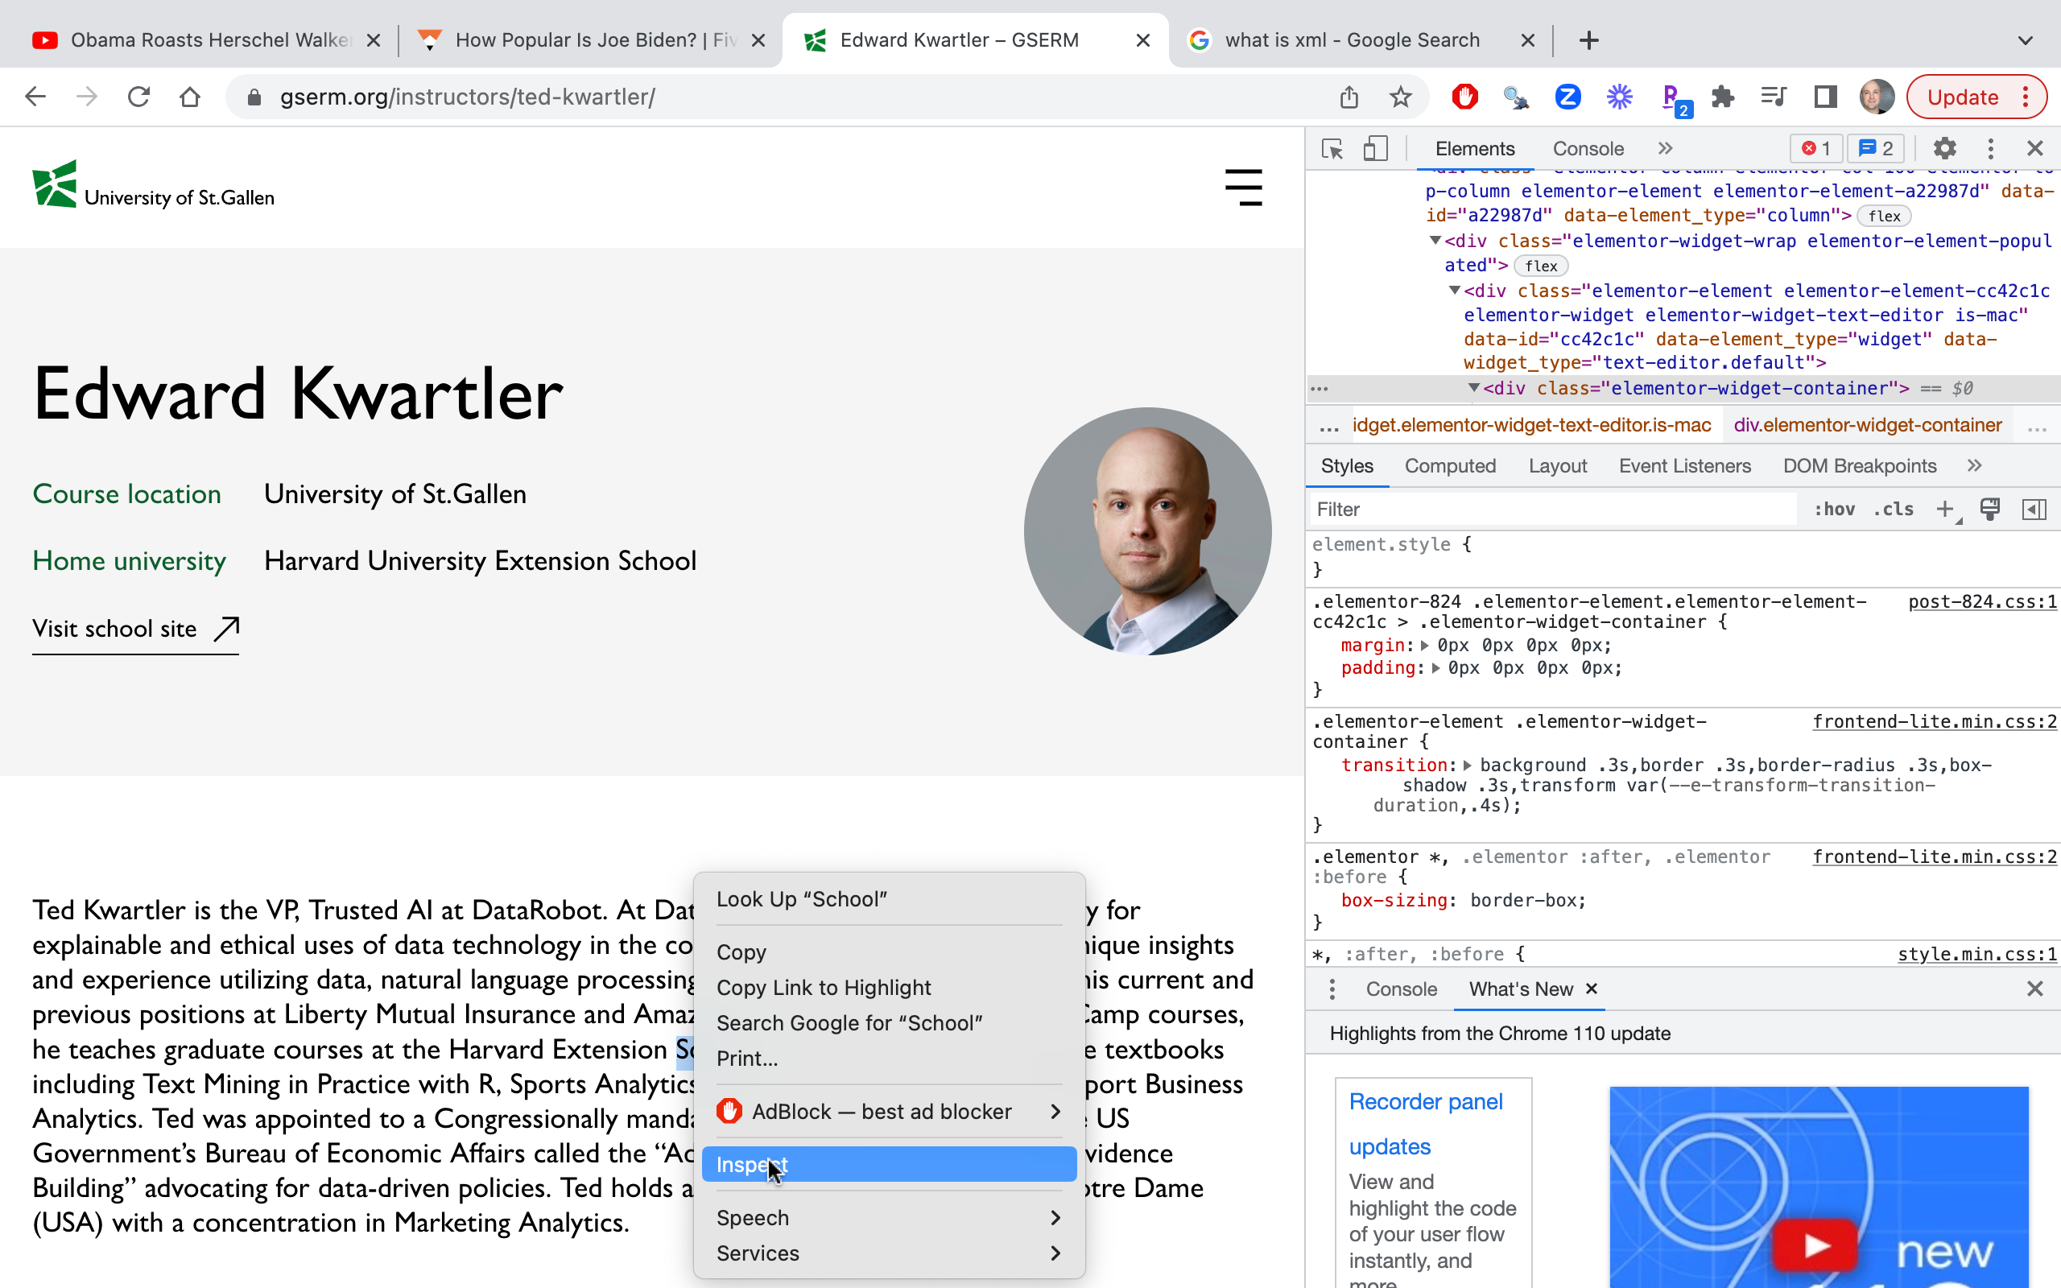
First, highlight what’s interesting on the page.
Next, right click or control-click and select “inspect” because you want to inspect this element.

Slide 9
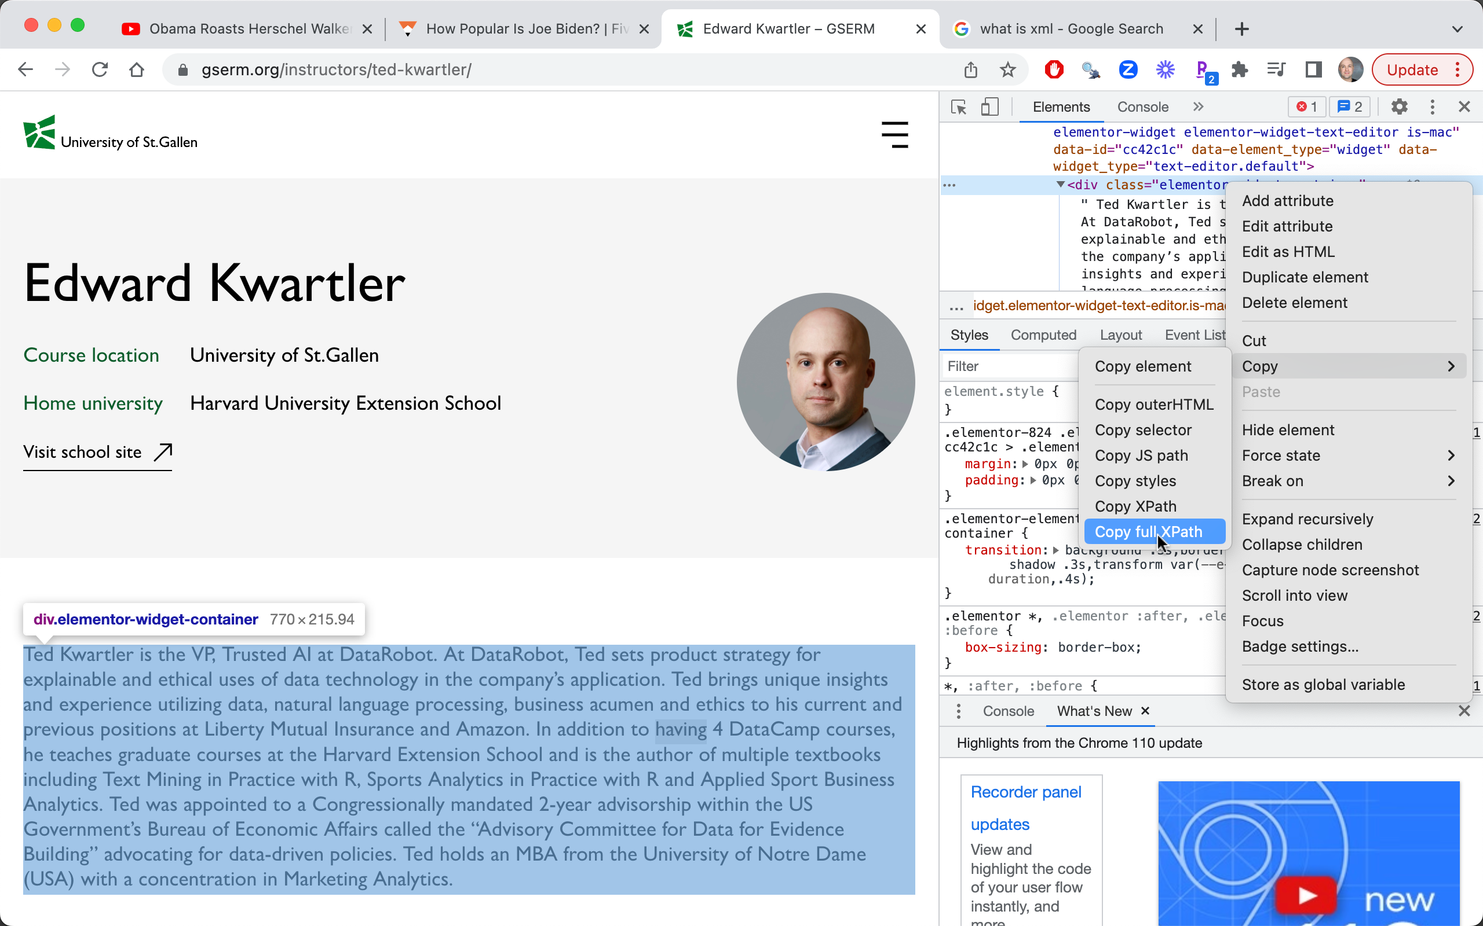
Within the developer panel, you will see it highlight again right click or control-click.
Select COPY > Copy full Xpath.
On some sites, I’ve had better luck with just Copy Xpath not full xpath…it all depends!

Slide 10
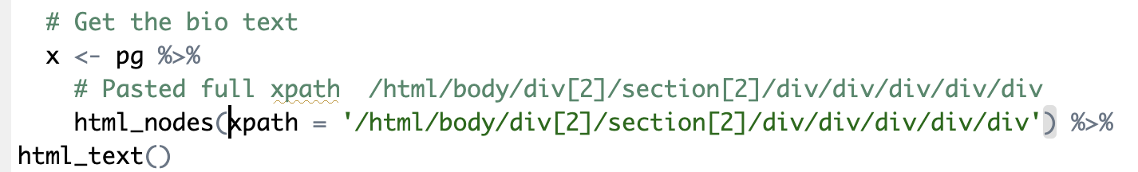
Paste the xpath into your code. Here the pg object was created previously and now we select the html nodes of the document at this location then the text itself is extracted.

Slide 11

Cascading Style Sheets
Cascading Style Sheets is a style sheet language used for describing the presentation of a document written in a markup language such as HTML or XML
Many sites use CSS with named elements called a “selector”. These named selectors can be used in place of xpath sometimes.

Slide 12
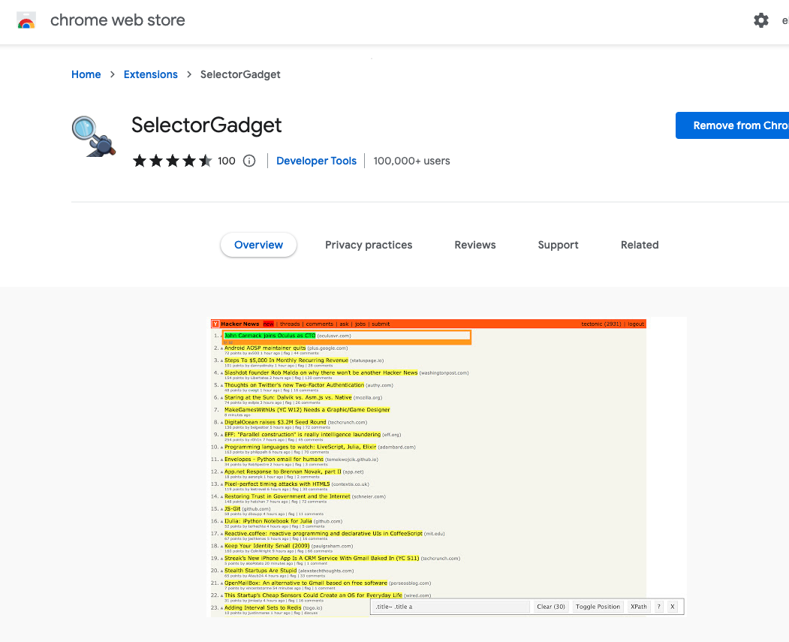
Easy to use Chrome Add-in

Slide 13
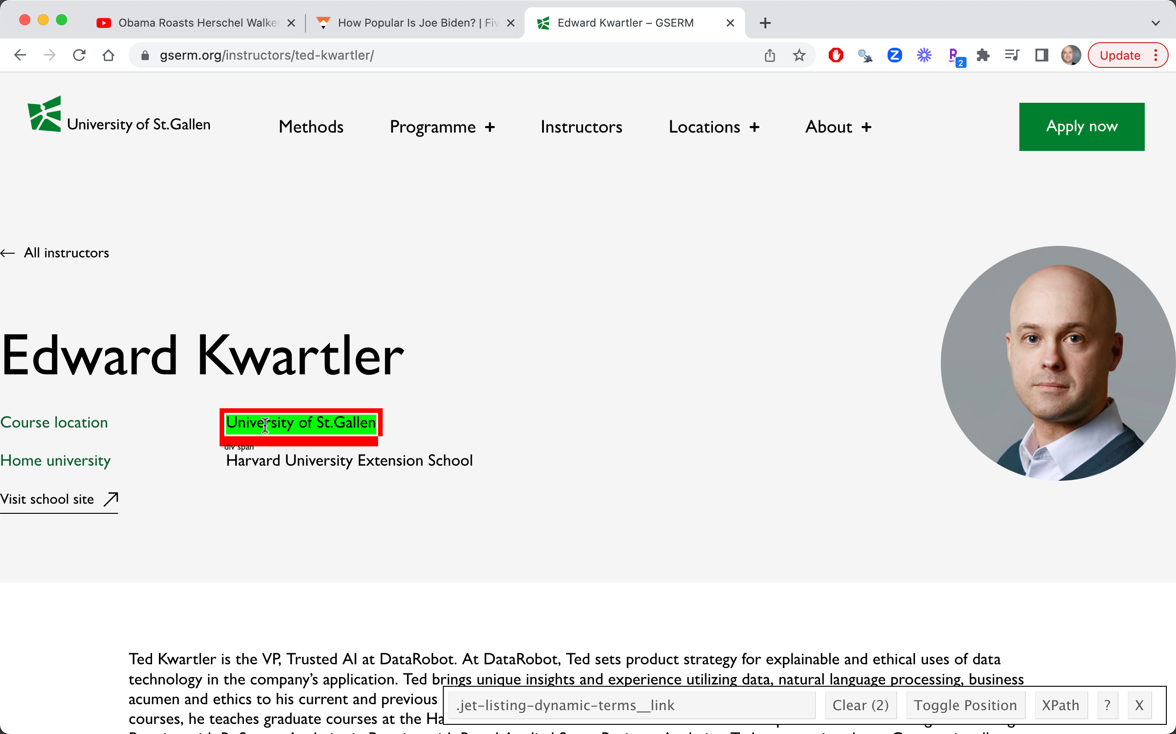
After enabling the chrome extension, the highlighted area of the page has a “selector” shown which can be used in code to *sometimes* get the element scraped.

Slide 14

Here, the pg object nodes with CSS tag “.size-large” is obtained. Instead of text, the “src” attribute is retained which is a URL link.

Slide 15

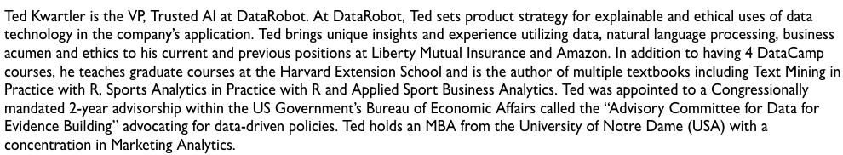
Let’s get the dirt on these profs.
C_webScraping_multipleURLS.R
Page1 Get the “Read more” Link
Open a “headless” browser to the instructor page. Find all appropriate URLS which is represented by each picture.
Loop through all ID’ed URLs to get the bio of each professor.
Extract the bio text from each page and organize
Navigate to Page 2 & scrape the text

